Slide 1

MATHEMATICS FOR ROBOTICS
PROJECT
ProfessorName:-KUMAR UJJWAL
Student Name:- IMMANDI SRI LIKHITA
Roll.No:-SE25MROB009

Slide 2
Title
Smart Room Temperature Control Using Fuzzy Logic Controller
Using MATLAB Fuzzy Logic Designer and Simulink

Slide 3
Problem Statement
Traditional controllers cannot adapt efficiently to varying room conditions.
Objective:
To design a Fuzzy Logic Controller (FLC) for automatic room temperature regulation.

Slide 4
Inputs and Output
Inputs:
Temperature Error
Change in Temperature
Output:
Cooling Power (AC Intensity)

Slide 5
Membership Functions
Triangular membership functions (trimf) are used.
Temperature Error Range: [-10 10]
Change in Temperature Range: [-30 30]
Cooling Power Range: [0 100]
Linguistic variables:
Negative, Zero, Positive

Slide 6
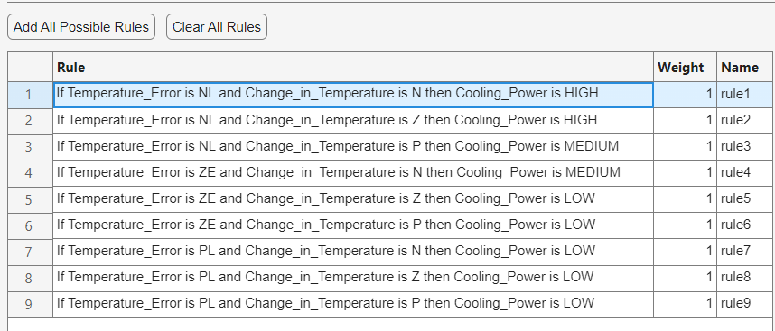
Rule Base
9 fuzzy IF-THEN rules are created.

Slide 7
Justification of Ranges
Ranges are selected to avoid simulation saturation and cover all possible room conditions.
Larger range for Change in Temperature prevents rule firing warnings.

Slide 8
Practical Implementation
Simulink blocks used:
• Step
• Sum
• Unit Delay
• Mux
• Fuzzy Logic Controller
• Transfer Function
• Scope

Slide 9
Validation and Results
The fuzzy controller provides smooth and stable temperature regulation.
Simulation completed successfully without warnings.

Slide 10
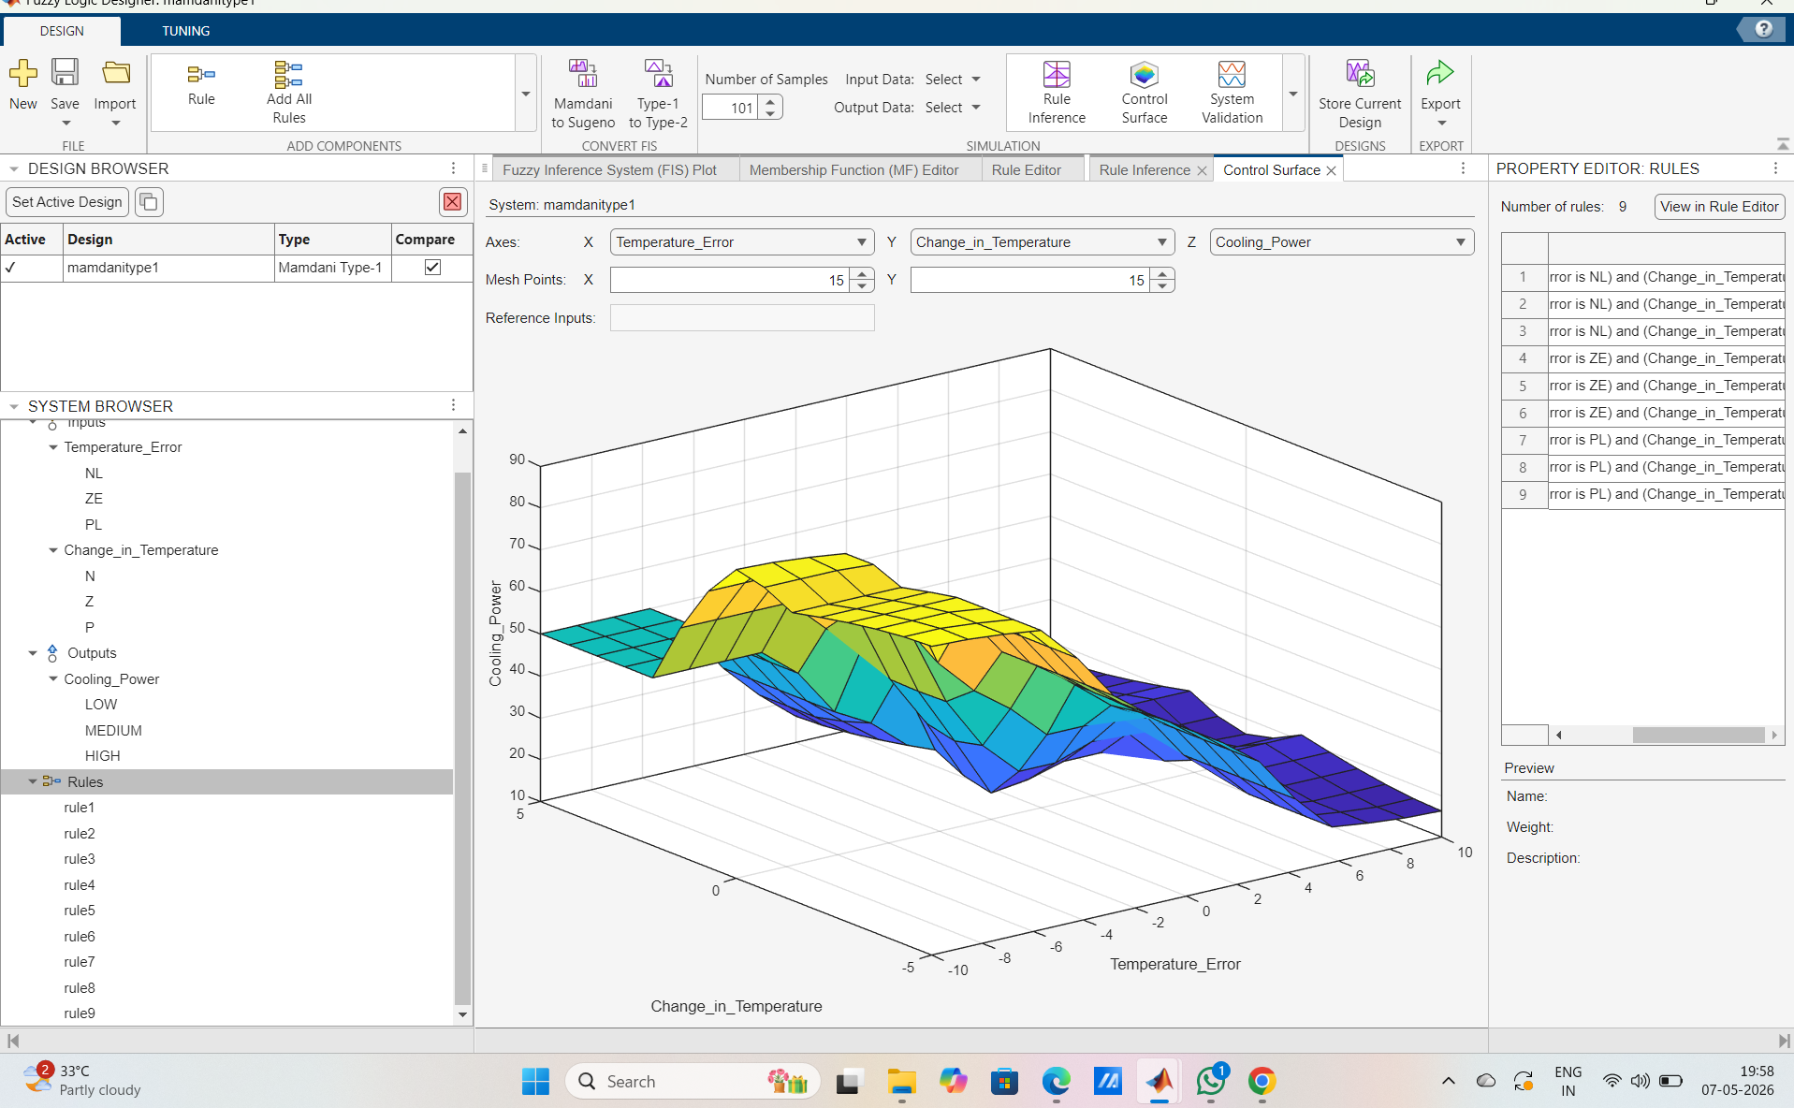

Slide 11
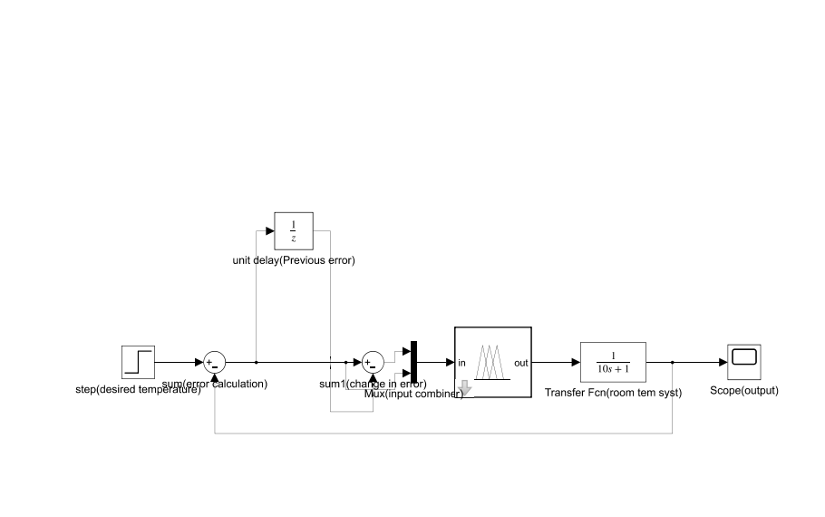

Slide 12
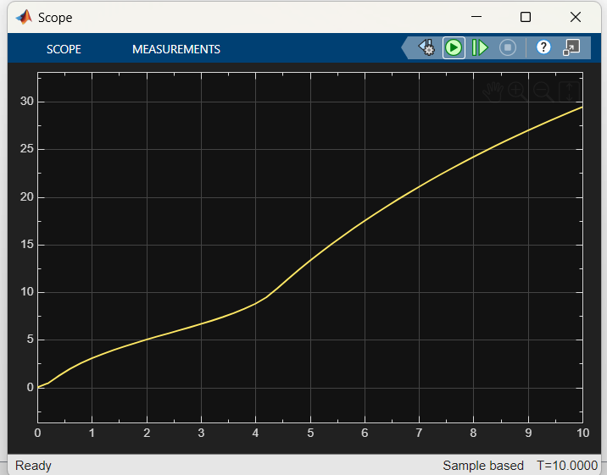
Simulation Response Curve

Slide 13
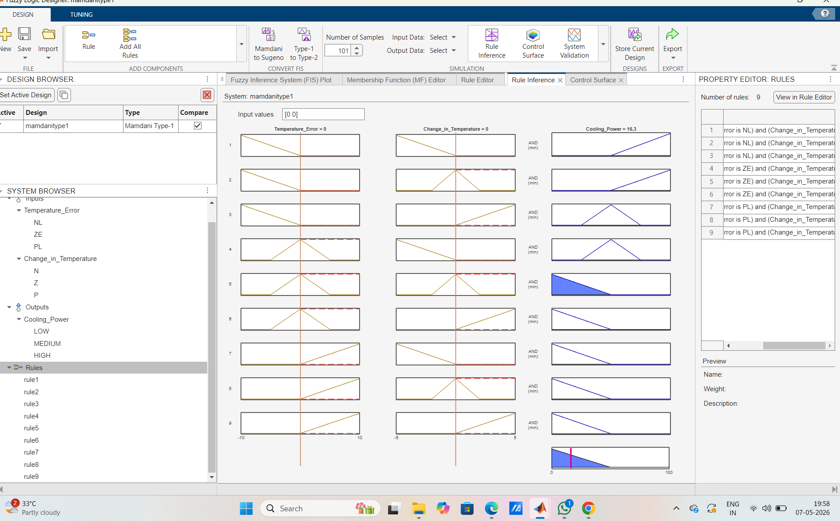

Slide 14
Conclusion
The fuzzy logic controller successfully regulates room temperature using intelligent rule-based control and provides smooth cooling performance.

