Slide 1
AI-Powered Job Matching System
Using AI to Simplify Job Search and Skills Analysis
-Likhita Yerra (PGE4)

Slide 2
Introduction
This presentation focuses on an AI-powered job matching system designed to streamline job searching, match skills with job requirements, and analyze the job market trends.
1

Slide 3
Table of contents
Project Overview
Solution Architecture
Real Results
Benefits
Demo
Future Plans
2

Slide 4
1.Project Overview
Problem Statement:
Manual job searching is time-consuming.
Hard to match skills with job requirements. Difficult to identify skill gaps. No easy way to analyze job market trends.
3

Slide 5
2. Solution Architecture
Two Main Components: Data Processing Script processes job postings and extracts structured information using AI to create a standardized job dataset. Web Application includes resume analysis, job matching, interactive visualizations, and customizable filtering.
4

Slide 6
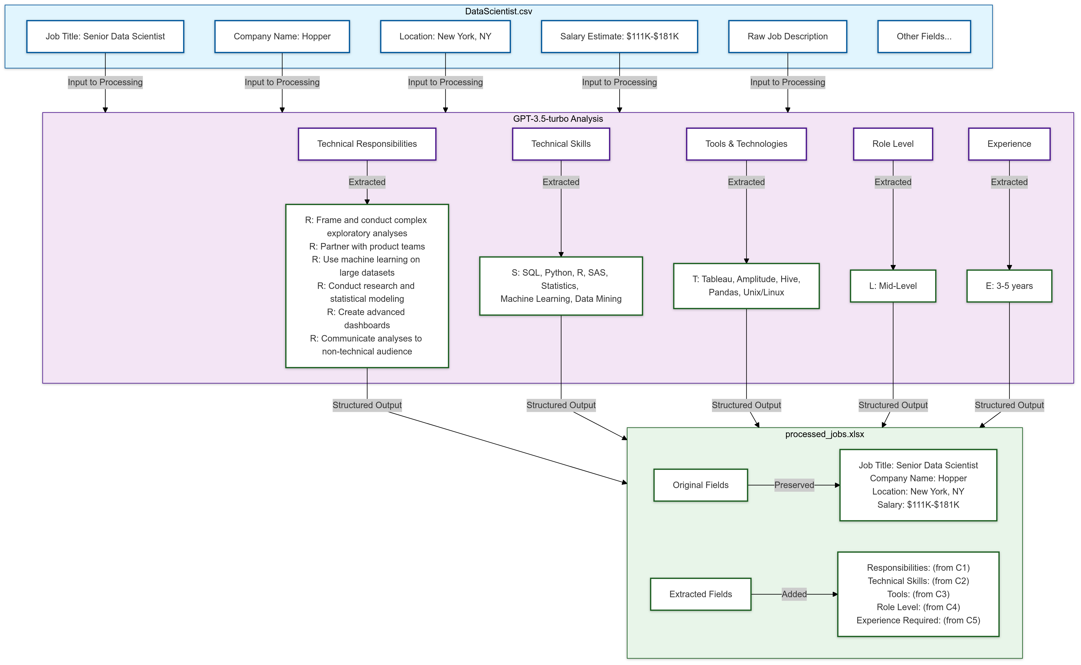
Data Processing Pipeline

Slide 7
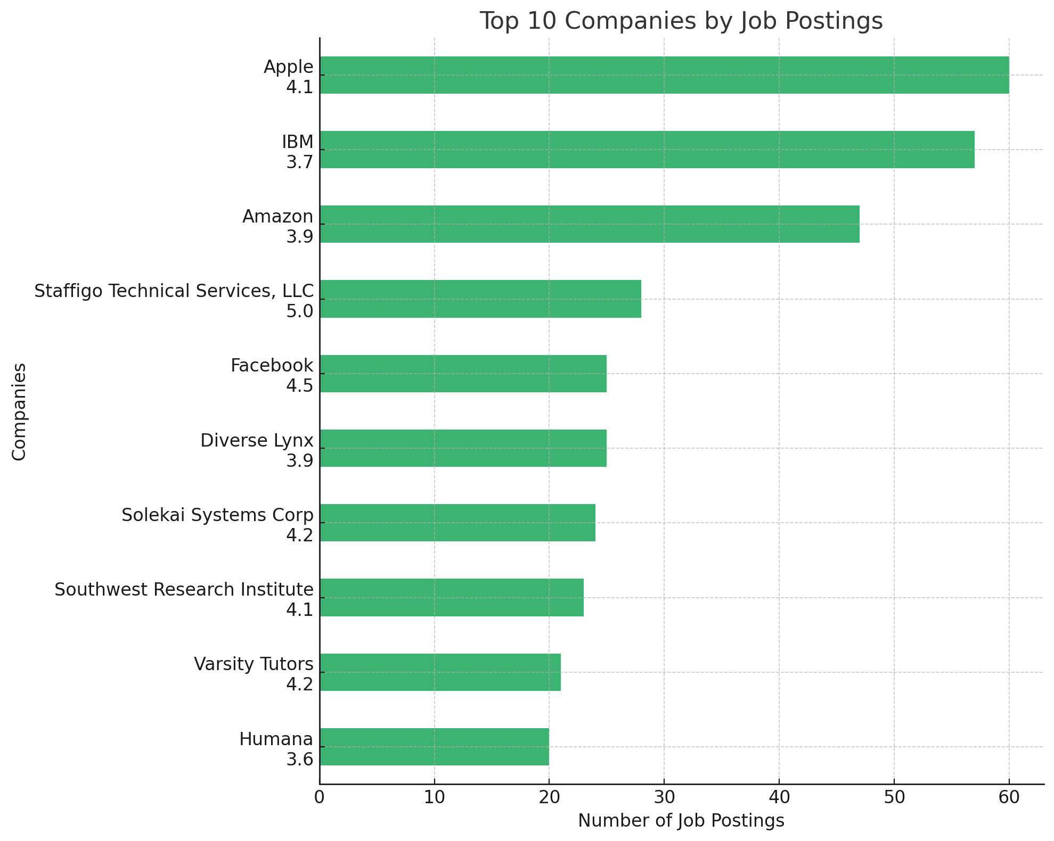
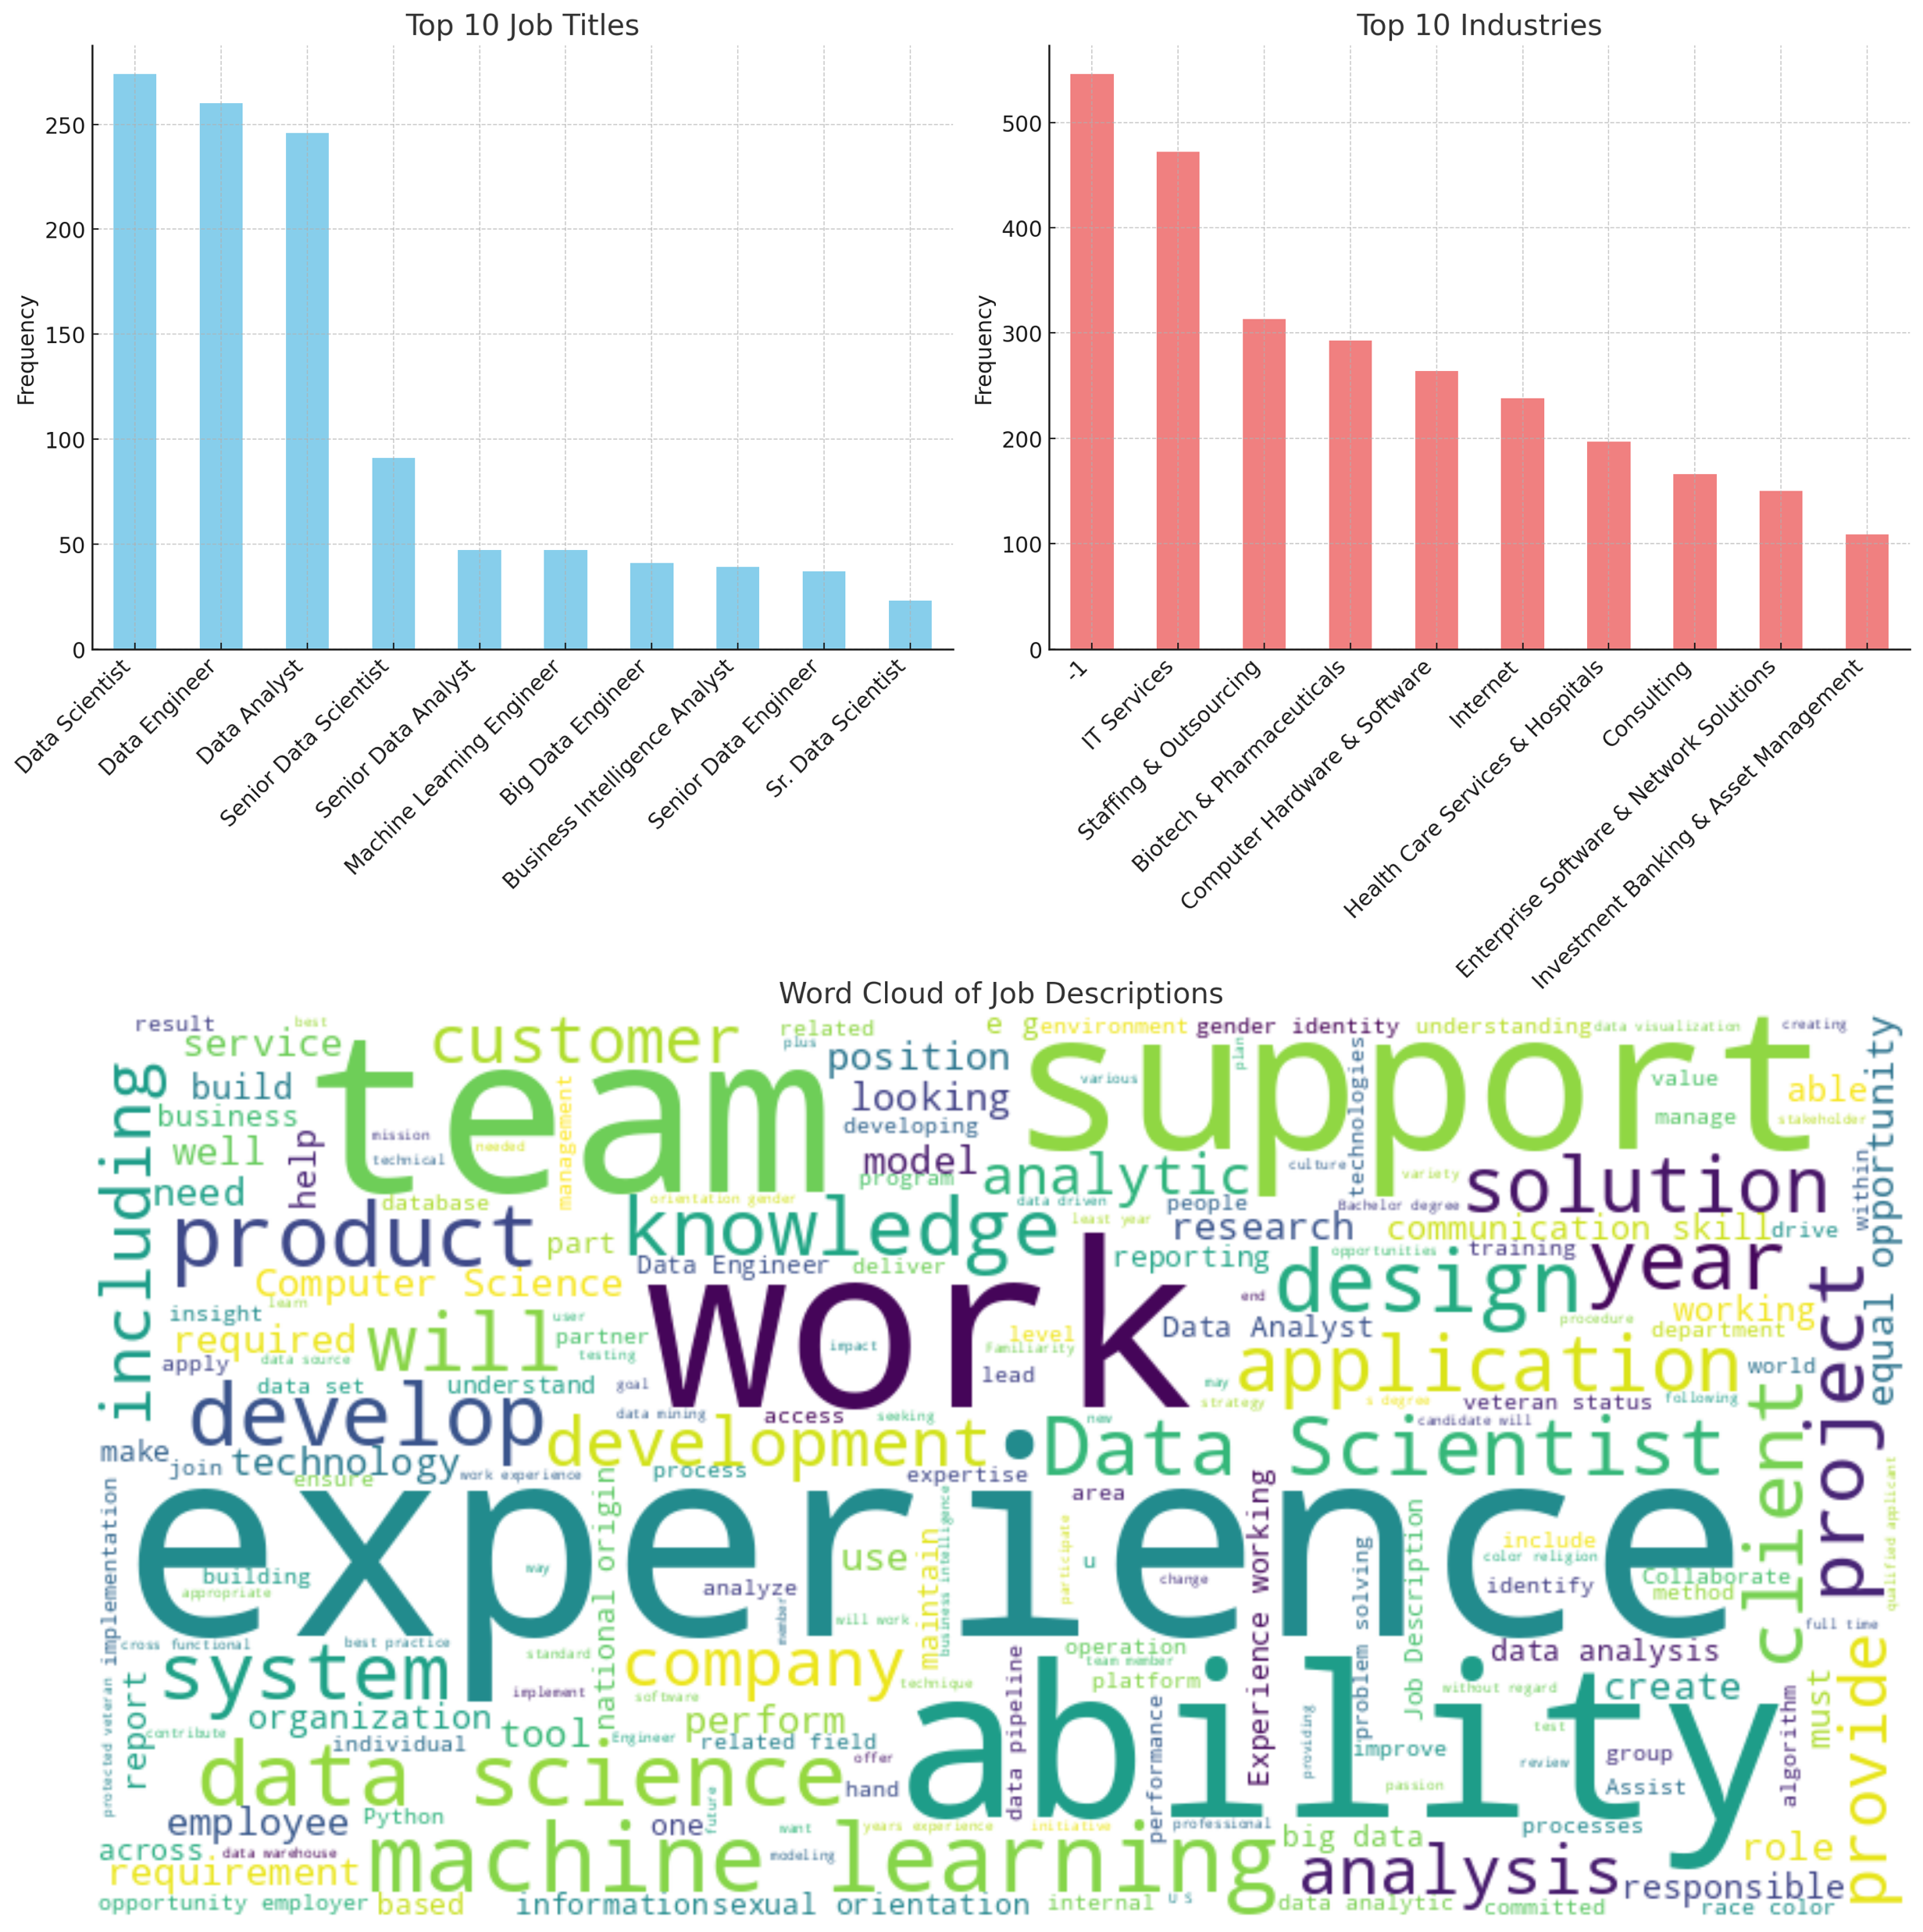

Slide 8
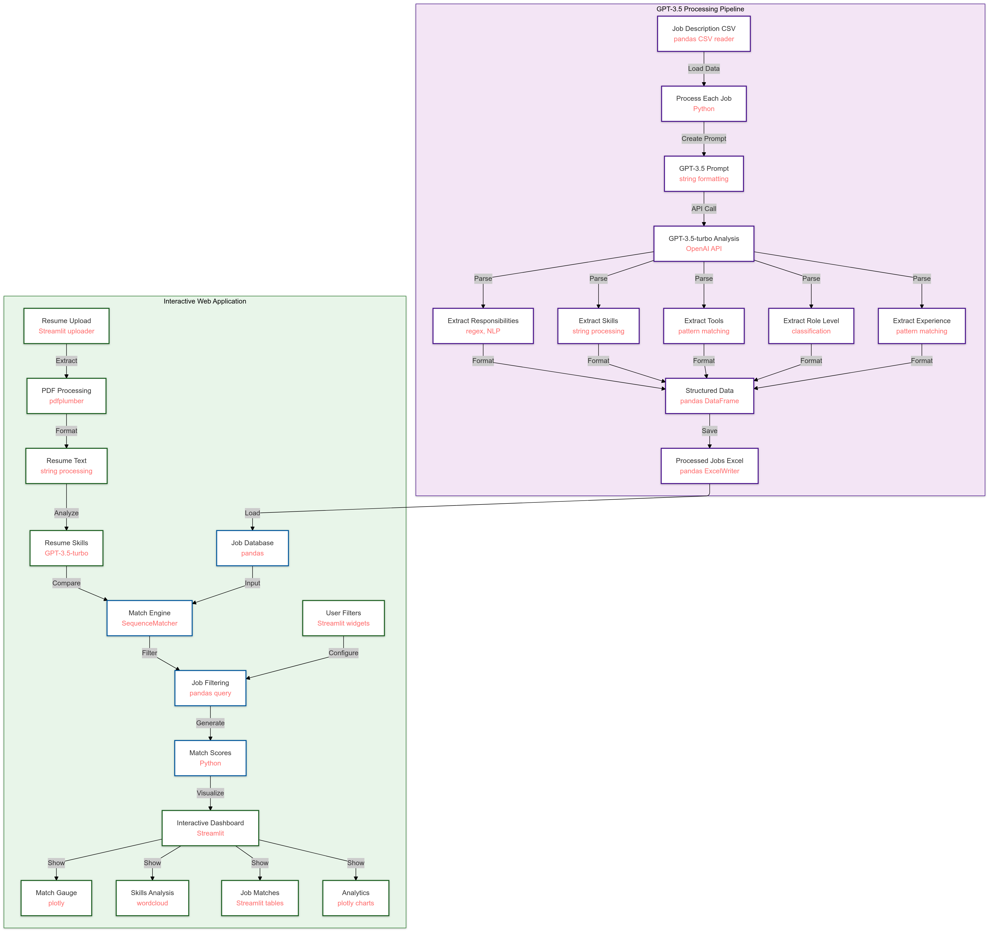
WEB UI
PROCESSING PIPELINE

Slide 9
3.Real Results
System Performance showcases:
Processes 500 jobs in 23 minutes.
Average processing time of 2.78 seconds per job.
Comprehensive skill extraction and accurate matching.
7

Slide 10
4.Benefits
For Job Seekers: Quick skill assessment, targeted job recommendations, clear skill gap identification, and market insights. For Recruiters: Standardized job data, better candidate matching, efficient screening, and market analysis.
8

Slide 11
5.Demo
Live System Features include: Resume upload and analysis. Job matching and filtering. Interactive visualizations. Skill gap analysis.
9

Slide 12
6.Future Plans
Upcoming Features include: Enhanced matching algorithm like ATS More visualization options. Advanced filtering capabilities. API integration.
10

Slide 13
Conclusion
The AI-Powered Job Matching System aims to significantly improve the job search process by efficiently analyzing skills, matching them with job requirements, and providing valuable insights to both job seekers and recruiters.
11

Slide 14
Thank you!
12

