Slide 1
Stock Price Prediction using Python & ML
Using simple GUI
A.LIKHITHI – N170307
A.SATISH – N170455
P.NAGA MANEENDRA –N170465
V.VINOD KUMAR – N170482
D.JEEVAN SAI – N170466

Slide 2
content
Abstract
Introduction
Related works
Proposed method
Experimental results
Technologies used
Datasets
System Hardware
Result comparison with other approaches
Conclusion
Future scope

Slide 3
ABSTRACT
The prediction of stock value is a complex task which needs a robust algorithm background in order to compute the longer term share prices. Stock prices are correlated within the nature of market; hence it will be difficult to predict the costs.
The proposed algorithm using the market data to predict the share price using machine learning techniques like recurrent neural
network named as Long Short Term Memory.
This system will provide accurate outcomes in comparison to currently available stock price predictor algorithms. The network is trained and evaluated with various sizes
of input data to urge the graphical outcomes.

Slide 4
introduction
Real-world Problem:
The task of predicting stock prices is one of the difficult tasks for many analysts and in fact for investors. For a successful investment, many investors are very keen in predicting the future ups and down of share in the market. Good and effective prediction models help investors and analysts to predict the future of the
stock market

Slide 5
Related works
Prediction of stock prices using python and ML using Linear regression by Zack West
Ref link : https://www.alpharithms.com/predicting-stock-prices-with-linear-regression-214618/
Prediction of stock prices using LSTM LAYERS
Ref link : https://towardsdatascience.com/lstm-for-google-stock-price-prediction-e35f5cc84165

Slide 6
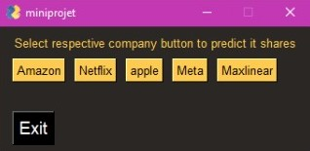
GUI APPLICATION
A graphical user interface is an application that has buttons, windows, and lots of other widgets that the user can use to interact with your application.
We created GUI application using PySimpleGUI library.
PySimpleGUI is a python library that wraps tkinter, Qt (pyside2), wxPython and Remi (for browser support), allowing very fast and simple-to-learn GUI programming.
You can use Python and the PySimpleGUI package to create nice-looking user interfaces that you and your users will enjoy!

Slide 7
Flow chart
Proposed Model
1.Loading the data
2.Preparing the data
3.Building the model
4.Testing the model
5.Visualizng the prediction and Predicting the output

Slide 8
Loading the data
Downloaded the dataset of stocks of 9 years from Yahoo’s financial API site using pandas Data Reader
2.Preparing the data
Using the MinMax scaler
We shrink the data into a given range (0,1) and transform the data.

Slide 9
3.Building the Model.
we built the model using Tensor flow layers i.e., LSTM, Dropout , Dense layers.
4.Testing the Model
We tested the model accuracy on existing data and the model has not seen this dataset before

Slide 10
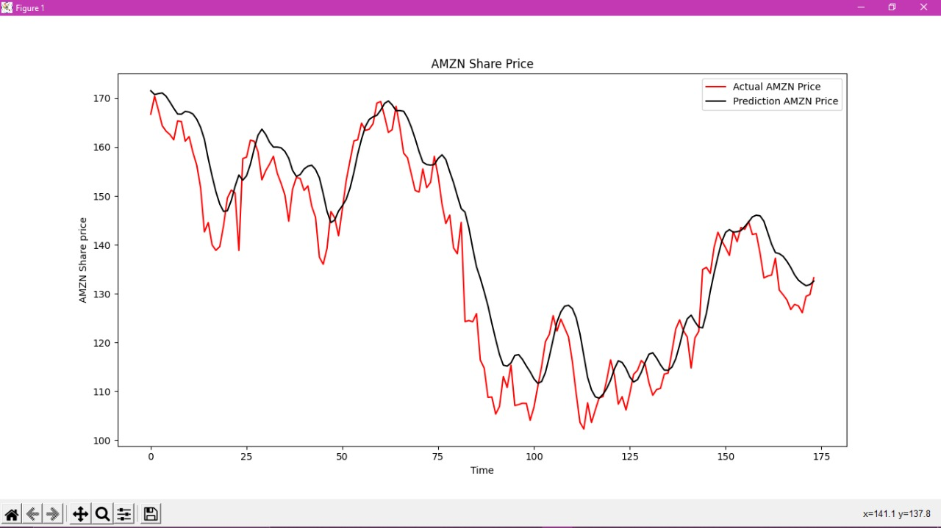
5. Visualization of actual and predicted prices

Slide 11
5. Experimental Results
Libraries used :
numpy: NumPy stands for Numerical Python,
it's a python library used for working with arrays
Matplotlib : for data visualization
Pandas : data analysis and associated manipulation of tabular data in
Data frames
Sklearn : It provides a selection of efficient tools for machine learning and statistical modeling like classification , regression and dimensionality reduction.
Tensor Flow : Tensor Flow is a Python library for fast numerical computing created and released by Google. It is a foundation library that can be used to create Deep Learning models directly or by using wrapper libraries that simplify the process built on top of Tensor Flow

Slide 12
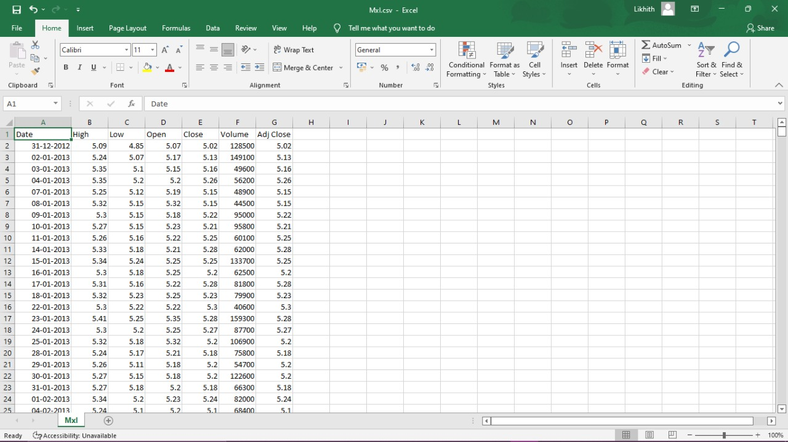
Data set : it’s 7 feature dataset comprises of date, high , low, open, close, Volume, Adj close as features.
training data set is of 9 years from 2013 10 2022
testing data set is of up to now from 2022.

Slide 13
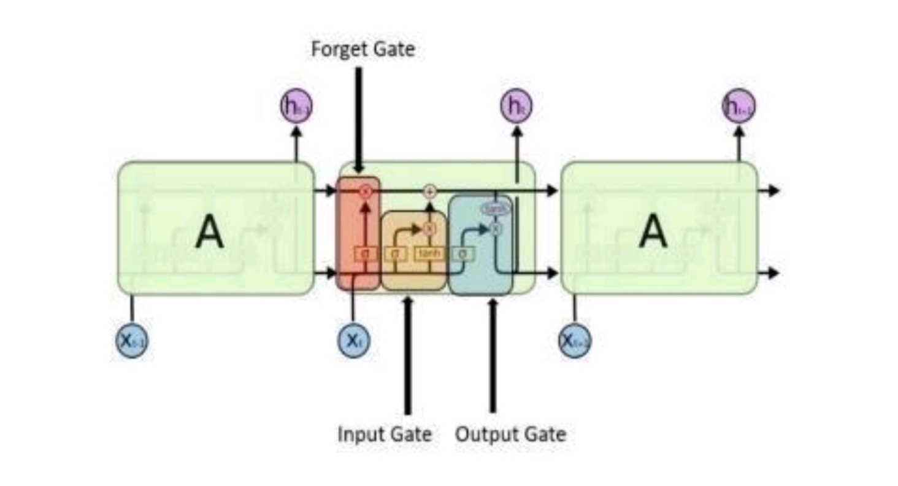
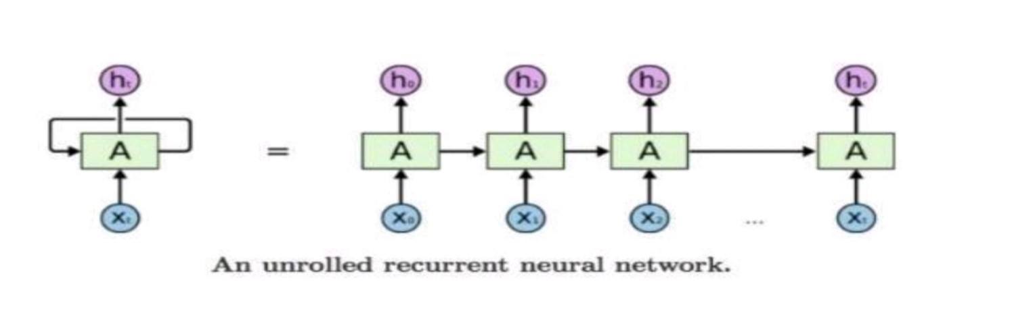
Functionality of LSTM LAYERS
An LSTM layer learns long-term dependencies between time steps in time series and sequence data . The layer performs additive interactions, which can help improve gradient flow over long sequences during training. LSTM’s have a Nature of Remembering information for a long periods of time is their Default behavior.

Slide 14
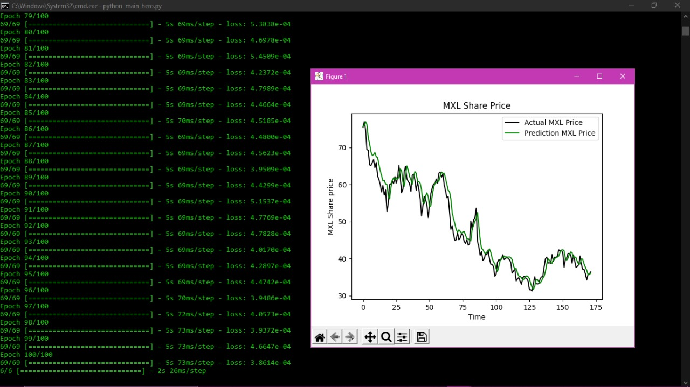
Results screenshots :

Slide 15
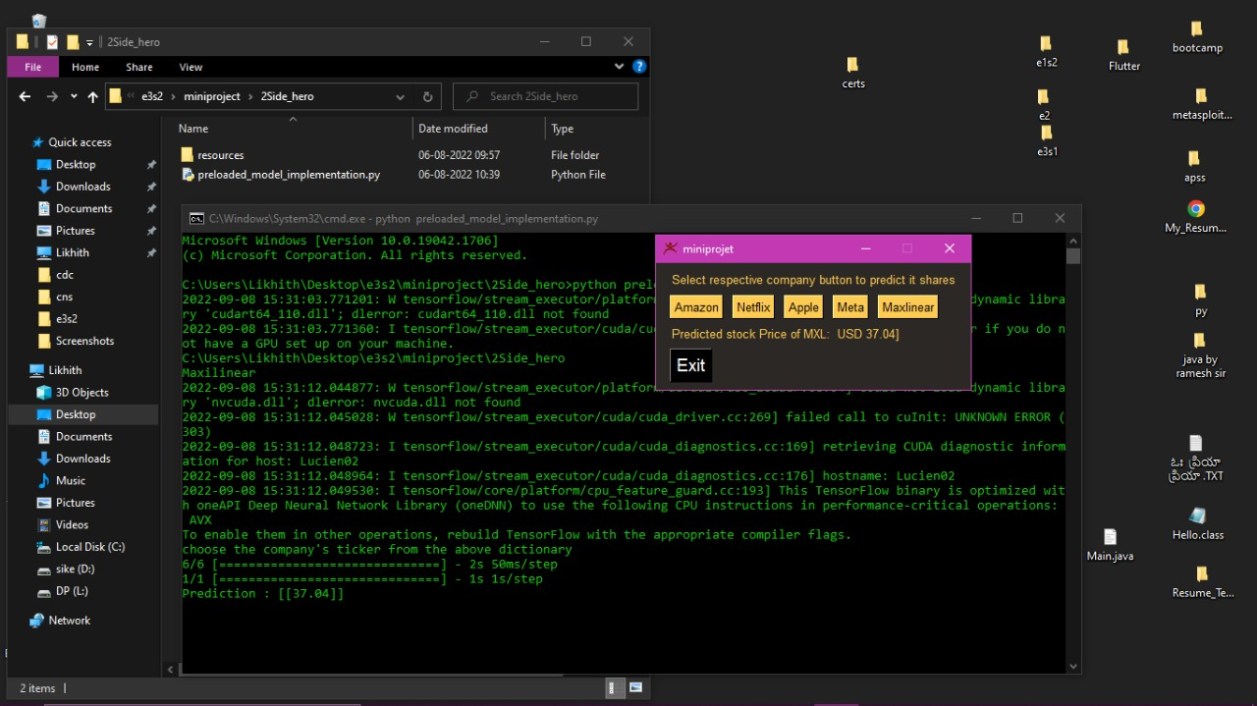
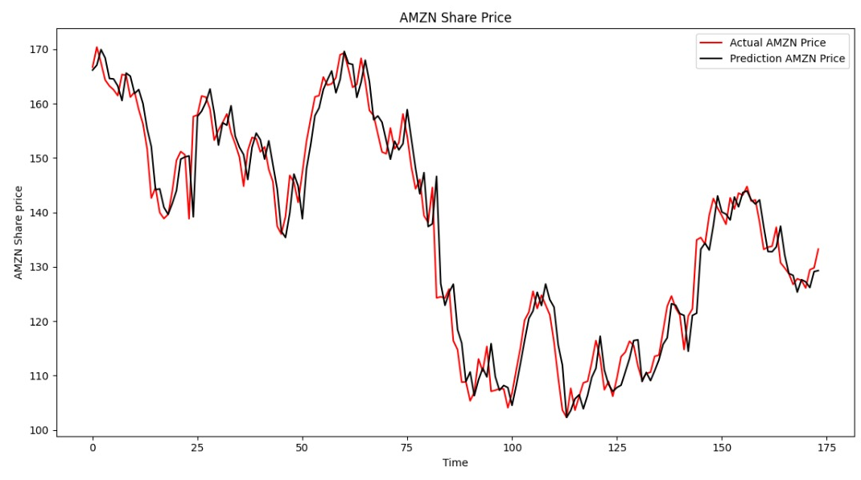
Results comparison with other approaches
USING LINEAR REGRESSION
Using LSTM LAYERS

Slide 16
CONCLUSION
NOW, WE CAN PREDICT THE VALUE OF ONE DAY INTO THE FUTURE BY TAKING THE DATA OF PAST 60 DAYS.
We visualized the both actual values and predicted values.
By observing those, we can say the using LSTM layers we can predict the values more accurately than using LINEAR REGRESSION

Slide 17
FUTURE SCOPE
As we have designed a desktop application for predicting future stock prices of the
Companies it is limited to a selected set of companies stocks and every time we create
or update internal working of our application the user must update the app manually for this, we can create a web application implementing our project and deploy in our server so that
The users can directly access from browser and even select any company for prediction.

Slide 18
Thank you
.

