Slide 1


Team Details
  Team name: Andon Agent
  Team leader name: Likhith M
  Problem Statement: Manufacturing: Intelligent Operations & Industrial Efficiency
When an automotive assembly line stops, the alarm often fires downstream of the real cause. Find a verified root cause fast and hand a human a safety-gated work order, without touching a machine.
Notes:
Theme string is exact. Team name 'Andon Agent' is a placeholder unless a registered team name exists.

Slide 2
Brief about the idea
Andon Agent investigates a stopped line like a reliability engineer, then hands a human a verified root cause and a safety-gated draft work order.
$2.3M
lost per hour when a large automotive plant stops
1
Investigate
2
Verify
3
Approve
Siemens, The True Cost of Downtime 2024, p.2
Commander plans competing checks; agents run change points, spectra and machine-sound analysis on telemetry, read alarms and shift notes, cite the manual.
Deterministic code (no LLM) re-runs every number, timestamp, quote and causal claim. Rejected claims are struck through, never hidden.
Draft work order with lockout/tagout steps quoted verbatim with page numbers. A named human approves; nothing touches a machine.
The problem
The andon alarm fires where the symptom shows (a weld cell starved of air), not where the cause is (a plant-air header upstream). Engineers stitch telemetry, alarms, shift notes and manuals together by hand while the line waits.
0.98
0.76
1 / 586
≈ $0.11
top-1 root cause, 60 synthetic scenarios
top-1, 17 real-signal scenarios
claims code could not back (vs 54 / 645)
per diagnosis, 81 s median
Eval run final_v2 (Gemini 3.8 Flash judge); 95% Wilson intervals on slide 13. Real public signals mapped onto a synthetic line, not real plant data.

Slide 3
Who it serves
L
Line technician
M
Maintenance supervisor
R
Reliability engineer
P
Plant manager
PAIN TODAY
PAIN TODAY
PAIN TODAY
PAIN TODAY
Sent to the station that alarmed; safety steps live in a thick English manual.
Must approve repair work without seeing why the cause was chosen.
Stitches historian exports, alarm logs, shift notes and manuals by hand.
Every stopped minute is worth about $38,333 (Siemens $2.3M/h ÷ 60).
WHAT ANDON AGENT GIVES
WHAT ANDON AGENT GIVES
WHAT ANDON AGENT GIVES
WHAT ANDON AGENT GIVES
/tech phone view: one card at a time, big verbatim LOTO checklist, voice note → shift note, work order in Hindi, Tamil, Bahasa Indonesia or Vietnamese beside the binding English text.
Ranked root cause with verified evidence, draft work order PENDING_APPROVAL, approval recorded with the approver's name in a mock CMMS.
Evidence drawer charts the telemetry behind every claim; change points, spectra, audio; upload your own CSV and investigate it.
Cost per run on screen (≈ $0.11), append-only audit of every model call and human decision, no physical writes.
Notes:
$38,333/min = $2.3M/h ÷ 60, Siemens, The True Cost of Downtime 2024, p.2 (large automotive plant)

Slide 4
Opportunities how it differs · how it solves · USP
Dashboards
Rule engines
RAG chatbot
Andon Agent
HOW IT SOLVES THE PROBLEM
Works upstream from the alarming station to the real cause
Fuses telemetry, alarms, shift notes, manuals and machine audio
Abstains (insufficient evidence) instead of guessing
Ends in a draft work order, never an actuator
Runs analytics on signals and machine sound
Charts only
No
No
Yes
Forms competing hypotheses, ranks causes
No
Fixed rules
Partly
Yes
Code re-checks every claim before display
n/a
n/a
No
Yes
Safety steps quoted verbatim with page
No
No
Paraphrases
Yes
Drafts action; a human approves
No
Alerts only
No
Yes
USP
The model never grades itself.
Verifier stress test: 2,778 injected faults, 97.1% caught; without the verifier 0%. Safety text is inserted by code, verbatim.
“Isn't this just RAG?” No.
RAG retrieves text and paraphrases it. Andon Agent runs analytics on telemetry and audio, forms competing hypotheses, and every claim cites evidence ids that deterministic code re-runs before a human acts. Measured against one long prompt given the same evidence: 1 of 586 claims unsupported vs 54 of 645.

Slide 5
List of features offered by the solution all built and live
1
Incident console
2
Live agent trace
3
7-step stepper
4
Evidence drawer
Line mimic of synthetic Line L1 with utilities rail; stopped station and root cause marked.
Every plan, tool call and result streams in (SSE), with provenance chips on real signals.
Stop → Plan → Evidence → Hypotheses → Verify → Work order → You.
Click any evidence id: the telemetry window behind the claim is charted (real signal where marked).
5
Deterministic verifier
6
Root cause + actions
7
Safety-gated work order
8
Multilingual work order
Code re-checks each claim; rejected ones are struck through with the measured value.
Ranked causes citing evidence ids; accept, edit or reject; downtime cost estimate.
LOTO steps verbatim with page numbers; approver name; human approval → mock CMMS.
Hindi, Tamil, Bahasa Indonesia, Vietnamese machine translation beside untouched English safety text.
9
Bring your own CSV
10
Technician view /tech
11
Replay + per-run cost
12
/eval page
Gemini Flash-Lite proposes a column → tag mapping; a human confirms; a normal investigation runs.
Phone-first cards, big safety checklist, voice note → structured shift note marked untrusted.
Recorded runs replay free for anyone; live runs show tokens and $ per diagnosis.
Committed benchmark results with intervals, inside the app.

Slide 6
Process flow diagram one stopped line, end to end
1 Stop
2 Plan
3 Evidence
4 Hypotheses
5 Verify
6 Work order
7 You
The console's investigation stepper, step by step
IN PARALLEL
Incident Commander
Signal Analyst
RCA Judge
Deterministic Verifier
Line stops
change points, spectrum, anomaly score, listen() on machine audio
code, no LLM: re-runs every number, timestamp, quote, causal order and citation premise
andon alarm at a station (e.g. ST20 weld cell)
reads the stop, lists assets upstream, plans competing checks
ranks causes; every claim cites evidence ids
Evidence Librarian
Gemini 3.8 Flash
alarms, shift notes, work orders (SQL); manual citations (context cache)
Gemini 3.8 Flash
no model · cannot be talked round
FAIL: rejected claims go back · max 3 loops
PASS
Guarantees
No PLC / SCADA / historian writes; one write tool only
Loops exhausted → "insufficient evidence" (abstains)
Uploads, shift notes, voice notes treated as untrusted
Mock CMMS (Firestore)
Human approval
Action Drafter
PENDING_APPROVAL → APPROVED; every step in an append-only audit log
accepts the cause, ticks every LOTO step, enters approver name
work order; code inserts each mandatory LOTO step verbatim + page
Gemini 3.8 Flash

Slide 7
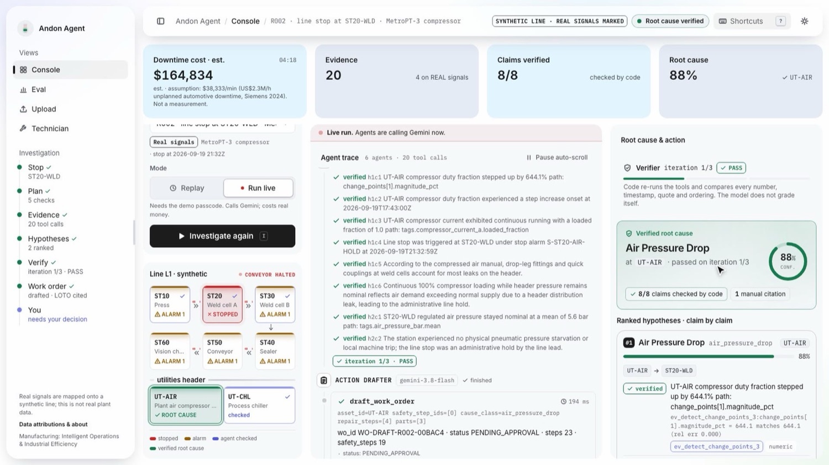
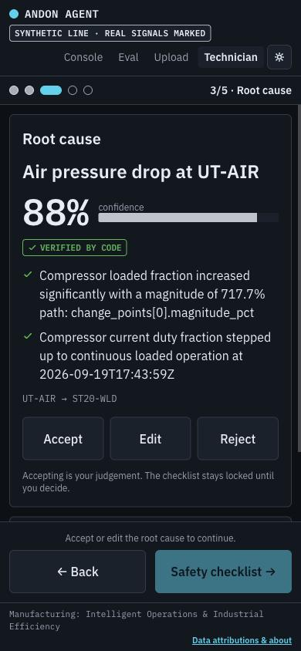
Wireframes / mock real deployed screens, annotated · live run, 17 Oct 2026
2
1
Investigation stepper
Stop → Plan → Evidence → Hypotheses → Verify → Work order → You
2
Status strip
downtime estimate (labelled assumption), claims verified, confidence
4
Line mimic
1
3
stopped station red, root cause on the utilities rail
5
4
Live agent trace
3
tool calls, per-claim verdicts, provenance chips
Technician view /tech (phone)
5
Verified root cause
cause, asset, confidence, ranked hypotheses
One card at a time: cause → safety checklist → approve, voice note
Layout logic
Left: where. Middle: how the agents got there. Right: what to do, and what a human must approve.
Live run, 17 Oct 2026 · R002, real MetroPT-3 signals on the synthetic line · 20 tool calls · 8/8 verified · 88% at UT-AIR

Slide 8
Architecture diagram Google Cloud, asia-south1 · Gemini on the global endpoint
Incident console
Cloud Run · andon-api (FastAPI, SSE, ADK runner)
Gemini on Vertex AI Agent Platform
React + Vite + TS; plant engineer, supervisor
/investigate (live | replay) · /approve · /uploads · /voice-note · /work-order?lang · /health
gemini-3.8-flash: plan, analyse, judge, draft (thinking levels)
gemini-3.1-flash-lite: triage, CSV mapping, voice transcription, translation
Explicit context cache: 5 equipment manuals
Structured output: RCAReport, WorkOrder (Pydantic)
SSE
Commander
Signal Analyst
RCA Judge
Technician /tech
6 ADK agents
5 on Gemini + 1 deterministic verifier; 11 read-only tools + 1 gated write tool
Evidence Librarian
phone view, voice notes
loop ≤3
Verifier (code)
Action Drafter
Firestore
Firebase Hosting
agents/llm.py gateway: every Gemini call logged with tokens and $, daily kill switch, fallback; passcode + per-IP limits; replay = $0
append-only audit log, mock CMMS work orders, shared daily spend counter, rate limits
serves the SPA (static)
Cloud Storage
Offline data build
Public datasets (MetroPT-3, UCI hydraulic, IMS, MIMII) → synthetic Line L1 + real-signal mapping + provenance → publish
per-incident Parquet store, MIMII audio clips, manuals
BigQuery
Secret Manager
Live tools query a per-incident DuckDB built from Parquet in Cloud Storage (ADR-021).
provisioned for analytics / eval at scale; not on the live path
demo passcode, daily budget; ADC, no keys
Deployed via Cloud Build + Artifact Registry. Eval harness calls the same pipeline (eval/run_eval.py).

Slide 9
Technologies used in the solution
GOOGLE CLOUD
GEMINI CAPABILITIES USED
Gemini 3.8 Flash
Commander, Signal Analyst, Librarian, RCA Judge, Action Drafter; thinking LOW → HIGH by role
Agentic planning + loop revision
Function calling: 11 read-only tools, 1 gated write
Gemini 3.1 Flash-Lite
cheap calls: CSV column mapping, voice-note transcription, work-order translation
Audio understanding: listen() on MIMII clips
Long context + explicit caching
Vertex AI Agent Platform + ADK
google-adk graph: Sequential, Parallel and Loop agents; google-genai client
Gemini context caching
5 equipment manuals cached once per session, cited by page
Structured output (response_schema)
Thinking levels + cost routing
Cloud Run
FastAPI API streaming Server-Sent Events, asia-south1
OPEN-SOURCE STACK
Firebase Hosting
React incident console and /tech technician view
Python 3.12 · uv
FastAPI · SSE
Firestore
append-only audit, mock CMMS work orders, shared budget counter, rate limits
Pydantic v2
DuckDB
Cloud Storage
per-incident Parquet store, machine audio, manuals
React · Vite
TypeScript · Tailwind
BigQuery
provisioned for analytics / eval at scale; live tools use DuckDB from GCS Parquet (ADR-021)
pytest · ruff
Vitest
Secret Manager
passcode and daily budget; service accounts via ADC, no keys
Tests run offline with recorded Gemini fixtures; 700+ tests (README).

Slide 10
Estimated implementation cost measured, then a labelled assumption
$0.107
≈ $107
$0
ASSUMPTION · not measured
Gemini cost for one plant
If a plant runs 1,000 diagnoses a month:
1,000 × $0.107 ≈ $107 / month
Hosting runs on serverless services that scale to zero (Cloud Run, Firebase Hosting, Firestore); our budget sets aside $35 for infrastructure through Dec 4 (allocation, not a bill).
Main levers: replay and caching cost $0; Flash-Lite for cheap steps; the Pro judge was measured worse and dearer ($0.16 vs $0.11 per run) and dropped.
Gemini cost per diagnosis
all Gemini spend to build
per replay
S1 mean, S-set; $0.109 R-set (final_v2)
incl. ≈ $99.8 on evaluation (ledger, Oct 17)
recorded runs never call a model
WHERE A DIAGNOSIS'S MONEY GOES (77 S1 runs, eval/results/final_v2/cost.json)
gemini-3.8-flash $8.14 (98%)
Flash-Lite $0.14 (2%)
Voice note → shift note
≈ $0.0008 per 21 s clip (ADR-029)
BUILD BUDGET (ledger, DEVELOPMENT.md §7)
$300 total to Dec 4
≈ $107 Gemini spent · ≈ $190 left for judging window and finals
Work-order translation
$0.0020–0.0024 per order, cached (ADR-030)
CSV upload investigation
$0.093 live run (ADR-028)
Guard rails
$8/day kill switch; $300 total budget to Dec 4

Slide 11
Business value & ROI one sourced number, the rest labelled assumption
$2.3M
$38,333
20 min
≈ $0.77M
per hour of downtime
per stopped minute
saved per month, per plant
value at stake / month
Siemens 2024, p.2 (sourced)
= $2.3M ÷ 60 (arithmetic)
ASSUMPTION: 10 diagnosed stops × 2 min faster restart; plant-level rate applied
= 20 × $38,333 (assumption-based)
Against a cost of
10 × $0.107 ≈ $1.07 / month
One saved minute of downtime pays for about 358,000 diagnoses ($38,333 ÷ $0.107).
Value we did not price
Safety: LOTO steps verbatim, every step ticked before approval
Knowledge capture: every claim, tool call and decision in an audit log
JAPAC workforce: work orders in Hindi, Tamil, Bahasa Indonesia, Vietnamese
Honest limit: we have not measured time-to-restart in a real plant. The stop rate and minutes saved are illustrative assumptions; a pilot would measure them. Model cost is measured (final_v2).

Slide 12
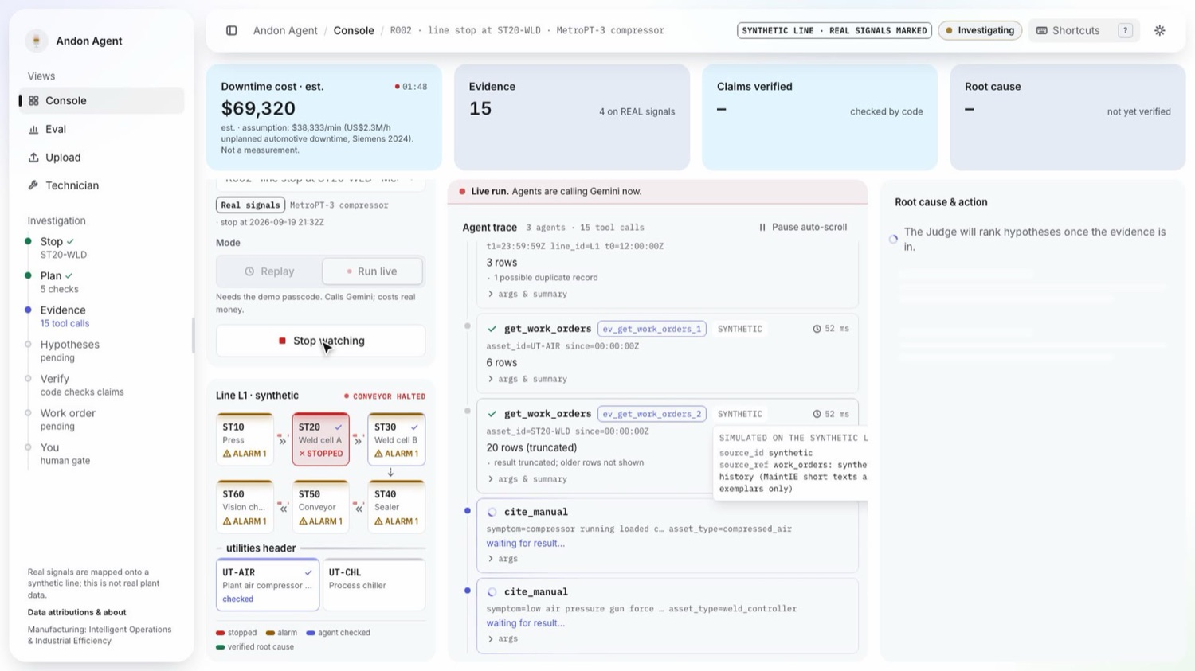
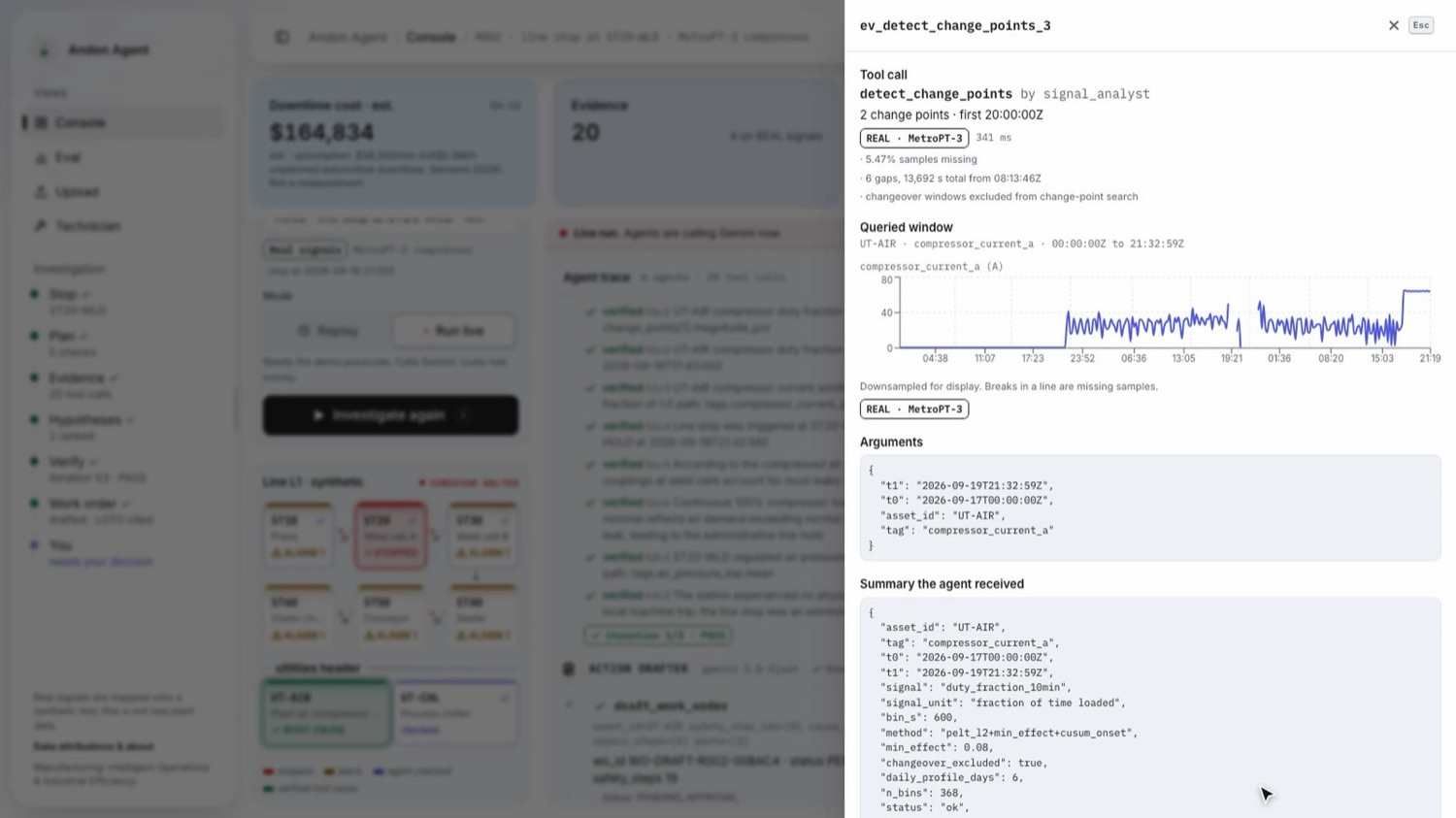
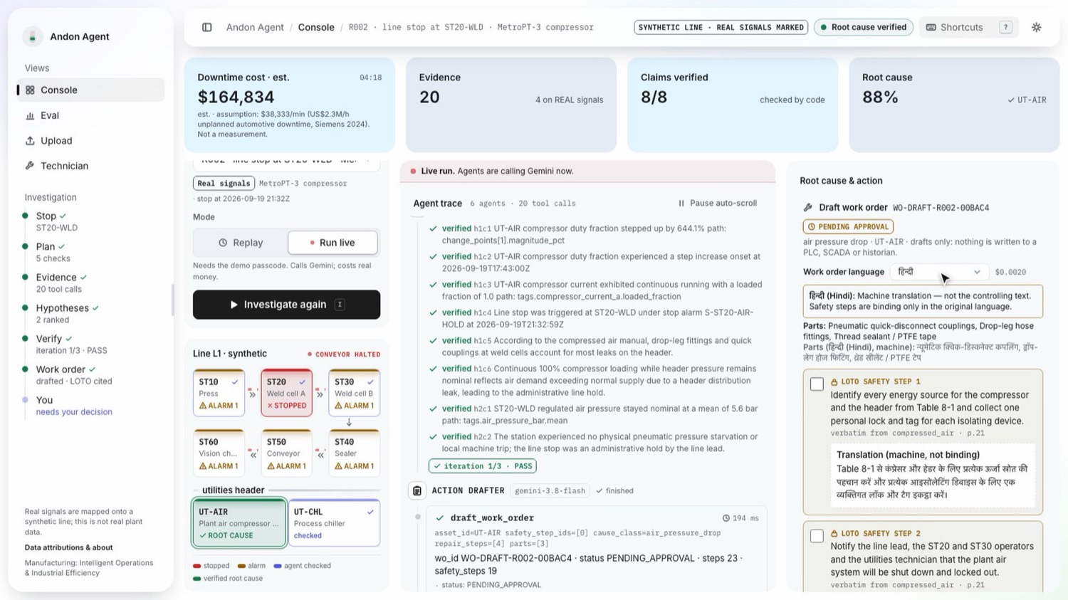
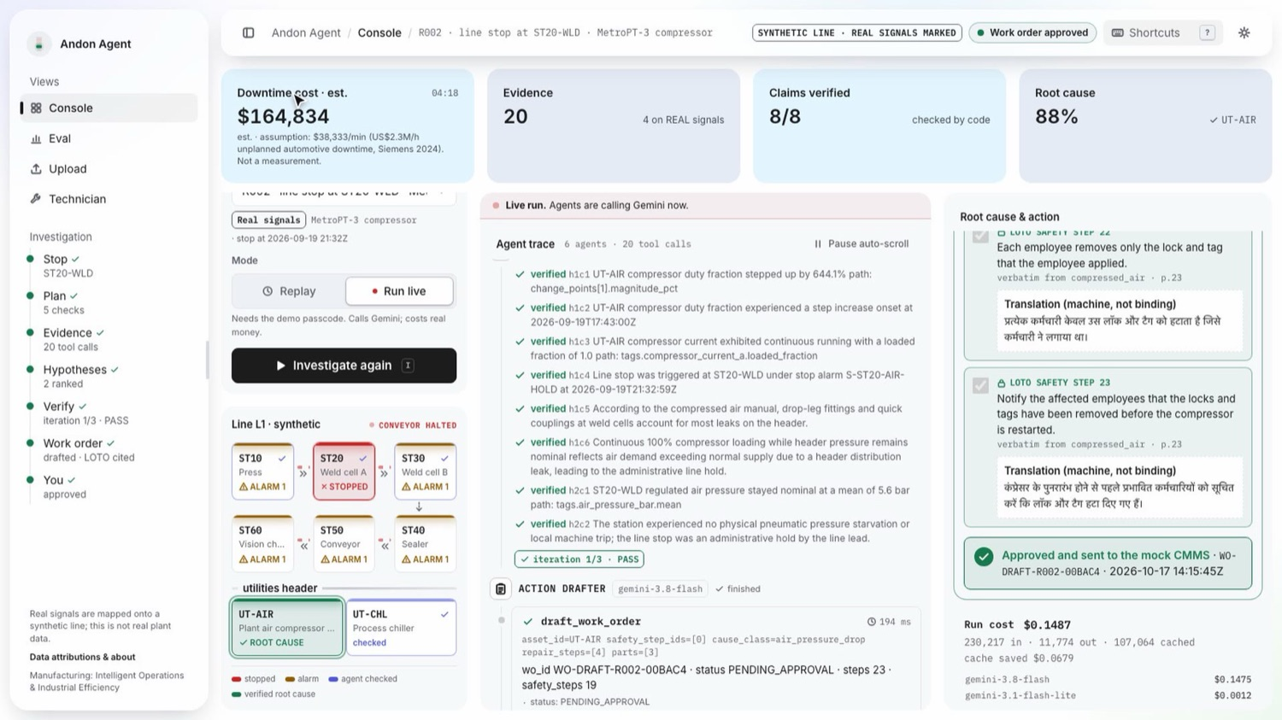
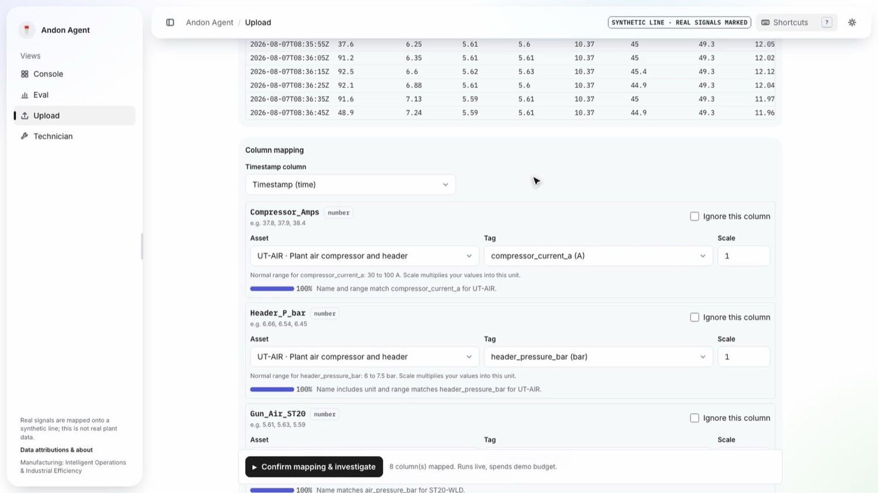
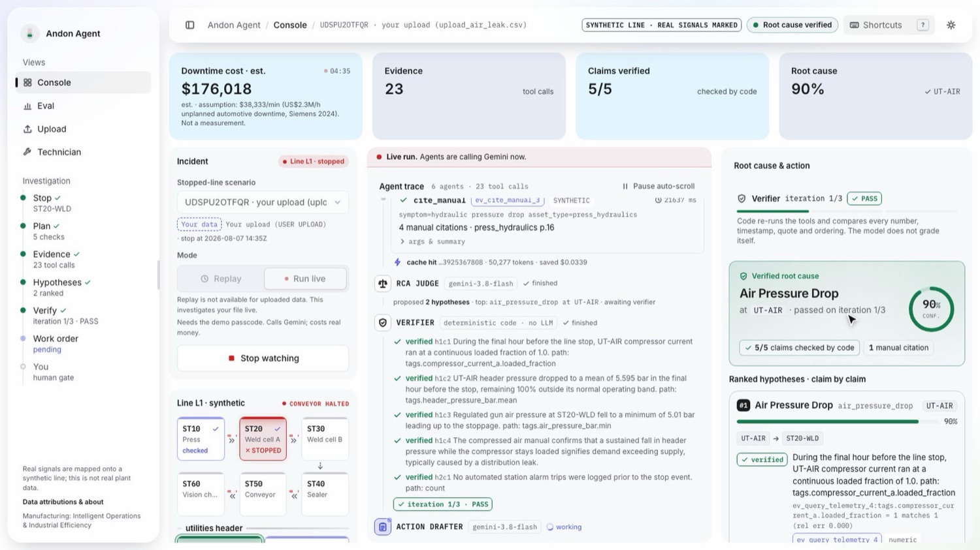
Snapshots of the prototype deployed app · live run, 17 Oct 2026
Agents calling Gemini live
Evidence drawer: real MetroPT-3 window
Hindi beside verbatim English LOTO
Approved to mock CMMS · run cost shown
Your CSV: Flash-Lite maps, human confirms
Live investigation on that CSV, verified
Live run, 17 Oct 2026. R002: 20 tool calls, 8/8 claims verified by code, 88% air pressure drop at UT-AIR, 19 LOTO steps, approved; Gemini cost $0.1487. Upload (upload_air_leak.csv): 23 tool calls, 5/5 verified, 90% at UT-AIR.

Slide 13
Prototype performance report / benchmarking eval run final_v2
Top-1 root cause (right cause class and asset)
GROUNDING · claims independent code could not back (S + R)
1 / 586 0.2% vs 54 / 645 8.4%
Andon Agent vs single long prompt with the same evidence. No-verifier ablation (S2): 4 / 609. Grounding comes from evidence-id citations plus the verifier; the verifier's own value is the stress test below.
VERIFIER STRESS TEST · offline, $0 (ADR-032)
97.1% caught [96.4, 97.7] vs 0% with it off
2,778 faults injected into real S1 reports: wrong numbers, timestamps, misquotes, reversed cause and effect, false premises. Weakest: sign flips 92.6%.
95% Wilson CIs: S1 [0.91, 1.00] / [0.53, 0.90] · B1 [0.82, 0.96] / [0.36, 0.78] · B2 [0.08, 0.26] / [0.10, 0.47]. S2, same pipeline with the verifier always passing: 1.00 / 0.76. Failed runs count as misses.
≈ $0.11 per diagnosis · 81 s median (S-set)
Honest reading: top-1 vs the single prompt is not significant (exact McNemar p = 0.219 S-set, 0.375 R-set). The win is grounding.

Slide 14
Post-hoc rerun and open weakness labelled post-hoc, not the headline
POST-HOC
Measured after two changes made following the final_v2 eval: a judge rule (R002 was unstable across repeats, ADR-026) and an end-anchored short-shift detector (ADR-033). Run eval/results/posthoc_v4.
0.97
0.82
0.50
0 / 648
S-set top-1, n=60
R-set top-1, n=17
C-set top-1, n=10
unsupported claims
[0.89, 0.99]
[0.59, 0.94]
[0.24, 0.76]
S + R + C
Pre-registered confirmation (C-set)
Before running, we fixed 10 new scenarios from unused segments of the real sources and a pass bar (top-1 ≥ 0.6). Result: S1 0.40, failing our own bar. It still beat the single prompt (0.20) with 0 / 80 unsupported claims vs 6 / 91.
Open weakness, said plainly
Short real hydraulic faults (R009–R011; C-set 0 / 5) are still called healthy. The detector now reports the shift (7 / 10 on a synthetic dev set, 0 false positives in 8,000+ healthy windows), but the judge does not yet trust a 0.3–6% change over minutes.
OTHER CHECKS (final eval)
Held-out S051–S060: 10 / 10. · Variance, 3 repeats of 15 scenarios: 0.80 / 0.73 / 0.87. · Gemini 3.1 Pro as judge measured worse (S 0.90, R 0.71) at $0.16 vs $0.11 a run, so Flash is the judge.

Slide 15
Responsible AI & safety enforced in code and tests
1
No physical writes
2
Safety text is verbatim
3
Every claim checked by code
No tool can write to a PLC, SCADA or historian. The only write tool drafts PENDING_APPROVAL work orders in a mock CMMS; a named human approves.
Lockout/tagout steps are exact manual quotes with page numbers, inserted by code (ADR-025); structure follows OSHA 29 CFR 1910.147. Translations sit beside, never replace.
Numbers, timestamps, quotes, causal order and citation premises are re-run. Unverifiable claims are struck through, never dropped.
4
Untrusted text stays data
5
Honest data
6
Access, cost, audit
Shift notes, CSV uploads, voice notes and stop text are wrapped as untrusted; voice notes never reach an agent and cannot change a work order.
Public datasets under their licences; real signals mapped onto a synthetic line, every real segment carries provenance; the UI shows SYNTHETIC LINE · REAL SIGNALS MARKED.
Live runs need a passcode, per-IP limits, $8/day kill switch; append-only audit of every model call and human action; secrets in Secret Manager.
Residency mode (designed, not deployed): pin Gemini 3.5 Flash to asia-south1 / asia-southeast1 for Indian and Singapore plants. Equipment manuals are fictional, written for this demo.

Slide 16
Additional details / future development
NEXT
SCALE
PROVE
Close the known gap
From one line to a plant
Pilot and finale
Teach the judge to trust the short-shift detector (short real hydraulic faults)
Historian / OPC UA / MQTT adapters behind the same TelemetryStore interface (CSV upload proves the pattern)
Residency mode live in asia-south1 / asia-southeast1
Dataproc ingestion for plant-wide history
Vector search once work orders pass ~1M (SQL by asset and time today)
Gemma 4 at the edge for plants that cannot send data out
Pilot with a plant to measure time-to-restart (today an assumption)
More real-signal scenarios graded on source labels
If selected, show it live at the Singapore finale, Dec 4
Known limits today: the line is synthetic (real signals mapped onto it); the real-signal set is small (n = 17); translations are machine output, labelled as not binding; uploads are held per instance, so upload mode runs one instance.
Built fresh in the hackathon window: dated public commits; 33 architecture decisions logged (docs/DECISIONS.md); 700+ offline tests; every number in this deck traces to a committed results file.

Slide 17
Links
GitHub public repository
https://github.com/Likhith-BlueLotus/andon-agent
1
Demo video (3:29)
<YouTube link — added at upload>
2
Final product (live app)
https://andon-agent-b9c77.web.app
3
API health
https://andon-api-359520289475.asia-south1.run.app/health
4
60-second judge path: open the live app → pick R002 · MetroPT-3 compressor (replay) → Investigate stop → click an evidence chip → tick the LOTO steps and approve. Replay S014 shows the verifier rejecting a reversed cause-and-effect claim. Replays need no login; live investigations call Gemini and need the demo passcode.
Theme: Manufacturing: Intelligent Operations & Industrial Efficiency · code MIT · data sources and licences: data/SOURCES.md

Slide 18
Built like a product team
Two full-stack builders worked through nine role lenses. Each lens is backed by a role-specialised AI review agent (.claude/agents/), and a sceptical judge agent scored us against the rubric.
Principal Engineer / Architect
Staff Engineer · agents
Senior Backend Engineer
Architecture, the three contracts, 33 ADRs, cost and latency budgets, scope cuts
ADK graph, prompts, tool wiring, model routing and fallback, verifier loop, context cache
FastAPI + SSE, Firestore audit and mock CMMS, replay, passcode, rate limits, kill switch
Senior Data & ML Engineer
SRE / DevOps
UX / UI Engineer
Dataset fetch and provenance, synthetic line, real-signal mapping, fault injector, signal maths
GCP bootstrap, IAM, Cloud Run, Firebase Hosting, Secret Manager, budgets, deploy scripts
Incident console, trace and provenance chips, evidence drawer, technician view, accessibility
QA & Eval Engineer
Security & Responsible-AI
Product & Pitch Lead / BA
Offline tests with recorded fixtures, eval harness and baselines, Wilson CIs, McNemar, stress test
Read-only reviews before each deploy: IAM, secrets, prompt injection, safety rules, licences
Personas, demo script, deck, judge Q&A, ROI assumptions, sourcing of every number
Ownership: Person A: agents, backend, infra, eval harness · Person B: data (S-set, R-set), frontend, deck and video.

Slide 19


