Slide 1

CRYPTOVERSE

Slide 2

What is Cryptocurrency?!
Cryptocurrency is a digital payment system that doesn't rely on banks to verify transactions. It’s a peer-to-peer system that can enable anyone anywhere to send and receive payments. Instead of being physical money carried around and exchanged in the real world, cryptocurrency payments exist purely as digital entries to an online database describing specific transactions. When you transfer cryptocurrency funds, the transactions are recorded in a public ledger. Cryptocurrency is stored in digital wallets.
Cryptocurrency received its name because it uses encryption to verify transactions. This means advanced coding is involved in storing and transmitting cryptocurrency data between wallets and to public ledgers. The aim of encryption is to provide security and safety.
The first cryptocurrency was Bitcoin, which was founded in 2009 and remains the best known today. Much of the interest in cryptocurrencies is to trade for profit, with speculators at times driving prices skyward.

Slide 3
How does Cryptocurrency work?!
Cryptocurrencies run on a distributed public ledger called blockchain, a record of all transactions updated and held by currency holders.
Units of cryptocurrency are created through a process called mining, which involves using computer power to solve complicated mathematical problems that generate coins. Users can also buy the currencies from brokers, then store and spend them using cryptographic wallets.
If you own cryptocurrency, you don’t own anything tangible. What you own is a key that allows you to move a record or a unit of measure from one person to another without a trusted third party.
Although Bitcoin has been around since 2009, cryptocurrencies and applications of blockchain technology are still emerging in financial terms, and more uses are expected in the future. Transactions including bonds, stocks, and other financial assets could eventually be traded using the technology.

Slide 4
Why is Crypto so important and should I care?
In essence, cryptocurrency is – as blockchain based platforms are meant to be – completely decentralised. As a financial based blockchain, that means it is not governed by any central bank or monetary authority. It is rather maintained by a peer-to-peer community computer network made up of users’ machines or “nodes”. If you know what BitTorrent is, the same principle applies.
Using blockchain, it is effectively a digital database a “distributed public ledger” – which is run via cryptography. Cryptocurrency such as Bitcoin is secure as it has been digitally confirmed by a process called “mining”. Mining is a process where all the information entering the Bitcoin blockchain has been mathematically checked using a highly complex digital code set up on the network. That blockchain network will confirm and verify all new entries into the ledger, as well as any changes to it.

Slide 5
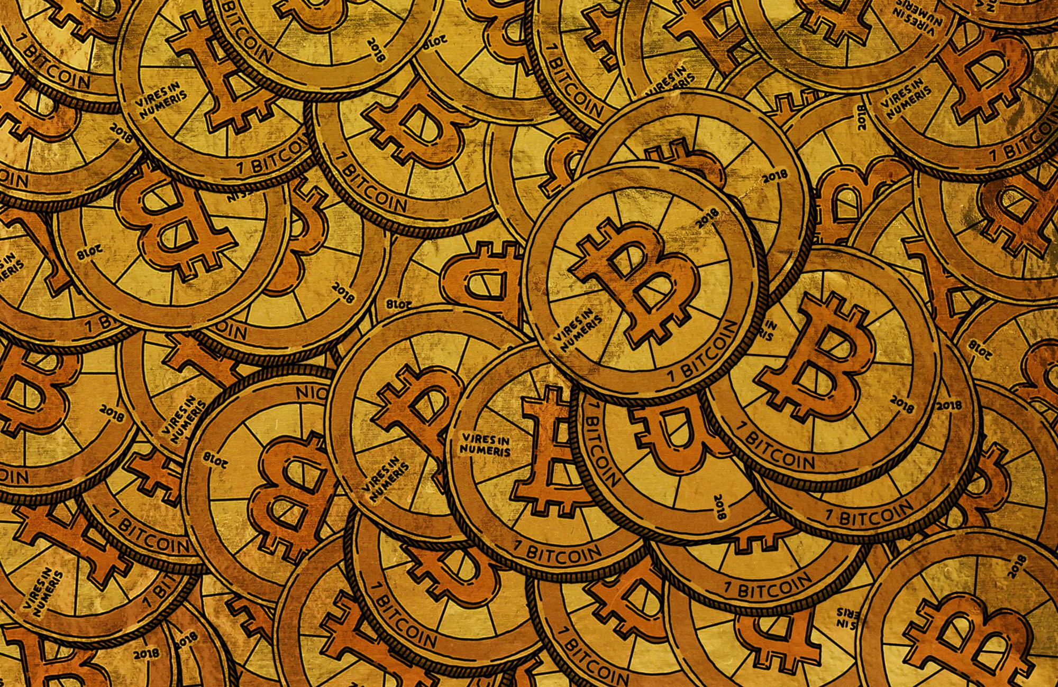
Advantages of News Distribution Through Apps over Print Media
Portable
Better user experience
Stay up to date
Clear Visualization
Knowing information time to time

Slide 6
Importance of financial news:
Financial news is important because it tells you about the market trends and the performances of the various financial instruments. It guides you in the correct direction and helps you to invest in a correct and effective manner.
There are various sources of financial news, some of them are:
=> Television
=> Newspapers
=> News-apps
=> Journals
=> Research-material
39
4
29
27
4
5
20
35
5
25
22
15
20XX
20XX
20XX
20XX

Slide 7



Environment Setup
Visual Studio
Rapid API
Ant Design Framework

Slide 8
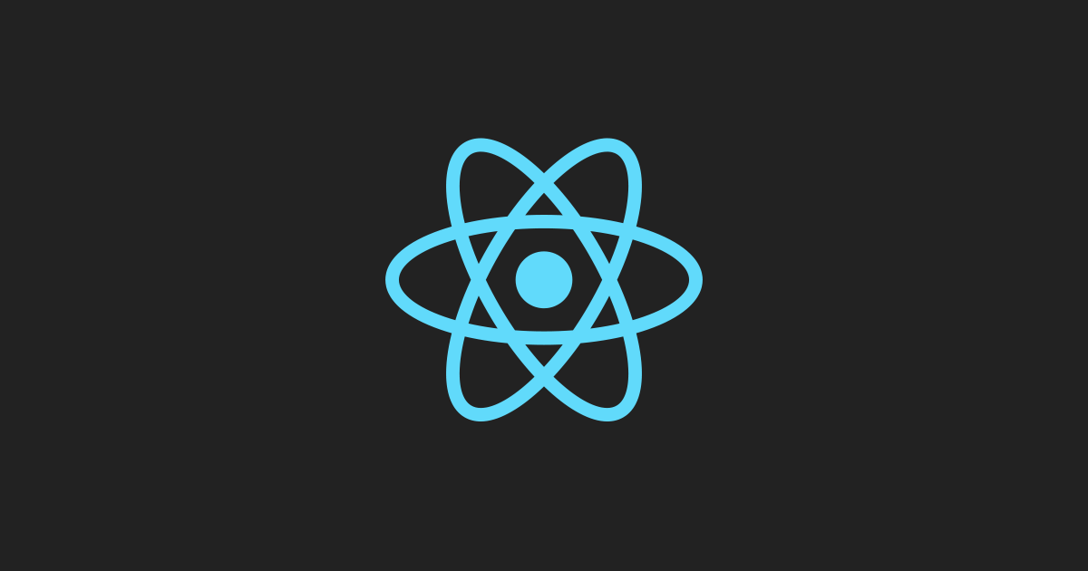
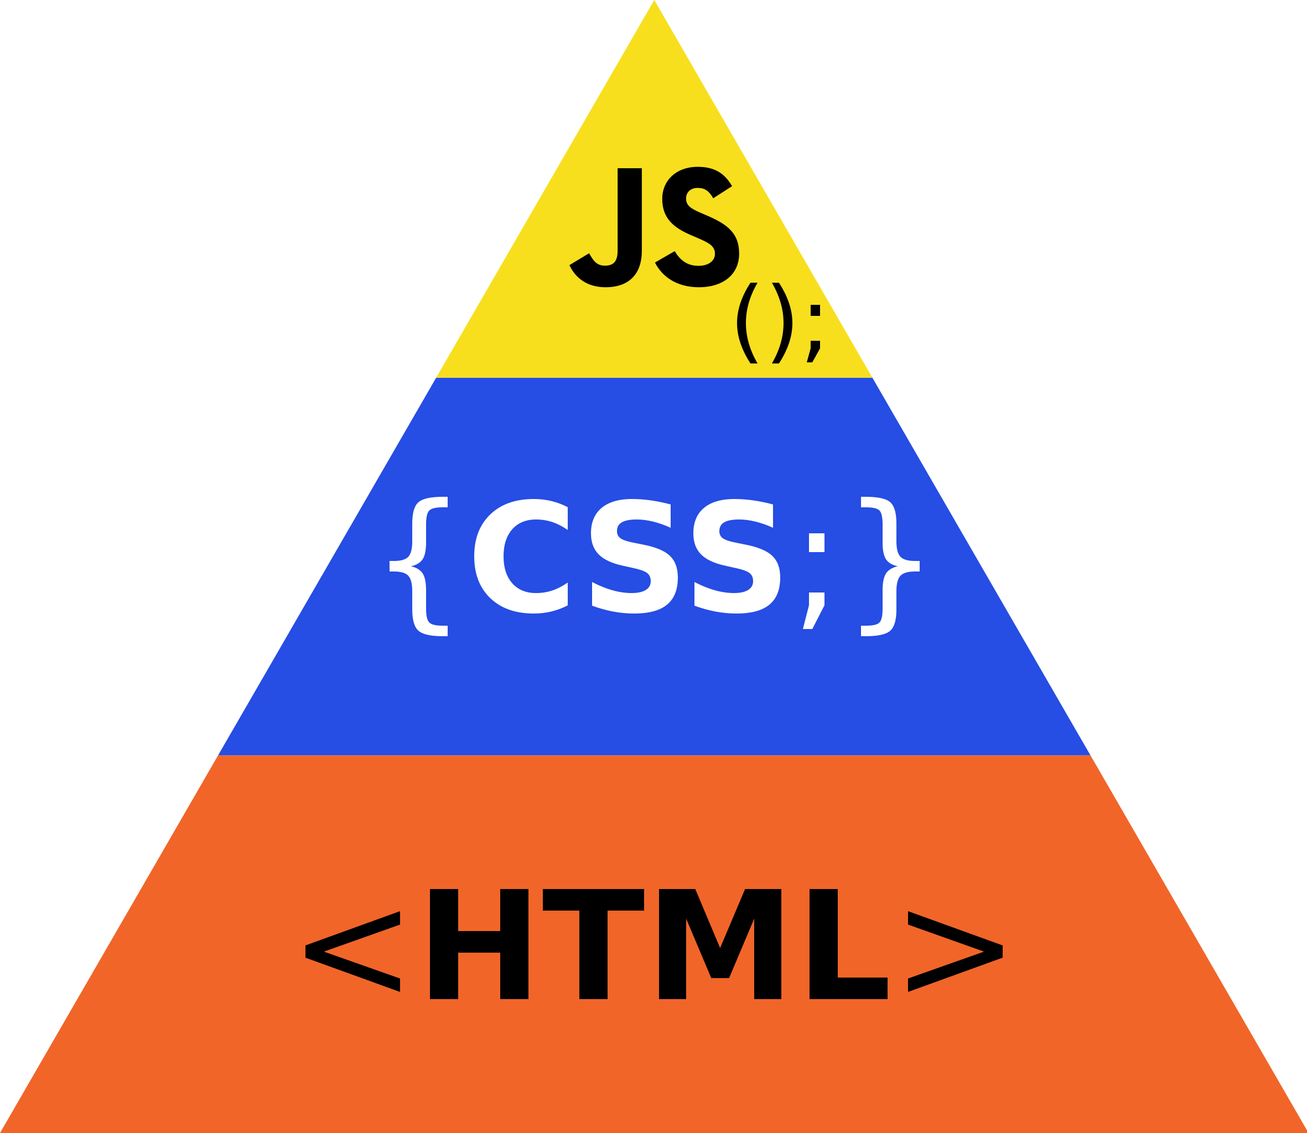
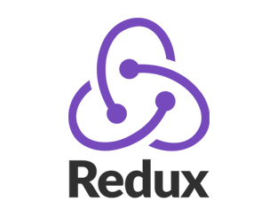
Languages Used
React JS + Redux
HTML/CSS/JS
Ant Design Language

Slide 9

Teammates
Keerthy
Karthik
Rohit
Sandeep
Likhith

