Slide 1


CANARA ENGINEERING COLLEGE
Sudhindra Nagara, Benjanapadavu, Mangalore– 574219, D.K Karnataka
DEPARTMENT OF COMPUTER SCIENCE AND ENGINEERING
Internship Presentation – BCS803
Name: Kartik Devidas Nayak
USN: 4CB22IS022
Type of Internship: Industry Internship
Organization Name: Glowlogics
Guide Name: Mrs. Shilpa B
Duration of Internship: 4 Months

Slide 2
Internship Overview
Company/Organization Introduction
Glowlogics is a software development and training company.
Focuses on building real-world technical skills.
Provides industry-oriented training programs.
Works on modern technologies like web development and backend systems.
Internship Role & Responsibilities
Role: Full Stack Java Developer
Technologies/Tools Used
HTML – Structure of web pages
CSS – Styling and layout design
JavaScript – Interactivity and dynamic behavior
Java – Object-oriented programming concepts
Spring Framework – Backend development

Slide 3
Summary of Daily Report
Completed day-wise development of a portfolio website and full-stack online bookstore, progressing from UI design to backend integration.
Performed tasks including responsive frontend design, API development, cart implementation, and checkout functionality.
Faced challenges in responsive layout handling, Spring MVC understanding, and frontend-backend data flow management
Gained key learnings in full-stack development, REST API integration, debugging techniques, and structured application design.

Slide 4
Deliverables and Outcomes
Project(s) Completed
Developed a personal portfolio website with responsive UI and interactive elements.
Built a full-stack online bookstore with browsing, cart, and checkout features.
Implemented both frontend and backend integration using Java and Spring MVC.
Application of Engineering Knowledge
Applied web development principles like responsive design and UI/UX structuring.
Used software engineering concepts such as MVC architecture and modular design.
Implemented problem-solving and debugging techniques in full-stack development.
Tools / Techniques Used
Used HTML, CSS (Flexbox, Media Queries), and JavaScript for frontend development.
Utilized Java and Spring Web MVC for backend logic and API creation.
Applied RESTful API design and optional JDBC for data handling.

Slide 5
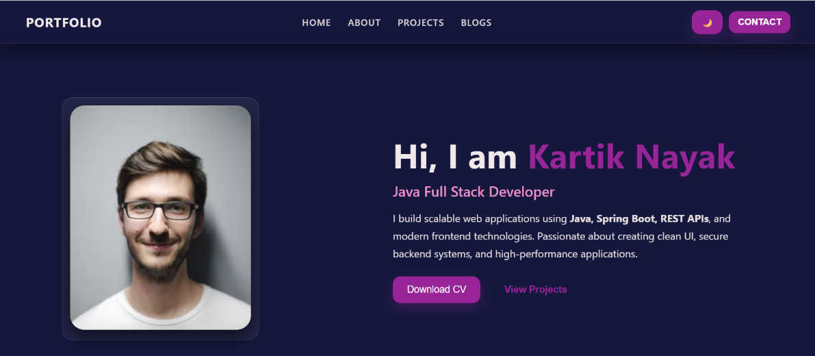
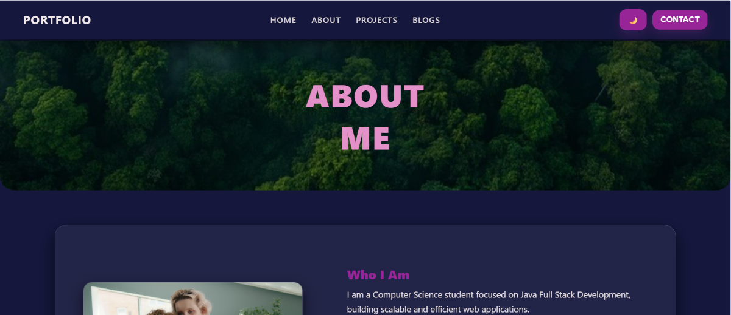
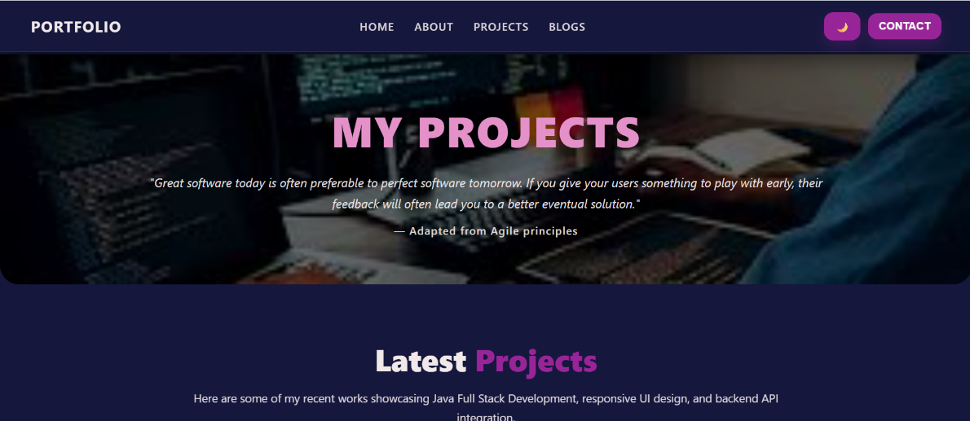
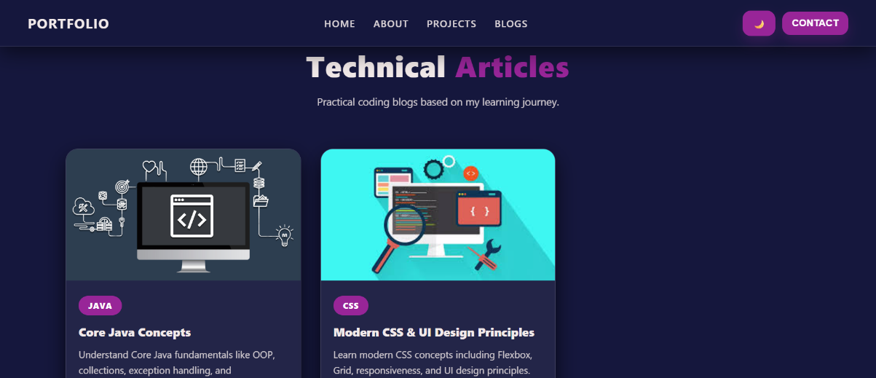
Deliverables and Outcomes
Outputs / Results Achieved
Mini Project 1: Portfolio

Slide 6

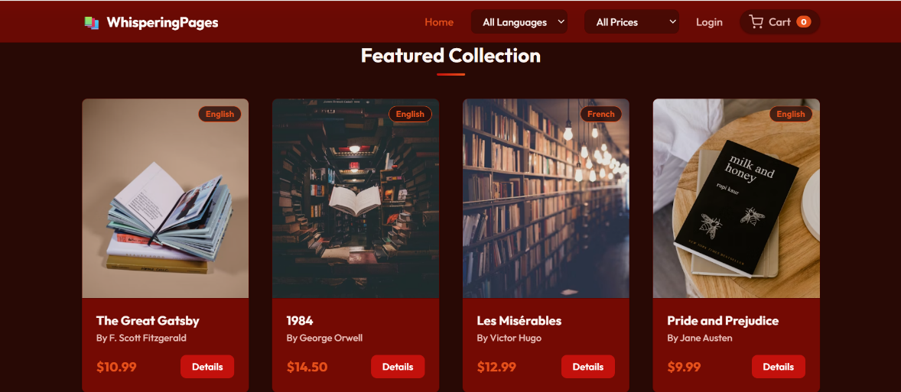
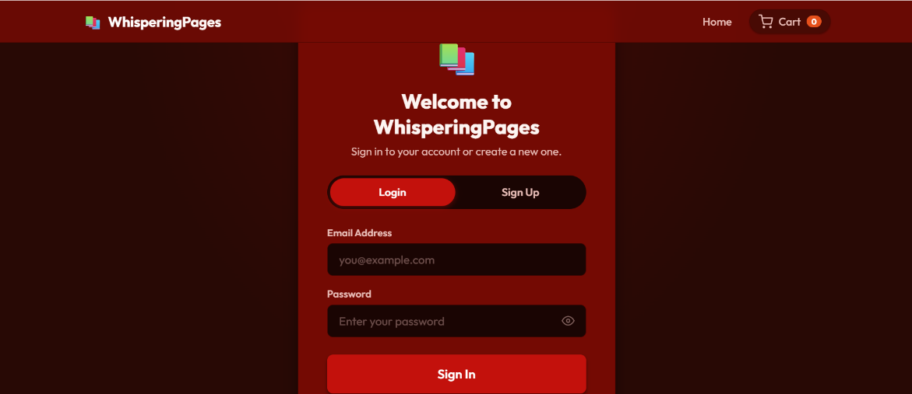
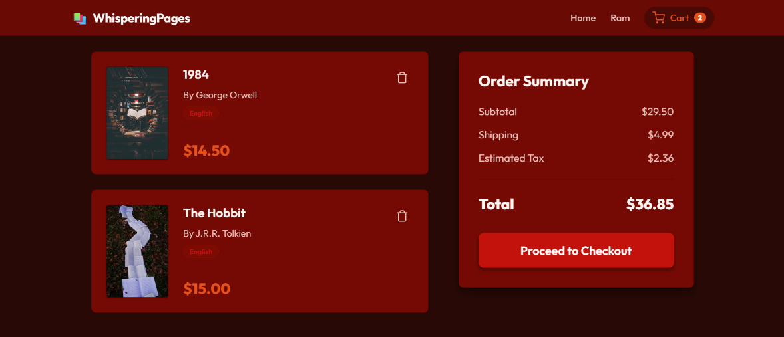
Deliverables and Outcomes
Outputs / Results Achieved
Mini Project 2: Online Book Store

Slide 7
Deliverables and Outcomes
Impact of Your Work
Created a professional online presence through the portfolio website.
Built a scalable foundation for real-world e-commerce applications.
Improved user experience with responsive design and smooth interactions.
Practical Implementation
Implemented real-world features like project showcases and contact links.
Developed cart management and checkout flow similar to e-commerce systems.
Applied end-to-end development workflow from UI design to backend integration.

Slide 8
Individual / Team Work
Role in Team
Currently worked as an individual developer for both portfolio and bookstore projects.
Handled end-to-end development including design, coding, and testing.
Preparing to take on a collaborative role in upcoming major team project.
Contributions as an Individual
Independently designed and developed complete frontend and backend systems.
Implemented all core features including UI, APIs, and application logic.
Managed the full development lifecycle from planning to execution and debugging.

Slide 9
Challenges & Solutions
Major Challenges Faced
Designing a fully responsive layout that works across different devices.
Understanding and implementing Spring MVC flow and API routing.
Managing data flow and cart functionality between frontend and backend.
Methods to Solve the Challenges
Used Flexbox, Media Queries, and continuous testing for responsiveness.
Studied Spring MVC concepts and practiced controller-based implementations.
Debugged using console logs, step-by-step testing, and API validation.
Lessons Learned
Importance of structured planning before starting development.
Value of debugging and iterative testing in building stable applications.
Understanding how frontend and backend integration works in real projects.

Slide 10
Conclusion
Completed day-wise development of a portfolio website and full-stack online bookstore, progressing from UI design to backend integration.
Performed tasks including responsive frontend design, API development, cart implementation, and checkout functionality.
Faced challenges in responsive layout handling, Spring MVC understanding, and frontend-backend data flow management.
Gained key learnings in full-stack development, REST API integration, debugging techniques, and structured application design.

Slide 11
THANK YOU

