Slide 1
databroker
Publisher-1
databroker_exit_timestamp
Subscriber -1
begin_timestamp
databroker_enter_timestamp
broker_to_client_ts
client_to_broker_ts
Subscriber -2
request_process_ts

Slide 2
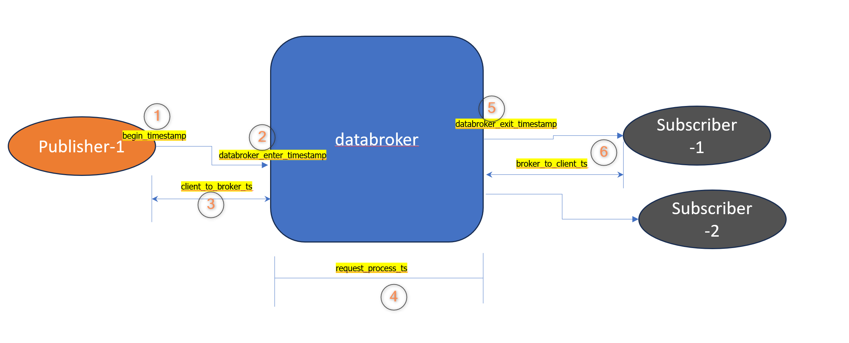


Slide 3
Terminology
Attribute | Description
latency | End to end latency from publisher to subscriber
begin_timestamp
databroker_enter_timestamp
databroker_exit_timestamp
request_process_ts | How much time it took to process request within KUKSA data broker
client_to_broker_ts
broker_to_client_ts
request_id | Experiment ID

Slide 4
