Slide 1

CIS 530: ADVANCED DATA MINING Team Project Title: "Critical Applications: Predicting Stock Market Trends Through Sentiment Analysis and Machine Learning“
By : Sree Likhitha Ninarapu (Student ID: 02147323)

Slide 2
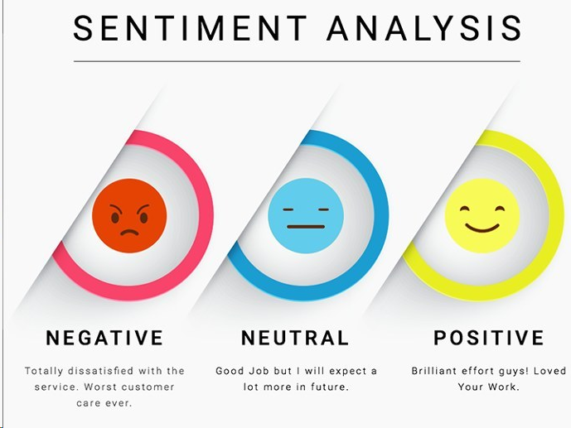
Introduction to Stock Market Prediction through Sentiment Analysis
Objective:
Predict stock market trends using sentiment analysis of financial news headlines.
Combine sentiment data with historical stock prices to forecast market movements (up, down, stable).
Key Techniques:
Sentiment analysis using Vader Sentiment and TextBlob.
Machine learning models: Logistic Regression, Random Forest, LSTM (Long Short-Term Memory) networks for time-series prediction.
Dataset:
Financial Sentiment Analysis Dataset (from Kaggle) and Yahoo Finance Data.

Slide 3
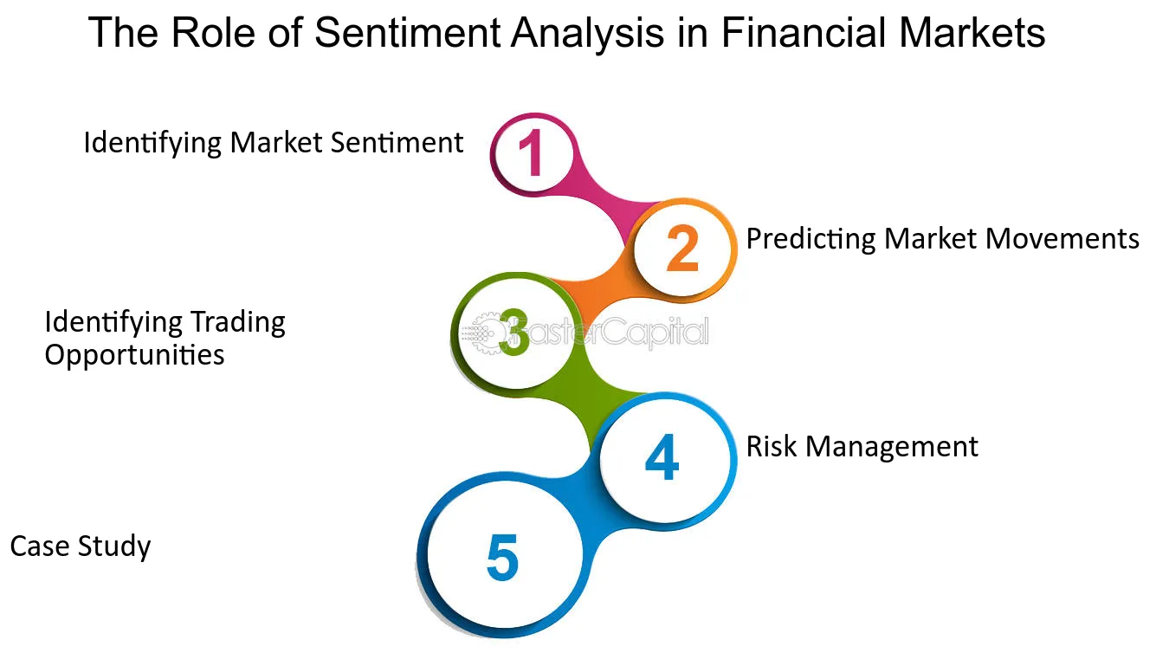
The Power of Sentiment in Financial Markets
What is Sentiment Analysis?
Sentiment analysis extracts emotional tone from text.
Financial news can influence stock prices directly as investors react to positive or negative sentiments.
Examples:
Positive Sentiment: “Tech stocks soar after record earnings” → Stock price rises.
Negative Sentiment: “Global recession fears rise” → Stock price falls.
Why It Matters:
Sentiment provides context beyond hard data, adding a psychological dimension to market predictions.

Slide 4
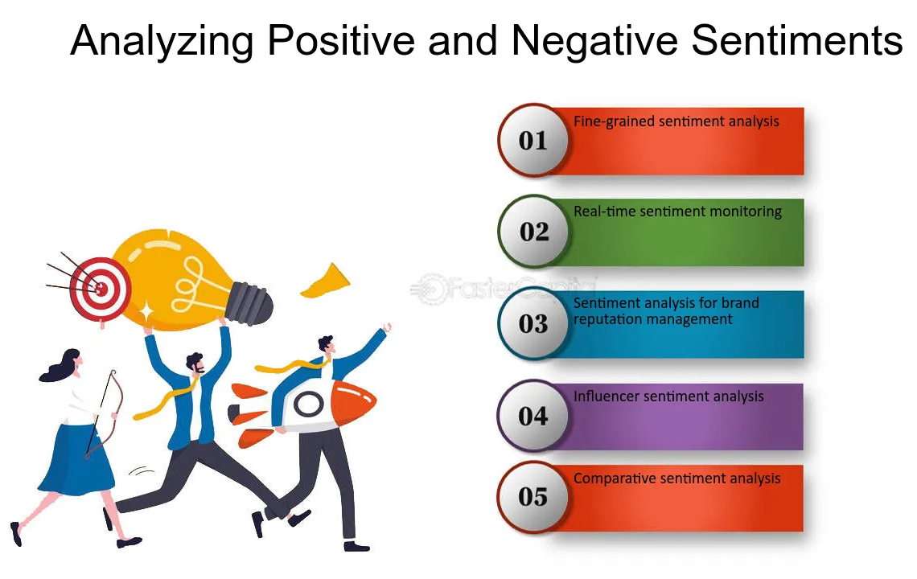
Related Work: Sentiment Analysis in Stock Market Forecasting
Previous Research:
Bollen et al. (2011): Explored the impact of Twitter sentiment on stock market movements.
Hu et al. (2020): Analyzed financial headlines using machine learning models like Support Vector Machines (SVM).
Challenges in Prior Research:
Limited to traditional machine learning and lacked advanced deep learning methods like LSTM.
No integration of both numerical stock data and sentiment analysis.

Slide 5
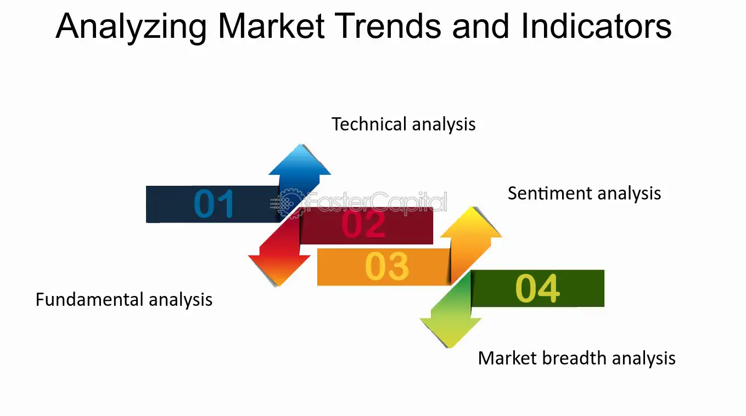
Problem Definition: Predicting Stock Trends
CORE RESEARCH PROBLEM:
Can we predict stock market trends (up, down, or stable) using both sentiment and numerical stock data?
KEY CHALLENGES:
Data Alignment: Aligning sentiment data with stock price movements over time.
Sentiment Ambiguity: Headlines with mixed sentiment (positive and negative).
Time-Series Data: Stock prices are sequential, needing models that can capture these long-term dependencies.
GOAL:
Build a robust model that combines both sentiment analysis and numerical stock data to predict market trends.

Slide 6
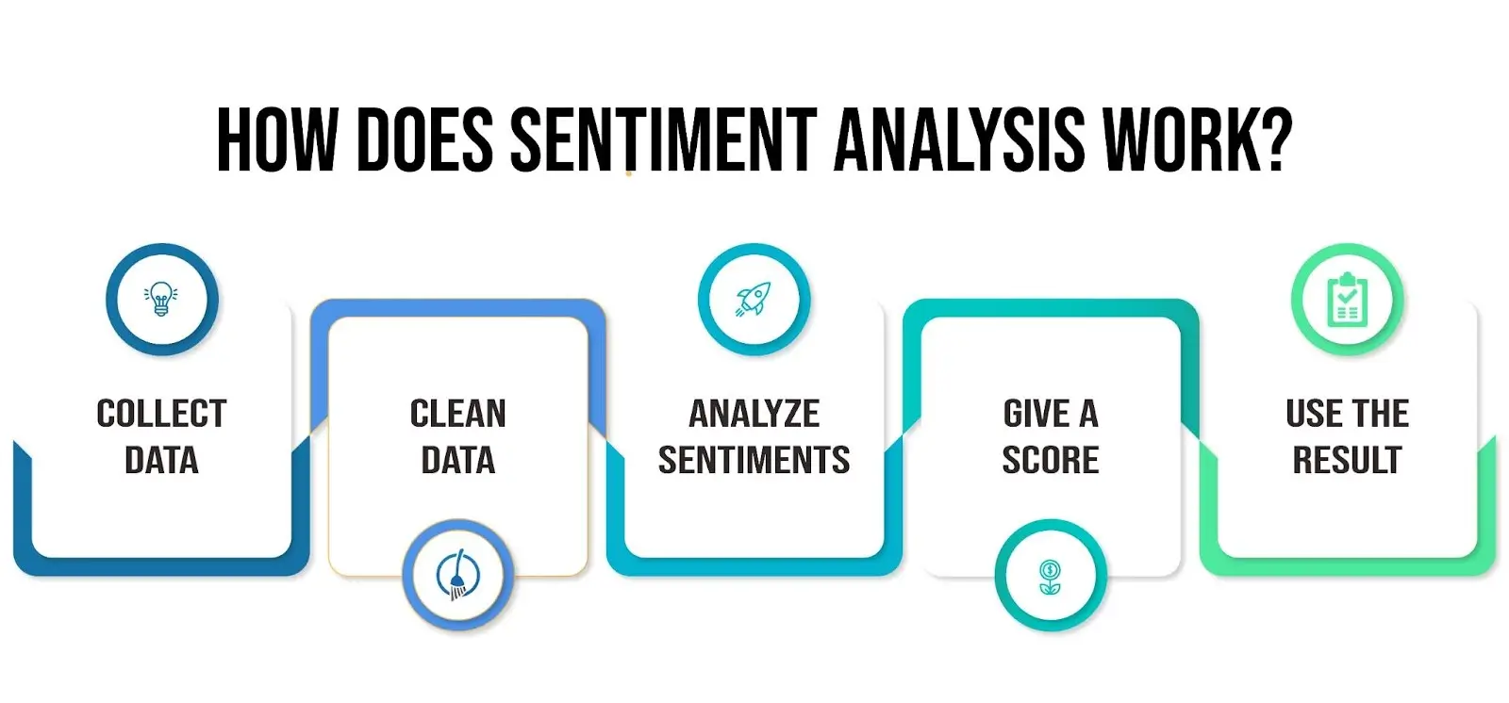
Methodology - Extracting and Processing Sentiment
SENTIMENT ANALYSIS TOOLS:
Vader Sentiment: Analyzes emotive text and is perfect for headlines.
TextBlob: Provides both polarity (positive/negative) and subjectivity (factual/opinionated).
Sentiment Scores:
Extract sentiment from financial news and assign a score for positive, neutral, or negative sentiment.
Importance of Sentiment Data:
Captures emotional tone from the news, directly influencing investor behavior.

Slide 7
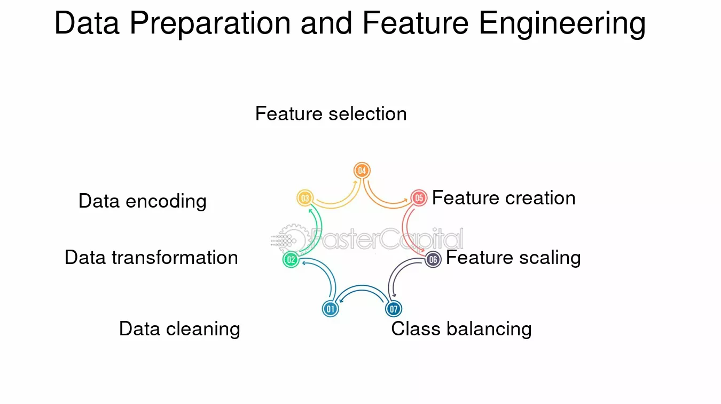
Methodology - Feature Engineering
DATA TRANSFORMATION:
Sentiment Aggregation: Calculate daily or weekly sentiment averages.
Numerical Stock Features:
Moving averages (10-day, 50-day), price volatility, and lagged returns.
FEATURE COMBINATION:
Combine sentiment features with historical stock data to improve prediction accuracy.

Slide 8
Model Development
Objective: Predict stock market movements (Rise/Fall) based on the sentiment of news headlines.
Data Preprocessing:
Text Normalization: Convert sentences to lowercase.
Stopword Removal: Eliminate common stopwords using NLTK.
Sentiment Mapping: Map sentiments to binary outcomes (1 = Rise, 0 = Fall).
Modeling Techniques:
Logistic Regression: Simple linear model for binary classification.
Random Forest Classifier: Ensemble method for improved accuracy and robustness.
Text Vectorization:
TF-IDF: Converts text data into numerical features, limited to 5,000 features for efficiency.
Model Evaluation:
Classification Report: Precision, recall, F1-score, and accuracy.
Confusion Matrix: Visualizes true vs. predicted labels.
Performance Comparison:
Test Splits: Evaluation across different train-test splits (20%, 25%, 30%).

Slide 9
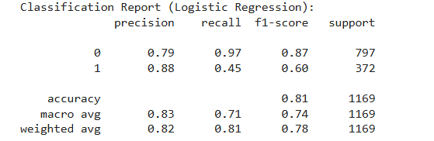
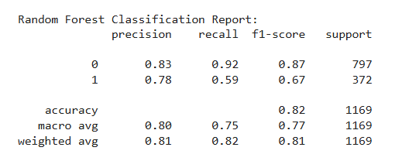
Training and Evaluation - Optimizing the Model
TRAINING STRATEGY:
Data Split:
80% training, 20% testing (default)
Different splits (20%, 25%, 30%) used for model comparison.
Optimizer:
Logistic Regression: Default solver (e.g., LBFGS).
Random Forest: No explicit optimizer; uses decision trees.
Metrics Used:
Classification Report: Precision, Recall, F1-Score
Confusion Matrix: True/False Positives/Negatives
Accuracy: Proportion of correct predictions.

Slide 10
Experimental Setup - Datasets and Preprocessing
DATASETS USED:
Financial Sentiment Analysis Dataset (Kaggle) for headlines.
Yahoo Finance Data for stock market information.
PREPROCESSING STEPS:
Sentiment analysis applied to headlines.
Stock data cleaned and merged with sentiment data.

Slide 11
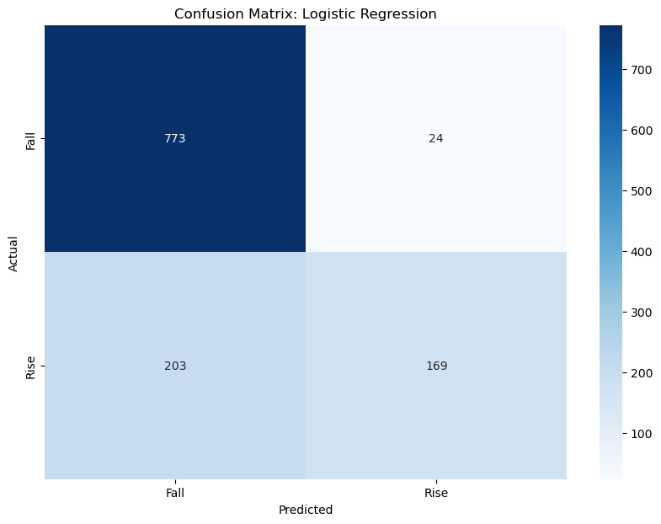
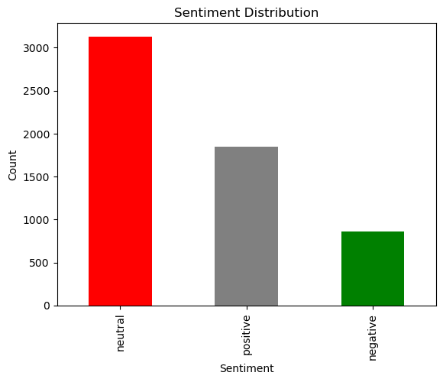
Results - Model Evaluation Metrics

Slide 12
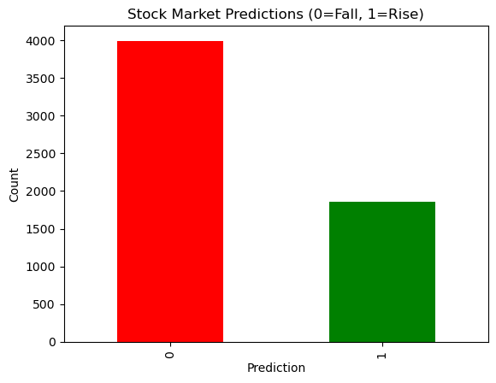
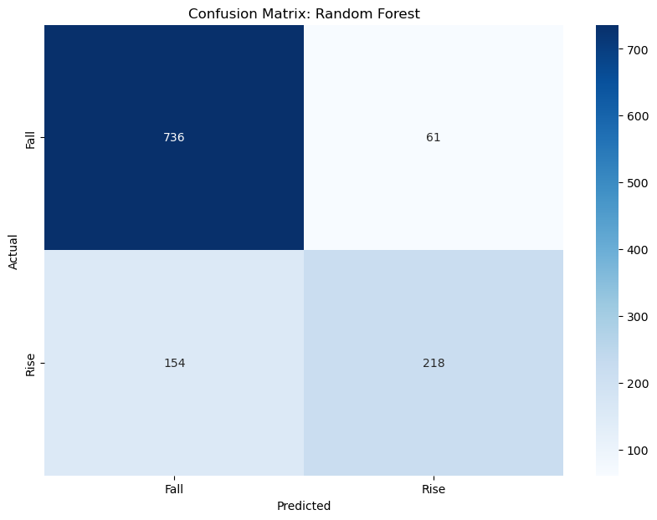
Results - Model Evaluation Metrics

Slide 13
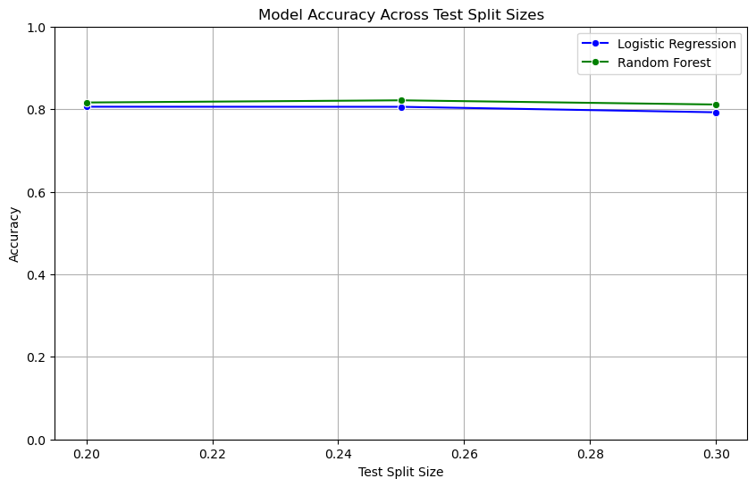
Results - Model Performance
COMPARISON OF MODELS:
Logistic Regression: 81% accuracy.
Random Forest: 82% accuracy.
KEY Insights:
Positive sentiment correlates with stock price rises.
Negative sentiment causes price falls, especially short-term.

Slide 14
Challenges in Sentiment Interpretation
CHALLENGES FACED:
Sentiment Ambiguity: Headlines with mixed sentiment.
Timing Lag: Stock prices don’t always react immediately to news.
Market Noise: Not all news affects stock prices equally.
HOW WE OVERCAME THESE CHALLENGES:
By combining sentiment and historical stock data to create a more comprehensive predictive model.

Slide 15
Future Work and Conclusion
FUTURE DIRECTIONS:
Expanding Data Sources: Integrating social media sentiment from Twitter, Reddit, etc.
Leveraging Advanced Models: Exploring BERT and GPT-based models for deeper sentiment analysis.
Real-Time Predictions: Building a live pipeline for stock market predictions.
CONCLUSION:
This research demonstrates that sentiment analysis can significantly improve stock market predictions, and we could further work on this by adding LSTM model will be well-suited to capture both sentiment and time-series data.

Slide 16
References: "Acknowledging Knowledge: Citing Our Inspirations"
Bollen, J., Mao, H., & Zeng, X. (2011). Twitter mood predicts the stock market. Journal of Computational Science, 2(1), 1-8.
https://doi.org/10.1016/j.jocs.2010.12.007
Hu, X., Zhang, H., & Xie, S. (2020). Financial News and Stock Market Prediction using Machine Learning: A Review. Financial Engineering, 11(2), 99-112. https://doi.org/10.1109/FE.2020.8457789
Kaggle (2020). Financial Sentiment Analysis Dataset. Kaggle. https://www.kaggle.com/datasets/sbhatti/financial-sentiment-analysis
Yahoo Finance (2020). Historical Stock Data. Yahoo Finance API. https://www.yahoo.com/finance
VaderSentiment (2020). VADER Sentiment Analysis. Python Package. https://github.com/cjhutto/vaderSentiment
TextBlob (2020). TextBlob: Simplified Text Processing. Python Package. https://textblob.readthedocs.io/en/dev/
Chollet, F. (2015). Keras: Deep Learning for Python. GitHub Repository. https://github.com/keras-team/keras

Slide 17
THANK YOU

