Slide 1


Hackathon
Ashna AI
SMART INDIA AI AJENT
TEAM NAME : BHARAT NAVIGATOR
TEAM MEMBER: AVULA LIKHITHA
Please view this in Slide Show mode
Page
01

Slide 2
Hackathon
Ashna AI
Travel Navigator
A polite, smart, and fast AI-powered travel guide that delivers accurate answers with elegance and clarity
Page
02

Slide 3

Travel navigator
Ashna AI
PROBLEM
STATEMENT
Tourists face several challenges while traveling in India:
Difficulty in finding nearby attractions quickly
Confusion in navigating unfamiliar routes
Limited knowledge of authentic food & cultural experiences
Lack of quick, polite, and reliable assistance
Page
03

Slide 4
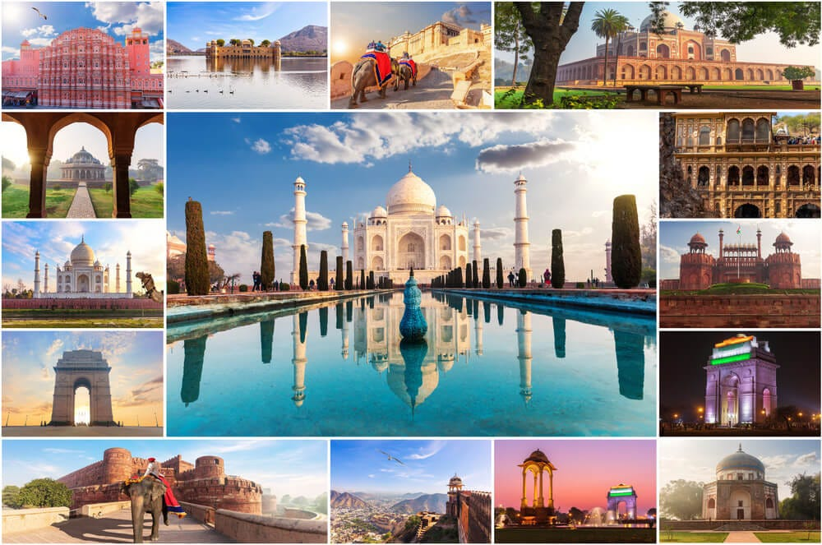

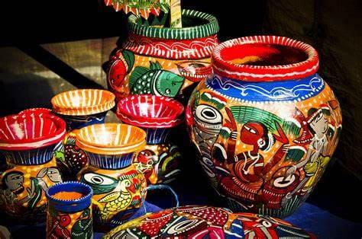
IDEA AND APPROACH
PURPOSE
To build an AI agent that acts as a smart travel companion for tourists in India.
To simplify travel by offering instant navigation help, cultural insights, and food recommendations.
To promote local heritage and authentic experiences while ensuring polite and accurate responses.
To support rural and cultural tourism by highlighting lesser-known destinations.
To enhance safety and confidence for travelers by providing reliable guidance.
Page
04

Slide 5
APPROACH
TOURISM AND NAVIGATION
To support rural and cultural tourism by highlighting lesser-known destinations.
To enhance safety and confidence for travelers by providing reliable guidance.
RECOMMENDATIONS AND SUGGESTION
Recommend local cuisine and traditional experiences unique to each place.
Encourage eco-friendly and respectful tourism.
ACCURACY OF RESPONSE
This is trained agent which gives polite and accurate reports about the question
Provide well framed answers .
DATA SOURCES & FUNCTION
Use trusted sources like Incredible India and state tourism portals.
Add functions like getNearbyPlaces, getNavigationRoute, and getFoodRecommendations.
Use Safer Functions to ensure controlled and secure responses.
Page
04

Slide 6
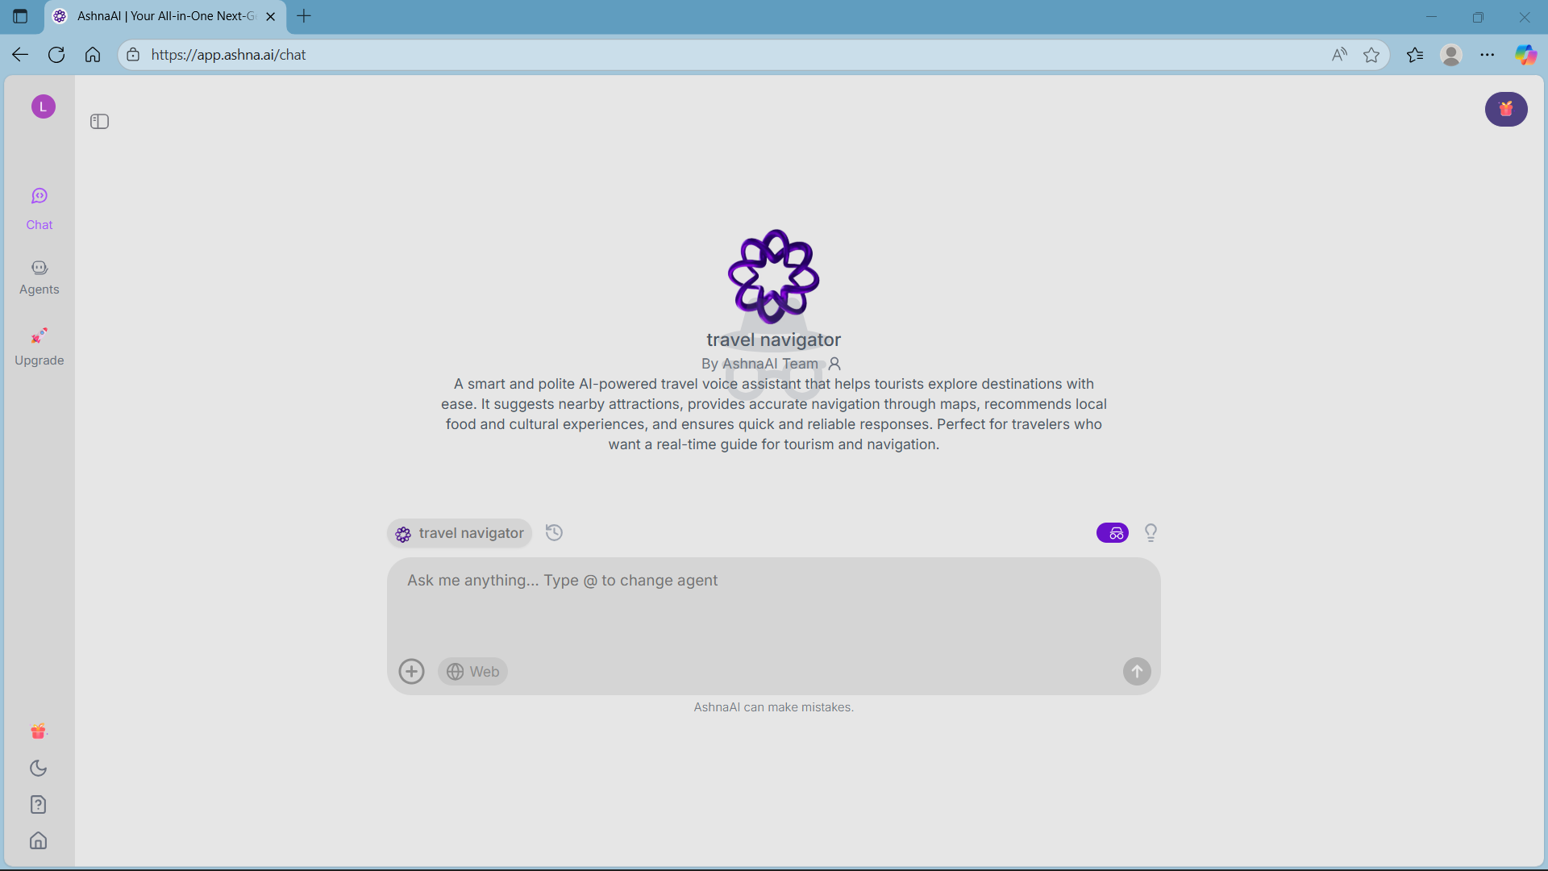

Slide 7
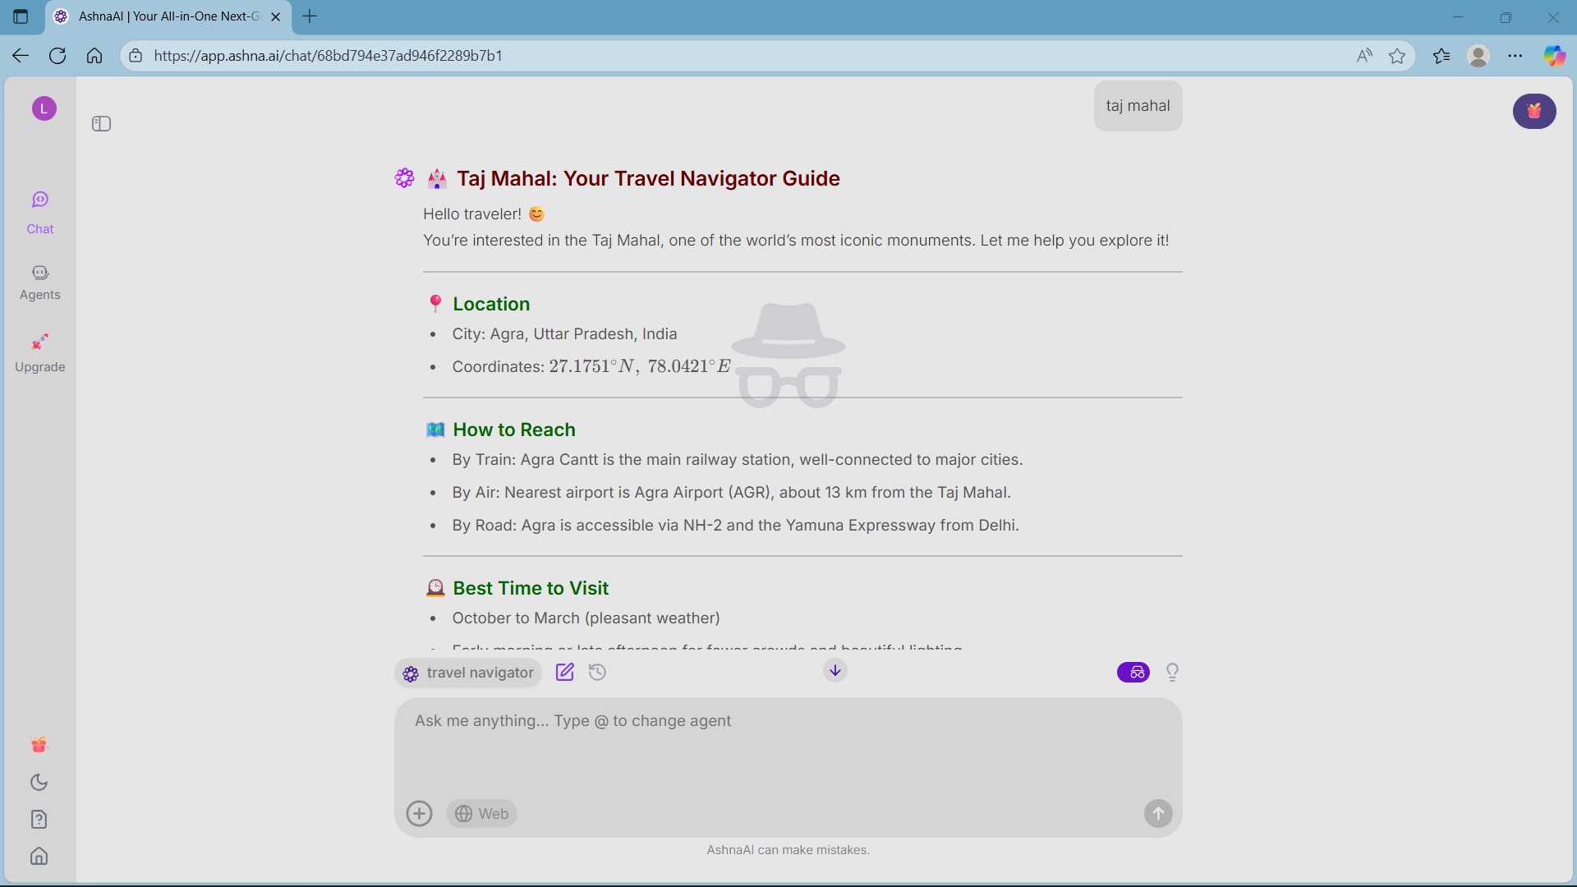
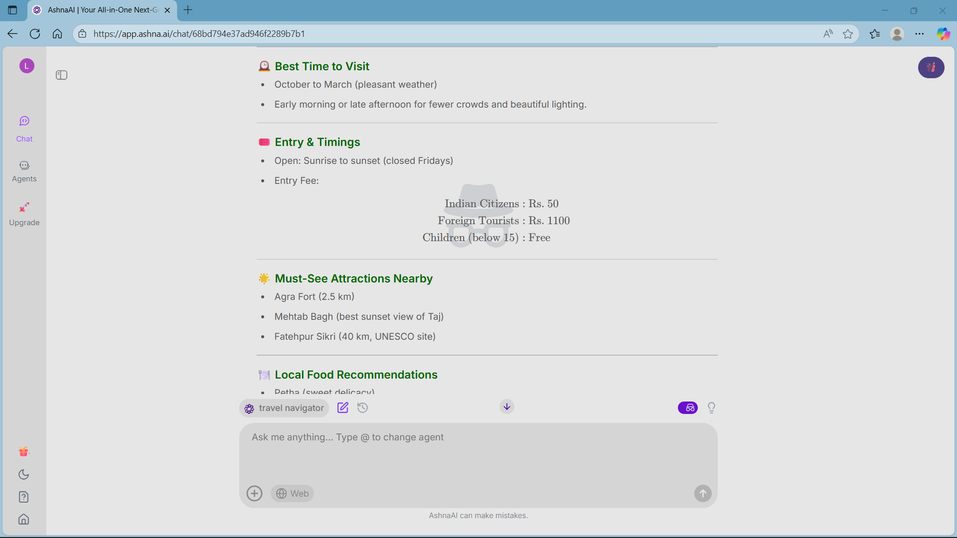

Slide 8
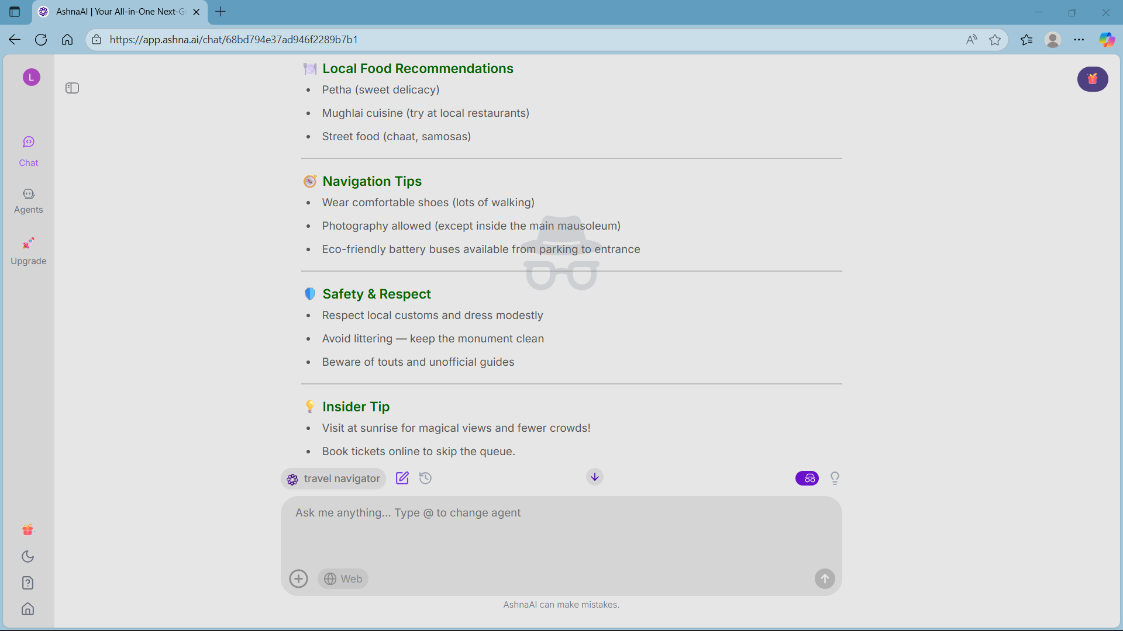
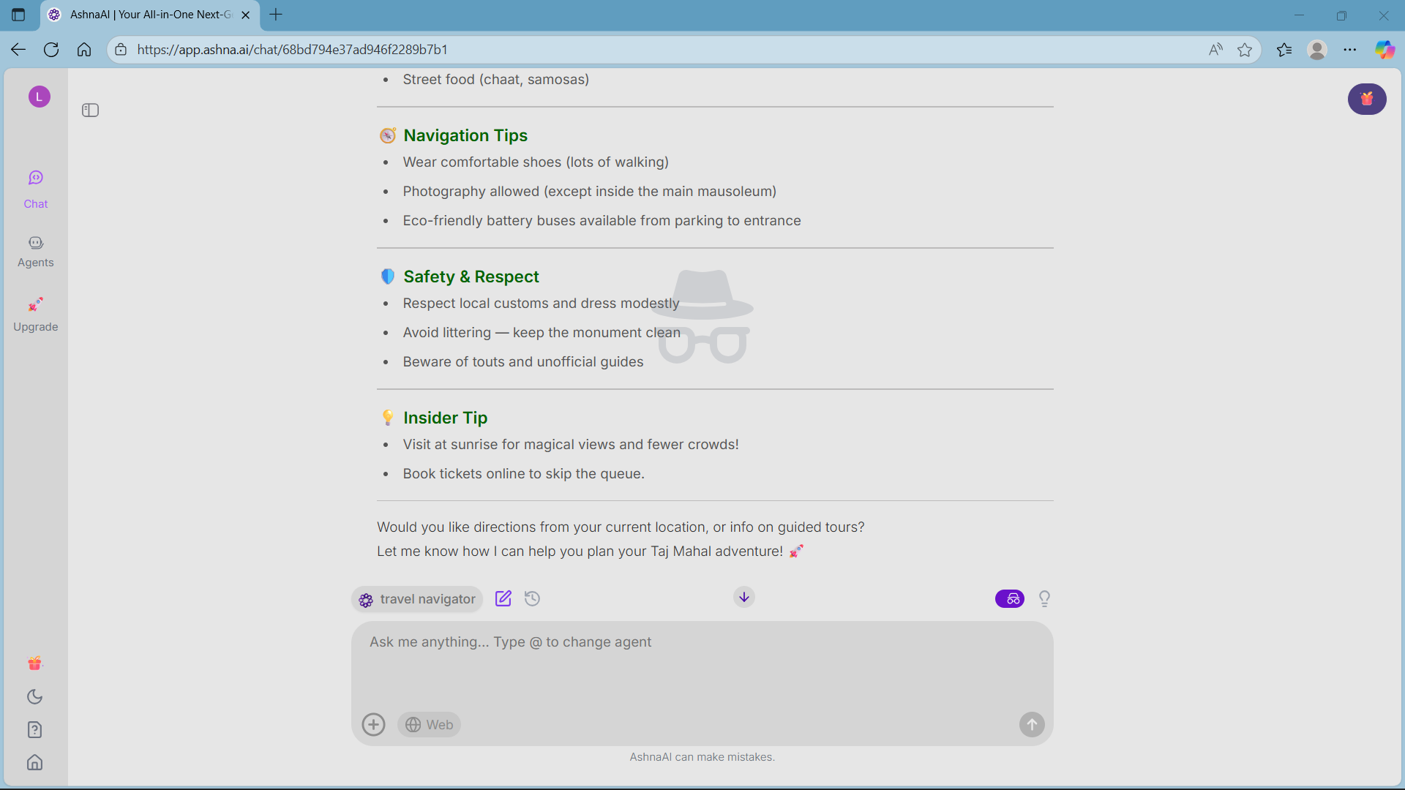

Slide 9
EXAMPLE
MustSee Attractions Nearby
Agra Fort 2.5 km
Mehtab Bagh best sunset view of Taj
Fatehpur Sikri 40 km, UNESCO site
Local Food Recommendations
Petha sweet delicacy
Mughlai cuisine try at local restaurants
Street food chaat, samosas
Navigation Tips
Wear comfortable shoes lots of walking
Photography allowed except inside the main mausoleum
Ecofriendly battery buses available from parking to entrance
Safety & Respect
Respect local customs and dress modestly
Avoid littering keep the monument clean
Beware of touts and unofficial guides
Insider Tip
Visit at sunrise for magical views and fewer crowds
Book tickets online to skip the queue.
Would you like directions from your current location, or info on guided tours
Let me know how I can help you plan your Taj Mahal adventure
When we enter a place name “TAJ MAHAL“ , then it respond;
Taj Mahal: Your Travel Navigator Guide
Hello traveler
You’re interested in the Taj Mahal, one of the worlds most iconic monuments. Let me help you explore it
Location
City: Agra, Uttar Pradesh, India
Coordinates: 27.1751^circ N, 78.0421^circ E
How to Reach
By Train: Agra Cantt is the main railway station, wellconnected to major cities.
By Air: Nearest airport is Agra Airport AGR, about 13 km from the Taj Mahal.
By Road: Agra is accessible via NH2 and the Yamuna Expressway from Delhi.
Best Time to Visit
October to March pleasant weather
Early morning or late afternoon for fewer crowds and beautiful lighting.
Entry & Timings
Open: Sunrise to sunset closed Fridays
Entry Fee:
beginalign
textIndian Citizens &: textRs. 50
textForeign Tourists &: textRs. 1100
textChildren below 15 &: textFree
endalign
Page
09

Slide 10
RESOURCES
Ashna AGENT
Google Maps
Ashna AGENT
https://app.ashna.ai/signup?referral_code=KWSWWB
Google Maps
AshnaAI | Your All-in-One Next-Gen AI Assistant
Page
10

Slide 11

Thank
You.
DONE BY AVULA LIKHITHA
likhithaavula9416@gmail.com
Page
11

