Slide 1


Capstone Group 9
Online News Popularity Prediction
Team members
Likhitha Karumanchi
Ruchika Madanmohan Polasa
Anish Narayanna
VeenaSri M
Raghavan kannan
Pramod M.A
Mentored by
Srikar Muppidi

Slide 2

Problem Statement
Dataset Information
Pre-Processing
Exploratory Data Analysis
Transformation of Target variable.
Algorithms used
Feature Selection
Tuning of the model
Final Results
Business Insights

Slide 3

Problem Statement
News articles are shared on social media, but how can we determine which news or topics are most popular?
The goal is to create and develop a predictive model to show the numbers of shares in social networks based on several features of online news.
.

Slide 4

Dataset Information
39,643 news articles were collected over 2 years from Jan 2013 to Jan 2015.
A heterogeneous set of features about articles published
by online news source Mashable.
61 attributes which with 1 target attribute, 2 non-predictive features and 58 predictive features.

Slide 5
Data pre-Processing
Dropping Columns
Missing value treatment
Outlier Analysis
Converting negative values to positive
Transformation techniques
a. Box-cox Transformation

Slide 6
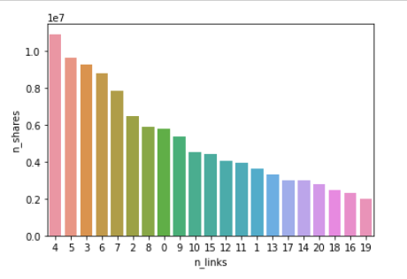
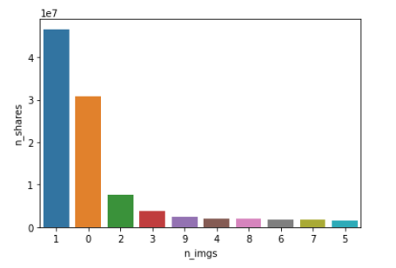
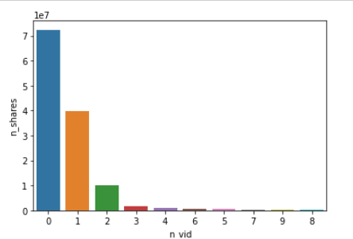
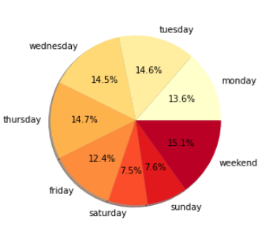
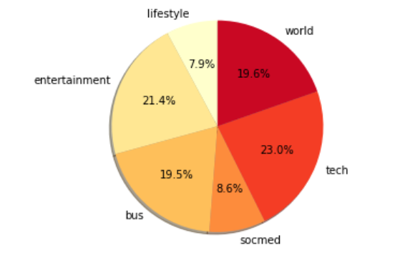
Exploratory Data Analysis
Weekday wise distribution of articles
Channel wise distribution of articles

Slide 7
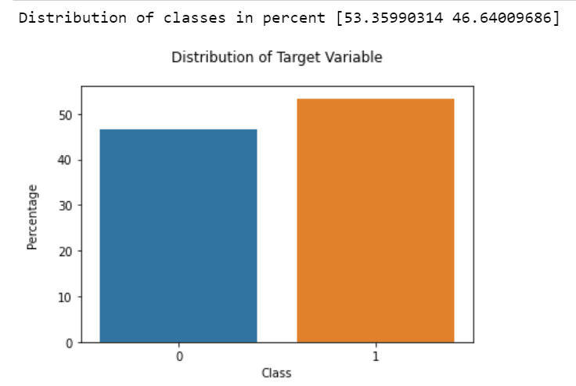
Transformation of Target Variable
Transformation of target variable from a discrete variable to a categorical variable.

Slide 8
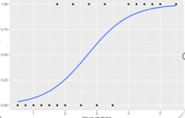
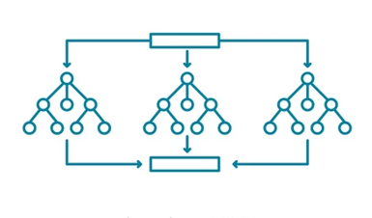
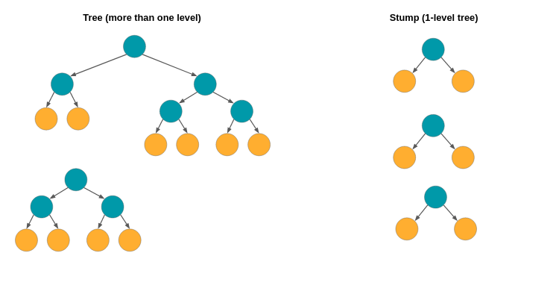
Algorithms Used
Random Forest:
Overfitting is controlled.
The sub-samples of the given data
set are fed into each decision tree.
Logistic Regression:
It is easier to implement, interpret, and very efficient to train.
AdaBoost :
AdaBoost helps you combine multiple “weak classifiers”
into a single “strong classifier”.

Slide 9
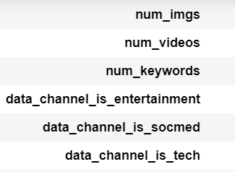
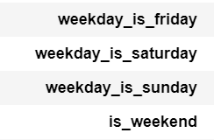
Feature selection RFE recursively removes features, and builds a model using the remaining attributes, and calculates model accuracy.
58
29
Various FS tried:
Variance Inflation Factor
Sequential Feature Selection
RFE

Slide 10
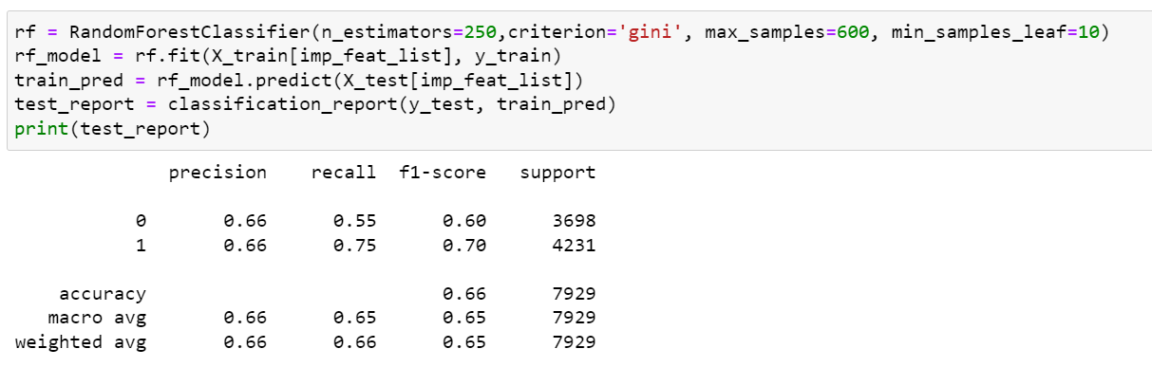
Tuning of the Model
Hyperparameter tuning using GridSearchCV() on Random Forest model

Slide 11
Final Results
Tested the robustness of the model, using 10-Fold Cross-Validation.
 | Precision (Class1) | Recall (Class1) | F1-Score (Class1) | Accuracy | AUC | Train Score | Test Score
Logistic Regression | 67 | 70 | 68 | 65 | 66 | 66 | 65
Random Forest | 66 | 75 | 70 | 67 | 71 | 67 | 67
Adaboost | 68 | 71 | 69 | 67 | 67 | 67 | 66

Slide 12
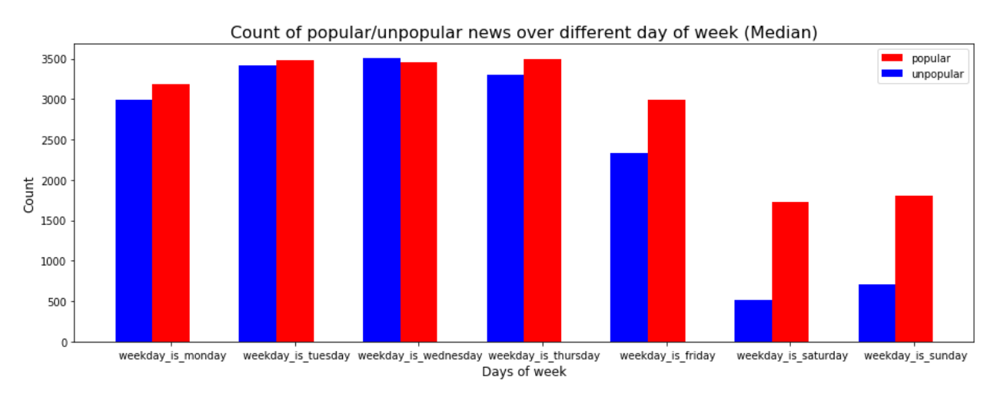
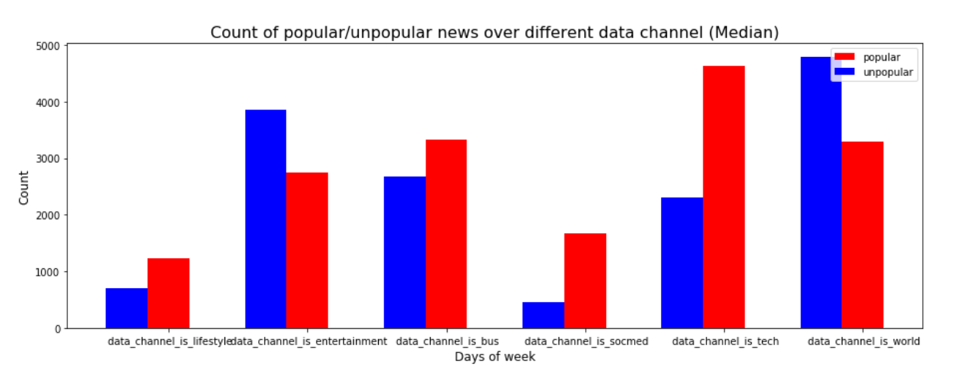
Business Insights
Post on the Weekends
Easiest way to improve popularity
Improve Keyword Strength
To help articles to reach more users
Focus on Popular Genres
Release more articles under popular genre

Slide 13
Thank you!

