Slide 1
S.LIKHITHA
FINAL PROJECT

Slide 2

KEY LOGGER AND SECURITY

Slide 3
AGENDA
Introduction
Problem Statement
Problem Overview
Who are the End users?
Your Solution and its Value Proposition
The Wow in your solution
Modelling
Result

Slide 4
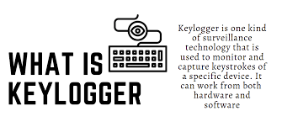
INTRODUCTION

Slide 5
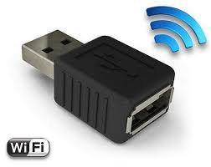

TYPES OF KEY LOGGERS
There are two main types of keyloggers: software and hardware. Keylogger software is more common than keylogger hardware, because the latter requires actual physical access to a device
SOFTWARE KEYLOGGER
HARDWARE KEYLOGGER

Slide 6
PROBLEM STATEMENT
* Record all your keystrokes.
* Record both sides of conversations in messaging apps and emails.
* Record your browsing history
* Take screenshots when certain keywords are typed.
* Take remote control over your device.
* Remotely log in or out of your device.
* keyloggers can be detected using antiviruses.
* Installation of hardware keyloggers is difficult without the knowledge of the owner of the system.

Slide 7

PROJECT OVERVIEW
** working of keylogger in real time and types of keylogger attacks*
**Keylogger is a software that records every keystroke you enter, including mouse clicks.
**Hardware keyloggers are also available which will be inserted between the keyboard and
CPU.
**The best way to protect your devices from keylogging is to use a high-quality antivirus or firewall.

Slide 8

WHO ARE THE END USERS?
End users are the individuals within an organization who interact with various digital platforms, applications, and devices daily. They are often the first line of defense against cyber threats
Companies: Some companies use keyloggers to track which apps employees use, and how they are using their time.
Hackers: When most people think of keyloggers, they think of hackers
Parents: Some parental monitoring software is essentially spyware or even a keylogger. While it’s legal for parents to monitor their under-age children

Slide 9
YOUR SOLUTION AND ITS VALUE PROPOSITION
Password Manager: You may use a password manager to generate highly complex passwords In many cases, these programs can auto-fill your passwords, which allows you to bypass using the keyboard altogether.
Antivirus and Anti-malware Scans: Run a full system scan using reputable antivirus and anti-malware software. These tools can detect and remove many types of keyloggers and other malware.
Two-step authentication: In addition, use two-step verification when you have the option. A keylogger may deduce your password, but the second phase of the authentication process may deter them

Slide 10

THE WOW IN YOUR SOLUTION
Innovative Approach: Combining technical measures with user education for comprehensive protection.
Demonstration: Real-time demonstration of a simple keylogger to illustrate the threat and the effectiveness of security measures
Clearer Protection Against Liability
Less Risk of Data Theft
Better Password Access.
More Productivity.
Tougher Deterrent Against Phishing & Viruses.

Slide 11
MODELLING
Before we start, we need to install Python and some libraries of Python in the system which can be installed by the commands in the command prompt(cmd).
pip install pynput
pip install jsons
Pynput helps in reading keystrokes as the user types in stuff Jsons is a later changing format that often exchanges data between a web server and user agent
* Initialization of keylogger : Set up the main GUI window. Initialize global variables for keylogging.
* Data Logging into text files : Continuously update text and JSON log files with captured key events.
* Stop Logging : Stop capturing key events when the "Stop" button is pressed. Update the GUI status to indicate that the keylogger is stopped.

Slide 12
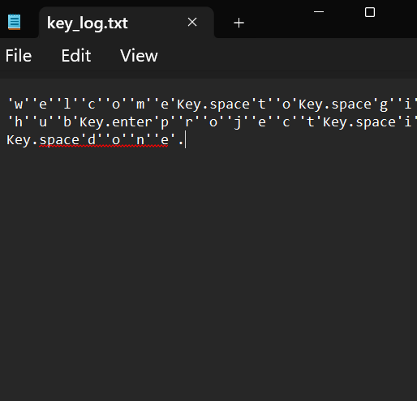
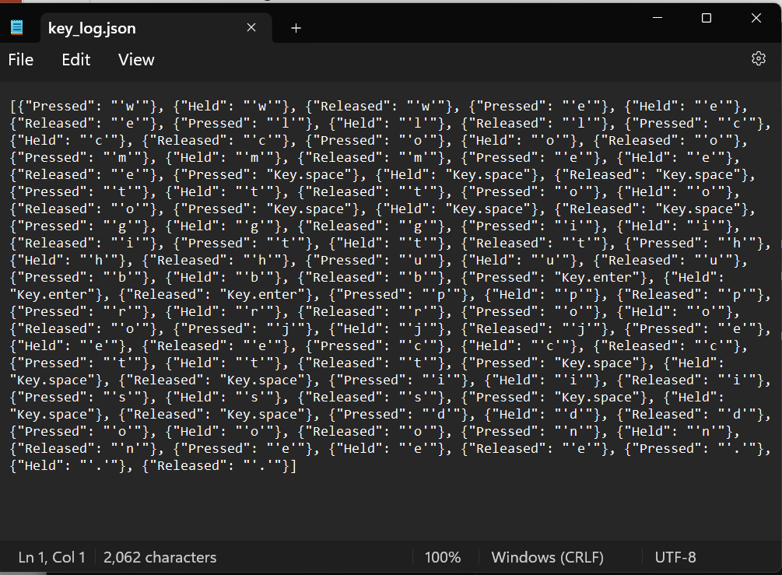
OUTPUTS:
Text file
Json file

Slide 13
RESULT
Step 1: The start button is initialized to start keylogging in the machine
Step 2: As the keylogger running it saves the keys in the keylogger.txt file
Step 3: The keylogger stops and the keys has been saved in the text document file
*Real-time keylogging with start and stop functionality controlled via a simple GUI.
**The implementation of a keylogger that captures keystrokes and records them into both text and JSON files is successful.**

Slide 14
PROJECT LINK:
GIT link:
https://github.com/Likhitha0811/Keylogger.git

