Slide 1
Hand Gesture Classifier using Convolution Neural Network and Transfer Learning
ECE – GY 6123
Introduction to Machine Learning
Full Project Deployed at
http://signpredictor.herokuapp.com/
Contributors
Lakshmi Likhitha Mankali (lm4344)
Muhammad Sharjeel Javaid (mj2580)

Slide 2

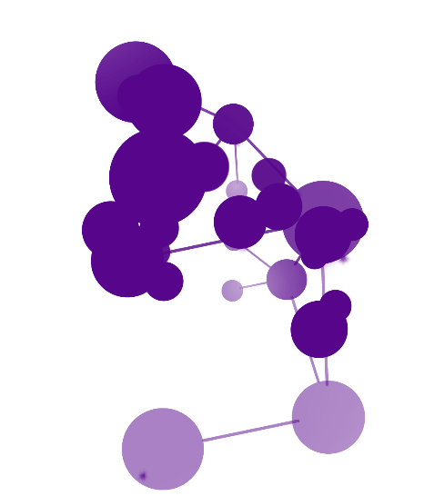



Presentation Outline
Introduction
Objectives
Models
Results
Conclusions

Slide 3

Project Idea
Introduction
Objectives
Models
Results
Conclusions
An Expressive Tool
Hand gestures are a fun and sometimes essential way to communicate our feelings and messages to others.
Hand Gesture Recognizer
A digital hand gesture recognizer will be used in various camera applications to convert hand gestures into respective emoji and feeling.

Slide 4
Introduction
Objectives
Models
Results
Conclusions
Objectives
Train CNN model on fashion MNIST data to get more than 95% accuracy on the test set
Acquire custom hand gesture images and label them according to Table in the next slide
Pre-process the images (resize, greyscale, normalise) to be able to feed into the CNN classifier trained on fashion MNIST
Use transfer learning while retraining the existing CNN classifier on a new data set of acquired and processed hand gesture images
Fine-tune model hyperparameters to achieve high test accuracy and a balanced bias and variance
Compare the results with a case when transfer learning is not used (training from the scratch)
Report and analyse the results and discuss the possible trade-offs between accuracy and training time

Slide 5
Hand Gestures and Labels
Introduction
Objectives
Models
Results
Conclusions
Fantastic
Hi-five
Thumbs Down
Yolo
Thumbs Up
Strength
Victory

Slide 6
Introduction
Objectives
Models
Results
Conclusions
From Scratch
Transfer Learning on Fashion MNIST

Slide 7
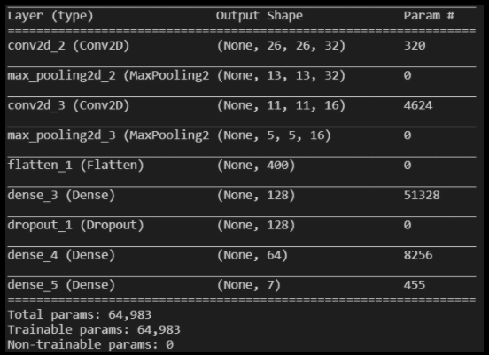
Layers of Model trained from Scratch
Introduction
Objectives
Models
Results
Conclusions

Slide 8
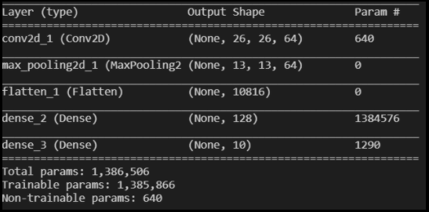
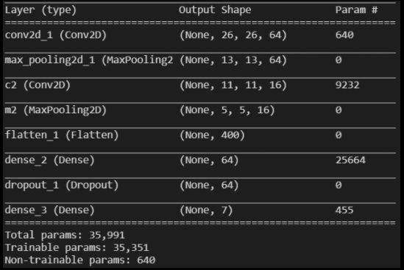
Transfer Learning Model
Introduction
Objectives
Models
Results
Conclusions
Pretrained Model on Fashion MNIST
Additional layers added
Loading and adding other trainable layers

Slide 9
Training Dataset
Introduction
Objectives
Models
Results
Conclusions
Class | Number of custom images
Fantastic | 200
Hi-Five | 200
Thumbs Down | 200
Thumbs Up | 200
Strength | 200
Victory | 200
YOLO | 200
Total | 1400
Training | 1120
Cross Validation | 280
Notes:
Images are resized and converted to gray scale

Slide 10
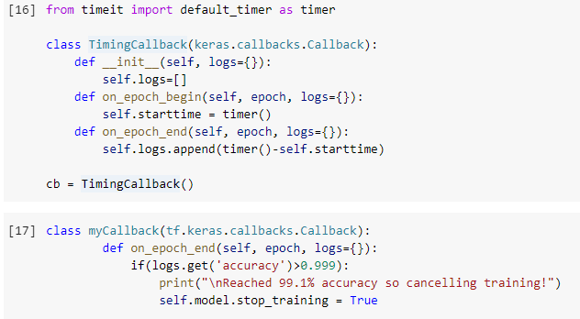
Callbacks
Introduction
Objectives
Models
Results
Conclusions
Two callbacks are used for each mode.
One callback is to keep track of time taken by each epoch
The other callback is to track the accuracy and stop the training once a suitable accuracy is achieved, as shown below
Notes:
Images are resized and converted to gray scale

Slide 11
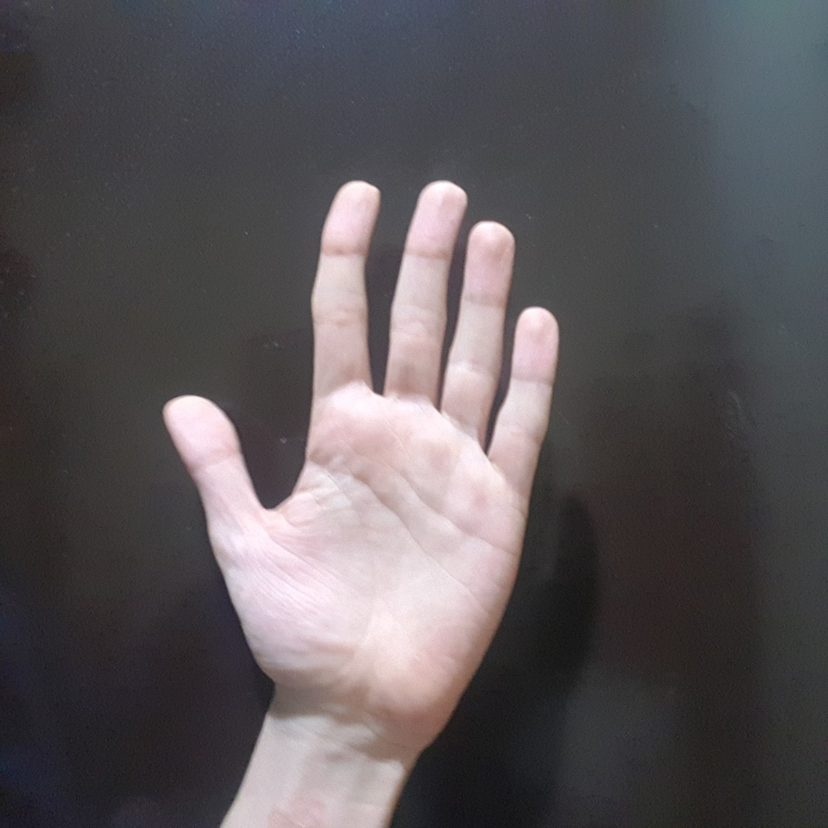
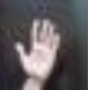
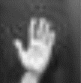
Training Dataset Preprocessing (A Sample)
Introduction
Objectives
Models
Results
Conclusions
2448 x 2448 x 3
28 x 28 x 3
28 x 28 x 1
Resizing
Converting to grayscale
Notes:
Images are resized and converted to gray scale

Slide 12
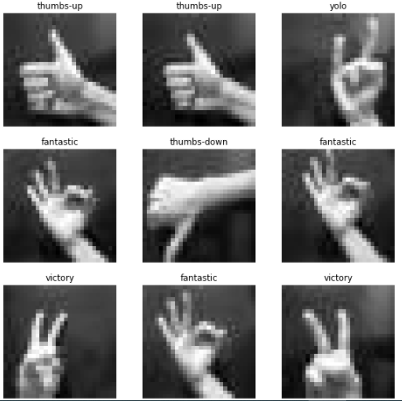
9 samples of labeled input images
Introduction
Objectives
Models
Results
Conclusions

Slide 13
Comparing Number of Trainable Parameters
Introduction
Objectives
Models
Results
Conclusions
45.59% Reduction in Training Parameters
Notes:
Convergence time, epochs till convergence

Slide 14
Comparing Training Time
Introduction
Objectives
Models
Results
Conclusions
On same machine and settings
Notes:
Convergence time, epochs till convergence

Slide 15
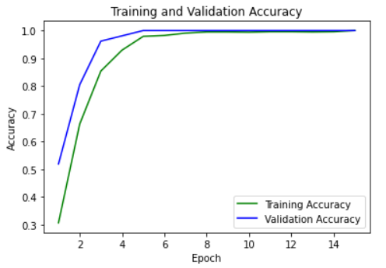
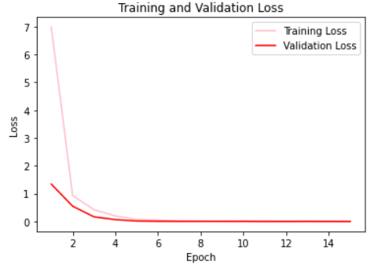
Model from the scratch
Introduction
Objectives
Models
Results
Conclusions
Epochs = 25
Batch Size = 32

Slide 16
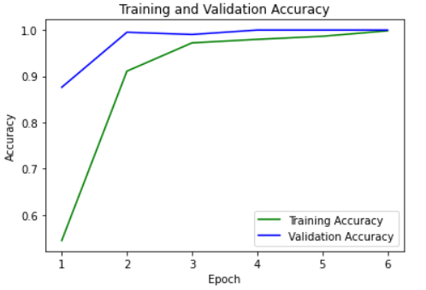
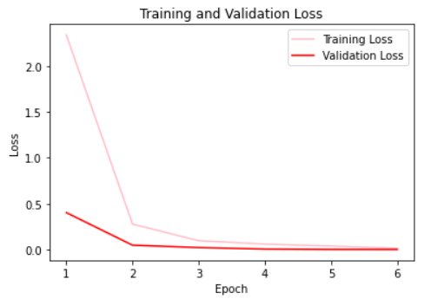
Model using Transfer Learning
Introduction
Objectives
Models
Results
Conclusions
Epochs = 25
Batch Size = 32

Slide 17
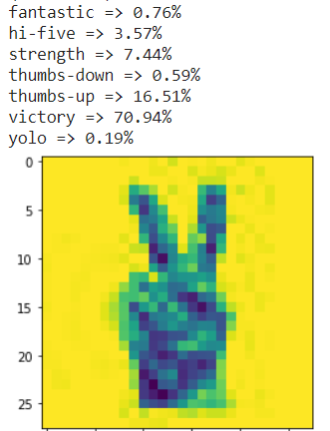
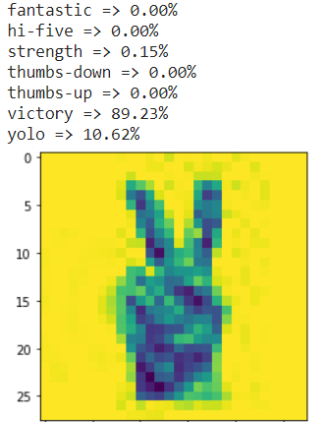
Model using Transfer Learning
Introduction
Objectives
Models
Results
Conclusions
Model from the scratch
Therefore, model trained using Transfer Learning is more confident in its prediction for this example

Slide 18
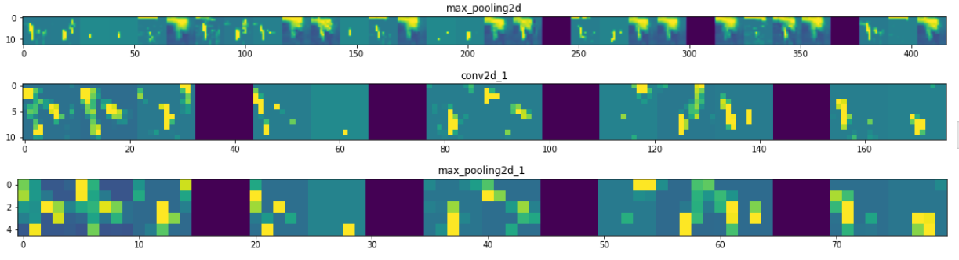
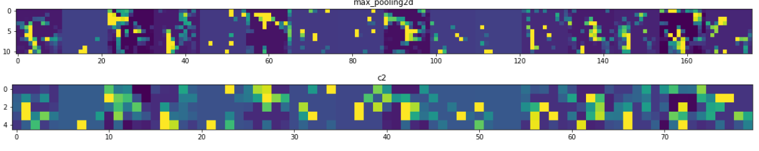
Model using Transfer Learning
Introduction
Objectives
Models
Results
Conclusions
Output from intermediate layers
Model from the scratch

Slide 19
Introduction
Objectives
Models
Results
Conclusions
Project in a nutshell
Two convolutional neural networks (CNN) are trained on custom obtained images of hand gestures; model from scratch and model using transfer learning on Fashion MNIST model
1400 Images were obtained using smart phone cameras at different orientation and distance, 200 for each of the seven class
All images were pre-processed in a uniform manner. The resolution was reduced to 28x28 for quick training. All images were converted to grey scale
Batch of 32 images are set for 32 epochs and two callbacks
Findings
Transfer learning method was quicker with less number of trainable parameters
It shows higher reliability and more confident probability on unseen images
Images of intermediate convolutional layers reveal that layers imported from fashion MNIST model help in finding stark features while newly added layers check for more subtle details
Overall, it was an amazing learning experience and it opened up new horizons for future research in Machine Vision.
Notes:
Layer wise output scratch

Slide 20
Introduction
Objectives
Models
Results
Conclusions
References
‘Introduction to TensorFlow for Artificial Intelligence, Machine Learning, and Deep Learning - Home | Coursera’, https://www.coursera.org/learn/introduction-tensorflow/ungradedLab/txwV5/lab, accessed December 2020
‘Fashion MNIST | Kaggle’, https://www.kaggle.com/zalando-research/fashionmnist, accessed December 2020
‘Course 1 - Part 8 - Lesson 2 - Notebook.ipynb - Colaboratory’, https://colab.research.google.com/github/lmoroney/dlaicourse/blob/master/Course 1 - Part 8 - Lesson 2 - Notebook.ipynb#scrollTo=-5tES8rXFjux, accessed December 2020
Notes:
Layer wise output scratch

Slide 21
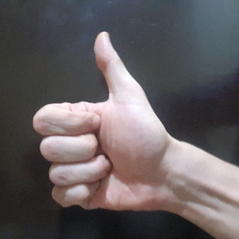
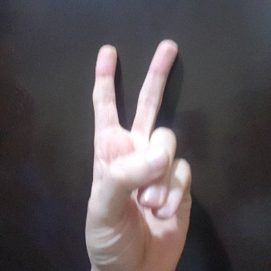
Introduction
Modelling
Formulation
Results
Conclusions
Thank you all!
http://signpredictor.herokuapp.com/

