Slide 1
TESTING ON EBAY PROJECT
Under Guidance of Mrs. Vaishali Sonawane Mam.

Slide 2
Introduction :
Ebay is a global e-commerce platform that connects buyers and sellers. It offers a wide range of products and services through auctions and fixed-price sales. This project focuses on automating key functionalities of the ebay website to ensure a smooth user experience.
This project involved developing and executing automated tests for critical modules, including user authentication, product search, cart management and user profile updates.

Slide 3
Members of Team
LIKHITHA G N – TEAM MEMBER

Slide 4
Responsibilities
Planning: Creating a comprehensive test plan and designing test cases.
Execution: Writing and running automation scripts for all identified modules.
Maintenance: Updating test scripts to adapt to website changes.
Reporting: Documenting and reporting defects found during testing.

Slide 5
.
What is eBay?
Ebay is an e-commerce platform that allows users to buy and sell goods and services online.
It is known for its auction-style listings and fixed-price sales.The platform helps sellers to set up their online storefronts.
It provides a global marketplace where users can access a vast selection of products including electronics, fashion and collectibles.
Ebay's layout is designed to help users easily search for items, manage their accounts and track orders.

Slide 6
Modules
Module 1: Login
Verified the login functionality using valid credentials.
Module 2: Multiple Searches
Used an ArrayList to test the search bar with multiple product queries.
Module 3: Add to Cart
Automated the process of searching for a product and adding it to the shopping cart.
Module 4: Delete from Cart
Tested the functionality of removing an item from the shopping cart.
Notes:
Module 1: Signn in page
Checked all the functionalities on Sign in page which included personal info as email
address, password
Module 2: Women page
Checked all the functionalities on Women page which included item details, Quantity, Filters,compare button,Add to cart button,product info,grid,list button
Module 3: Tshirt page
Checked all the functionalities on T-Shirt page which included item details, Quantity, Filters,compare button,Add to cart button,product info,grid,list button
Module 4: All Buttons and Drop Down Arrow :
team checked if all the buttons and drop down arrows of different fields are functioning properly or not

Slide 7
Module 5: Change Login Name
Verified the ability to update the user's display name in their profile settings.
Module 6: Change Current Address
Tested the feature that allows users to change their shipping address.
Module 7: Shop by Categories
Ensured that navigating to a specific category (e.g., Electronics) works correctly.
Module 8: Select Particular Product and Find Description
Developed a script to search for a product and right-click on its image to find the description, verifying context menu functionality.

Slide 8
Module 9: Shop by All Categories
Confirmed that the "Shop by All Categories" link functions as expected and leads to the correct page.
Module 10: Change Language
Automated the process of changing the website's language settings via the profile menu.

Slide 9
DEFECts
When the galaxy F54 5G back cover is out of stock, the website should display a "product not found" message instead of showing related items.

Slide 10
Defect Identifier :- B_001
DEFECT SUMMARY :- When the Galaxy F54 5G back cover is out of stock, the website should display a "product not found" message instead of showing related items.
TEST ID :- TC_008
TEST CASE NAME :- TC_SEARCH_NON_EXISTENT_PRODUCT
MODULE NAME :- SEARCH
REPRODUCIBLE :- YES
SEVERITY :- HIGH
PRIORITY :-Low
RAISED BY :- LIKHITHA
ASSIGNED TO :- DEVELOPER TEAM LEAD
STATUS :- PENDING
FIXED BY :- DEVELOPER

Slide 11
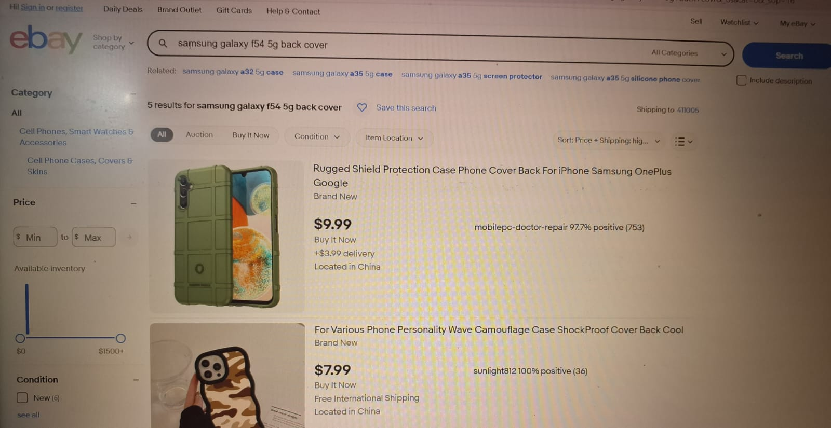

Slide 12
DEFECTS
There's a defect with the kurtha set product display: the product shown on the website differs between desktop and mobile views.

Slide 13
Defect Identifier :- B_002
DEFECT SUMMARY :- THERE'S A DEFECT WITH THE KURTHA SET PRODUCT DISPLAY: THE PRODUCT SHOWN ON THE WEBSITE DIFFERS BETWEEN DESKTOP AND MOBILE VIEWS.
TEST ID :- TC_008
TEST CASE NAME :- TC_SEARCH_PRODUCT_DIFFERS
MODULE NAME :- SEARCH
REPRODUCIBLE :- YES
SEVERITY :- HIGH
PRIORITY :-HIGH
RAISED BY :- LIKHITHA
ASSIGNED TO :- DEVELOPER TEAM LEAD
STATUS :- PENDING
FIXED BY :- DEVELOPER

Slide 14
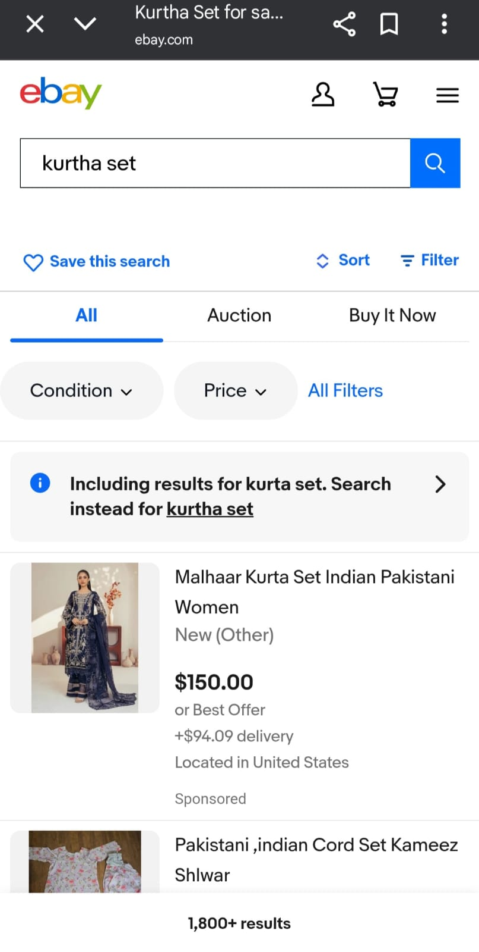
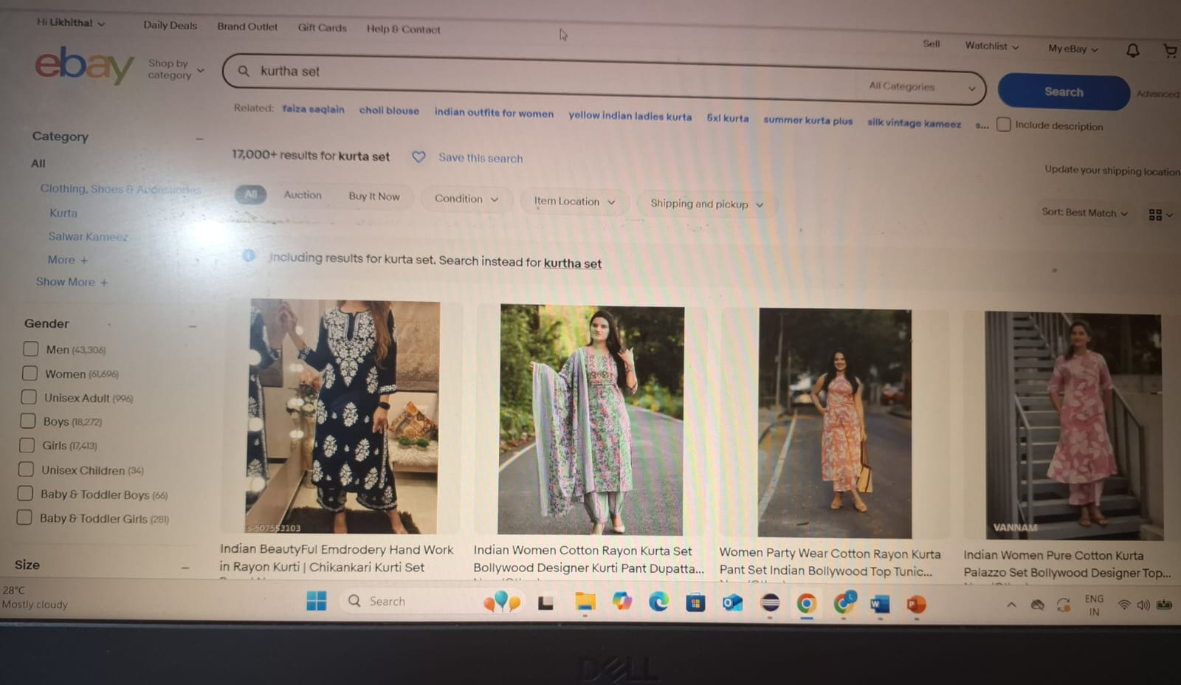

Slide 15
Challenges
Finding defects and making conclusions regarding their priority and severity are challenging
Troubleshooting: Troubleshooting complex code and identifying issues

Slide 16
Experience
Enhance Technical Skills: I gained hands-on experience in writing, debugging
and maintaining automation scripts using Selenium WebDriver and Java.
Improve Problem-Solving: The process of identifying and reporting defects enhanced my problem-solving
abilities and attention to detail.
Time Management: I learned to prioritize tasks and manage my time effectively to ensure
all modules were tested thoroughly.

Slide 17
Thank You!!!
Vaishali Mam For Guiding Us through out the Project.

