Slide 1
OPTIMIZATION OF ELECTRONIC CLAIM SUBMISSION
Group-10 :
Likhitha Guggilla
Nimisha Ekka
Vinay Kiran Reddy Chinnakondu

Slide 2
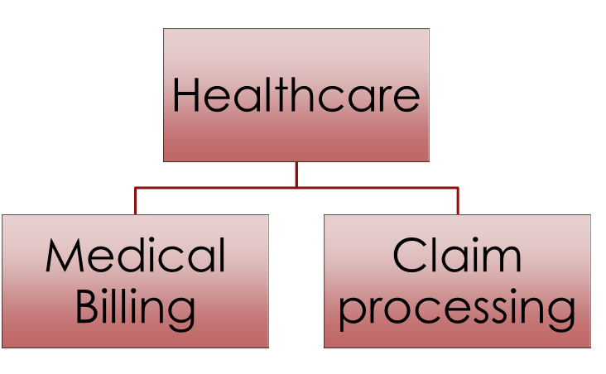
Introduction(Recap)
Healthcare + Insurance
Accurate & Efficient
Quality Patient Care & Financial Sustainability

Slide 3
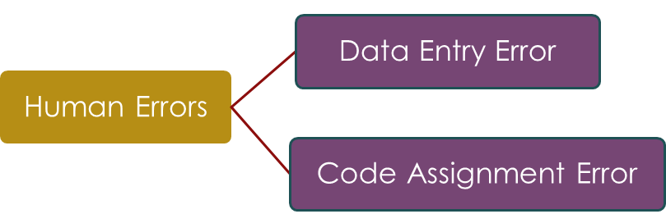
FOCUS
Issue : Delay in Insurance Claim Process
Cause :
Effects : Patients
Healthcare
Insurance Companies

Slide 4

SOLUTION

Slide 5
DELIVERABLES
Develop User Interface
Implement Automation
Design a Database

Slide 6
Table of Contents
Business Process Diagram
Business Process Improvement
Implementation of Data base Design
SQL Queries
Conclusion
Data Base Performance Evaluation
Optimization
E-R Model

Slide 7
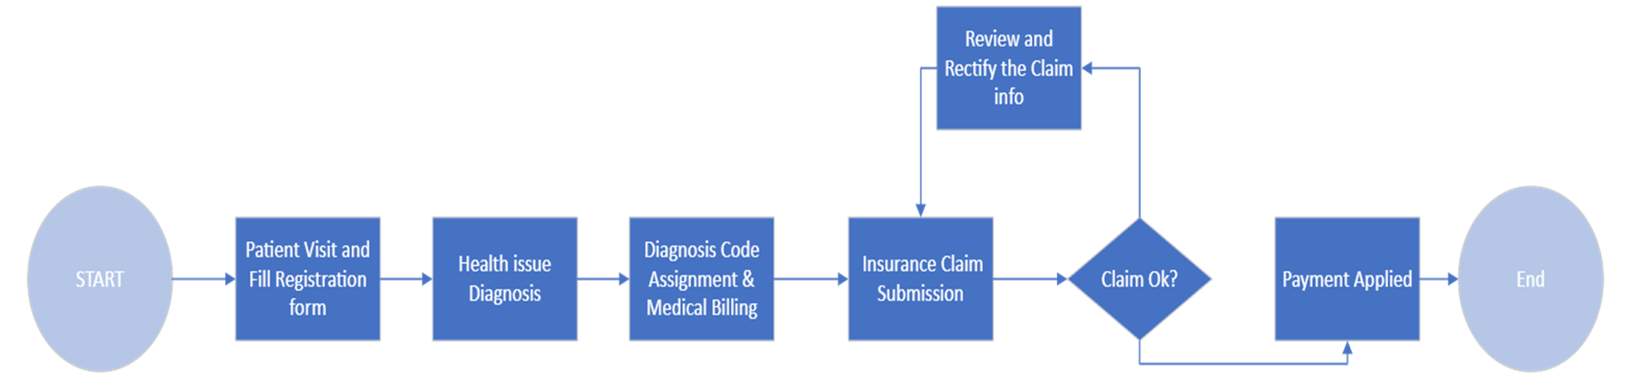
Business Process Diagram

Slide 8

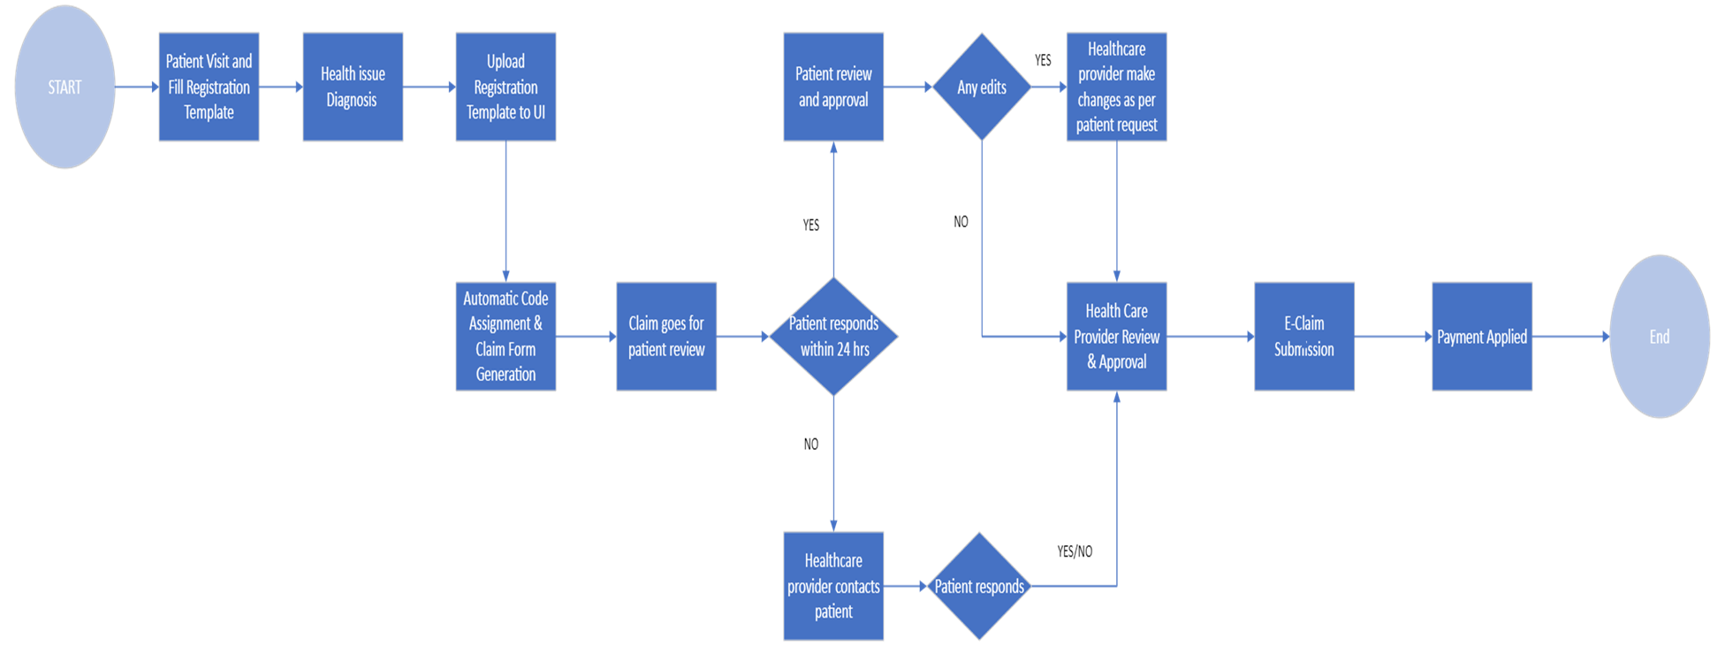
Business Process Improvement
AUTOMATION
Yes
No
No
Yes/No

Slide 9
Implementation of Data Base Design
Create Database
02
Create Tables
03
Insert Data
04
Test Data Base & Optimize
05
Design E-R Model
01

Slide 10
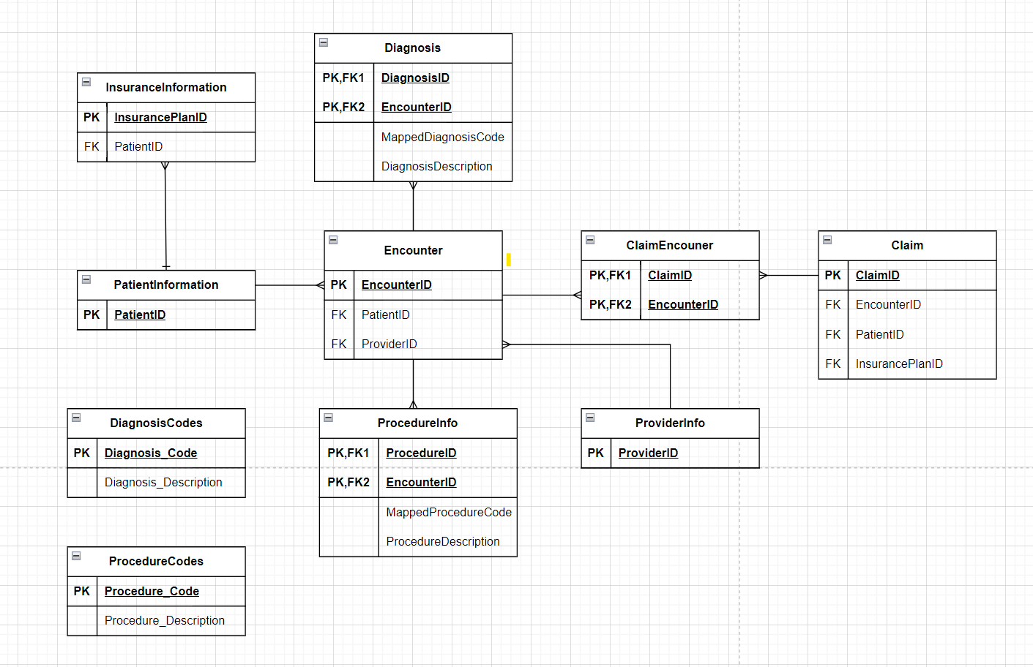
E-R Model

Slide 11
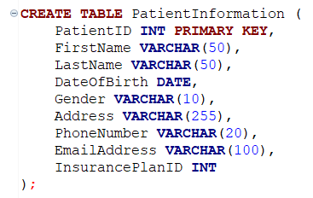
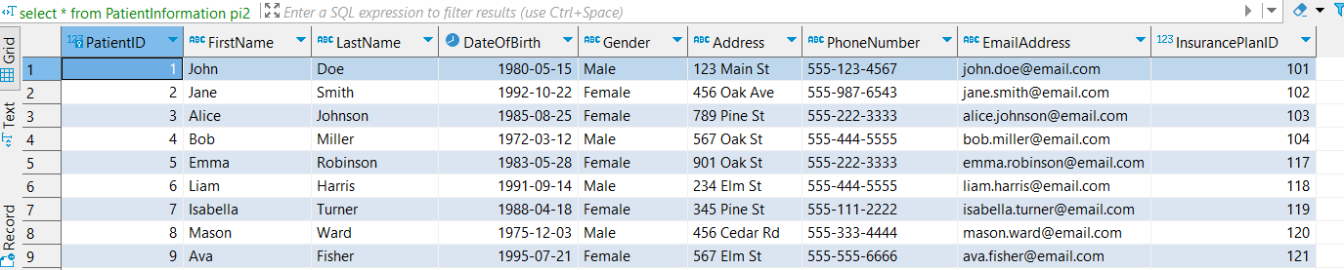
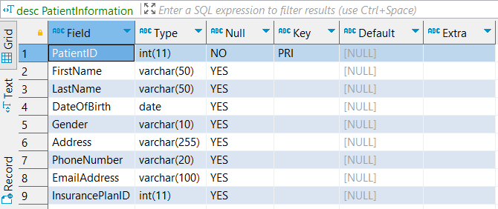
Creating Tables & Insert Data
CREATE TABLE
INSERT DATA

Slide 12
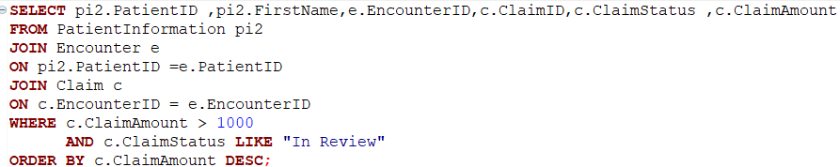
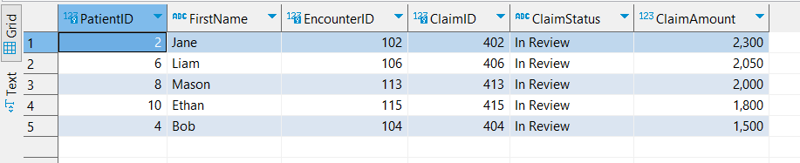
Test the Data Base
Generate a report giving patient details whose claim amount is greater than $1000 and status is still in Review ?

Slide 13

Data Base Performance Evaluation
Analyze the query

Slide 14
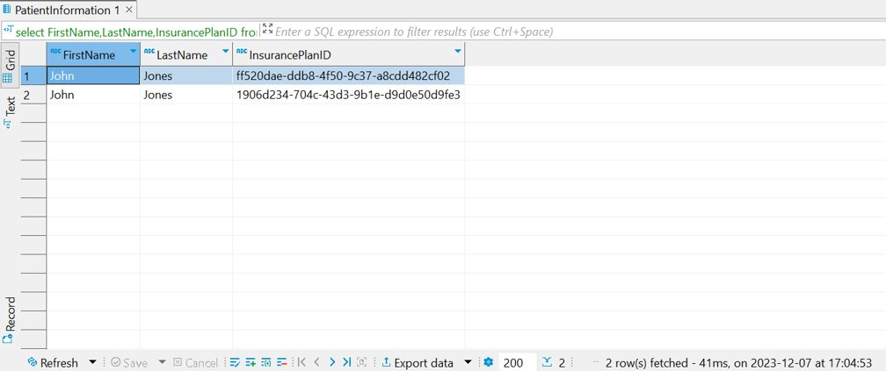

Slide 15
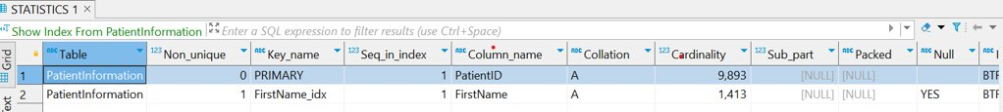
Performance Optimization
Created Index on First_Name
ANALYZE

Slide 16
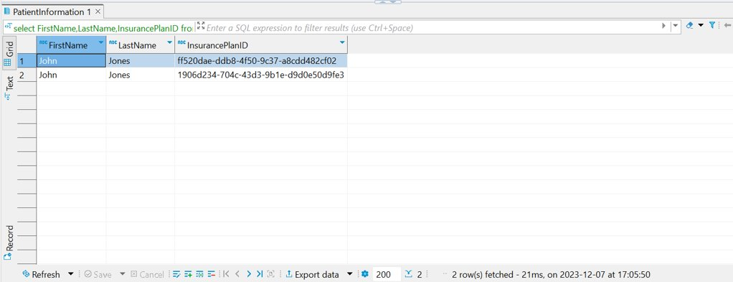
Improved Performance of Data Base

Slide 17
Conclusion
Optimizing critical Processes
Reducing administrative burdens
Improving financial transparency
Effortless

Slide 18


CLAIM PROCESSING NO more DELAY !

Slide 19

Q&A

Slide 20

THANK YOU

