Slide 1
IMAGE AUGMENTATION
Presented by
Likhitha Mandapati
Eswara Poosapati

Slide 2
Introduction
In this project, we introduce a comprehensive system for augmenting medical imaging data, specifically focusing on the diversification of Magnetic Resonance Imaging (MRI) datasets.
Utilizing Python and a suite of specialized libraries, we developed a series of algorithms to apply various augmentation techniques, including Gaussian noise, salt-and-pepper noise, and k-space truncation.
The project also features an organized approach to processing and visualizing the augmented images.
These techniques were rigorously applied to a selected set of MRI images, and the resulting augmented dataset was meticulously analyzed..

Slide 3
Introduction (cont.)
The findings from this augmentation process are presented, demonstrating the potential of these methods to significantly enhance the quality and variability of medical imaging data for improved machine learning model training and analysis

Slide 4
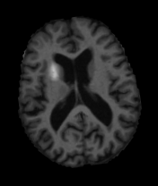
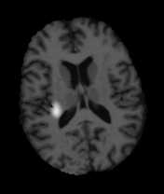
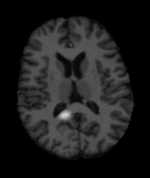
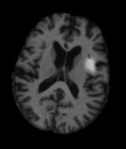
Datasets
OASIS

Slide 5
Algorithm
1. Initialization
2. Image Loading and Preprocessing
3. Image Augmentation
4. K-Space Truncation

Slide 6
Algorithm (cont.)
5. Noise Addition
6. Nearest Neighbor Interpolation
7. Save and Organize Output Images
8. Visualization

Slide 7
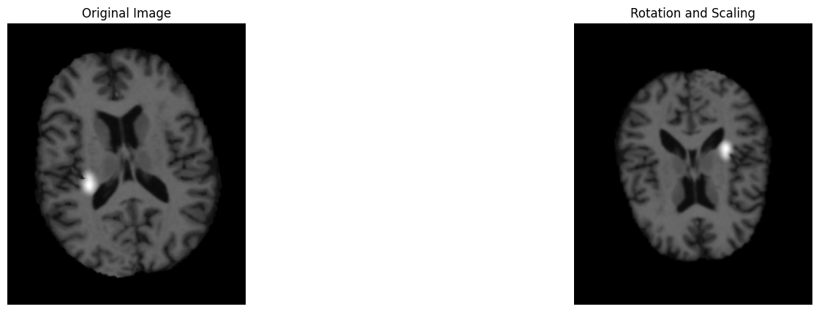
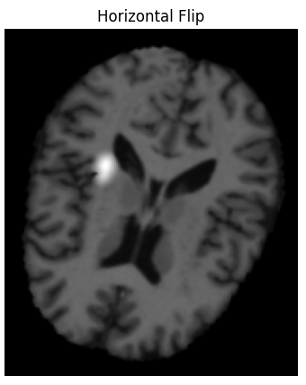
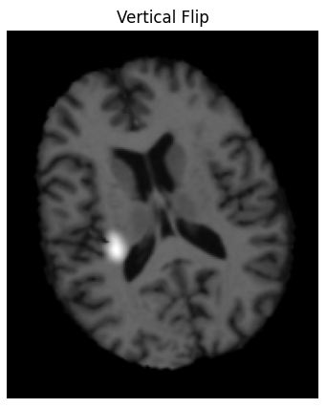

Image Augmentation
Image augmentation's primary purpose is to enhance the diversity of a dataset by applying various transformations to the original images.
Rotation and scaling are applied to simulate changes in orientation and size.
Horizontal and vertical flipping introduces variations in the orientation of objects within the images.
Gaussian blur adds a smoothing effect to the images, by introducing a degree of blurriness.

Slide 8
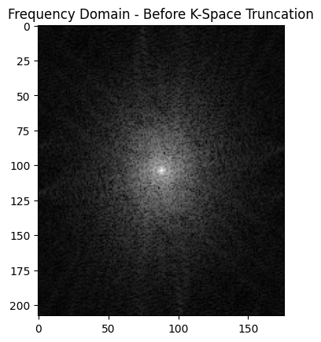
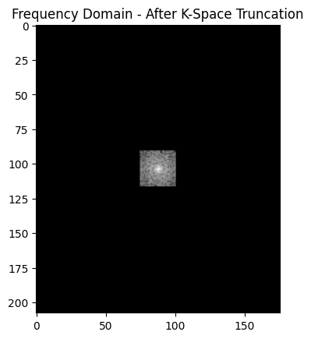
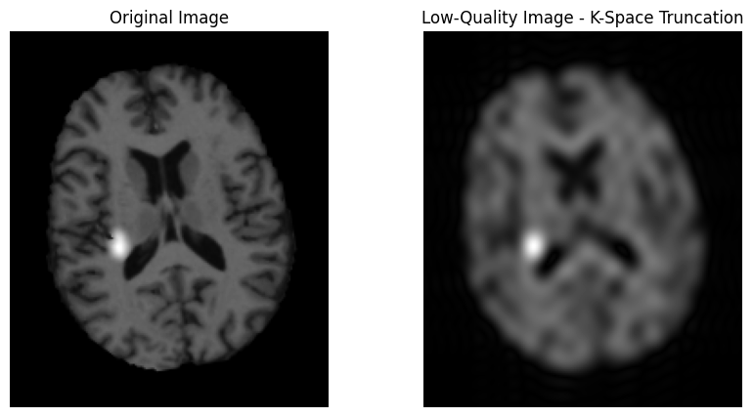
K-Space Truncation
K-space truncation removes high-frequency components from the image's frequency domain. This produces a low-resolution image.
The script utilizes the fast Fourier transform (FFT) to convert the image to its frequency domain.
A mask is created, setting a central region to 1 and the remaining areas to 0, effectively truncating high frequencies.
The inverse FFT is then applied to obtain the low-quality image in the spatial domain.
The result is a low-quality version of the input image.

Slide 9
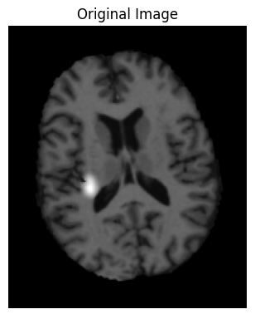
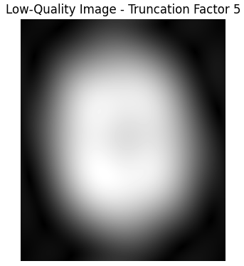
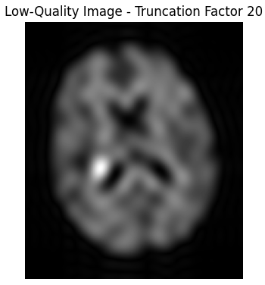
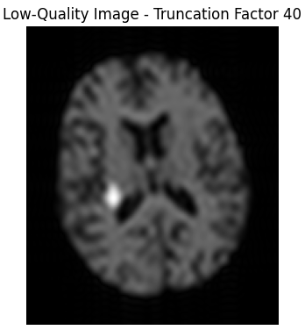
Truncation Factor
The truncation factor is a versatile parameter that allows practitioners to control the level of degradation introduced during K-space truncation.
It is important for simulating Low-Resolution, control over image quality and effect on noise.
Its careful adjustment is essential for tailoring the image processing to specific tasks, simulation scenarios, and dataset requirements.

Slide 10
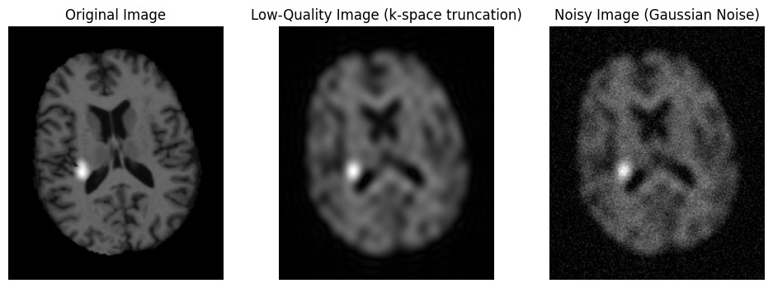
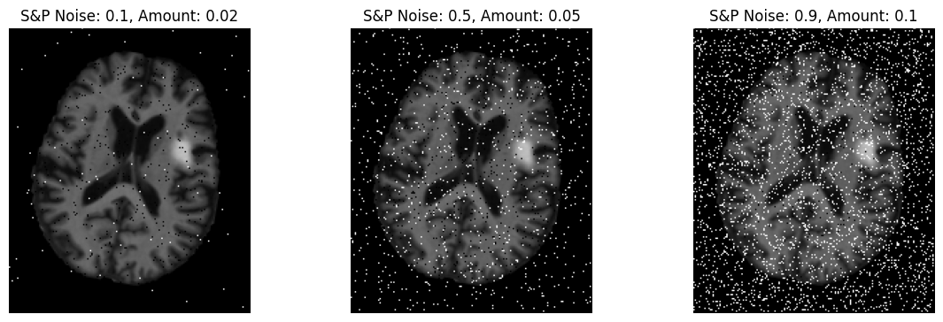
Gaussian and Salt-Pepper Noise Addition
Samples from a normal distribution are characterized by mean (0) and standard deviation.
Gaussian noise added pixel-by-pixel to low-quality images.
Maintains pixel values in [0, 1] range by producing a realistic low-quality image.
Characterized by random white (salt) and black (pepper) pixels.
Pixels randomly selected for modification.
Altered to either 0 (black) or 1 (white) to simulate noise.
By determining the percentage of affected pixels it produces images with realistic salt-and-pepper noise.

Slide 11
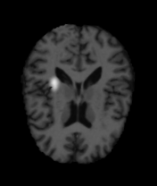
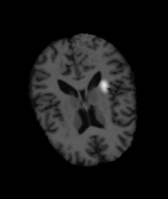



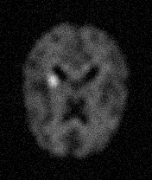
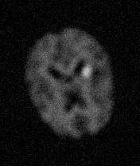
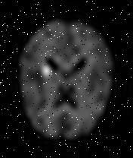
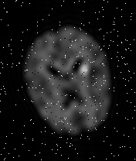
Results
Augmented images
Low quality images
Input
Gaussian noise
Salt and Pepper noise

Slide 12
Thank You

