Slide 1
Reddipalli Nagalikhitha
Evaluation of State-Of-The-Art image generation models in Unsupervised Anomaly Detection using Brain MRI
Notes:
design

Slide 2
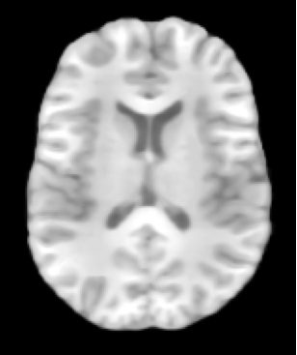
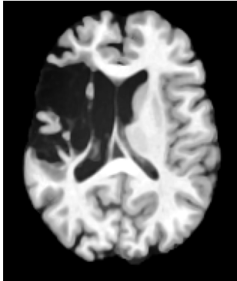
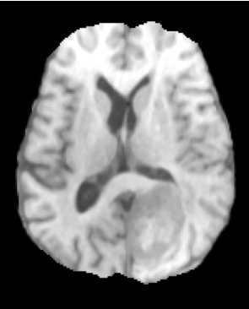
Motivation
Detection of lesions is time consuming , error prone
Difficult to obtain unhealthy brain images
Like humans, training on Healthy images
Unsupervised Anomaly Detection
Healthy
Stroke
Tumor

Slide 3

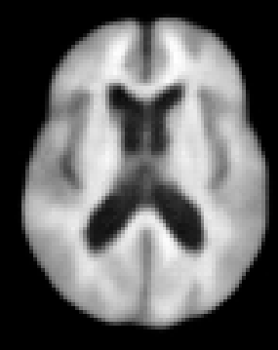
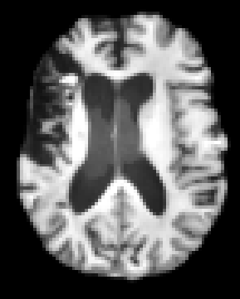
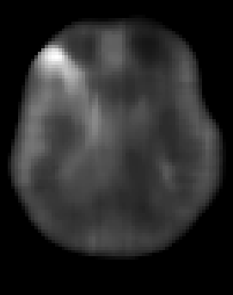



Principle of UAD
Training
-
$$ℒ$$
Encoder
$$z$$
Decoder
-
Inference

Slide 4
Data and Methods
Data:
Healthy data - Mixednormals and IXI
Test data - Stroke , Brats19
Methods:
Variational Auto Encoders(VAE)
Vector Quantized Variational Auto Encoders (VQVAE)
Vector Quantized Generative Adversial Networks (VQGAN)

Slide 5



VAE
$${ℒ }_{KL}$$
µ
Encoder
(q)
ɛ
$$z$$
Decoder
(p)
$$ℒ$$
+
-
+
x
σ
$$Loss= \log\left(p\left(x | q\left(x\right)\right)\right) + DKL (q\left(z | x\right)||p\left(z\right))$$
Reconstruction loss
Kullback Divergence
loss

Slide 6
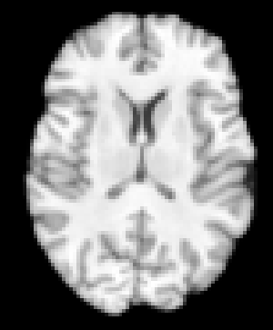
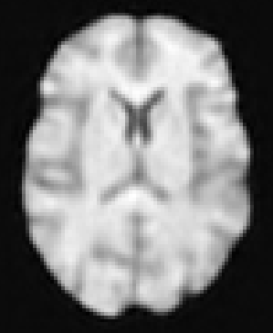




VQVAE
Codebook
e₁
e₃
e_{x}
e₂
$$∇_{z}L$$
Encoder
e₁
Decoder
$$q(z|x)$$
e₆
$$z_{e}(x)$$
1
$$z_{q}(x)$$
$$z_{ }$$
6
$$Loss=\left|\left|x−\hat{x}\right|\right|2+ \left|\left|sg\left[ze\left(x\right)\right]−e_{i}\right|\right|22+ \text{β} ||ze\left(x\right)−sg\left[e_{i}\right]||22$$
Reconstruction loss
Codebook commitment loss
Codebook alignment loss

Slide 7


VQGAN
Codebook (Z)
Discriminator
(D)
e₁
e₃
e_{x}
e₂
$$∇_{z}L$$
Encoder
(E)
e₁
Decoder
(Z)
$$q(z|x)$$
e₆
$$z_{e}(x)$$
1
$$z_{q}(x)$$
$$z_{ }$$
6
$Loss=\left|\left|x−\hat{x}\right|\right|2+ \left|\left|sg\left[ze\left(x\right)\right]−e\right|\right|22+ \text{β} \left|\left|ze\left(x\right)−sg\left[e\right]\right|\right|22+ λ LGAN(\left\{E, G, Z\right\}, D)$
Reconstruction loss
Codebook commitment loss
Codebook alignment loss
Discriminator loss

Slide 8



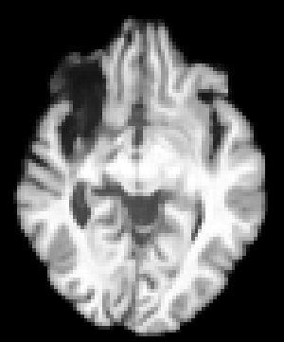
Evaluation Methods
Comparision of models
Pixel-wise evaluation Sample-wise evaluation Slice-wise evaluation
Effect of latent sizes of models
Assessment of model performance on non-brain images

Slide 9
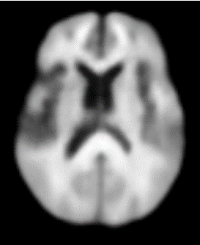
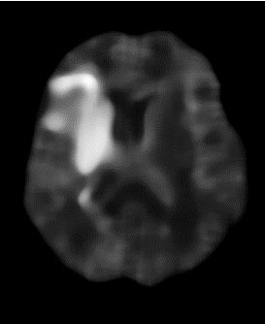


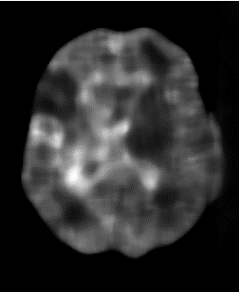

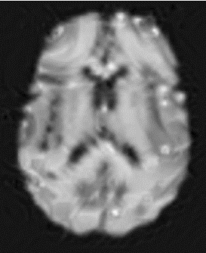
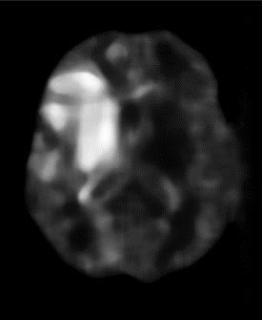

Segmentation of Stroke data
Reconstructed
Image
Difference
Image
Segmentation
Ground Truth
0.54
VAE
0.24
VQVAE
Original Image
0.59
VQGAN

Slide 10
Pixel-wise Evaluation
DICE_{S}
13.68

Slide 11
Pixel-wise Evaluation

Slide 12
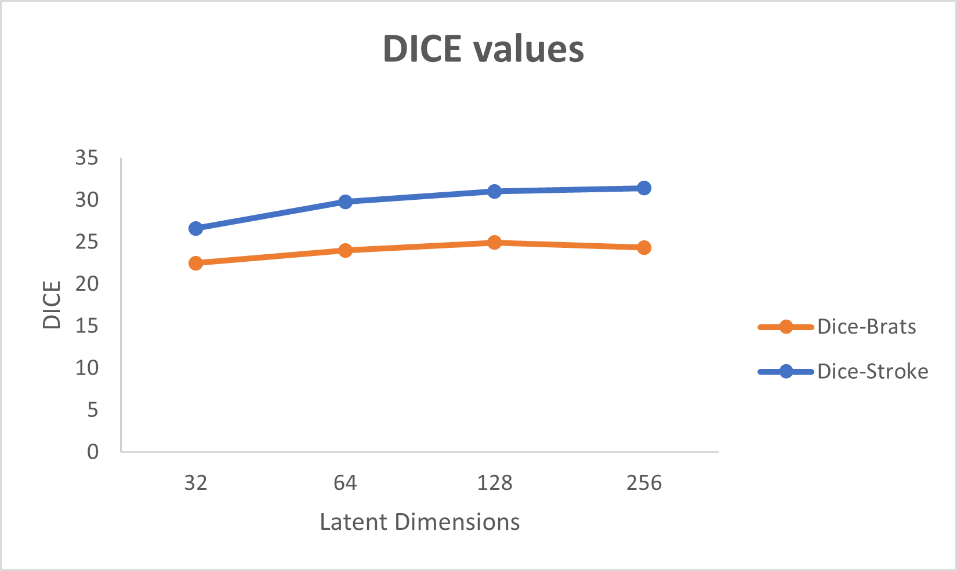
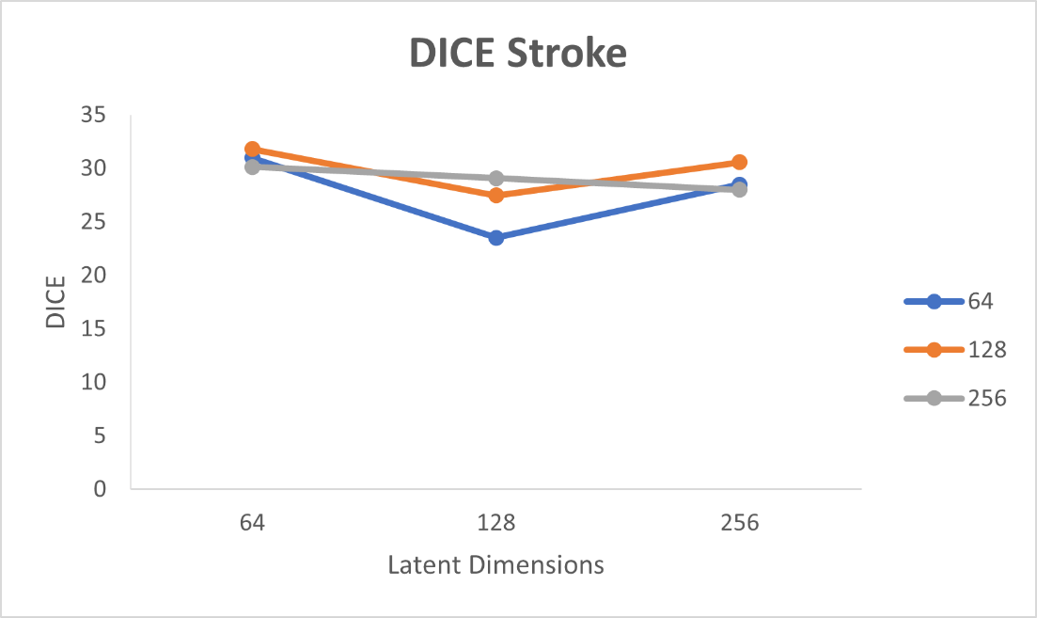
Effect of latent size on Pixel-wise evaluation
VAE
VQGAN

Slide 13
Sample-wise evaluation

Slide 14
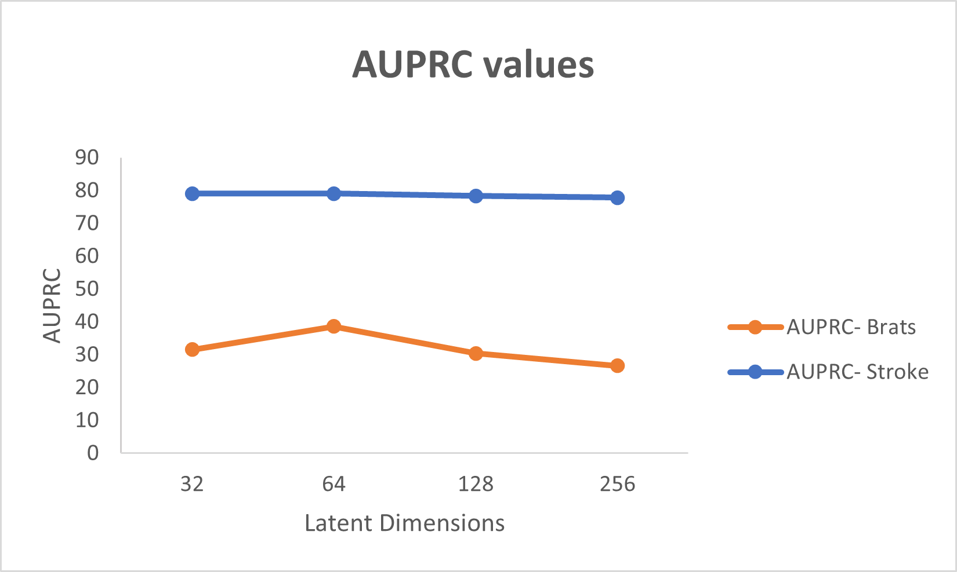
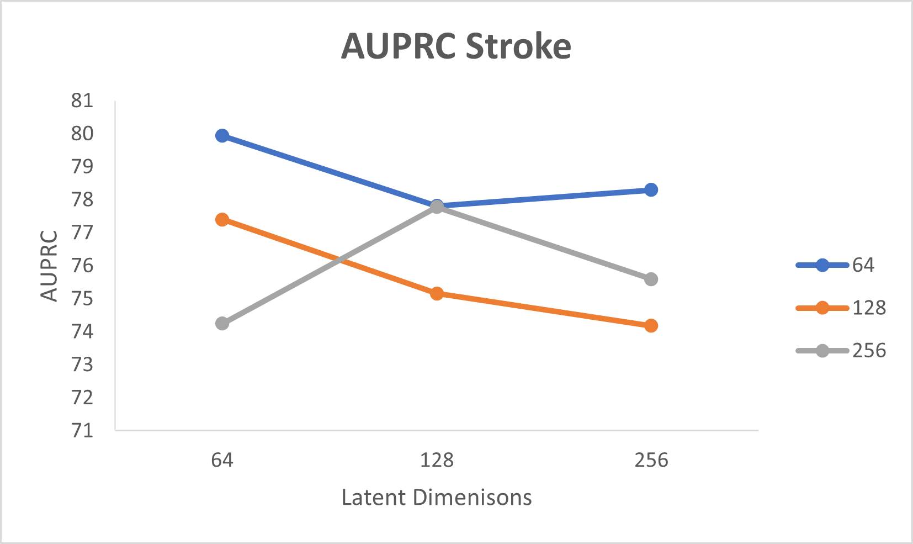
Effect of latent size on Sample-wise evaluation
VAE
VQGAN

Slide 15
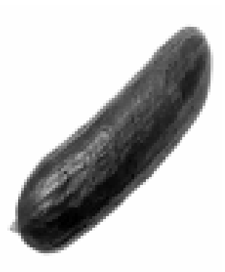
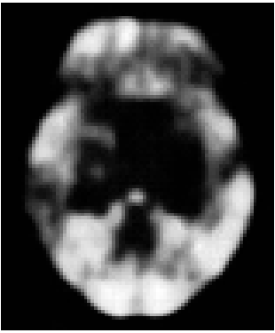
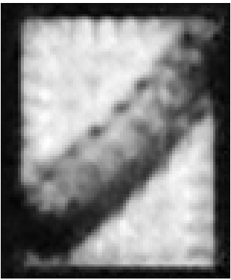
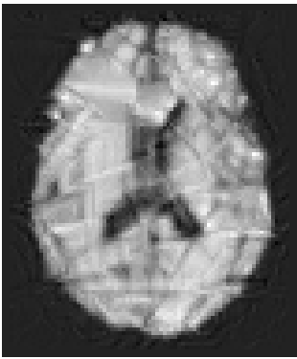
Model performance on non-brain images
Original
VAE
VQVAE
VQGAN

Slide 16
Conclusion
Comparison of models:
VQGAN outperformed
VQVAE is not suitable for the setting
Effect of latent sizes:
No significant effect observed

Slide 17
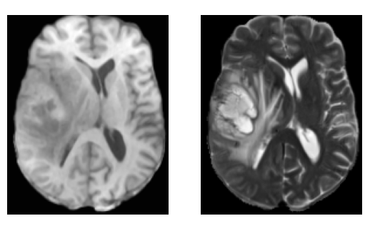
Further steps
Transformers can be used for further improvement
Tuning of architectures
Using T2 weighted images as they are high contrast
T1
T2

Slide 18
Thank you

