Slide 1
Capstone_2019_18005_2
Novel Approach for Image Enhancement
(Comparative Analysis of Filters for Image Enhancement)
Under the guidance of Dr. Jatindra Kumar Dash
Group Members:
Likhitha Parvathi Tadikonda - AP19110010006
Masoom Anas Khan - AP19110010016
Yogitha Goli - AP19110010320

Slide 2
Image Enhancement-Based Detection with Small Infrared Targets Shuai Liu 1,2, Pengfei Chen 1,2 and MarcinWo´zniak 3
background clutter
noise inundation
very small targets
=> Detail Enhancement: enhances the mutation information, detail & edge information of the image. then improves the contrast between the target edge and the adjacent pixels to make the target more prominent.improves the robustness of detection with background clutter or noise-flooded scenes.
=> Target Expansion: Upsampling
Reasons for detection failure:
The imaging distance of small infrared target
The target radiance
The existence of interference objects similar to the target
Object size,shape,SCR,
clutter background differ ?
Existing Algo’s:
Fixed hyper parameters
Likhitha
Notes:
This method first enhances… The target occupies only a few pixels. The existing algorithms have difficulty to solve this kind of problem effectively.
(1) The imaging distance of small infrared target usually makes the pixel ratio of small target to the whole image very small.
(2) The target radiance decreases with the increase of the action distance,& makes the target weak and the distance from the environment is low.
(3) Among other factors, the existence of interference objects similar to the target in complex imaging environment and complex background will result in a high rate of false alarms.

Slide 3
Algorithm
Module 1: Feature Extraction Module
DNA Net, Downsampling
Module 2: Feature Pyramid Fusion Module
Up-sampling
Module 3: Eight Connected Neighbourhood Clustering Algorithm
Predict behaviour with Ground Truth/Mask
Image analysis/synthesis:
Detection rate(Pd), False Alarm Rate(Fa),Mean Intersection of Union (mIoU) & Pixel Accuracy
Likhitha

Slide 4
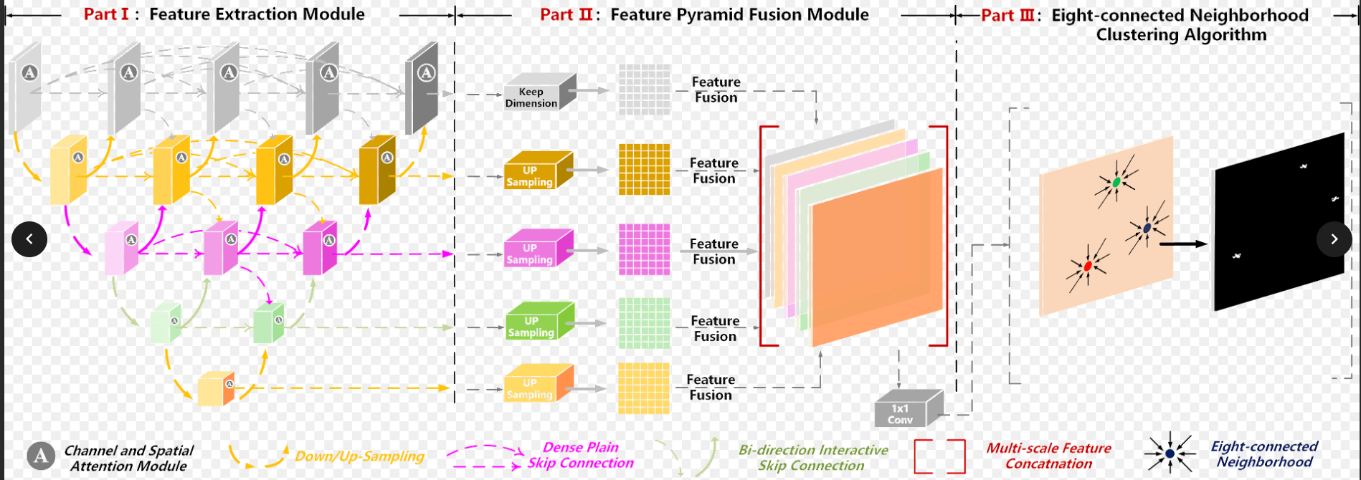
Liu S, Chen P, Woźniak M. Image Enhancement-Based Detection with Small Infrared Targets. Remote Sensing. 2022; 14(13):3232.
sharpening the spatial filter + Upsampling
Likhitha
Notes:
The first step is to use the idea of sharpening spatial filtering to improve the pixel value of the target. On this basis, the enhanced image is upsampled to increase the number of target pixels.

Slide 5
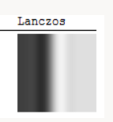
Our Proposed Method:
lanczos interpolation
lanczos2 upsampling for spatial filtering
Likhitha

Slide 6
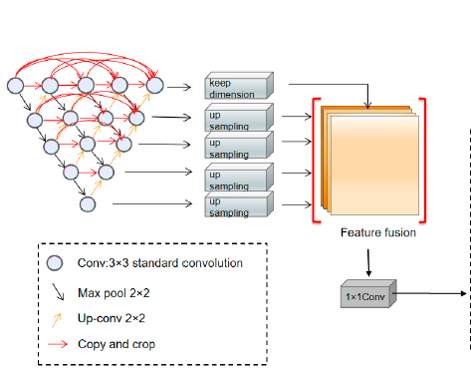
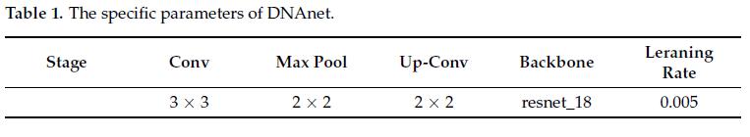
DNA Network:
INPUT
Likhitha
Notes:
the feature map is fed into the eight-connected neighbourhood-clusteringmodule, and if any two pixel points g(m0, n0), g(m1, n1) have intersecting regions in their eight neighbourhoods (as in Equation (2)) and have the same value (0 or 1) (as in Equation(3)), then the spatial location of the target centre of mass is calculated and the target is
predicted.
The existing CNN-based methods cannot be directly applied for infrared small targets since pooling layers in their networks could lead to the loss of targets in deep layers. To handle this problem, a DNANet is proposed,

Slide 7
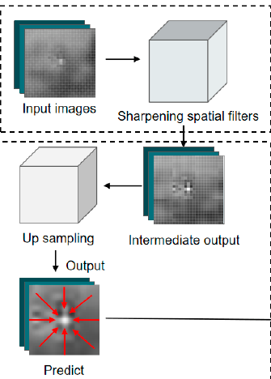
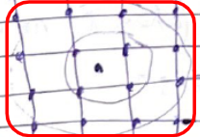
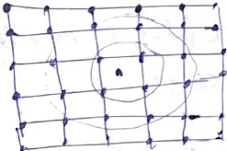
CNN Based Algo - Pixel Level evaluation metric: IoU &
Accuracy (target shape eval)
DNA NET - Three evaluation metrics : Detection rate(Pd),
False Alarm Rate(Fa) and
Intersection of Union (mIoU)
Quantitatively
enhances the detection effectiveness for tiny targets in complex backgrounds.
Sharpening spatial filters Input Image
bicubic interpolation (4*4)
Upsampling target pixels
Eight connected
Yogitha
Notes:
techniques are bilinear interpolation for the downsampling and bicubic interpolation for upsampling of images.
the image is sharpened by spatial filter to enhance the part of the gray scale and the details of the image,improve the separation degree between the small target and the background. By sharpening the input image first, the pixel values of the target edges are increased, thus enhancing the features of small targets.Compared with existing algorithms, this algorithm makes small targets clearer and easier to detect,Thus, the detection failure caused by background clutter and noise inundation is avoided.
After that, the upsampling operation will further expand the pixels on the basis of the enhanced small target, that is, increase the number of pixels meeting the constraints, so as to fully improve the number of pixels meeting the constraints and improve the detection ability.
Upsampling: the purpose of this is to enlarge the target. this paper emphasizes small targets from the subtle level, focusing on strengthening the edge of small targets, improving the separation between small targets and the background and expanding the number of target pixels that meet the DNANet prediction conditions on this basis, so as to improve the detection effect.
This is because Pd and Fa can evaluate the detection results more intuitively & results more intuitively, and IoU is more indicative of the difference between the coordinates of the detected target and the ground truth. Therefore, IoU, Pd, and Fa are USED as evaluation tools in this paper.

Slide 8
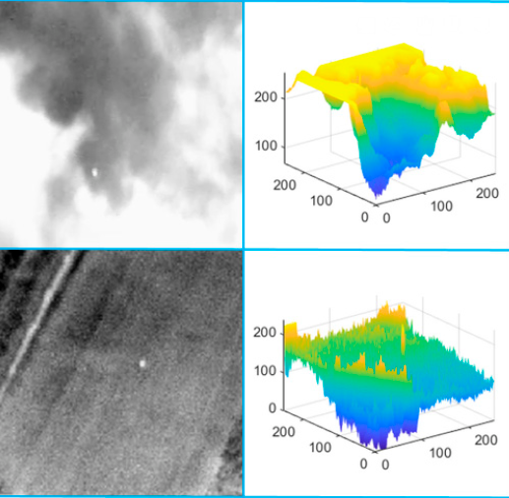
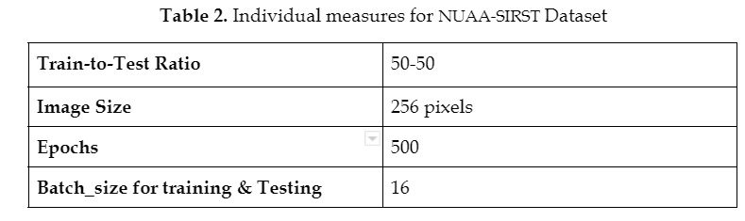
NUAA–SIRST dataset
Yogitha
Notes:
Therefore, this paper starts with improving the detection head of the algorithm by enhancing the small targets to improve the detection effect. This is because some small targets themselves do not have a prominent grey-scale jump in the area connected to the background, or the number of pixels in the small target is very small compared with the number of pixels in the whole image. This avoids the problem of detection failure due to background clutter, noise drowning and small targets.

Slide 9
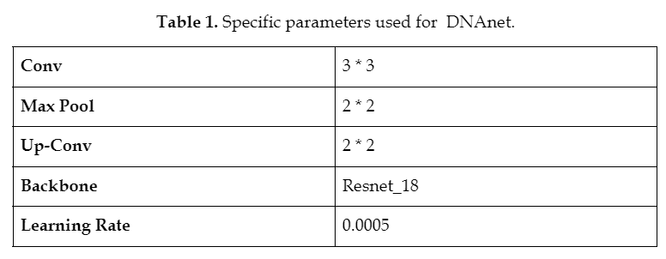
Notes:
if the image is only sharpened,although the pixel value of the edge of the small target will be increased, when the target proportion is extremely small, the number of pixels that meet the constraints is still not enough; therefore, this method has certain limitations.
LSTM encoders: It is a variety of recurrent neural networks (RNNs) that are capable of learning long-term dependencies, especially in sequence prediction problems. LSTM has feedback connections, i.e., it is capable of processing the entire sequence of data, apart from single data points such as images.
Extract image features such as edges and corners
Preprocess & Isolate potentially independent image components
(different locations, scales, orientations )
Use stride topic and extract sub images from the main image, find the suitable one & crop it
Highlight the edge to a fix intensity value so as to maintain evenness and to ignore the bg)
Tweaking this change: Using different machine learning models apart from the mentioned ones like LSTM encoders or Multiscale Transformation
Image enhancement/restoration
Image analysis/synthesis: Detection rate(Pd), False Alarm Rate(Fa),Intersection of Union (IoU)
IoU & Accuracy
Predict behaviour

Slide 10
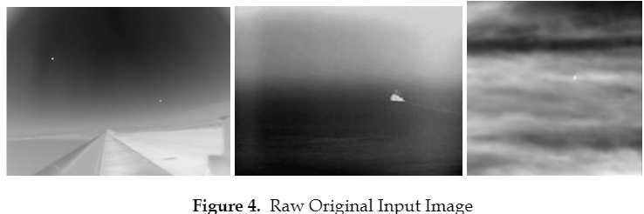
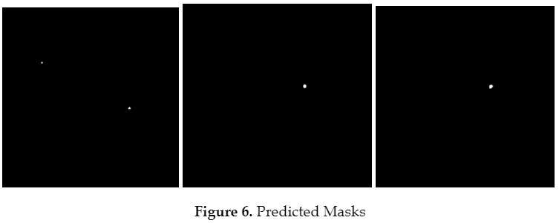
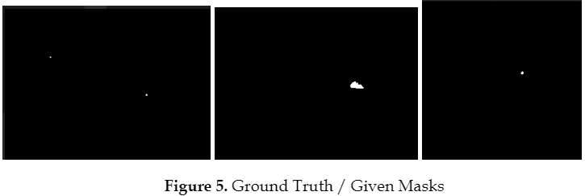
Results:
78% IOU is highest,We achieved 75.4 %
Masoom
Notes:
This is because the analogue has similar features
to the small target in the original image, but after our algorithm has increased its edge pixel
value and expanded the pixels, it weakens its similar features to the small target, allowing the
algorithm to detect it without false positives, thus reducing the false alarm rate.

Slide 11
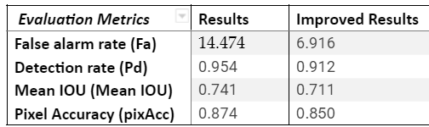
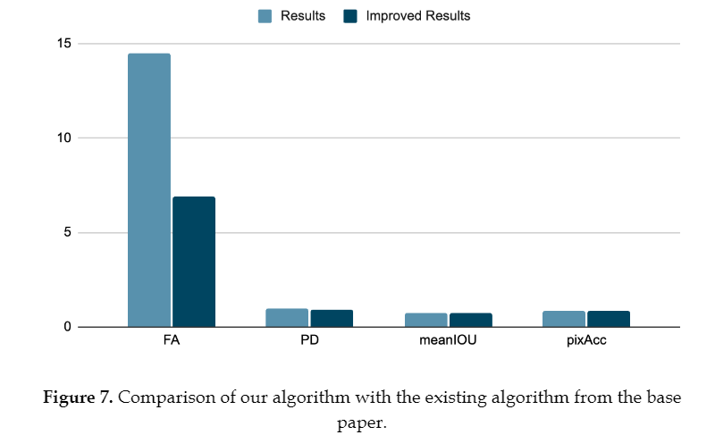
Masoom

Slide 12
References: [ APA Format ]
Liu S, Chen P, Woźniak M. Image Enhancement-Based Detection with Small Infrared Targets. Remote Sensing. 2022; 14(13):3232. https://doi.org/10.3390/rs14133232
Liao K-C, Wu H-Y, Wen H-T. Using Drones for Thermal Imaging Photography and Building 3D Images to Analyze the Defects of Solar Modules. Inventions. 2022; 7(3):67. https://doi.org/10.3390/inventions7030067
Junfeng Jing, Shenjuan Liu, Gang Wang, Weichuan Zhang, Changming Sun,Recent advances on image edge detection: A comprehensive review,Neurocomputing,Volume 503,2022,Pages 259-271,ISSN 0925-2312,https://doi.org/10.1016/j.neucom.2022.06.083. (https://www.sciencedirect.com/science/article/pii/S0925231222008141)
Tripathi, A. K., & Mukhopadhyay, S. (2012). Single image fog removal using anisotropic diffusion. IET Image processing, 6(7), 966-975.
https://digital-library.theiet.org/content/journals/10.1049/iet-ipr.2011.0472 I

Slide 13
Inputs or comments by Sir:
IMPLEMENT THE PAPER SOME PART FIRST BY NEXT TUESDAY (have the dataset ready and some implementation)
EVALUATE ITS PERFORMANCE as shown in the paper
try something other than BI CUBIC INTERPOLATION which came recently that improves the papers performance.
Use a different sharpening spatial filter
CROP THE IMAGE
Highlight the edge to a fix intensity value so as to maintain evenness and to ignore the bg
LSTM ENCODERS, MULTI SCALE TRANSFORMATION
Notes:
IMPLEMENT THE PAPER SOME PART FIRST BY NEXT TUESDAY (have the dataset ready and some implementation)
EVALUATE ITS PERFORMANCE as shown in the paper
try something other than BI CUBIC INTERPOLATION which came recently that improves the papers performance. Maybe POLYNOMIAL INTERPOLATION or HIGHER ORDER INTERPOLATION: SPLINE,SINC?
Use a different sharpening spatial filter maybe SECOND ORDER DERIVATIVE
CROP THE IMAGE
Highlight the edge to a fix intensity value so as to maintain evenness and to ignore the bg
LSTM ENCODERS, MULTI SCALE TRANSFORMATION

Slide 14
Progress:
Downloaded the dataset and Implemented the Base paper a little bit.
Paper we tried to implement: Liu S, Chen P, Woźniak M. Image Enhancement-Based Detection with Small Infrared Targets. Remote Sensing. 2022; 14(13):3232.
Here is the Link to Code of Base Paper: https://colab.research.google.com/drive/1-1reHoerlpp_Lg2gZdPZSZFo8nDyyQzv?usp=sharing
Drive folder with all the codes:
https://drive.google.com/drive/folders/1SKeffgHF0gNafhdmCuxMwnGl7e_3iYOT?usp=sharing
Main Paper that we implemented:
https://colab.research.google.com/drive/1mVTJEdnwz2ook5a1uw-yGRpaHxcyESf7?usp=sharing#scrollTo=m6Fbuk1aMivo
Report:
https://docs.google.com/document/d/1zlzFGK_meoF11vQKnNXx-pyDvY1NedYF6Xcbh6dEHlc/edit?usp=sharing

Slide 15


