Slide 1
AnemiaFusionNet: A Multimodal Feature Fusion Framework for Region-Aware Anemia Detection
Submitted By: Vasa Likhitha
This project presents a multimodal artificial intelligence framework for anemia detection by integrating conjunctiva eye images, clinical information, and geographical health indicators. The objective is to improve prediction accuracy through feature fusion and region-aware learning.

Slide 2
Introduction
Anemia is one of the most common health disorders worldwide and affects millions of individuals across different age groups. Conventional diagnosis primarily relies on laboratory blood tests, which may not always be accessible in remote or resource-constrained regions. To address this challenge, this project explores the use of artificial intelligence for non-invasive anemia risk prediction by combining information from multiple sources rather than relying on a single modality.
Problem Statement
Most existing anemia detection approaches focus on a single data source, such as clinical records or medical images. These approaches may overlook important contextual information that can influence prediction performance.
Objective
The goal of AnemiaFusionNet is to develop a multimodal framework capable of learning from conjunctiva eye images, patient clinical information, and geographical health data. By combining these modalities through a fusion architecture, the system aims to provide more robust and region-aware anemia predictions.

Slide 3
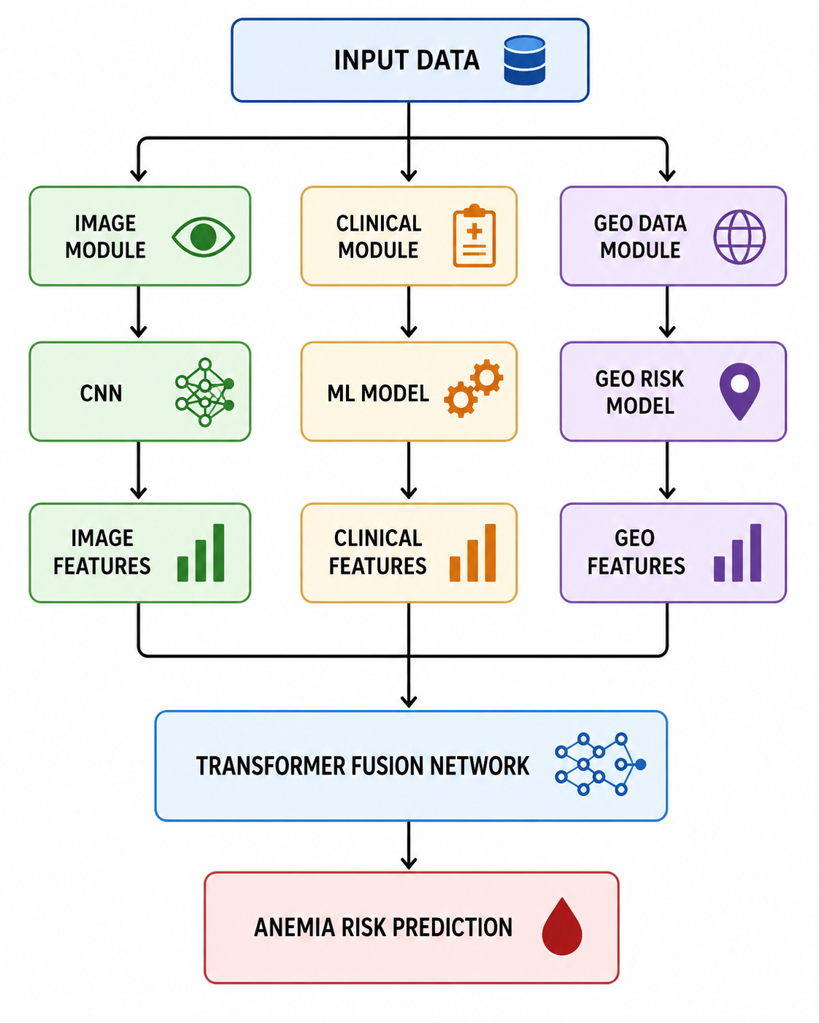
Dataset Description
The project utilizes three different categories of data. The image dataset consists of conjunctiva eye images collected from India and Italy. The clinical dataset includes patient attributes such as hemoglobin level, age, gender, and country. In addition, district-level NFHS-5 health indicators are used to capture geographical variations and regional anemia risk patterns. Together, these datasets provide complementary information for multimodal learning.
Proposed Architecture
The proposed framework processes image, clinical, and geographical information independently through dedicated feature extraction modules. Each module generates meaningful feature representations that are subsequently combined using a Transformer-based fusion network. The fused representation is then used to predict the final anemia risk.

Slide 4
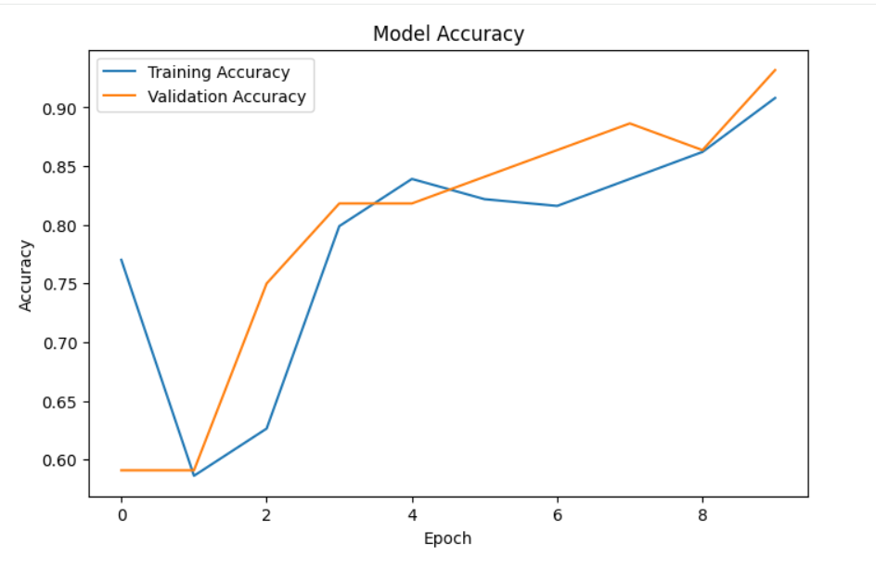
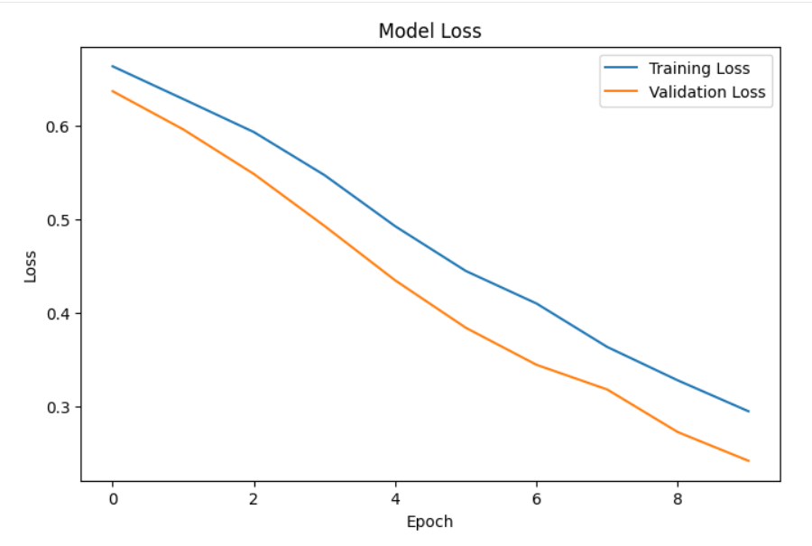
Image Modality
The image modality focuses on extracting visual features from conjunctiva eye images. A Convolutional Neural Network (CNN) was developed to learn patterns associated with anemia. The images undergo preprocessing and normalization before being passed through the network. The resulting feature vectors capture visual information that contributes to the final prediction.

Slide 5
Clinical Feature Extraction
The clinical module analyzes patient-specific attributes such as hemoglobin level, age, gender, and country. A machine learning model was trained to identify relationships between these attributes and anemia status.
Geo-Risk Module
The geo-risk module introduces region-aware intelligence into the framework. District-level NFHS-5 data is utilized to estimate anemia-related risk factors associated with specific geographical locations. This enables the model to account for population-level health trends and environmental influences.
Experimental Results
The developed models demonstrated promising performance across all modalities. The clinical model achieved high classification accuracy, while the geo-risk model successfully captured regional health patterns using NFHS-5 indicators. The Transformer fusion network further improved prediction capability by integrating information from multiple modalities. These results validate the effectiveness of multimodal learning for anemia detection.
Clinical Accuracy: 100%
Geo-Risk R² Score: 0.966
Geo-Risk MAE: 3.38
Fusion Validation Accuracy: ~75%

Slide 6
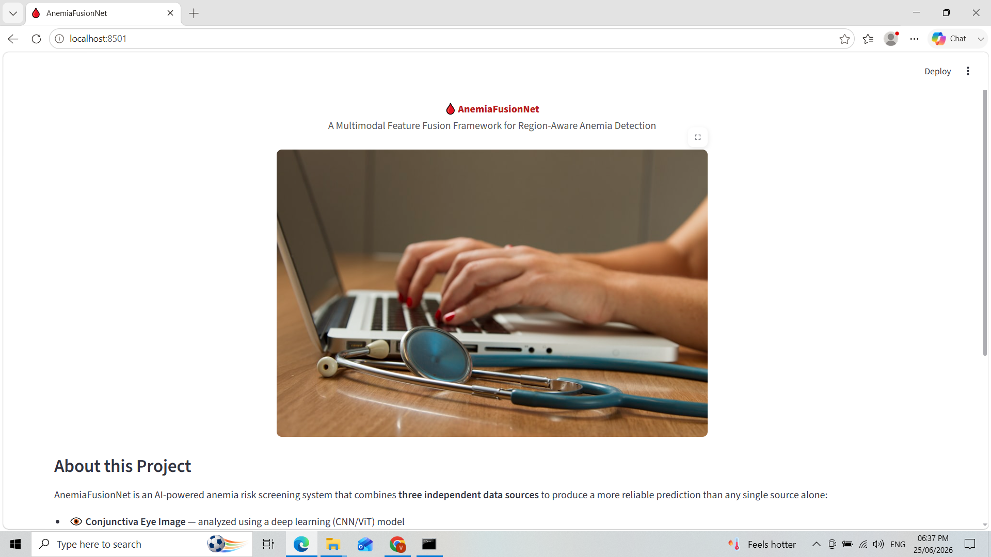
Developed Application
A Streamlit-based web application was created to provide an interactive interface for anemia risk prediction. The application allows users to upload conjunctiva images, enter clinical information, select geographical locations, and obtain anemia risk predictions through the integrated multimodal framework.

Slide 7
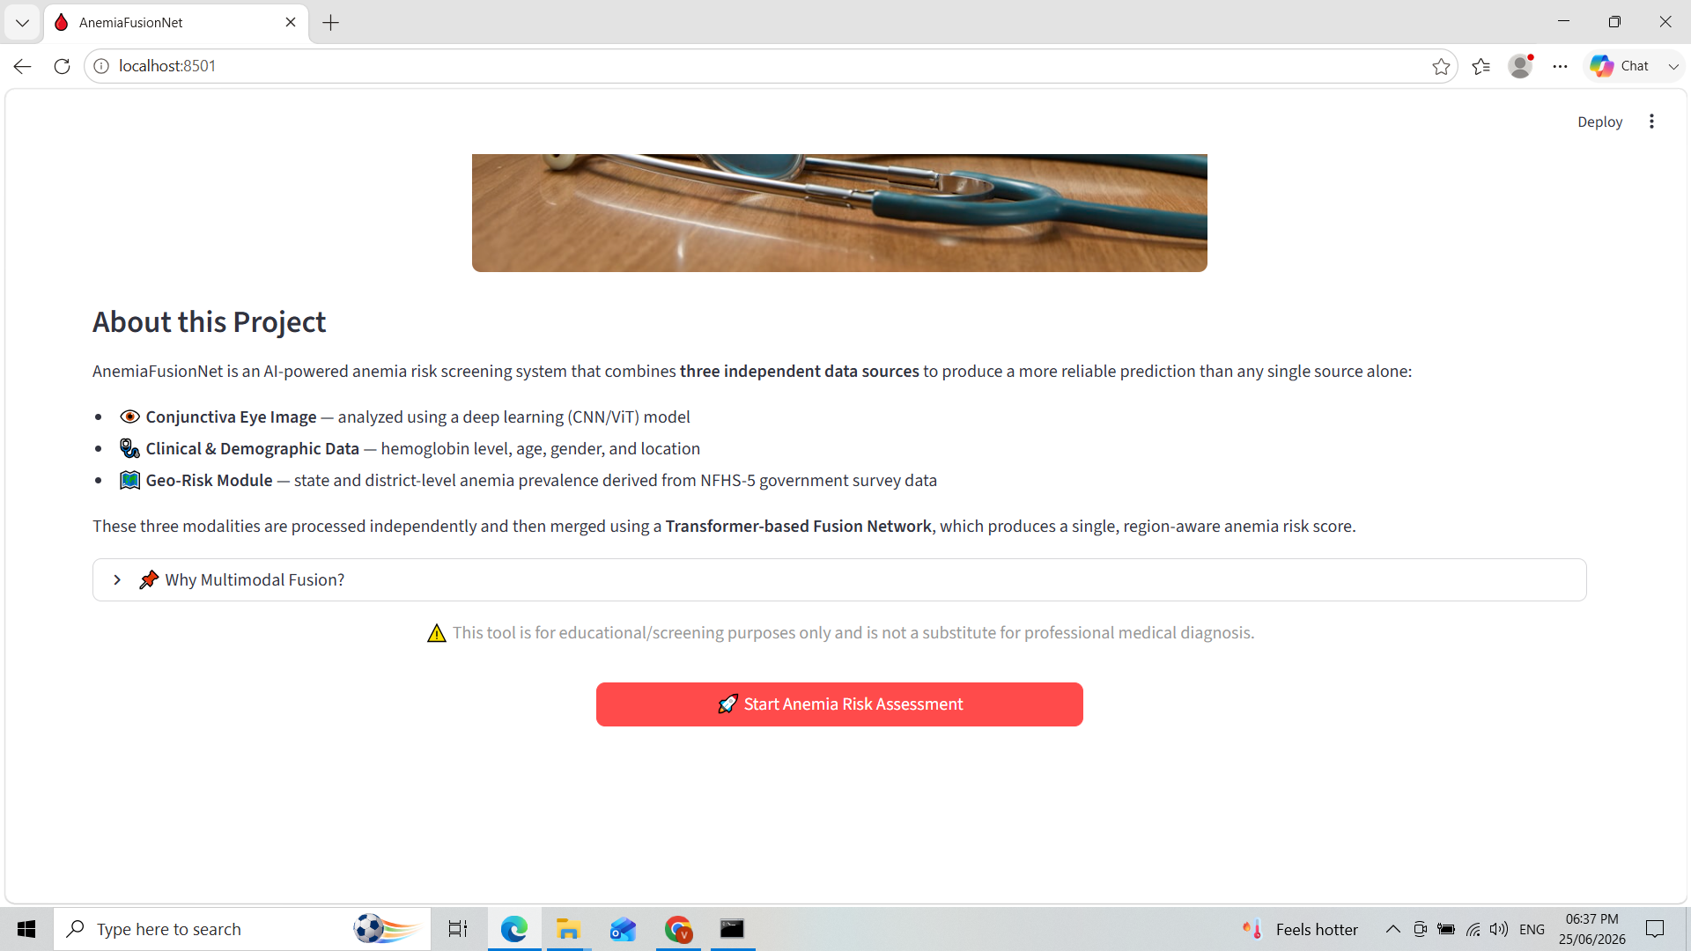

Slide 8
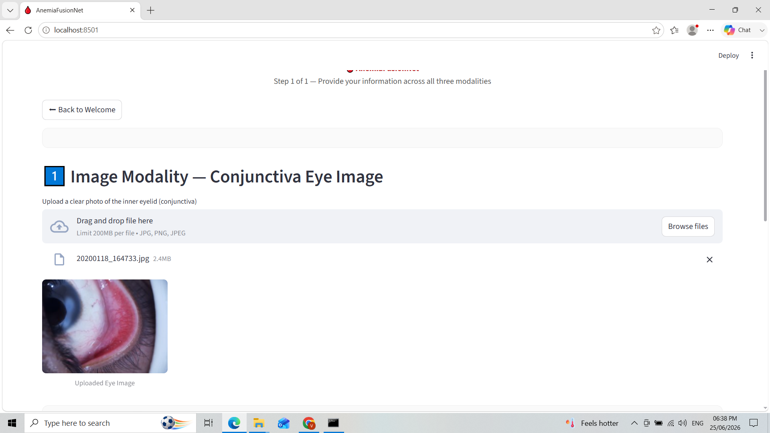

Slide 9
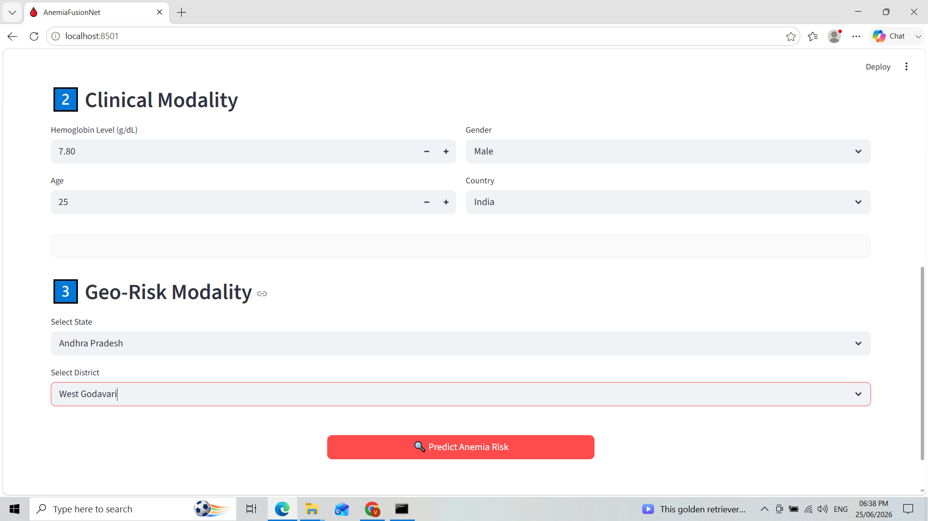

Slide 10
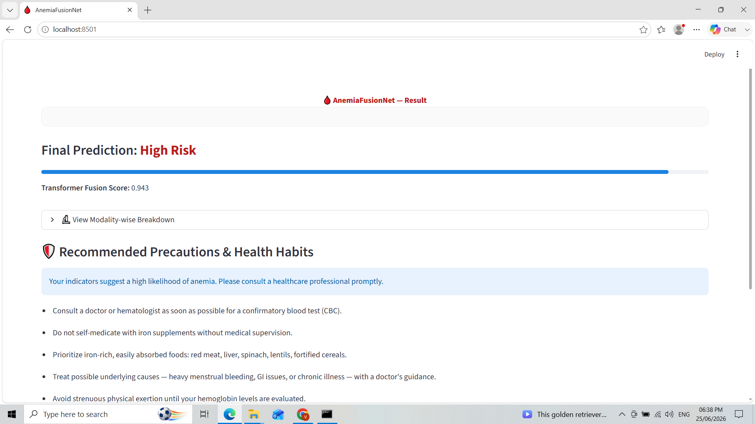

Slide 11
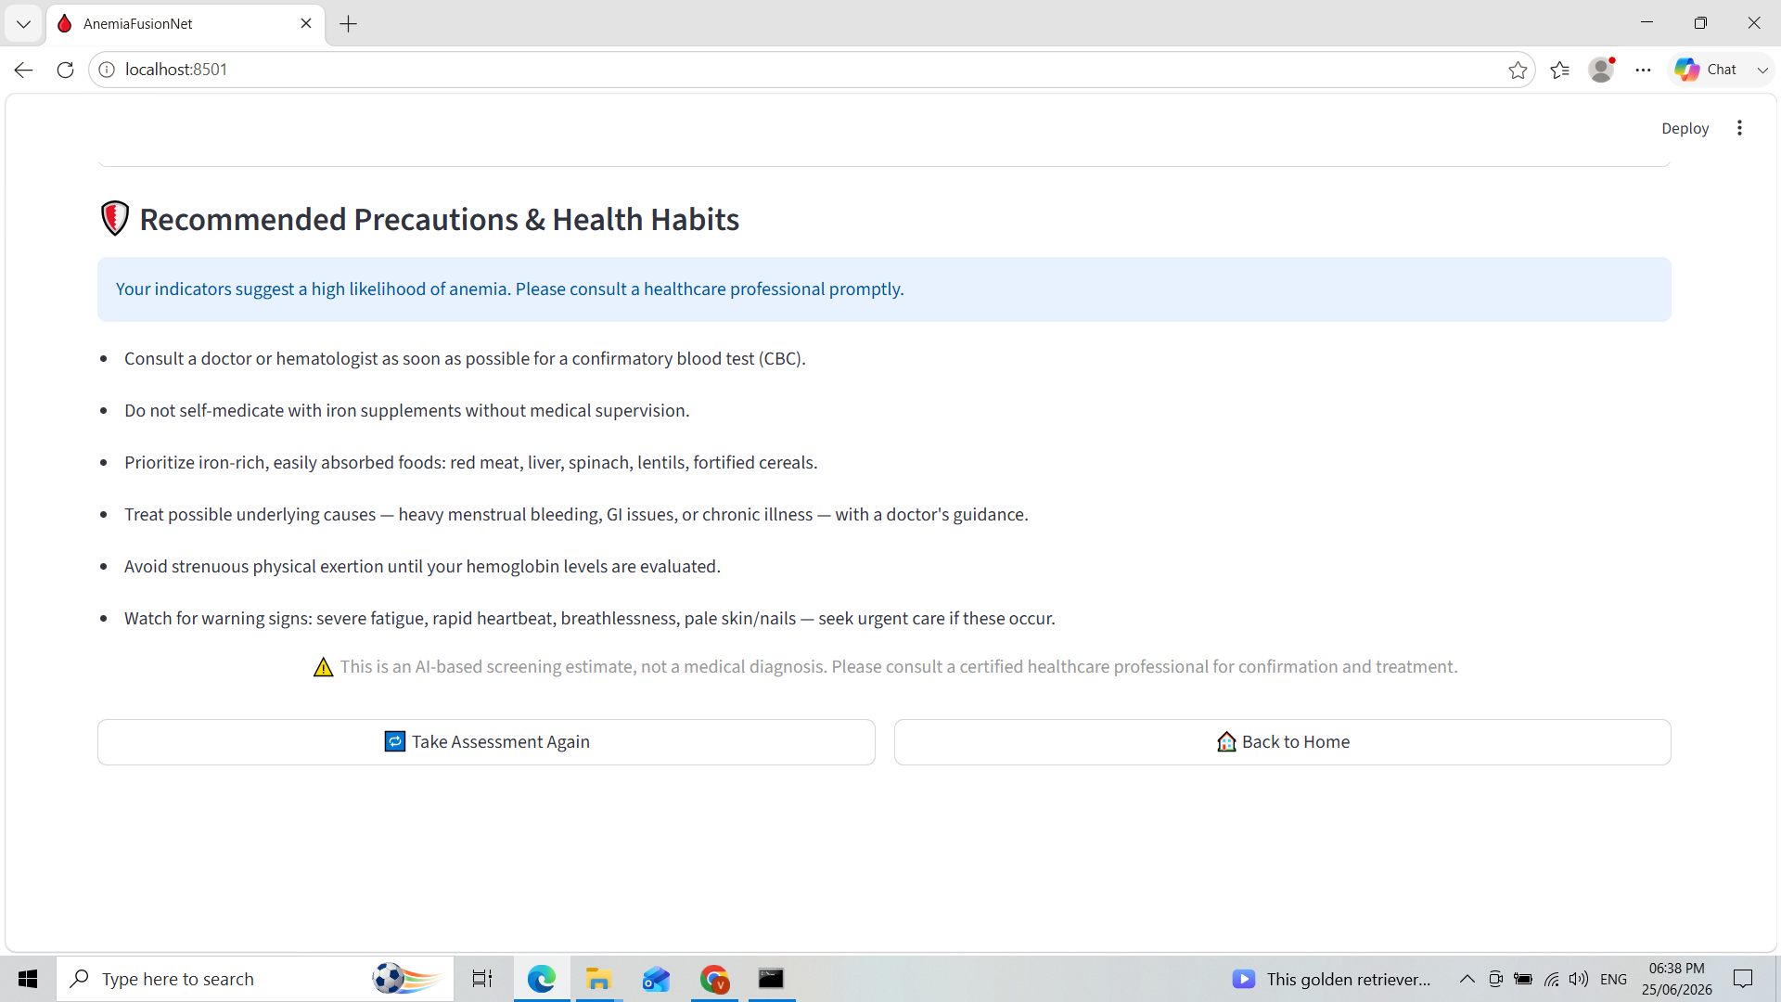

Slide 12
Conclusion
AnemiaFusionNet successfully demonstrates the integration of image analysis, clinical information, and geographical risk factors within a unified multimodal framework. The use of Transformer-based feature fusion enables the model to leverage complementary information from different modalities, resulting in a more comprehensive and region-aware prediction system. The developed Streamlit application further showcases the practical applicability of the proposed approach.
Future Enhancements
Future work may focus on expanding the dataset, incorporating Vision Transformers for image analysis, improving fusion strategies, and deploying the system on cloud platforms for real-time healthcare applications. Integration with mobile devices and telemedicine systems can further enhance accessibility and usability.

