Slide 1
DATAOPS – ETL PROCESS
INTRODUCTION ABOUT ARCHITECTURE OF ETL PROCESS
EXPLANATION OF TOOLS AND TECHNOLOGIES
DEMO OF PROCESS

Slide 2
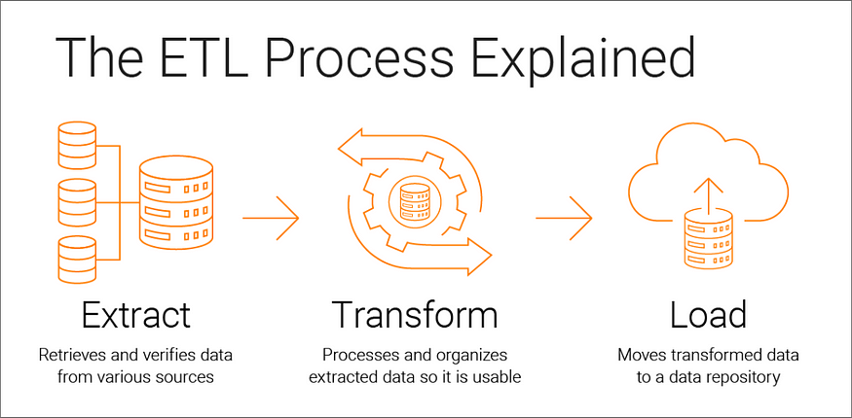
ETL PROCESS

Slide 3
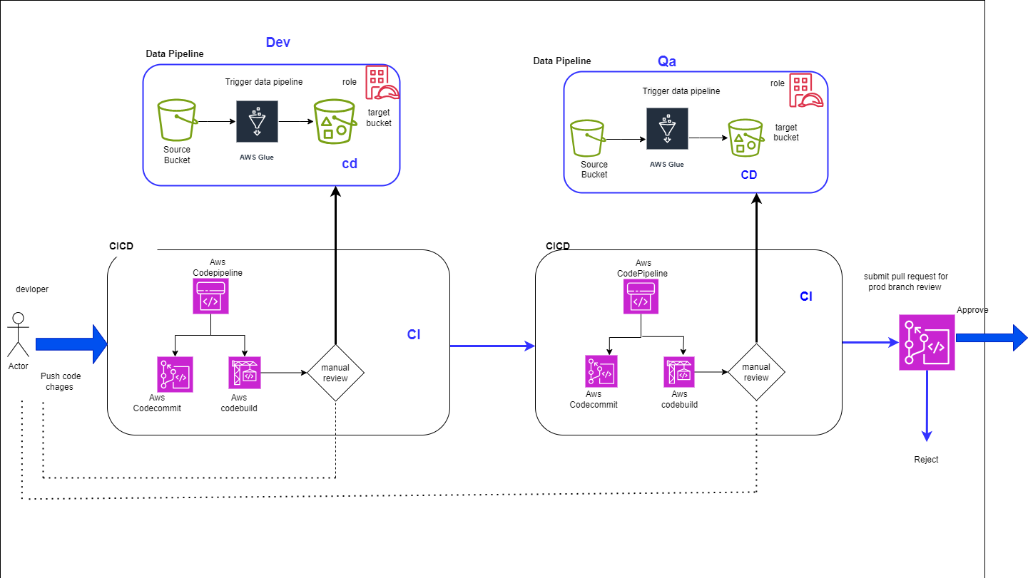
ARCHITECTURE OF ETL

Slide 4
S3 Buckets:
S3 buckets are used to store the raw unstructured data that needs to be transformed.
You can upload files to S3 buckets, and AWS Glue can read the data from these buckets during the extraction phase of the ETL process.
AWS Code Pipeline:
AWS Code Pipeline is a fully managed continuous integration and continuous delivery (CI/CD) service.
In the context of the ETL process, Code Pipeline can be used to orchestrate the execution of various stages (Dev, test, prod environment) involved in the data transformation pipeline.
code Pipeline can trigger the execution of AWS Glue jobs whenever there are updates or changes in the source data.
AWS Code Commit:
It allows you to store and manage your application code, including the code for AWS Glue jobs.
AWS Code Build:
Code Build can be integrated into your Code Pipeline workflow to build and package the code for your AWS Glue job.
For example we are using the code build responsible to trigger the pipeline
we are approving manually within the code pipeline before going to next environment.
AWS Glue Job:
An AWS Glue job is responsible for orchestrating the ETL process to transform unstructured data into structured data.
Aws Tools and technologies

Slide 5
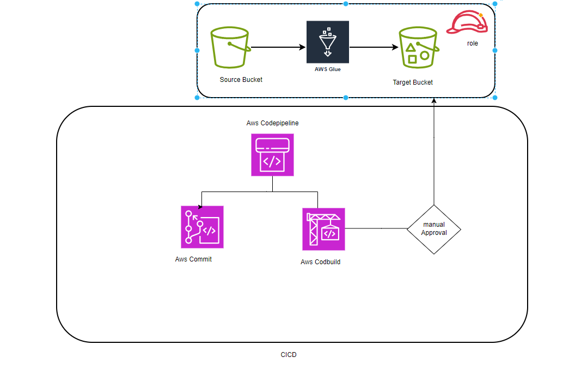
CICD FOR DEV ENV

Slide 6
CICD FOR PROD ENV

