Slide 1

Project Title - SEASONAL AGRICULTURE PERFORMANCE ANALYSIS
LIKHITHA VADDHI
PALLAVI ENGINEERING COLLEGE
AICTE STU ID : STU6825ae98cff401747299992

Slide 2

PROBLEM STATEMENT
Agricultural performance varies across seasons due to changes in environmental conditions, crop selection, farming practices, resource usage, and economic factors. However, it can be difficult to identify these seasonal patterns and understand their impact on crop yield, production, water efficiency, profitability, and disease/pest risk.
This project aims to analyze seasonal agricultural data to identify meaningful patterns, relationships, and variations and provide data-driven insights for better agricultural planning and resource management.

Slide 3
Project Description
**Seasonal Agriculture Performance Analysis** is a data analytics project that analyzes how agricultural performance varies across different seasons, crops, geographical regions, environmental conditions, farming practices, resource usage, and economic factors.
The project uses an agricultural dataset containing information such as rainfall, temperature, humidity, sunlight, soil conditions, fertilizer and pesticide usage, irrigation methods, water consumption, crop yield, production, market price, cost, revenue, profit, and disease/pest risk.
The dataset is cleaned and analyzed using exploratory data analysis, statistical techniques, correlation analysis, and data visualization. The project identifies seasonal patterns, compares crop performance, examines environmental and resource-related factors, evaluates economic outcomes, and studies disease and pest risk.
The analysis provides **evidence-based insights** that can support better seasonal planning, crop selection, resource allocation, irrigation management, and agricultural decision-making.

Slide 4

WHO ARE THE END USERS?
* **Farmers** – To make better decisions about crop selection, irrigation, and seasonal planning.
* **Agricultural Officers** – To monitor agricultural performance and identify seasonal or regional variations.
* **Agricultural Planners** – To support evidence-based seasonal planning and resource allocation.
* **Agribusinesses** – To understand crop production, market prices, costs, revenue, and profitability.
* **Researchers & Data Analysts** – To study relationships between environmental conditions, farming practices, resources, and agricultural outcomes.
* **Government & Policy Makers** – To support data-driven agricultural planning and resource management.

Slide 5

Technology Used
  * **Python** – Data cleaning, preprocessing, analysis, and calculations
  * **Pandas** – Data manipulation and dataset analysis
  * **NumPy** – Numerical computations
  * **Matplotlib** – Creating graphs and visualizations
  * **SciPy** – Statistical analysis, including ANOVA
  * **Google Colab** – Cloud-based environment for developing and running the analysis
  * **CSV Dataset** – Source format for storing and processing agricultural data
  |

Slide 6
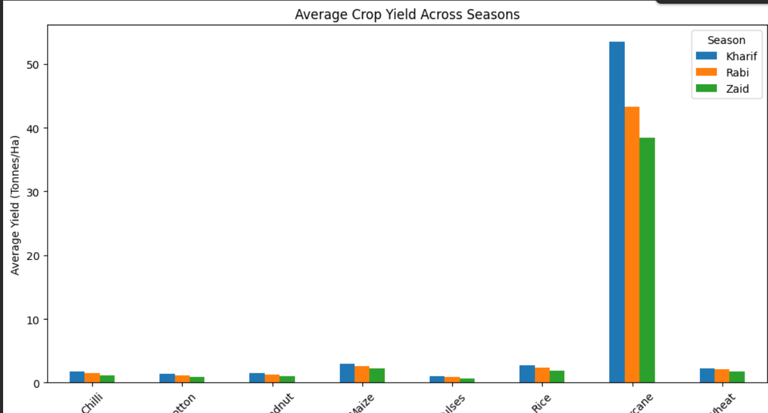
RESULTS

Slide 7
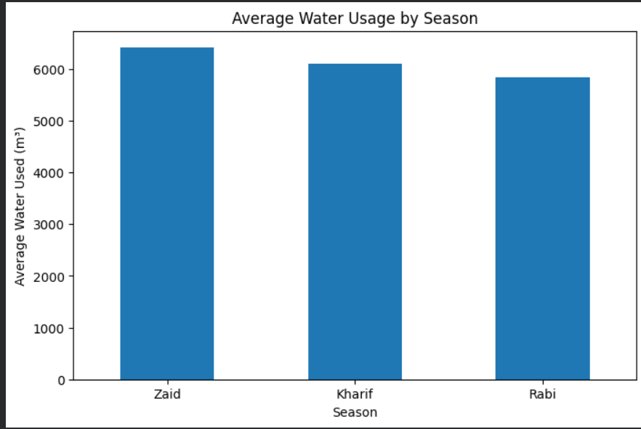
RESULTS

Slide 8
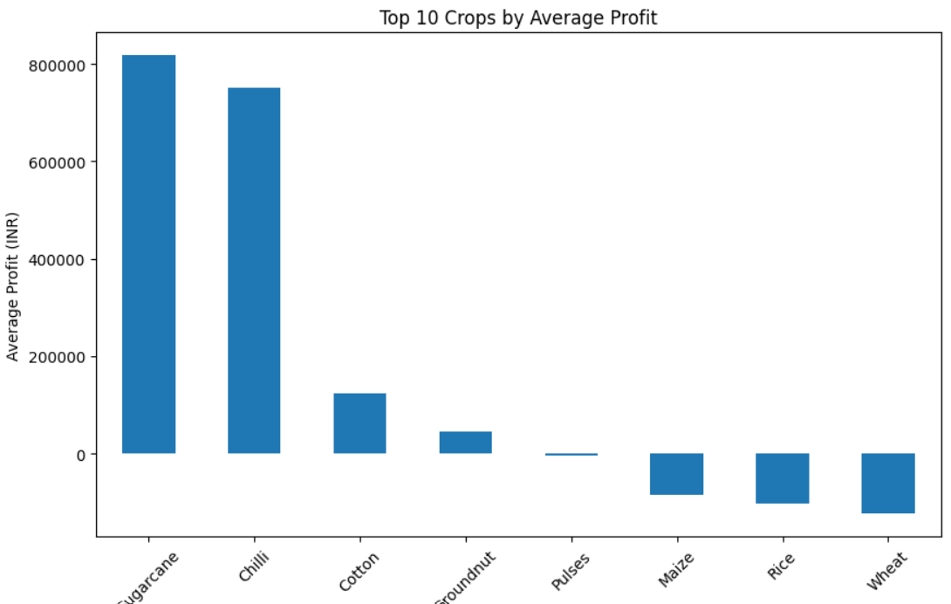
RESULTS

Slide 9
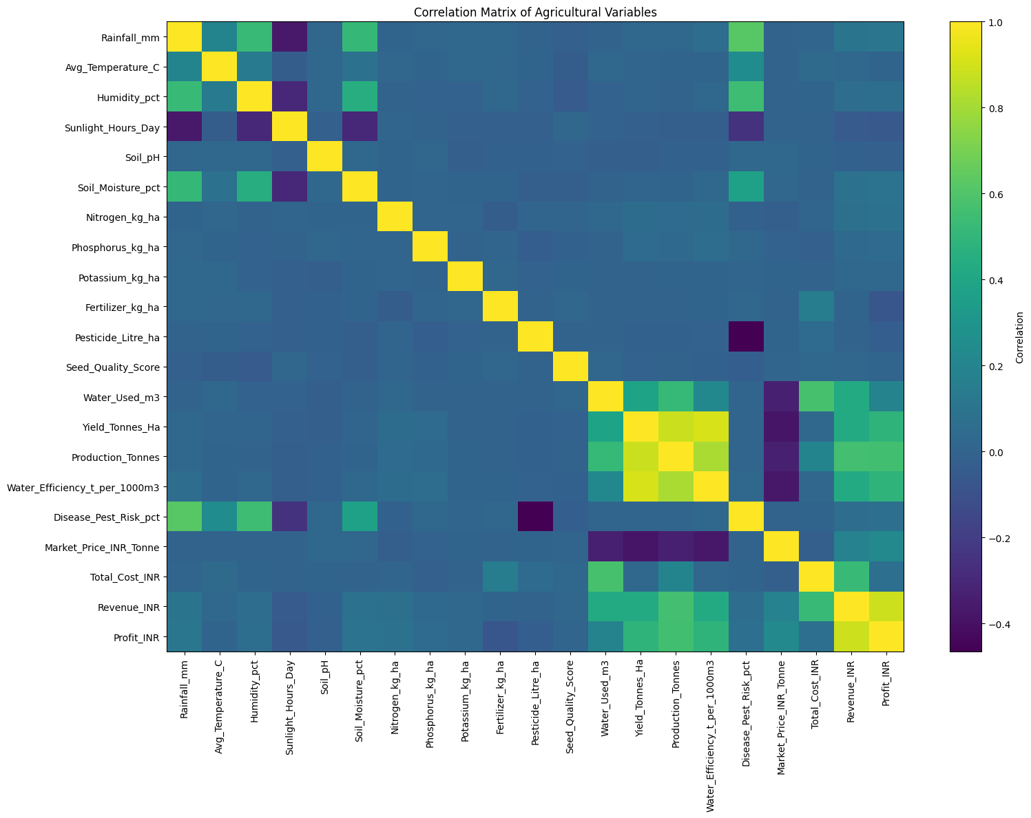
RESULTS

Slide 10
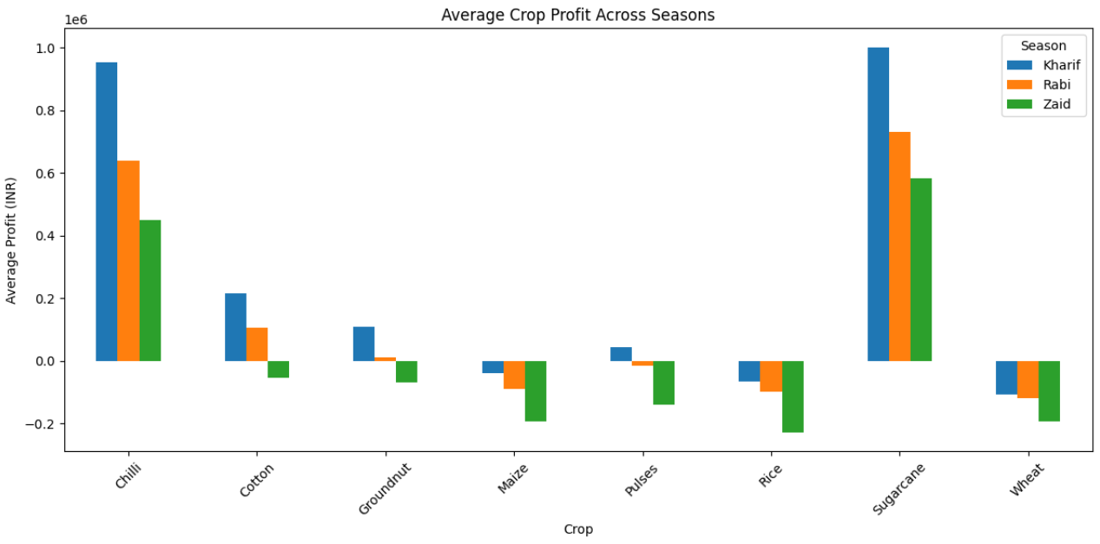
RESULTS

Slide 11
Future scope
Machine Learning: Develop models to predict crop yield, profit, and disease/pest risk.
Weather Integration: Use real-time weather and climate data for better seasonal analysis.
Crop Recommendation: Build a system to recommend suitable crops based on soil and environmental conditions.
Interactive Dashboard: Develop a Power BI or web-based dashboard for real-time monitoring.
IoT Integration: Use sensors to monitor soil moisture, temperature, rainfall, and other field conditions.
Smart Irrigation: Develop data-driven irrigation recommendations to reduce water wastage.
Mobile Application: Create a mobile app to provide agricultural insights and recommendations directly to farmers.

Slide 12
GitHub Link
https://github.com/Likhithavaddhi/-Seasonal-Agriculture-Performance-Analysis-/tree/main

Slide 13

VOIS Course completion certificate -
Course name- Data Visualization

Slide 14
Thank you
.
.

