Slide 1
AUTOMATED INVOICE PROCESSING USING OCR AND SMALL LANGUAGE MODEL

Slide 2
Abstract
Now-a-days, it has become a big challenge for businesses to automate the process of extracting the key details from the invoices since they receive invoices in various formats. Raw text can be extracted from the images by using traditional OCR (Optical Character Recognition) techniques, but the big deal is to understand and structure the data. The goal of our project is to use a SLM (Small Language Model) which integrates with the OCR to enhance the invoice processing. The SLM will be built in such a way that it helps in structuring the extracted text, identifying key details and reduce manual effort in financial data processing.

Slide 3
Problem Statement
Traditional OCR systems are used to extract text from different invoices, but they often fail to effectively understand the context and structure of the data. This leads to difficulty in identifying key fields (e.g., invoice number, total amount, dates, etc.,). These may be some other issues as well such as errors in misclassified text and lack of semantic understanding due to different invoice layouts.
To solve this, we propose a hybrid approach using:
Optical Character Recognition (OCR) for text extraction
A Small Language Model (SLM) for key field extraction and intelligent structuring.
By applying Machine Learning and Natural Language Processing (NLP), our model will be able to automatically detect, classify and extract relevant invoice details, improving efficiency and reducing errors in financial workflows.

Slide 4
Introduction
Traditional OCR systems have been used for text extraction but struggle with precise and organized data retrieval. Small Language Models (SLMs) offer improved performance by enhancing text structuring, field identification, and contextual understanding. Combining OCR with SLMs can boost invoice processing accuracy and efficiency, reducing manual effort while ensuring data reliability.

Slide 5
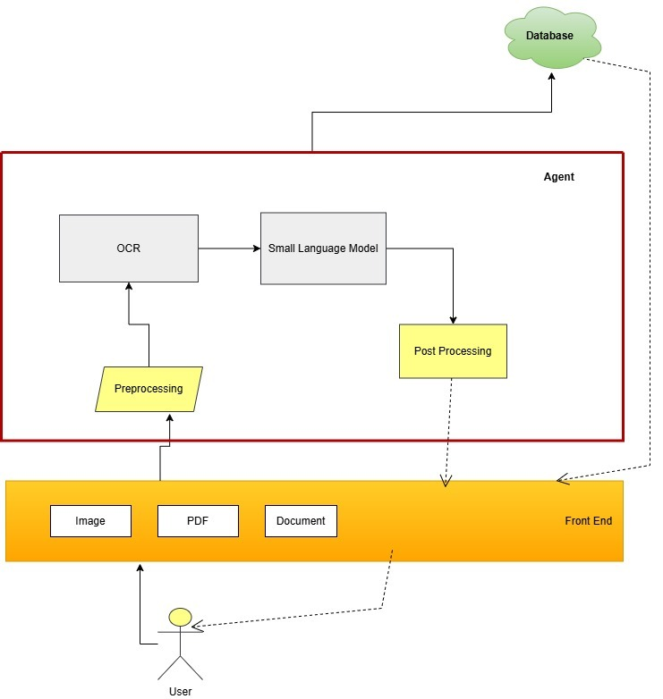
Architecture

Slide 6
Minimum Viable Product (MVP)
The MVP for this project will demonstrate the integration of Small Language Model (SLM) with OCR to automate invoice data extraction and structuring. The system will process invoices in PDF or image formats, apply OCR to extract raw text, and utilize a Small Language Model (SLM) to identify and organize key invoice details.
Text Extraction with OCR:
The MVP will use OCR techniques to extract raw text from invoices, converting unstructured data into machine-readable form.
Natural Language Processing (NLP) for Data Structuring:
A Small Language Model (SLM), trained using NLP techniques, will analyze the extracted text, recognize patterns, and classify key fields such as invoice number, total amount, date, and vendor details.
Pattern Recognition & Entity Extraction:
The system will implement Named Entity Recognition (NER) to identify critical invoice details, improving accuracy over traditional rule-based methods.

Slide 7
Literature Review
Challenges in Traditional OCR Systems:
The text extraction from invoices along with structured documents uses two primary OCR methods known as Tesseract and ABBYY FineReader. Traditional OCR systems encounter multiple obstacles while extracting information from invoices with detailed designs or handwritten entries or documents containing background noise. Numerous studies indicate that distorted text remains an obstacle for OCR models which results in subpar results when extracting critical financial information fields (Martínek et al., 2020). The semantic understanding capabilities of OCR systems remain limited because they struggle to recognize invoice-relevant elements such as invoice numbers dates and amounts according to Xue et al. (2020).
Small Language Models (SLM) for Enhanced Data Structuring:
Text extraction along with data structuring benefits from integration with Small Language Models through improved accuracy in OCR workflows. SLMs represent a lightweight solution for powerful text understanding that offers effective contextual awareness at a minimal computation cost. The study demonstrates that SLMs successfully process extracted text content to find patterns that lead to accurate invoice detail classification (Fukuda et al., 2025). SLMs excel specifically when the system calls for minimal training data combined with high performance levels (Kuzman & Ljubešić, 2025).

Slide 8
NER technology functions as a key information extraction system:
NER models alongside the integrated system now help invoice processing staff identify essential key points that include invoice numbers and dates and payment information. Digitized information becomes more precise when NER joins forces with OCR thus achieving elevated performance across finance and healthcare domains according to Xue et al. (2020) and Martínek et al. (2020). The NER model uses contextual information to pinpoint structured data precisely which leads to enhancement of system performance.
Hybrid Models: Combining OCR and SLM for Improved Efficiency:
Modern advancements have generated new models which unify OCR programming with SLM technology capabilities. Text extraction occurs through OCR while SLMs conduct automated data organization and remediate errors in these systems. The joint utilization of zero-shot learning and fine-tuning techniques makes hybrid models ready to process multiple invoice formats without significant retraining according to Lowe et al. (2024). Orthogonally to basic OCR outputs the OCR2SEQ model implements sequence-to-sequence learning to enhance text accuracy together with specialized domain data extraction in finance and healthcare applications (Lowe et al., 2024).

Slide 9
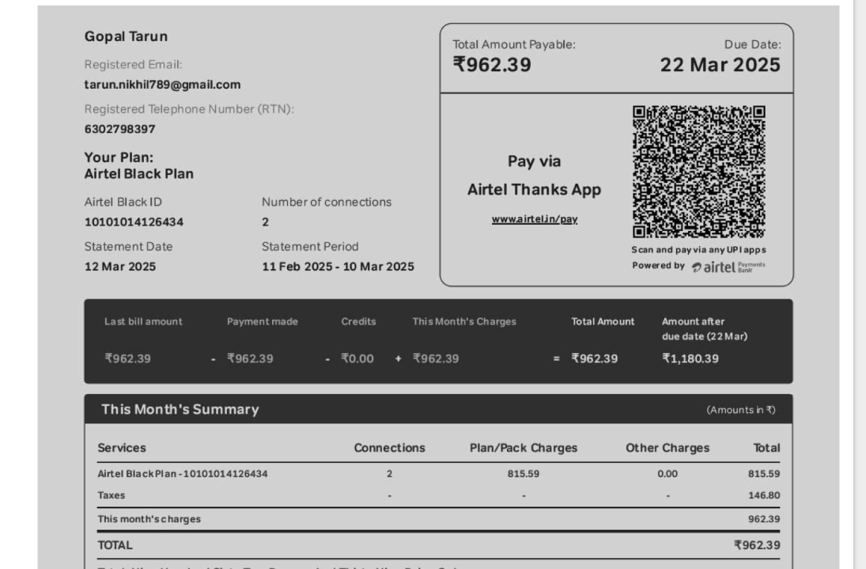
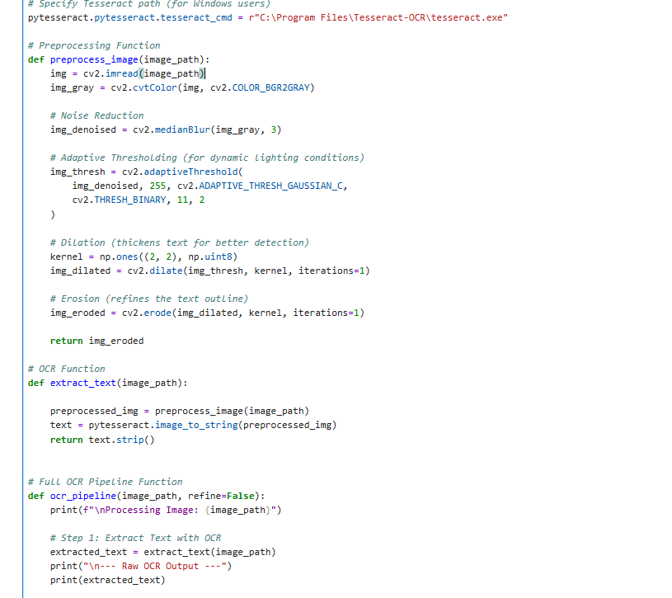
Screenshots from code

Slide 10
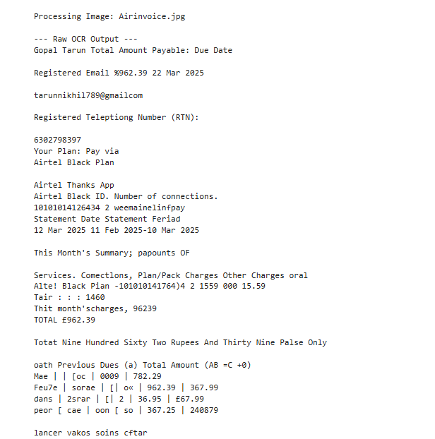

Slide 11
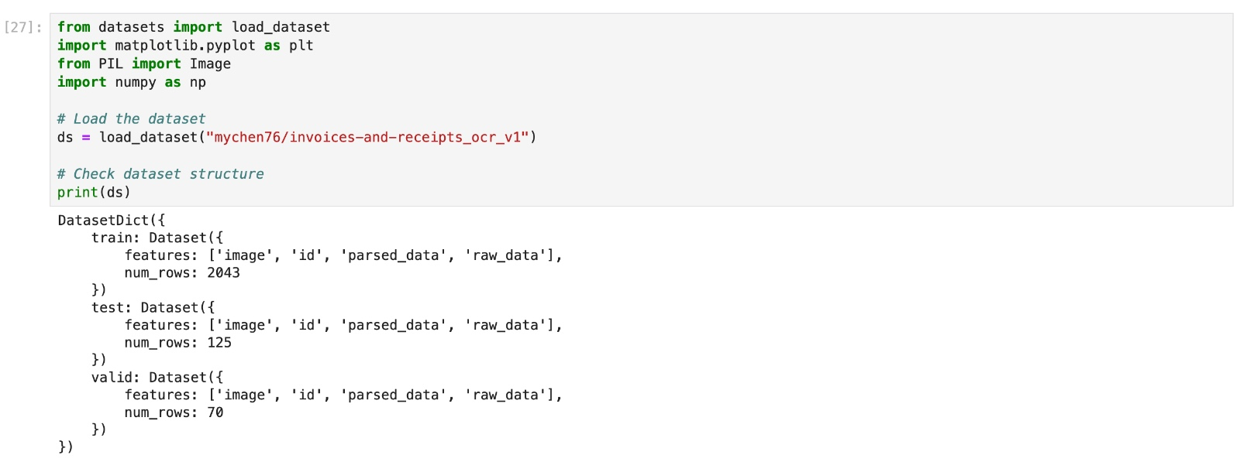
Importing necessary libraries and dataset

Slide 12
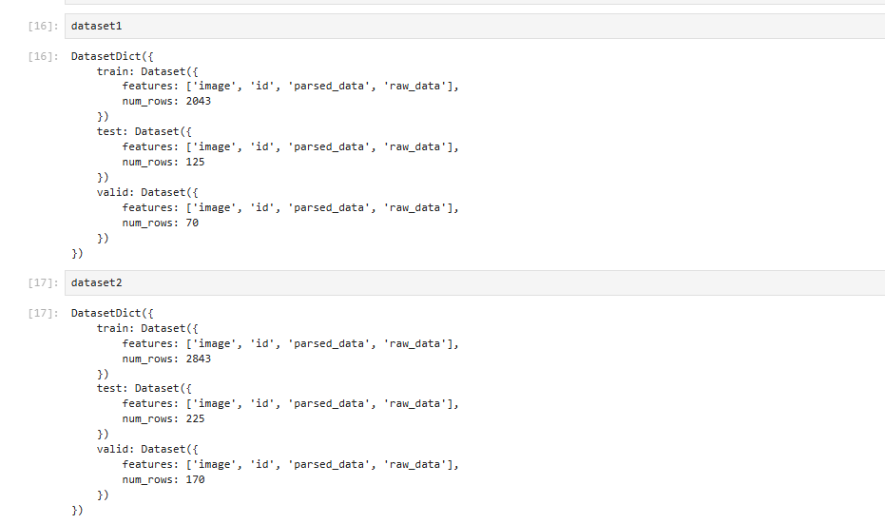
Dataset from Hugging Face link:mychen76/invoices-and-receipts_ocr_v1 · Datasets at Hugging Face

Slide 13
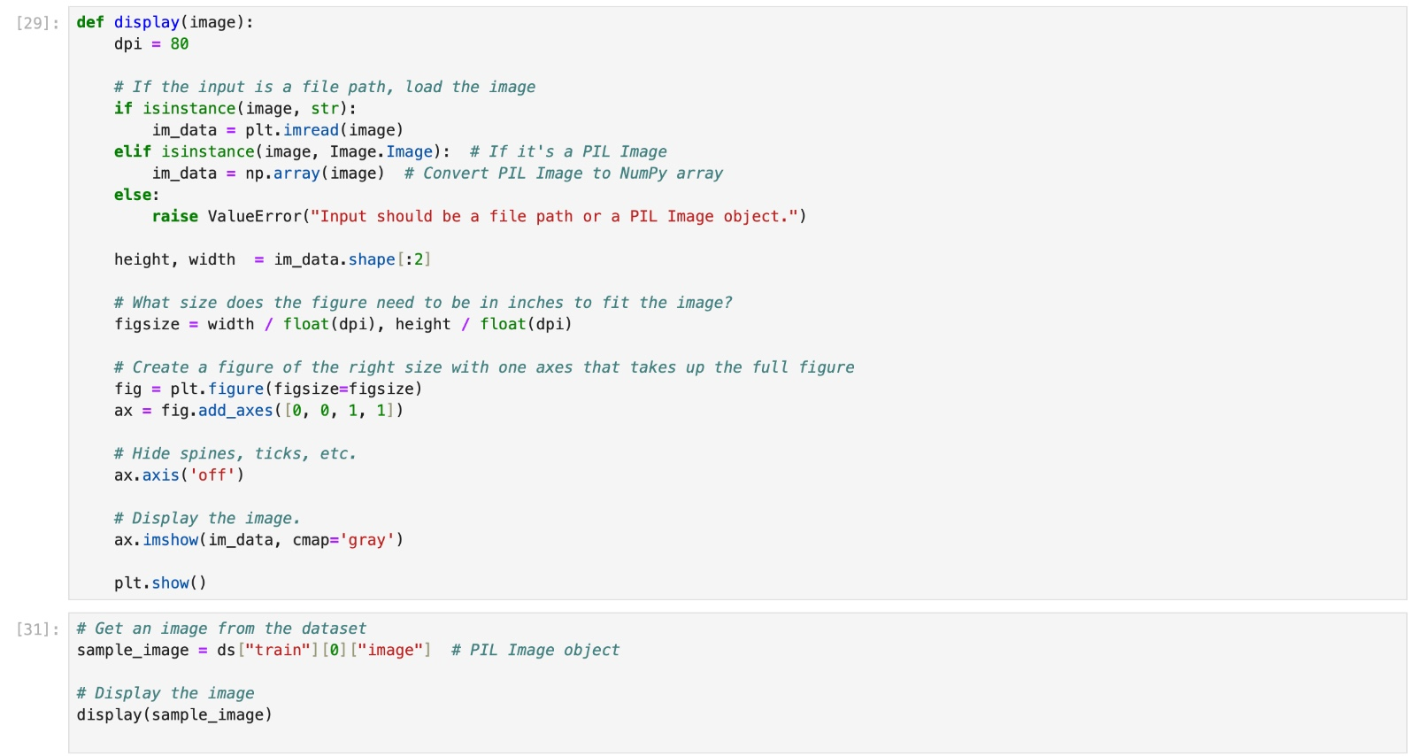
Code for displaying one of the image from the data set

Slide 14
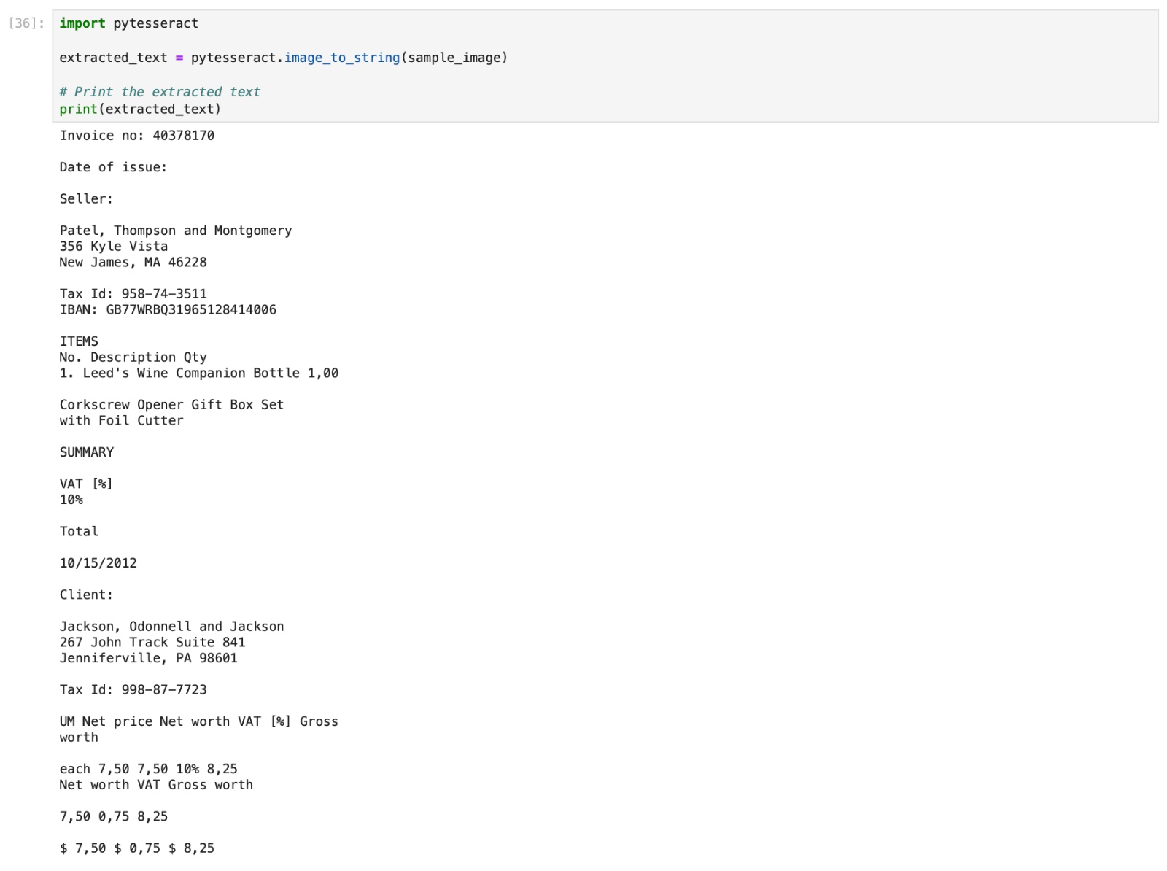
Code for extracting textusing pytesseract

Slide 15
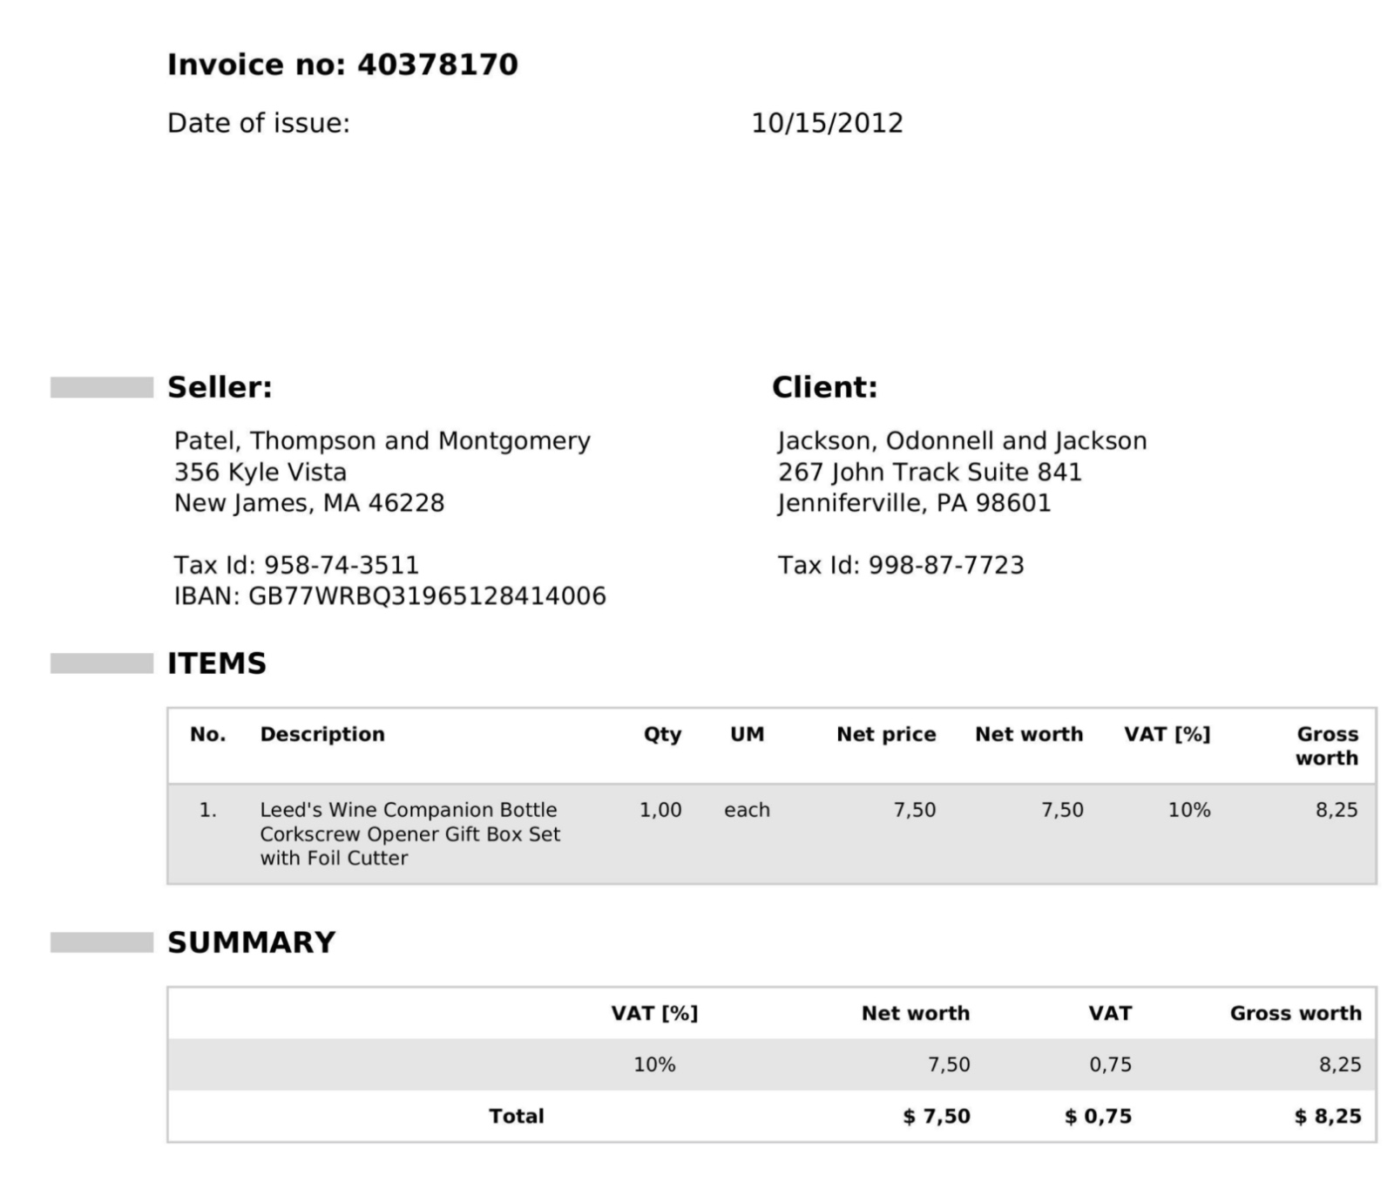
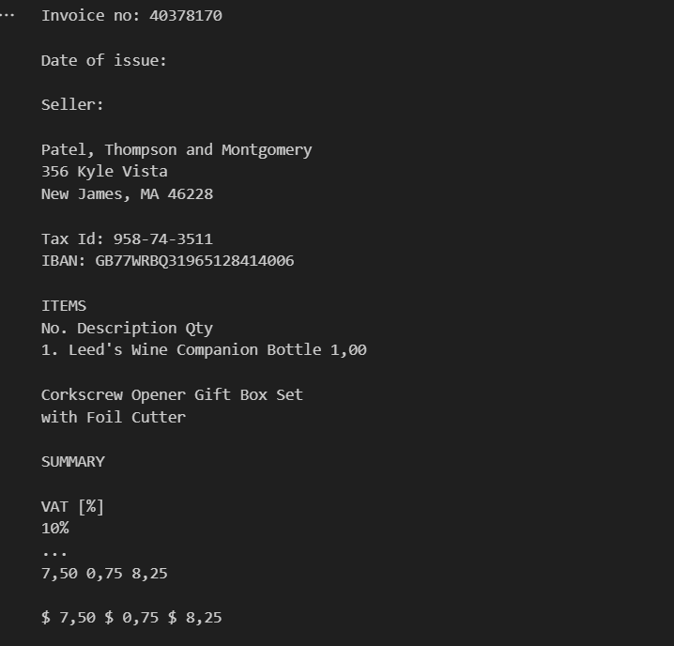
Input Image and output raw text

Slide 16
references
References
Fukuda, N., Nozue, H., & Oishi, H. (2025). Small Language Model Agent for the Operations of Continuously Updating ICT Systems. IEEE Access.
Kuzman, T., & Ljubešić, N. (2025). LLM Teacher-Student Framework for Text Classification With No Manually Annotated Data: A Case Study in IPTC News Topic Classification. IEEE Access.
Lowe, M., Prusa, J. D., Leevy, J. L., & Khoshgoftaar, T. M. (2024). Advancing Machine Learning with OCR2SEQ: An Innovative Approach to Multi-Modal Data Augmentation. Journal of Big Data.
Martínek, J., Lenc, L., & Král, P. (2020). Building an Efficient OCR System for Historical Documents with Little Training Data. Neural Computing and Applications.
Ponnurua, M., Ponmalar, S., Likhitha, A., Sree, T., & Chaitanya, G. (2024). Image-Based Extraction of Prescription Information Using OCR-Tesseract. Procedia Computer Science.

