Slide 1

Plant Disease Detection using Leaf Images and Deep Learning
22AIE304-Deep Learning
TEAM 9
CH.SC.U4AIE23033 – M. Likhith Reddy
CH.SC.U4AIE23035 – N. Harshith Varma
CH.SC.U4AIE23038 – N. Charan

Slide 2
Problem Statement
Plant diseases significantly reduce crop yield and quality, threatening food security and farmer income. Traditional detection methods require expert knowledge and manual observation, which are often unavailable to rural or small-scale farmers.
This project aims to develop an intelligent, automated system capable of detecting plant diseases from leaf images using Convolutional Neural Networks (CNNs). By leveraging deep learning and transfer learning with MobileNetV2 on the PlantVillage dataset, the system can accurately identify various plant diseases. This enables early diagnosis, minimizes unnecessary pesticide usage, and supports sustainable agricultural practices through data-driven decision-making.

Slide 3
Agenda
Introduction
Agriculture is vital for global food security, yet plant diseases remain a major threat to crop yield and farmer income. Traditional disease detection methods rely on manual inspection and expert knowledge, which are often slow, expensive, and inaccessible to many farmers. This highlights the need for an automated, intelligent system that can identify plant diseases accurately and efficiently.
In this project, a deep learning–based plant disease detection model is developed using TensorFlow and Keras with MobileNetV2 architecture. Trained on the PlantVillage dataset, the model analyzes leaf images to classify different plant diseases with high accuracy. By enabling early detection, this system helps farmers take timely action, reduce crop loss, and promote sustainable agricultural practices.

Slide 4
OBJECTIVES:
Disease Detection – Develop a deep learning model to automatically identify plant diseases from leaf images.
High Accuracy – Achieve classification accuracy above 90% using transfer learning.
Early Diagnosis – Enable timely detection of crop diseases to reduce losses and improve yield.
Farmer-Friendly Solution – Design a system that is simple, accessible, and usable by non-experts.
Sustainability – Reduce excessive pesticide use and promote eco-friendly farming practices.

Slide 5
DATASET:
The dataset utilized for this study comprises a curated collection of leaf images representing four distinct plant species: corn (maize), pepper bell, potato, and tomato. It encompasses a total of 11 unique classes, which include both healthy and diseased specimens. Specifically, the corn category is represented by three classes: Cercospora Leaf Spot (Gray Leaf Spot), Common Rust, and a healthy state. The pepper bell category includes images showing Bacterial Spot and a healthy condition. For potatoes, the dataset includes the two major fungal diseases, Early Blight and Late Blight, alongside healthy leaves. The tomato category, which is the most heavily represented in terms of sample size, includes images afflicted with Tomato Yellow Leaf Curl Virus and Tomato Mosaic Virus, in addition to healthy tomato leaves. This distribution provides a focused yet diverse foundation for developing a multi-class, multi-species plant disease detection model.

Slide 6
Agenda
Methodology
1. Dataset Collection and Preparation
Source: PlantVillage dataset containing images of healthy and diseased plant leaves.
Data Organization: Images stored in folders corresponding to each class.
Image Preprocessing:
  Resize to uniform dimensions (128×128 for CNN/ML, 224×224 for MobileNetV2).
  Convert images to RGB.
  Normalize pixel values (scale to [0,1]).
Label Encoding: Convert categorical class labels into numerical format.
Optional Subsetting: Limit to ~400 images per class to balance dataset.

Slide 7
Agenda
Methodology
2. Data Augmentation (for CNN and MobileNetV2)
Apply transformations to increase dataset diversity and reduce overfitting:
  Random rotations
  Width and height shifts
  Zoom
  Horizontal flips
3. Model Development
a. Traditional CNN
Architecture:
  4 convolutional blocks: Conv2D → BatchNormalization → MaxPooling2D
  Flatten layer
  Dense(512) + Dropout
  Output Dense layer with softmax activation

Slide 8
Agenda
Methodology
Training:
  Optimizer: Adam
  Loss: Sparse Categorical Crossentropy
  Epochs: 15, Batch size: 32
b. MobileNetV2 (Transfer Learning)
Transfer Learning: Use pretrained MobileNetV2 as feature extractor.
  Frozen layers: Base MobileNetV2 layers
  Trainable layers: Custom top layers (Pooling → Dense → Dropout → Output)
Advantages: Lightweight, faster training, high accuracy
Training:
  Optimizer: Adam
  Epochs: 10, Batch size: 32

Slide 9
Agenda
Methodology
c. Classical ML (Random Forest)
Feature Extraction: Flattened images, standardized with StandardScaler, dimensionality reduced via PCA (150 components).
Model: Random Forest classifier with 150 trees
Evaluation Metrics: Accuracy, classification report, confusion matrix
4. Model Evaluation
Cross-Validation: 5-Fold Stratified K-Fold applied to all models.
Metrics:
  Accuracy per fold
  Classification report (precision, recall, F1-score)
  Visualization:
  Training & validation accuracy/loss plots (for CNN and MobileNetV2)
  Confusion matrix heatmaps (for Random Forest)

Slide 10
Agenda
Methodology
5. Result Recording and Output
Save best-trained models per fold.
Store accuracy/loss plots and fold-wise performance summaries in output directory.
Compute average accuracy and standard deviation across folds.

Slide 11
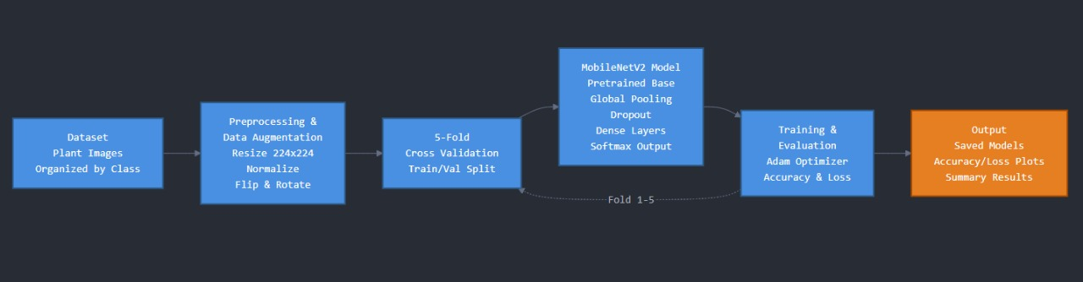
Agenda
ARCHITECTURE DIAGRAM:

Slide 12
Agenda
Motivation
Crop yield and quality are heavily affected by plant diseases, leading to significant economic losses for farmers.
Manual disease detection is slow, requires expertise, and is often unavailable in rural areas.
Early and accurate detection can reduce pesticide usage, save costs, and improve crop health.
Deep learning models, like CNNs and tensorflow, can automatically detect diseases from leaf images with high accuracy.
Enables real-time, on-field diagnosis, supporting farmers in timely intervention.
Promotes sustainable agriculture and food security by minimizing crop losses.

Slide 13
Agenda
Literature Review
S.NO | Title | Author Journal Year | Methodology/Algorithms/Architecture used | Merits | Demerits | Research gap
1. | Innovative deep learning approach for cross-crop plant disease detection: A generalized method for identifying unhealthy leaves. | Imane Bouacida ª, Brahim Farou ª, Lynda Djakhdjakha ª, Hamid Seridi ª, Muhammet Kurulay ^{b} DOI: https://doi.org/10.1016/j.inpa.2024.03.002 | Methodology Objective: To develop a generalized deep learning system that can identify plant diseases across different crops, even those not included in the training dataset. Data Collection and Preparation: Utilized the PlantVillage dataset, a comprehensive benchmark dataset for plant disease classification. Additional unseen datasets were used to test generalization ability. Leaf images were segmented to isolate small diseased regions instead of the whole leaf. | High Generalization Capability: Performs well on unseen crops and disease types. Focus on Diseased Regions: Region-based recognition enhances robustness against variation in leaf shape, color, and background. Lightweight Architecture: Small Inception model offers efficiency without sacrificing accuracy. Excellent Accuracy: Achieved state-of-the-art performance on benchmark and unseen datasets. | Dependence on High-Quality Images: Model performance may degrade with poor lighting or noisy field images. Limited Environmental Diversity: May not fully capture variations from real-world field conditions (humidity, weather, camera types). Region Segmentation Complexity: Accurate isolation of diseased regions can be computationally demanding. | Real-World Field Validation: Needs testing on diverse real-time field datasets with varying illumination, occlusion, and weather conditions. Explainable AI Integration: Incorporate visualization tools (e.g., Grad-CAM) to help farmers and agronomists interpret predictions. Multimodal Learning: Combine image data with environmental or sensor data (temperature, humidity) for improved prediction accuracy.

Slide 14
S.NO | Title | Author Journal Year | Methodology/Algorithms/Architecture used | Merits | Demerits | Research gap
2. | Image-based crop disease detection using machine learning | Aria Dolatabadian1 | Ting Xiang Neik 2,3 | Monica F. Danilevicz1,4 |Shriprabha R. Upadhyaya1,4 | Jacqueline Batley1,5 | David Edwards1,4,5 DOI:https://doi.org/10.1111/ppa.14006 | Objective: To provide a comprehensive review and synthesis of research on crop disease detection using image-based machine learning techniques, highlighting progress, challenges, and opportunities. Data Collection and Literature Review: The authors collected and analyzed existing research papers on ML- and AI-based approaches for crop disease detection. Included studies that applied imaging technologies such as RGB, multispectral, and hyperspectral imaging for identifying crop diseases. Focused on both controlled laboratory studies and field-based applications. | Comprehensive Synthesis: Consolidates a wide range of studies, providing a holistic view of current advancements in crop disease detection. Bridges Research and Practice: Offers guidance for practical deployment in real-world agricultural settings. Covers Multiple Technologies: Examines RGB, hyperspectral, UAV, and satellite-based imaging methods. Algorithm Comparison: Evaluates performance differences among traditional ML and deep learning models. | Lack of Experimental Validation: As a review paper, it doesn’t include original experiments or empirical testing. Data Diversity Limitation: May not fully represent all geographical or crop-specific conditions due to limited dataset coverage in existing studies. Absence of Standard Benchmarking: No unified evaluation metrics across reviewed methods. Limited Focus on Real-Time Systems: Most studies reviewed deal with laboratory or controlled environments rather than in-field deployment. | Standardized Datasets and Benchmarks: There is a need for large, publicly available, annotated datasets representing diverse crops, regions, and lighting conditions. Field-Based Validation: More emphasis on real-world testing under varying environmental conditions. Explainable AI for Agriculture: Future systems should provide interpretable outputs understandable by farmers. Multimodal Data Fusion: Integration of sensor data (temperature, humidity) with image data can improve robustness. .

Slide 15
S.NO | Title | Author Journal Year | Methodology/Algorithms/Architecture used | Merits | Demerits | Research gap
3. | Revolutionizing crop disease detection with computational deep learning a comprehensive review | Habiba N. Ngugi, Absalom E. Ezugwu, Andronicus A. Akinyelu & Laith Abualigah DOI:https://doi.org/10.1007/s10661-024-12454-z | Methodology Objective: To comprehensively review and evaluate recent advancements in digital image processing techniques using machine learning (ML) and deep learning (DL) for the detection, classification, and severity assessment of crop diseases. Literature Review Process: Collected and analyzed contemporary studies focusing on the use of CNN, KNN, SVM, ANN, and other DL models for crop disease detection. Compared different datasets, architectures, and preprocessing methods used in prior research. Evaluated performance metrics such as accuracy, precision, recall, and F1-score from various studies to identify strengths and weaknesses of existing models. | Comprehensive Coverage: Reviews a wide spectrum of ML and DL algorithms used in crop disease detection. Performance Benchmarking: Evaluates and compares different models based on real experimental metrics. Identifies Key Trends: Highlights the dominance of CNNs and the emerging potential of novel architectures like Vision Transformers. Dataset Evaluation: Analyzes limitations and strengths of popular datasets such as PlantVillage. | No Experimental Validation: The paper is purely a review and does not include original experiments or implementation results. Limited Quantitative Analysis: Relies heavily on reported results without unified comparison metrics. Dataset Bias: Most reviewed studies depend on datasets tailored to specific crops or controlled environments. | Need for Unified Frameworks: Current models focus on individual diseases or single algorithms. There is a need for ensemble or hybrid systems combining ML and DL to handle multiple diseases effectively. Diverse and Comprehensive Datasets: Development of large, generalized image datasets that cover multiple crops, diseases, and environmental conditions. Adoption of Emerging Architectures: Limited exploration of Capsule Networks, Vision Transformers, and Graph Neural Networks (GNNs) for crop disease detection.

Slide 16
S.NO | Title | Author Journal Year | Methodology/Algorithms/Architecture used | Merits | Demerits | Research gap
4. | Deep Learning for Plant Disease Detection | Munaf Mudheher Khalid1, Oguz Karan1,*1Altinbas University, 34217 İstanbul, Turkiyemalmoudher97@gmail.com; oguz.karan@altinbas.edu.tr DOI:10.59543/ijmscs.v2i.8343 | Dataset Preparation A collection of plant leaf images was used, containing samples of both healthy and diseased plants. Images were preprocessed using resizing, normalization, and augmentation techniques (e.g., rotation, flipping) to enhance model generalization and prevent overfitting. Model Design and Training Two Deep Learning models were implemented: Convolutional Neural Network (CNN) – built from scratch or adapted for disease classification. MobileNet – a lightweight pre-trained model optimized for computational efficiency and mobile deployment. Both models were trained to classify plant diseases based on visual symptoms in leaf images. Training parameters such as learning rate, batch size, and epochs were tuned for optimal performance. | High Accuracy: Both CNN and MobileNet achieved strong classification results, proving DL’s reliability in disease detection. Use of XAI: Grad-CAM adds transparency, making the model’s predictions interpretable and trustworthy. Automation: Reduces dependency on manual disease detection, saving time and labor. Scalable: Can be integrated into mobile applications for on-field plant monitoring. | Dataset Dependence: Performance heavily depends on dataset quality, diversity, and size. Computational Cost: CNN training requires significant computational resources and time. Limited Generalization: Models may underperform on unseen diseases or environmental variations (lighting, background). | Limited Dataset Coverage: Current models may not cover all plant species or disease variations. Absence of Real-Time Implementation: The study focuses on lab-based validation; deployment in real agricultural environments is missing. Environmental Robustness: The effect of varying illumination, camera quality, and environmental noise on model performance is not analyzed. Lack of Hybrid Approach: Integration of image-based and sensor-based data (like temperature or humidity) could improve accuracy.

Slide 17
S.NO | Title | Author Journal Year | Methodology/Algorithms/Architecture used | Merits | Demerits | Research gap
5. | Automatic recognition of Rice Plant leaf diseases detection using deep neural network with improved threshold neural network | K. Mahadevan ª, A. Punitha ^{b}, J. Suresh ^{c} DOI:https://doi.org/10.1016/j.prime.2024.100534 | Dataset Preparation The dataset includes images of healthy and diseased rice plant leaves collected from real agricultural environments. Images are preprocessed to standardize lighting, resolution, and background noise before being fed into the model. Image Enhancement (ITNN – Improved Threshold Neural Network) The Improved Threshold Neural Network (ITNN) method is applied to enhance image quality by adjusting brightness, contrast, and thresholding. This step ensures that disease symptoms (spots, discoloration, lesions) are clearly visible for subsequent segmentation. | High Detection Accuracy: The hybrid approach using GAN with spectral analysis improves classification precision. Reduced False Rate: Significantly lowers false detections compared to traditional CNN and AlexNet models. Enhanced Image Quality: ITNN preprocessing ensures better visibility of disease features. Improved Segmentation: SMNS accurately isolates diseased regions, overcoming previous segmentation issues. | High Computational Complexity: The combination of ITNN, SMNS, S2AFS, S2O-FCW, and DSGAN2 increases processing time. Large Dataset Requirement: GAN-based networks require extensive and balanced datasets to train effectively. Difficult Model Interpretation: GAN architectures are often considered “black boxes,” making interpretability challenging. | Lack of Real-Time Implementation: The study does not explore real-time detection or deployment on mobile/IoT platforms. Absence of Explainable AI (XAI): The model lacks interpretability mechanisms to explain how predictions are made. Dataset Diversity: The dataset used may not include different lighting, weather, or soil conditions, limiting generalization. Computational Efficiency: Further optimization is needed to reduce training time and resource usage for field-level applications.

Slide 18
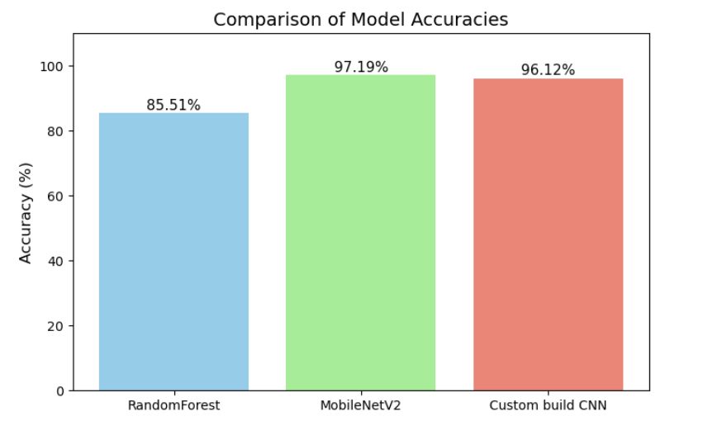
Agenda
RESULTS AND DISCUSSIONS:
Accuracies of Models:

Slide 19
Agenda
RESULTS AND DISCUSSIONS:
Class-wise Error Analysis
To better understand the performance of the three models—Random Forest, Custom CNN, and MobileNetV2—we performed a class-wise error analysis using the recall metric. The error rate for each class is calculated as:
Error Rate = 1- Recall
This analysis highlights which classes each model struggled to classify correctly, helping identify potential areas for improvement.

Slide 20
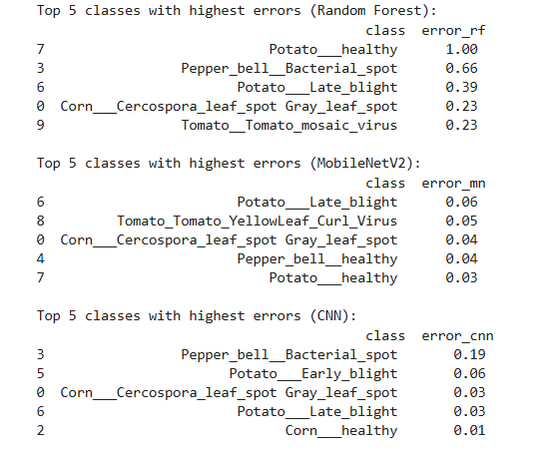
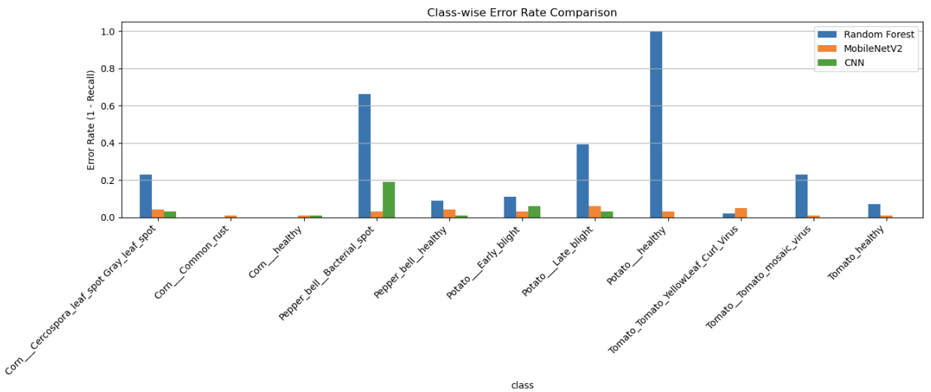
Agenda
RESULTS AND DISCUSSIONS:
Class-wise Error Analysis

Slide 21
Agenda
CONCLUSION:
This project successfully implemented and compared three approaches—Random Forest, a custom CNN, and MobileNetV2 transfer learning—for plant disease detection. The deep learning models (CNN and MobileNetV2) achieved high accuracy (97% and 96%) and effectively captured image features, outperforming the traditional Random Forest (85%), which struggled with underrepresented classes. MobileNetV2, with frozen pre-trained layers, offered faster training and a lightweight architecture suitable for deployment. Class-wise analysis highlighted challenges in rare disease classes, emphasizing the importance of data augmentation and balanced datasets. Overall, the project demonstrates that AI-based methods can provide reliable and scalable solutions for early plant disease detection, with potential for integration into real-time agricultural applications.

Slide 22
THANK YOU

