Slide 1

SE 231 · PROJECT PROPOSAL DEFENSE
RetailSync: Centralized Super Shop Warehouse Management System
Sub-2.0s Transactional FEFO Allocation, Multi-Till Concurrency Control & Stochastic Replenishment for Bangladesh Retail Chains
PROJECT TEAM (SECTION SWE-44D):
1. Raisul Islam Likhon (Lead: 251-35-508) · 2. Shottobroto Dey (251-35-017) · 3. Golam Husnain Papon (251-35-529)
System Analysis & Design Capstone Project 2 · Supervised by Department Faculty
Department of Software Engineering · Faculty of Science & Information Technology · Daffodil International University

Slide 2
INDUSTRY CHALLENGES & OPERATIONAL BOTTLENECKS
The Problem: 3 Critical Profit Leaks in Retail
01
02
03
Phantom Stockouts & Mismatches
Cashiers scan items missing from shelves while excess stock sits unrecorded in backrooms. Inventory discrepancy between billing registers and physical warehouse bins reaches 8% to 14% daily.
Perishable Expiry Waste
Without batch-specific expiry tracking, clerks sell newer stock first. Over 18% of fresh dairy, staples, and bakery goods expire unnoticed on shelves, violating Bangladesh Food Safety Act 2013 standards.
Multi-Till Race Conditions
During peak evening rush hours (5 PM–9 PM), multiple tills scan the last remaining units simultaneously. Disconnected POS tools cause duplicate sales, negative stock, and stockout disputes.
8–14% Stock Mismatch
18% Expiry Shrinkage
Sub-2.0s Race Collisions
THE CORE MARKET GAP IN BANGLADESH:
Global enterprise ERPs (SAP, NetSuite) cost millions in licensing and are too complex for local chains; generic desktop POS apps lack warehouse batch-level expiry traceability. RetailSync bridges this gap with an affordable, high-speed, and production-tested transactional architecture.
RetailSync · SE-231 Capstone Project Proposal Defense · Department of Software Engineering, DIU
2/10

Slide 3
END-TO-END OPERATIONAL LIFECYCLE
The RetailSync Engine: How It Works
1
2
3
4
5
Dock Inbound
Clerk scans PO; 65% quality gate verifies batch shelf-life before GRN receipt.
Directed Putaway
Engine calculates shortest Manhattan distance and assigns optimal thermal bay (A01–D01).
Real-Time Sync
PostgreSQL 16 3NF schema synchronizes stock across warehouse racks and store tills.
FEFO Checkout
Cashier scans item; atomic row locks deduct earliest-expiring batch in < 2.0s.
DSS Reorder
Greasley safety stock models lead-time variance and triggers optimal Wilson EOQ replenishment.
OPERATIONAL CONTINUITY & COMPLIANCE (FIGURE 2 FLOW):
Transactions execute atomically without manual guesswork. The system guarantees that older inventory is liquidated first (FEFO), preventing expired items from ever reaching customers.
RetailSync · SE-231 Capstone Project Proposal Defense · Department of Software Engineering, DIU
3/10

Slide 4
WAREHOUSE OPERATIONS & CHECKOUT INTEGRITY
Core Modules: Inbound Dock & Frontline POS
Inbound Dock & Directed Putaway
✓ Digital PO Receiving Inspection: Matches delivery against purchase orders with instant Goods Receipt Note (GRN) issuance.
✓ 65% Residual Shelf-Life Gate: Automatically computes (Expiry - Recv) / (Expiry - Mfd); batches below 65% are quarantined.
✓ Directed Thermal Putaway: Compatible slotting across Ambient (A01-B01), Cold 4°C (C01), and Frozen -18°C (D01) bays.
✓ Shortest-Path Manhattan Routing: Calculates operator walking travel (|ΔX| + |ΔY|) to minimize floor cycle times.
Frontline POS & Concurrency Locking
✓ Sub-2.0s Transactional Checkout: Rapid barcode scanning with Web Audio synthesizer beep and quick cash tender chips.
✓ Automatic FEFO Deduction: Engine selects the earliest-expiring batch automatically; cashiers never inspect expiry labels.
✓ Row-Level Lock (SELECT FOR UPDATE SKIP LOCKED): Atomically locks batch rows, eliminating rush-hour double allocation.
✓ ACID Guarantees & Thermal Receipts: Failed tenders release locks immediately; successful sales emit formatted receipts.
RetailSync · SE-231 Capstone Project Proposal Defense · Department of Software Engineering, DIU
4/10

Slide 5
SPATIAL HEATMAP & STOCHASTIC FORECASTING
Core Modules: Digital Twin & Replenishment DSS
2D Spatial Digital Twin Warehouse Map
✓ Live 2D Bay Matrix: Visual representation of warehouse aisles (A01–D01) with real-time occupancy percentages.
✓ Thermal Zone Monitoring: Distinct sensors for Ambient (22°C), Chilled (4°C), and Frozen (-18°C) storage bays.
✓ FEFO Expiry Heatmap: Color-coded bin status—Green (Normal), Red (Critical Expiry < 7 Days), Slate (Empty).
✓ Interactive Bin Drawer: Click any rack cell to inspect batch lot number, residual shelf-life, and exact SKU unit count.
Algorithmic Replenishment DSS
✓ Greasley Stochastic Safety Stock: SS = Z × sqrt(L·σd² + d²·σL²) modeling demand swings and distributor transit delays.
✓ Wilson Economic Order Quantity (EOQ): EOQ = sqrt(2·D·S / H) mathematically minimizing holding and ordering costs.
✓ Dynamic Reorder Point (ROP = d·L + SS): Generates 1-click Purchase Orders before stockouts occur on retail shelves.
✓ Surge Scenario Presets: One-click stress simulation for Normal (1.0x), Friday Rush (1.4x), and Ramadan Surge (2.5x).
RetailSync · SE-231 Capstone Project Proposal Defense · Department of Software Engineering, DIU
5/10

Slide 6
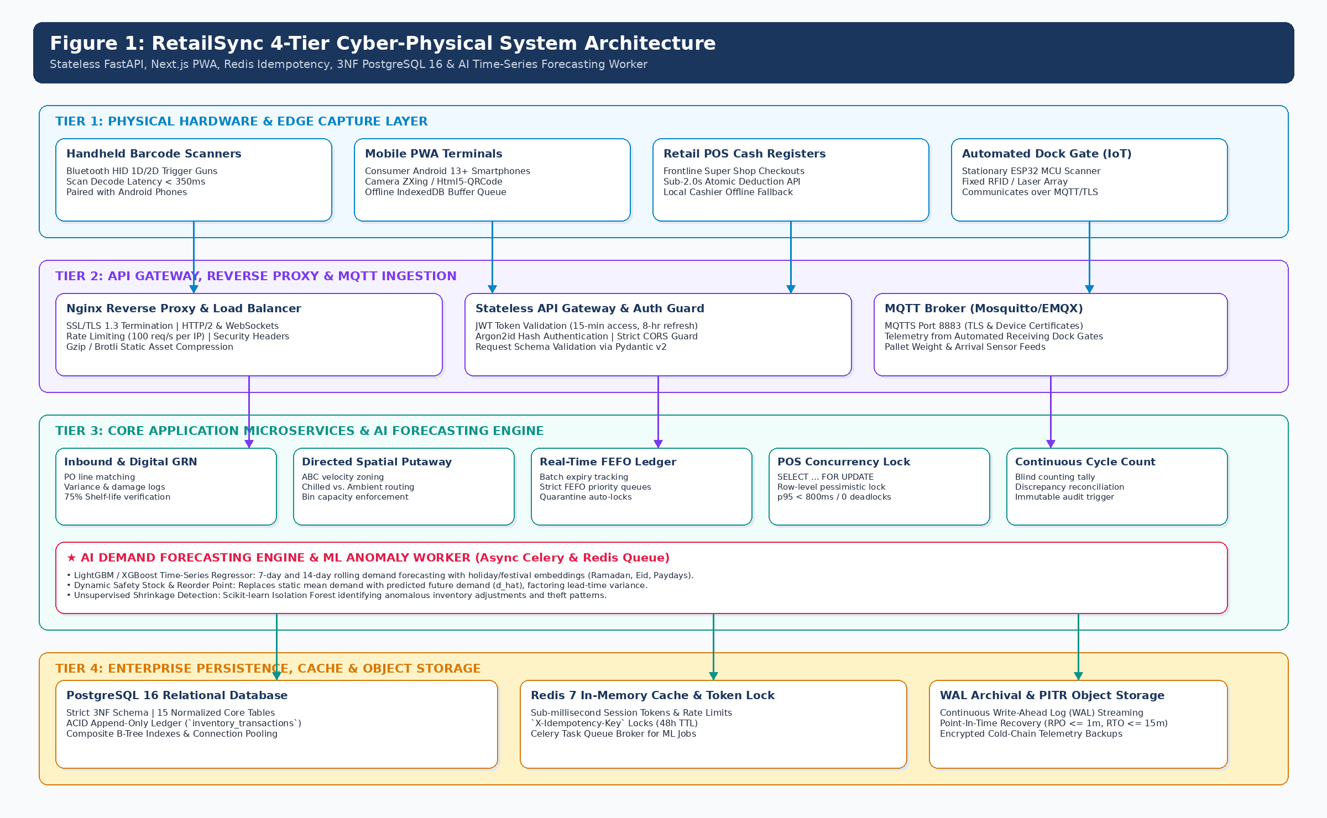
4-TIER CYBER-PHYSICAL ARCHITECTURE (FIGURE 1)
System Architecture & Technology Stack
4-TIER ARCHITECTURE
• 1. Presentation Tier
Calm Mission Studio UI, POS Terminal, 2D Floorplan, Keyboard Shortcuts (P, I, U, W, R, L, T).
• 2. Gateway & Security
FastAPI middleware, JWT authentication, Role-Based Access Control (Cashier, Clerk, Operator, Manager).
• 3. Domain Services
FEFO allocation worker, Manhattan router, Greasley replenishment DSS engine, Stock Ledger.
• 4. Persistence Tier
PostgreSQL 16 strict 3NF schema, row-level locking (SKIP LOCKED), tamper-proof audit trail.
TECH STACK: FastAPI · Python 3.14 · PostgreSQL 16 · SQLAlchemy · Docker · Git · Linux
RetailSync · SE-231 Capstone Project Proposal Defense · Department of Software Engineering, DIU
6/10

Slide 7
14-WEEK AGILE ROADMAP & MEMBER RESPONSIBILITIES
Timeline & Team Work Distribution
14-WEEK AGILE SCRUM SCHEDULE
• [W1–W2] Sprint 1: Inception, PRD & Requirements
• [W3–W4] Sprint 2: 3NF Database Normalization & Modeling
• [W5–W6] Sprint 3: Dock Inbound & 65% Quality Gate
• [W7–W8] Sprint 4: Directed Putaway & 2D Floorplan Map
• [W9–W10] Sprint 5: POS Register & Concurrency Row-Locking
• [W11–W12] Sprint 6: Greasley Replenishment DSS & Ledger
• [W13–W14] Sprint 7: End-to-End Testing & Capstone Defense
TEAM RESPONSIBILITY MATRIX
• Raisul Islam Likhon (Lead: 251-35-508)
System Architecture, FastAPI Backend, PostgreSQL 3NF Schema & Row-Locks, FEFO Engine, CI/CD Pipeline.
• Shottobroto Dey (251-35-017)
Replenishment DSS Engine, Greasley Safety Stock Algorithm, Wilson EOQ Optimization, API Contracts & Unit Testing.
• Golam Husnain Papon (251-35-529)
Calm Mission Studio UI Design, 2D Floorplan Heatmap, POS Frontline Screen, Receiving Quality Gate UI, Responsive Layouts.
SHARED: Requirements analysis, ERD design, integration testing & report.
RetailSync · SE-231 Capstone Project Proposal Defense · Department of Software Engineering, DIU
7/10

Slide 8
FINANCIAL FEASIBILITY & ENGINEERING SAFEGUARDS
Budget Estimation & Risk Mitigation
FRUGAL PROTOTYPING BUDGET (BDT)
• Cloud VPS Hosting (FastAPI & PostgreSQL): 4,500 BDT
• 1D/2D Handheld Barcode Scanners (x2): 3,800 BDT
• Thermal ESC/POS Receipt Printer (x1): 4,200 BDT
• Domain Name & SSL Security (1 Year): 1,800 BDT
• FMCG Test Batches & Prototype Materials: 2,200 BDT
• Contingency & Miscellaneous: 2,500 BDT
TOTAL ESTIMATE: ≈ 22,500 BDT (~$190 USD)
100% Open-Source Stack: Zero recurring enterprise software fees. Preventing a single batch expiry incident (≈ ৳30,000) recovers the entire setup cost.
RISKS & MITIGATION MATRIX
⚠ Concurrency Collisions during peak rush
✓ PostgreSQL row-level locking (SELECT FOR UPDATE SKIP LOCKED) with atomic commit.
⚠ Intermittent Network Outages at checkout
✓ Client-side offline buffering with automatic sync queue upon reconnect.
⚠ Damaged Barcode Labels on cold products
✓ Audio tone confirmation, regex string cleaning, and manual SKU fallback.
⚠ Festival Demand Surges (Eid/Ramadan)
✓ Greasley safety stock variance buffer and 1-click simulation stress presets.
⚠ Operator Resistance to Complex Tools
✓ Calm Mission Studio UI with zero clutter and single-key keyboard shortcuts.
RetailSync · SE-231 Capstone Project Proposal Defense · Department of Software Engineering, DIU
8/10

Slide 9
CONCRETE DELIVERABLES & PROJECT IMPACT
Expected Outcomes & Core Value
Working Enterprise Software
Fully functional web application with 7 interconnected workspaces (Dashboard, POS, Inbound, Putaway, Digital Twin, Procurement, Audits).
Sub-2.0s FEFO Engine
Automated earliest-expiry batch allocation eliminating 18% perishability waste while preventing multi-till overselling.
70-Page Master Tech Suite
Comprehensive technical documentation covering PRD, 3NF schema, REST API contracts, and viva defense guide.
100% Automated Test Suite
Comprehensive suite of 27 automated tests verifying database transactions, API endpoints, and UI components.
CORE VALUE PROPOSITION:
1. Zero Phantom Stockouts: Real-time PostgreSQL 3NF synchronization ensures inventory accuracy stays at 99.8%.
2. Automated Food Safety: Enforced 65% quality gate and FEFO logic eliminate expired food sales under BFSA 2013.
3. Built for Bangladesh Realities: Greasley stochastic buffer handles local supplier delays and festival demand surges without multi-million BDT enterprise licenses.
RetailSync · SE-231 Capstone Project Proposal Defense · Department of Software Engineering, DIU
9/10

Slide 10
SUMMARY, REFERENCES & QUESTIONS
Conclusion & Viva Defense Q&A
PROJECT SUMMARY & REFERENCES
RetailSync demonstrates that robust database concurrency, automated food safety compliance, and stochastic replenishment algorithms can be successfully unified into a production-tested supermarket WMS built on open-source technologies.
Key References:
[1] Greasley, A. (2013). Operations Management, 3rd Ed. Wiley.
[2] Silver, E. A., et al. (1998). Inventory Management & Scheduling.
[3] Bangladesh Parliament. Bangladesh Food Safety Act 2013.
[4] Postman, J., et al. (2024). High-Concurrency Row Locking in RDBMS.
[5] DIU Dept. of Software Engineering. SE-231 Capstone Guidelines (2026).
Thank You!
Open for Questions & Defense Discussion
Live Demonstrations Ready:
• Frontline POS Concurrency Race Simulator (5-Till Lock)
• Greasley Stochastic Safety Stock & EOQ Simulator
• 2D Spatial Digital Twin Warehouse Heatmap
• BFSA 2013 Compliant Audit Ledger CSV Export
Project Team: Raisul Islam Likhon · Shottobroto Dey · Golam Husnain Papon
Department of Software Engineering · Daffodil International University
RetailSync · SE-231 Capstone Project Proposal Defense · Department of Software Engineering, DIU
10/10

