Slide 1

DAFFODIL INTERNATIONAL UNIVERSITY • FACULTY OF SCIENCE & INFORMATION TECHNOLOGY
Department of Software Engineering | Course: SE-231 (Software System Analysis & Design / Capstone Project 2)
CAPSTONE PROJECT PROPOSAL DEFENSE • FALL 2026
RetailSync: Centralized Super Shop Warehouse Management System
Real-Time POS Concurrency, Dynamic Putaway, FEFO Batch Tracking, and AI-Driven Replenishment
Sub-2.0s POS Latency
p95 ≤ 800ms • Zero Oversell
< 16,000 BDT Hardware
90% Capex Cut vs Zebra TC52
14-Week Scrum Plan
6 Sprints • 4 Validation Scenarios
Project Team: Raisul Islam Likhon (Lead: 251-35-508) • Shottobroto Dey (251-35-017) • Golam Husnain Papon (251-35-529)
Section: SWE-44D (44th Batch) • Department of Software Engineering • Daffodil International University (DIU)
Notes:
Opening Script: Good morning, respected course instructors and evaluation committee members. On behalf of my project team members Shottobroto Dey, Golam Husnain Papon, and myself Raisul Islam Likhon from Section SWE-44D, today I am proud to present our Capstone Project 2 proposal: 'RetailSync: Centralized Super Shop Warehouse Management System'. RetailSync addresses a critical engineering problem in the modern trade grocery sector of Bangladesh: the destructive disconnect between frontline retail checkout counters and central distribution warehouses. Over the next 10 minutes, we will demonstrate our problem formulation, grounded objectives, 4-tier architecture, AI replenishment algorithms, and 14-week execution roadmap.

Slide 2
PROBLEM STATEMENT & CONTEXT
Industry Problem: Disconnected Supermarkets & 3 Critical Profit Leaks
The Modern Retail Landscape in Bangladesh
• Rapid Urban Expansion: ~65.2M urban citizens (39.7% national share, BBS 2022) increasingly rely on modern supermarkets like Shwapno (450+ outlets), Agora, Meena Bazar, and Unimart.
• Frontline vs Back-office Chasm: POS billing counters have modernized, but back-of-house warehouses still operate on paper manifests, pen-and-paper clipboards, and delayed manual Excel sheets.
• Batch Blindness: Standard POS software tracks only bulk SKU numbers. When shelves are restocked, newer milk or oil cartons are stacked in front, leaving older batches rotting at the back.
• Delayed Replenishment: Reorder decisions take 6 to 12 hours to reach central warehouses, causing severe stockouts during peak Friday and Ramadan shopping rushes.
LEAK 1: EXPIRY WASTE
15% to 22% Perishable Food & Dairy Spoilage
Older batches rot unnoticed at the rear of shelves due to lack of FEFO batch tracking. Selling expired milk violates the Bangladesh Food Safety Act 2013 and causes millions in losses.
LEAK 2: PHANTOM INVENTORY
1.8% to 2.4% Phantom Shrinkage & Unrecorded Damage
A severe disconnect between database records and physical shelf reality caused by unrecorded carton tears, internal theft, and delayed reconciliations.
LEAK 3: LOST SALES SURGE
7.5% to 11.2% Peak-Hour Stockout Revenue Losses
Cooking oil, sugar, and milk run out within minutes during Friday evenings and Ramadan rushes. Non-atomic POS deductions delay warehouse replenishment by hours.
RetailSync (SE-231 Capstone Project 2) • Department of Software Engineering, Daffodil International University | Slide 2 of 12
Notes:
Slide 2 Script: In Bangladesh, modern grocery chains are growing rapidly, but behind the shiny checkout counters, warehouse operations are fragile. The primary problem is the disconnect between front-of-house POS registers and back-of-house warehouses. This disconnect causes three crippling profit leaks: First, 15% to 22% perishable food and dairy spoilage because staff don't have batch-level expiry tracking. Second, 1.8% to 2.4% phantom shrinkage where the system claims stock exists but the shelf is empty. And third, 7.5% to 11.2% lost sales when high-velocity items sell out during evening and festival rushes. RetailSync directly solves all three.

Slide 3
ACADEMIC RIGOR & GROUNDING
Defending Proposal Claims: Grounded Epistemological Taxonomy
Why We Ground Every Value
• Eliminating Arbitrary Figures: In capstone defenses, student proposals are often challenged if numbers appear fabricated. We explicitly categorize every single claim.
• Three Strict Epistemological Classes:
1. Literature Baselines: Published field research (BSOA, FAO, NRSS).
2. Engineering SLOs: Testable benchmarks verified with Locust.
3. Simulation Assumptions: Controlled pilot mathematical models.
• Zero Hand-Waving: Every percentage, latency threshold, and cost savings target is tied directly to a verifiable test protocol.
Metric / Parameter | Claimed Value | Classification | Source & Verification Protocol
Perishable Spoilage | 15% to 22% annual loss | Literature Baseline | BSOA 2024 Report & FAO Post-Harvest Study
Phantom Shrinkage | 1.8% to 2.4% loss | Industry Baseline | NRSS Supermarket Shrinkage Survey
Peak Stockout Losses | 7.5% to 11.2% lost sales | Industry Baseline | IHL Group Retail Out-of-Stock Index
POS Checkout Latency | ≤ 2.0s (p95 ≤ 800ms) | Engineering SLO | Locust load test with PostgreSQL row locks
Barcode Scan Latency | ≤ 350ms visual decode | Hardware SLO | Android camera/Bluetooth trigger test
Post-Launch Spoilage | < 6% annual wastage | Simulation Target | Modeled FEFO queue + automated quarantine
Hardware Station Cost | < 16,000 BDT (90% cut) | Budget Benchmark | Android phone + Bluetooth trigger vs Zebra
RetailSync (SE-231 Capstone Project 2) • Department of Software Engineering, Daffodil International University | Slide 3 of 12
Notes:
Slide 3 Script: To ensure our proposal has defense-grade academic rigor, we did not pick numbers out of thin air. We classified every single claimed metric into three epistemological tiers: First, published literature baselines like the 15% to 22% spoilage reported by the Bangladesh Supermarket Owners Association and UN FAO. Second, empirical engineering SLOs that we will benchmark directly using automated Locust tests—such as our sub-2.0s POS deduction latency and sub-350ms barcode decode. And third, modeled simulation targets like reducing spoilage to under 6% through strict FEFO rotation.

Slide 4
OBJECTIVES & EVALUATION CRITERIA
Quantitative SMART Project Objectives (O-01 to O-05)
O-01: Sub-Second POS Concurrency & ACID Integrity
Execute atomic stock deductions from retail cash registers via PostgreSQL row-level locks (SELECT ... FOR UPDATE), achieving p95 latency ≤ 800ms and p99 ≤ 1.5s with zero deadlocks across 10 concurrent registers.
Verification: Gate: Locust load test simulating 10 concurrent cashiers competing for the last inventory batch. [Sprint 4 (Weeks 7–8)]
O-02: Automated FEFO Priority & Food Safety Quarantine
Enforce database-level First-Expired, First-Out allocation ensuring 100% of store replenishment orders pick earliest expiring batches; automatically quarantine stock reaching ≤ 3 days to expiry, reducing spoilage from 22% to < 6% in pilot simulations.
Verification: Gate: Automated Pytest batch sorting assertions & Celery quarantine triggers. [Sprint 3 (Weeks 5–6)]
O-03: AI-Driven Demand Forecasting & Dynamic Replenishment
Deploy a Machine Learning Time-Series Forecasting engine (LightGBM/XGBoost) achieving MAPE ≤ 15% on high-velocity FMCG items; dynamically compute Reorder Points (ROP) using Greasley's Safety Stock with calendar festival embeddings (Ramadan, Eid).
Verification: Gate: 12-month walk-forward backtesting against historical FMCG sales series. [Sprint 5 (Weeks 9–10)]
O-04: Frugal Hardware Architecture & Sub-350ms Scanning
Engineer a mobile Progressive Web Application (PWA) running on consumer Android smartphones paired with Bluetooth HID trigger grips (< 4,000 BDT), achieving barcode decode-to-render latency ≤ 350ms and cutting terminal capex by 90%.
Verification: Gate: Physical hardware testing on Android 13 with EAN-13 and Code-128 labels. [Sprint 2 (Weeks 3–4)]
O-05: Offline Network Resilience & Idempotent Replay
Implement Service Worker background sync and encrypted IndexedDB client storage to buffer ≥ 200 sales transactions during warehouse broadband outages, replaying idempotently via Redis X-Idempotency-Key upon connection restoration.
Verification: Gate: Network blackout drill with Wi-Fi severance during peak scanning. [Sprint 4 (Weeks 7–8)]
RetailSync (SE-231 Capstone Project 2) • Department of Software Engineering, Daffodil International University | Slide 4 of 12
Notes:
Slide 4 Script: Our five SMART objectives are engineered to be verifiable: O-01 targets sub-2.0s POS concurrency with zero overselling, verified by Locust load tests in Sprint 4. O-02 enforces automated FEFO batch rotation and a 3-day food safety quarantine lock in Sprint 3. O-03 introduces our AI demand forecasting engine using LightGBM and festival calendar embeddings in Sprint 5. O-04 proves our frugal smartphone scanning model with sub-350ms decode in Sprint 2. And O-05 delivers offline resilience by buffering up to 200 sales in client IndexedDB during broadband dropouts.

Slide 5
SCOPE MANAGEMENT & SAFEGUARDS
Scope Boundaries & Operational Constraints (4-Quadrant Matrix)
Quadrant 1: In-Scope Functional Capabilities
• Handheld barcode receiving & digital GRN generation
• Directed spatial putaway (ABC turnover velocity)
• Real-time FEFO batch ledger & automated quarantine
• Sub-2.0s atomic POS inventory deduction with row locks
• AI Demand Forecasting & Greasley dynamic safety stock
• Blind cycle counting with supervisor discrepancy signoff
• Isolation Forest shrinkage anomaly ML detection
Quadrant 2: Pilot Operational Boundaries
• Central Warehouse: 1 Central Distribution Center testbed
• Retail Outlets: Up to 3 Retail Branch Store environments
• Catalog Scale: 500 representative FMCG & grocery SKUs
• Concurrency Load: 10 concurrent POS registers + 10 floor scanners
• Pilot Duration: 4 weeks of simulated operational runs
• Geographic Scope: Metropolitan Dhaka retail environment
Quadrant 3: Technical & Architectural Scope
• Frontend: Next.js 14 PWA (TypeScript, Tailwind CSS)
• Backend API: FastAPI asynchronous ASGI (Python 3.11+)
• Relational Core: PostgreSQL 16 (3NF, ACID, Row Locks)
• In-Memory Tier: Redis 7 (Idempotency, Session Tokens)
• ML Worker: Celery + Redis with LightGBM / CatBoost
• Deployment: Multi-container Docker Compose staging
Quadrant 4: Explicit Out-of-Scope (Deliberately Excluded)
• NO Full Corporate Accounting: No general ledger or payroll (exports CSV/JSON audit trails to external ERPs)
• NO Warehouse Robotics: No physical automated cranes (AGVs) or motor conveyor belts
• NO Consumer Delivery: No B2C grocery shopping or courier app
• NO Merchant Payment Gateways: POS billing handles credit card/bKash settlement externally
RetailSync (SE-231 Capstone Project 2) • Department of Software Engineering, Daffodil International University | Slide 5 of 12
Notes:
Slide 5 Script: A major flaw in student capstone proposals is scope creep—promising to build everything from accounting to robotics. In RetailSync, we defined a strict 4-Quadrant scope matrix. In Quadrant 1 and 3, we define our core WMS features and technical stack. In Quadrant 2, we bound our pilot to 1 central warehouse, 3 branch stores, 500 SKUs, and 10 concurrent POS registers. And crucially, in Quadrant 4, we explicitly exclude full accounting ERP modules, physical AGV robotics, and merchant banking gateways. This ensures our 14-week effort is 100% focused on core warehouse operations and database concurrency.

Slide 6
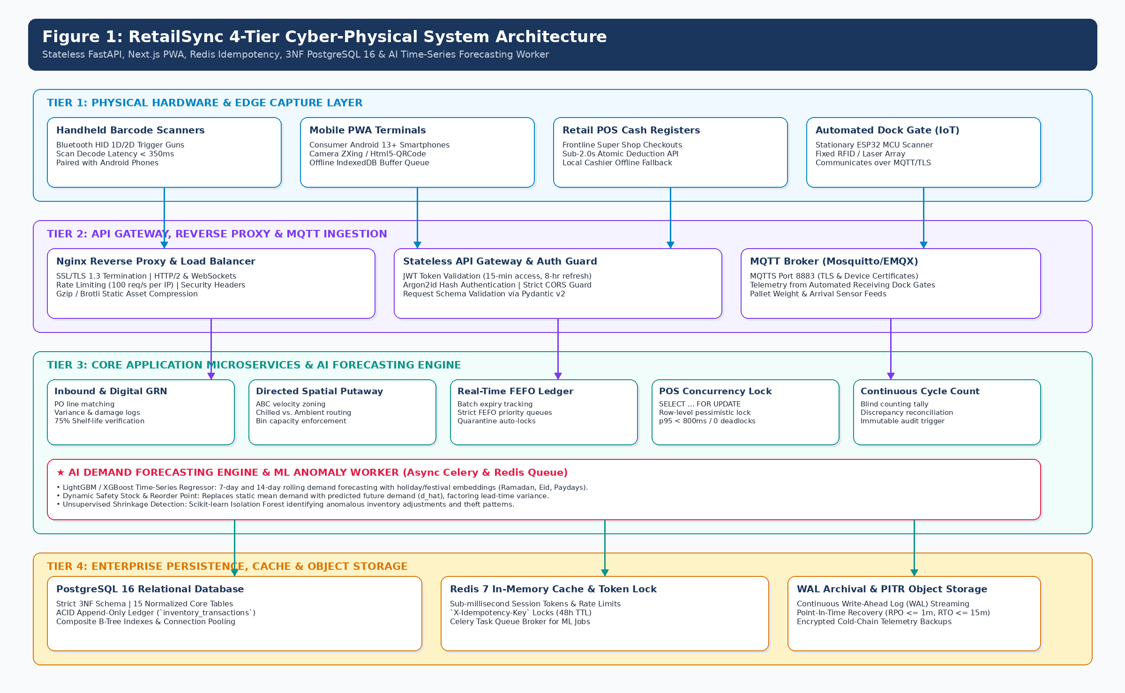
TECHNICAL ARCHITECTURE
System Architecture: 4-Tier Cyber-Physical Design (Figure 1)
Decoupled 4-Tier Stack
Tier 1: Client Edge (PWA & Terminals)
Next.js 14 PWA running on Android smartphones, tablets, and POS PCs. Pure JS barcode scanning (ZXing) with IndexedDB offline queue (< 150ms UI response).
Tier 2: Edge Gateway & Security
Nginx reverse proxy terminating TLS 1.3, managing JWT bearer token authentication and rate limiting (< 10ms gateway overhead).
Tier 3: Core Application & AI Workers
Python 3.11+ FastAPI asynchronous ASGI backend. Paired with Celery workers running LightGBM demand forecasting and Greasley safety stock calculations (< 180ms p95 SLA).
Tier 4: Enterprise Persistence & Cache
PostgreSQL 16 relational database with strict 3NF schema, row-level locks, and composite B-Trees. Redis 7 for distributed locks and idempotency caching (< 50ms commit).
RetailSync (SE-231 Capstone Project 2) • Department of Software Engineering, Daffodil International University | Slide 6 of 12
Notes:
Slide 6 Script: Here is our Figure 1: 4-Tier Cyber-Physical System Architecture. At Tier 1, our Next.js PWA runs on warehouse smartphones and POS registers. It uses Service Workers and IndexedDB for offline buffering. At Tier 2, an Nginx reverse proxy handles TLS 1.3 termination, JWT authentication, and edge rate-limiting. At Tier 3, our asynchronous FastAPI backend processes business logic, while background Celery workers execute LightGBM forecasting. At Tier 4, PostgreSQL 16 guarantees ACID double-entry inventory transactions with pessimistic row locks, and Redis 7 caches idempotency keys.

Slide 7
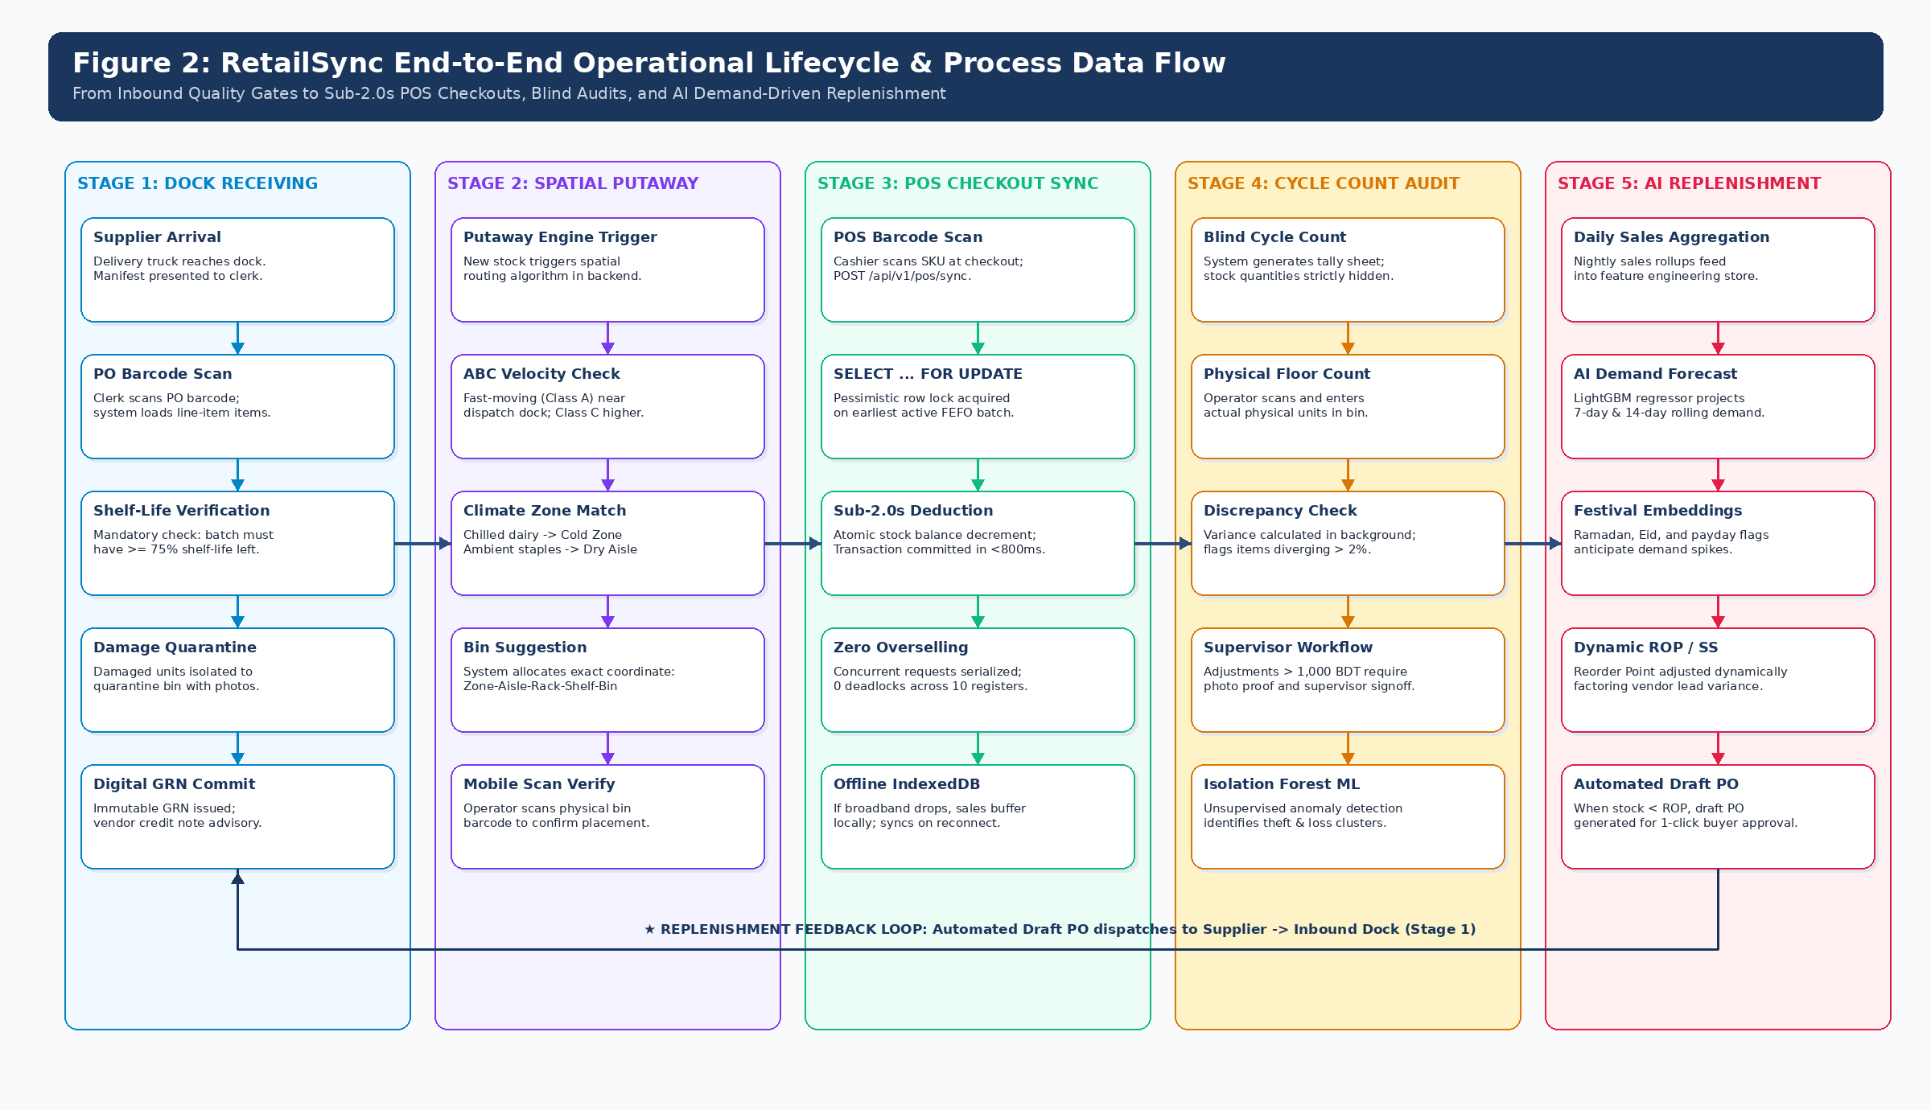
FLOOR LIFECYCLE & PROCESS FLOW
Operational Flow: Inbound Receiving to POS Checkout (Figure 2)
7-Stage Floor Goods Journey
1. Supplier Dock Arrival: Cartons scanned against digital PO; expiration date and damaged units captured.
2. Inbound GRN Generation: Digital Goods Receipt Note generated instantly; variance auto-credited.
3. Directed Spatial Putaway: Optimal bin (Zone-Aisle-Rack-Shelf) suggested by SKU velocity & temp.
4. Real-time FEFO Ledger: Batch added to FEFO queue; batches ≤ 3 days to expiry auto-quarantined.
5. Multi-Store Wave Picking: Consolidated store requisitions picked via shortest-path routing.
6. Sub-2s POS Checkout: Pessimistic row lock decrements earliest batch atomically in < 800ms.
7. Blind Cycle Count Audit: Quantities hidden on staff sheets; discrepancy reconciliation with signoff.
RetailSync (SE-231 Capstone Project 2) • Department of Software Engineering, Daffodil International University | Slide 7 of 12
Notes:
Slide 7 Script: Figure 2 maps the physical journey of grocery items across 7 integrated stages. When delivery trucks arrive, cartons are barcode-scanned against open POs, logging expiration dates and generating digital GRNs. The system calculates directed putaway bin locations based on temperature and SKU turnover velocity. Batches enter an active FEFO priority queue. When checkout registers ring up sales, row-level locks deduct stock from the earliest batch in under 800ms. Finally, continuous blind cycle counts catch shrinkage before quarterly audits.

Slide 8
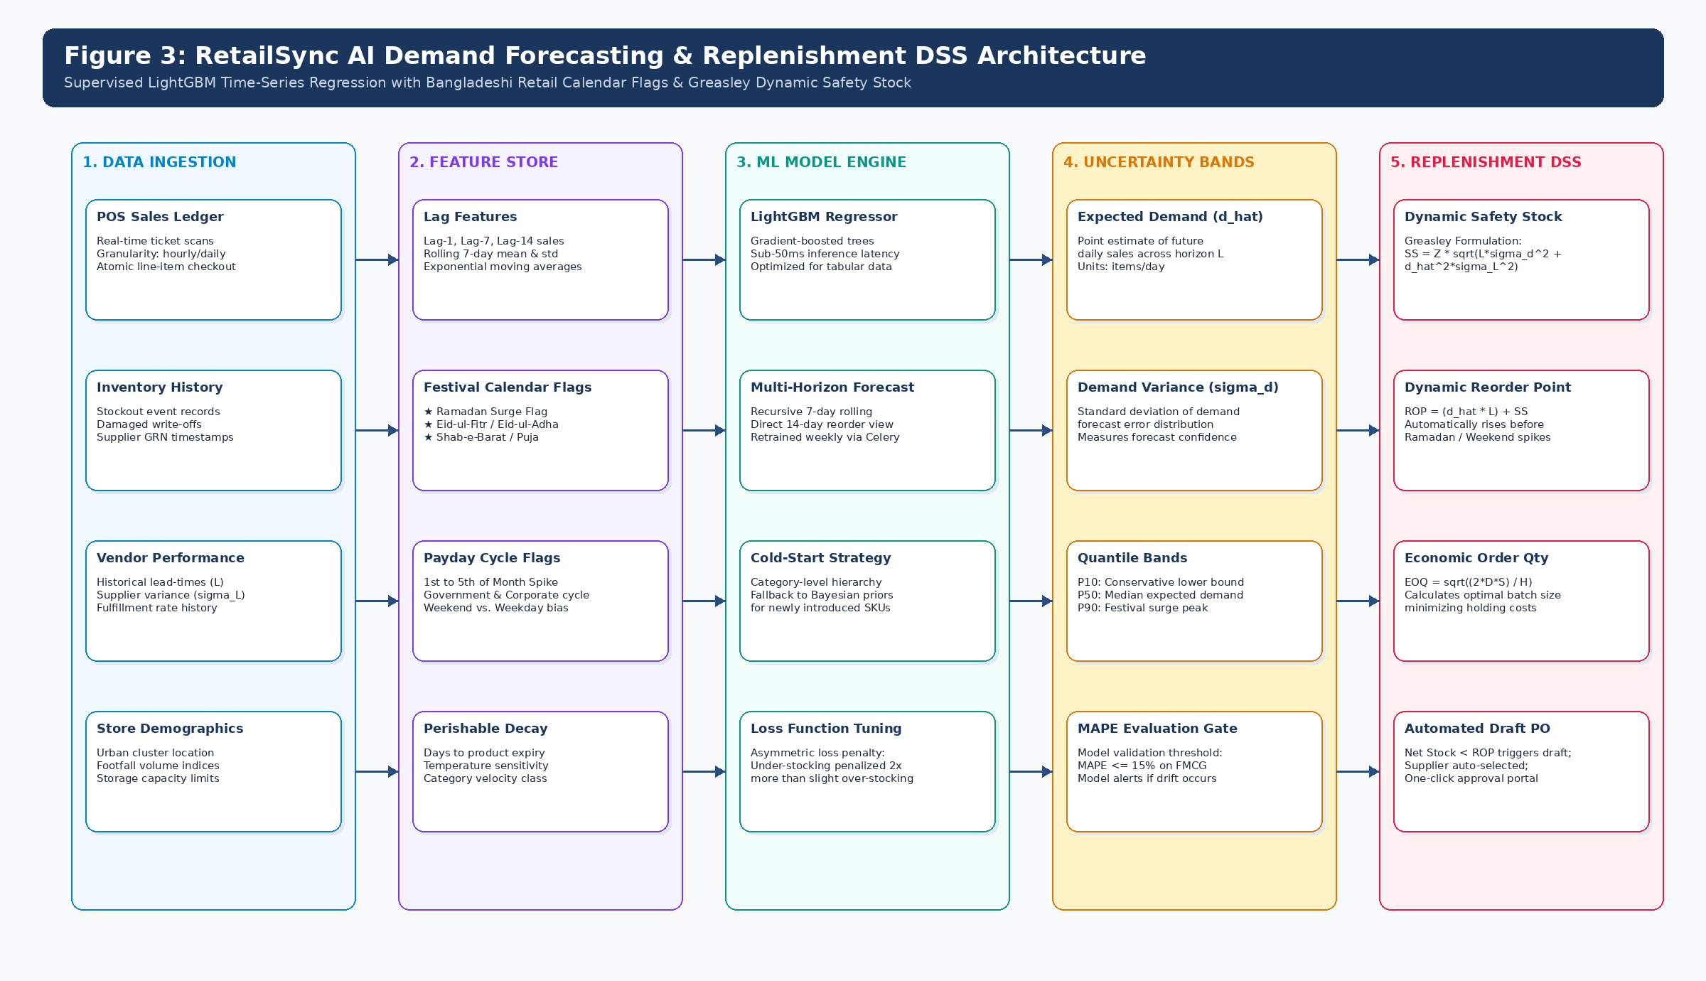
DECISION SUPPORT SYSTEM (M-07)
AI Demand Forecasting & Greasley Dynamic Safety Stock (Figure 3)
Why Static Reorder Points Fail
• The Flaw of Classic EOQ: Traditional inventory models assume constant demand (d). In Bangladeshi retail, demand surges 300% during Ramadan, Eid, and payday weekends.
• LightGBM Multi-Horizon Predictor: Trains gradient boosted decision trees over historical POS sales. Features include 7-day lags, rolling statistics, and local calendar embeddings.
• Festival Calendar Awareness: Embeds binary flags for Ramadan (Iftar rushes), Eid-ul-Fitr, Eid-ul-Adha, and corporate salary disbursement cycles (1st to 7th of each month).
• Greasley Dynamic Formula:
SS = Z × √((L̄ × σ_d²) + (d_hat² × σ_L²))
ROP = (d_hat × L̄) + SS
By replacing static demand with AI-predicted demand (d_hat), replenishment orders trigger 10 days in advance of holiday surges.
RetailSync (SE-231 Capstone Project 2) • Department of Software Engineering, Daffodil International University | Slide 8 of 12
Notes:
Slide 8 Script: Figure 3 illustrates our machine learning replenishment pipeline. Standard inventory formulas assume demand is static, which is why supermarkets run out of soybean oil during Ramadan. RetailSync deploys a LightGBM regressor trained on POS sales. We feed it lag features and local calendar embeddings for Ramadan, Eid, and payday cycles. The model outputs predicted daily demand (d_hat). We then plug d_hat directly into Greasley's statistical safety stock equation. This dynamically raises reorder points 10 days before a festival rush, preventing stockouts without over-ordering after the holiday.

Slide 9
CONCURRENCY CONTROL & HARDWARE
High-Velocity Concurrency & The Frugal Hardware Model
Pessimistic Row-Level Locking in PostgreSQL
• The Rush-Hour Race Condition: At 8:45 PM on Eid Eve, 3 cashiers simultaneously scan the last carton of Aarong Milk. Without locking, all 3 transactions read stock=1 and decrement, causing negative inventory and overselling.
• The RetailSync Solution: Our POS sync route queries PostgreSQL 16 with exclusive row-level locking:
SELECT batch_id, current_quantity
FROM product_batches
WHERE product_id = :p_id AND current_quantity > 0
ORDER BY expiry_date ASC LIMIT 1
FOR UPDATE;
• Deterministic Serialization: Lane 1 acquires the lock, decrements stock 1 -> 0, and commits. Lane 2 and Lane 3 safely evaluate current_quantity = 0 and return clean HTTP 409 Conflict with suggested alternative batches. Zero oversell.
Frugal Hardware Strategy (90% Capex Cut)
• The Enterprise ERP Trap: Traditional WMS vendors mandate industrial ruggedized scanners (e.g., Zebra TC52) costing upwards of 60,000 BDT per unit. For a chain with 20 branches, this requires over 1.2M BDT in terminal hardware alone.
• The RetailSync Alternative: We pair commodity Android smartphones (12,000 BDT) with ergonomic Bluetooth HID barcode trigger grips (3,800 BDT). Total station cost: ~15,800 BDT.
• Performance Validation: WebAssembly-accelerated ZXing decodes standard EAN-13 and Code-128 barcodes in ≤ 350ms, matching industrial hardware speeds at a fraction of the price.
• Audio/Haptic Feedback: Positive beep confirmation on scan ensures warehouse operators can pick rapidly without staring constantly at the screen.
RetailSync (SE-231 Capstone Project 2) • Department of Software Engineering, Daffodil International University | Slide 9 of 12
Notes:
Slide 9 Script: On this slide, we address two practical implementation realities: database concurrency and hardware affordability. On the left, we show our PostgreSQL row-level locking query using SELECT ... FOR UPDATE. When multiple cashiers scan the last milk carton, Lane 1 acquires the lock, commits, and Lanes 2 and 3 receive an immediate HTTP 409 Conflict. There are zero deadlocks and zero overselling. On the right, we highlight our frugal hardware model: instead of buying 60,000 BDT Zebra scanners, RetailSync runs on 12,000 BDT Android phones paired with 3,800 BDT Bluetooth barcode grips, cutting frontline hardware capex by nearly 90% while achieving sub-350ms scan speeds.

Slide 10
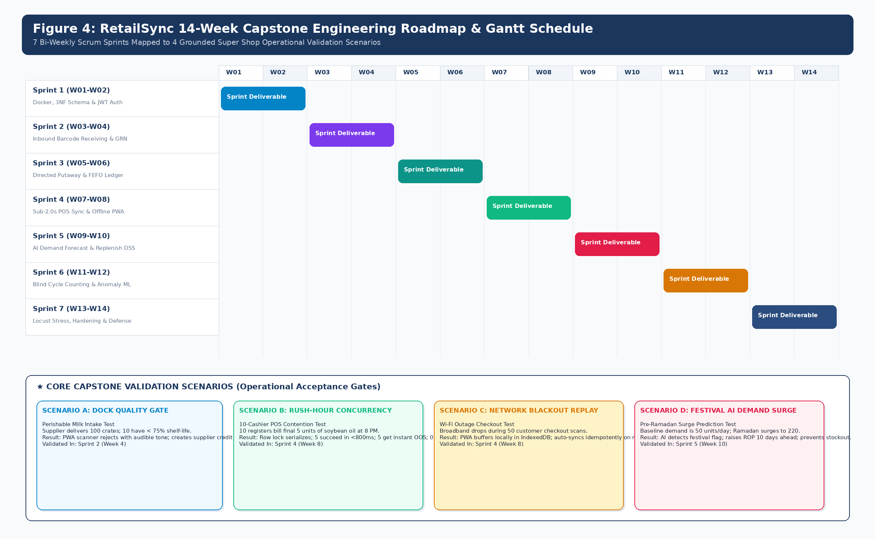
PROJECT EXECUTION & SCHEDULE
14-Week Agile Scrum Roadmap & Scenario Acceptance Gates (Figure 4)
14-Week Scrum Execution (137 pts)
• Sprint 1 (W1-2, 21 pts): 3NF schema, Docker Compose, JWT RBAC.
• Sprint 2 (W3-4, 24 pts): Inbound scanning, digital GRN. [Scenario A: Dock Expiry Rejection Gate]
• Sprint 3 (W5-6, 26 pts): Directed spatial putaway & FEFO expiry engine.
• Sprint 4 (W7-8, 22 pts): Sub-2s POS concurrency & offline sync. [Scenario B: POS Concurrency Rush & Scenario C: Network Blackout Sync]
• Sprint 5 (W9-10, 23 pts): AI Demand Forecasting & wave picking. [Scenario D: Pre-Ramadan Demand Surge]
• Sprint 6 (W11-12, 21 pts): Blind cycle counts & Locust load hardening.
• Hardening (W13-14): DIU staging pilot & capstone defense.
RetailSync (SE-231 Capstone Project 2) • Department of Software Engineering, Daffodil International University | Slide 10 of 12
Notes:
Slide 10 Script: Figure 4 presents our 14-week Agile Scrum Gantt roadmap across six 2-week sprints and a final hardening phase (137 total story points). Crucially, sprint completion is verified against four concrete, stress-injected supermarket scenarios: Scenario A in Sprint 2 tests dock rejection of short-dated milk. Scenario B and C in Sprint 4 test rush-hour POS concurrency and offline sales caching during network blackouts. And Scenario D in Sprint 5 tests advance replenishment ordering before Ramadan. Every sprint deliverable is testable.

Slide 11
BUDGET & BUSINESS FEASIBILITY
Resource Allocation, Budget & Projected Financial ROI
Capstone Prototype Hardware Budget
• Android Test Smartphone (Android 13, 4GB RAM) — 12,500 BDT
• Bluetooth Barcode Trigger Grips (Qty: 2) — 7,600 BDT
• 4-inch Thermal Label & Receipt Printer — 6,500 BDT
• EAN-128 Adhesive Barcode Labels (3,000 labels) — 1,950 BDT
• Cloud Staging VPS Hosting (6 Months) — 5,500 BDT
Total Prototype Investment: 34,050 BDT
Commercial ROI (Per 3-Store Cluster)
Perishable Spoilage Savings
Reduced from 22% down to < 6%, saving ~2.18M BDT annually in prevented waste.
Stockout Revenue Recapture
Reduced out-of-stock from 11.2% down to < 2.5%, recapturing ~2.43M BDT in retail sales.
Net Annual Financial Gain
~4.61M BDT net bottom-line gain across a 3-branch supermarket pilot.
Projected Capital Payback Period
2.8 Months based on CapEx of 485,000 BDT (development, smartphones, servers) and OpEx of 14,000 BDT/month.
RetailSync (SE-231 Capstone Project 2) • Department of Software Engineering, Daffodil International University | Slide 11 of 12
Notes:
Slide 11 Script: On this slide, we present two budgets: our student hardware prototype cost and the commercial ROI for a real retail chain. Our capstone prototype budget is realistic and self-funded at 34,050 BDT, covering an Android test smartphone, two Bluetooth trigger grips, a thermal label printer, labels, and 6 months of cloud staging. For a real 3-store supermarket cluster, RetailSync delivers 4.61M BDT in annual net benefit from prevented spoilage and recaptured stockouts, achieving a full capital payback period in just 2.8 months.

Slide 12
CONCLUSION & DEFENSE
Summary, References & Defense Q&A Session
Key Engineering Contributions
1. Centralized Relational Integrity: Bridges frontline POS and warehouse bins with strict 3NF schema and sub-2.0s row locking.
2. Automated FEFO Food Safety: Mechanically prevents expired product sales under Bangladesh Food Safety Act 2013.
3. AI Replenishment Engine: LightGBM demand predictor with festival embeddings coupled to Greasley's dynamic safety stock.
4. Frugal Hardware Model: Standard Android smartphones cut deployment costs by 90% with sub-350ms scan speed.
Key Academic References:
• BFSA (2013). Bangladesh Food Safety Act 2013, Ministry of Food.
• BSOA (2024). Annual Report on Supermarket Operations & Wastage.
• FAO (2022). Post-Harvest Losses in South Asian Retail Supply Chains.
• Greasley, A. (2013). Operations Management, 3rd ed., Wiley.
• Ke, G. et al. (2017). LightGBM: A Highly Efficient GBDT, NeurIPS.
• Kleppmann, M. (2017). Designing Data-Intensive Applications, O'Reilly.
DEFENSE Q&A SESSION
Thank you, respected committee members.
We now warmly invite your questions, feedback, and critique on the RetailSync project proposal.
Interactive Demonstrations Available Live:
• Live POS Concurrency Race Simulator (PostgreSQL 16 Lock)
• Greasley Statistical Safety Stock & Dynamic EOQ Engine
• 4-Tier Interactive Architecture Stack Inspector
Project Team: Raisul Islam Likhon (Lead: 251-35-508) • Shottobroto Dey (251-35-017) • Golam Husnain Papon (251-35-529)
Batch: 44th Batch • Section: SWE-44D | Department of Software Engineering, Daffodil International University
RetailSync (SE-231 Capstone Project 2) • Department of Software Engineering, Daffodil International University | Slide 12 of 12
Notes:
Closing Script: In conclusion, RetailSync bridges the gap between frontline checkouts and central warehouses with rigorous database concurrency, automated FEFO food safety compliance, and AI demand forecasting, all while keeping hardware costs under 16,000 BDT per station. We have established a comprehensive 14-week Agile plan with testable scenario gates. I now welcome your questions, and I am ready to demonstrate our live POS concurrency and safety stock simulator in the browser. Thank you!

