Slide 1
5G-nr interleaving algorithm
Mini project - 1

Slide 2
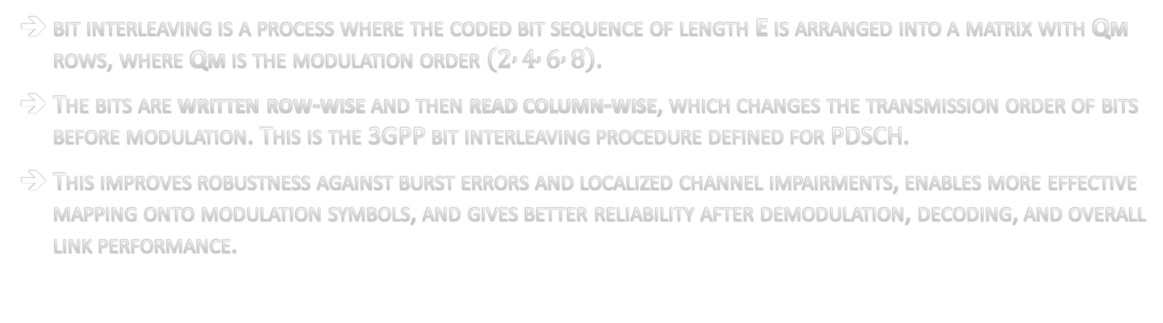
NR Interleaving and Why It Matters for 5G-NR PDSCH
bit interleaving is a process where the coded bit sequence of length E is arranged into a matrix with Qm rows, where Qm is the modulation order $\left(2 , 4 , 6 , 8\right)$.
The bits are written row-wise and then read column-wise, which changes the transmission order of bits before modulation. This is the 3GPP bit interleaving procedure defined for PDSCH.
This improves robustness against burst errors and localized channel impairments, enables more effective mapping onto modulation symbols, and gives better reliability after demodulation, decoding, and overall link performance.

Slide 3
Why 96 bits input and output data bus width may be a good design choice ?
It is and efficient choice for NR- Interleaver because the interleaving operation depends on modulation order Qm, where it belongs to {2, 4, 6, 8}. So, 96 is divisible by all these values.
Using 96-bits at both input and output also improves throughput because a large block of bits can be processed in one transfer instead of sending many small words.
It is not excessively large, so it gives a good balance between high data parallelism and reasonable hardware usage.
Implementation overview:
This solution achieves speed and efficiency on hardware:
  - Processes large amounts of data quickly without overloading the chip.
  - Uses a pipeline approach — like an assembly line, each stage hands off to the next.
  - Avoids running everything at once, keeping chip resource usage low
  - Every operation completes within the 260µs time limit
  - Result: High throughput. Compact design. Always on time.

Slide 4
Interface and parameter extraction:
  - Axi – stream interfaces for input data, config and output.
  - Reads a 128-bit config word and extracts G (bits [14:0]) and Qm (bits [18:15]).
  - Computes: columns = G / Qm and num_bursts = ⌈G/96⌉.
Storage and interleaving logic:
  - Uses 96-bit internal buffers (E_buff[], f_buf[]).
  - Interleaving done through indexing based remapping:
  -> Row index: i = dst % Qm, Column index: j = dst / Qm, Source location: src = i × columns + j.
  Funtionality performs row wise write and column wise read as per 3gpp standard.
  Arrays not fully partitioned → stored in BRAM instead of flip-flops/LUTs.
Performance and pipeline strategy:
- Inner bit-processing loop pipelined with II=1 — no full unrolling.
- Bits processed one per cycle in a regular, streamed manner and Avoids large resource growth from full parallel expansion.
- Loop tripcount directives added for accurate HLS performance estimation

Slide 5
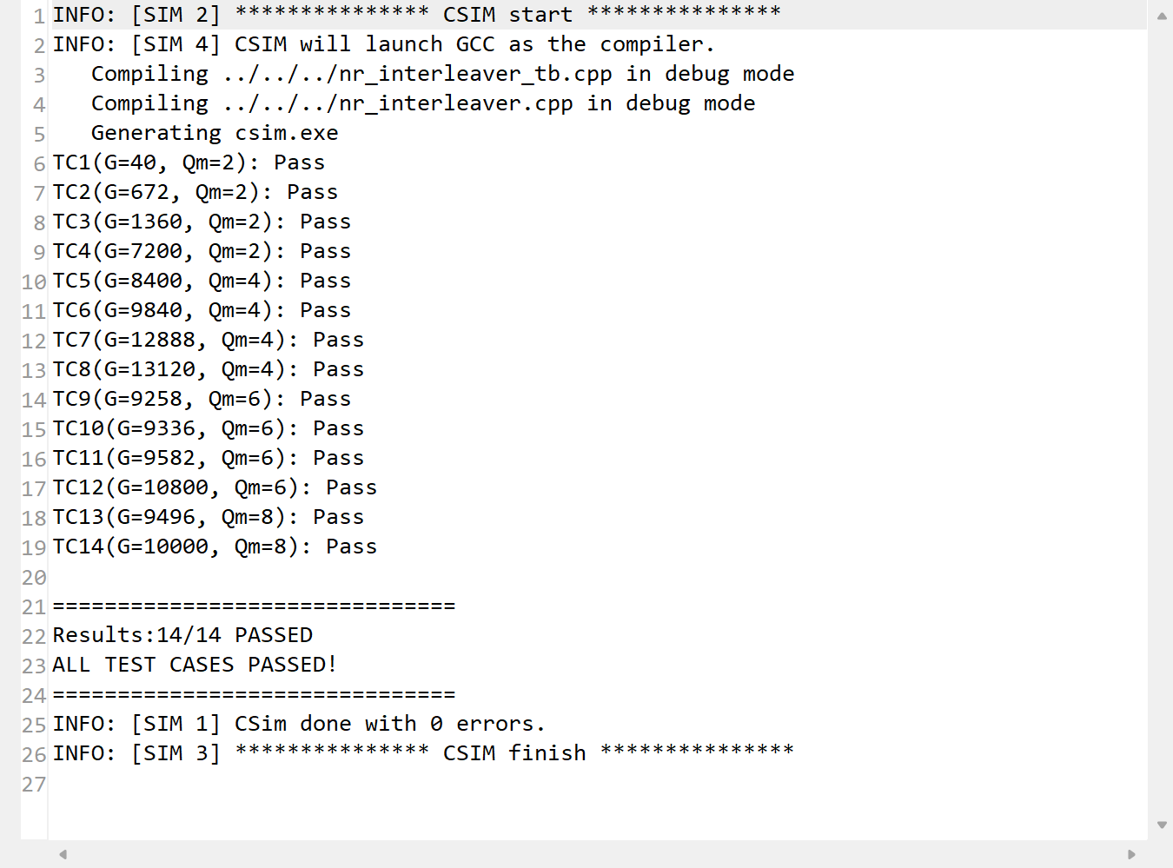
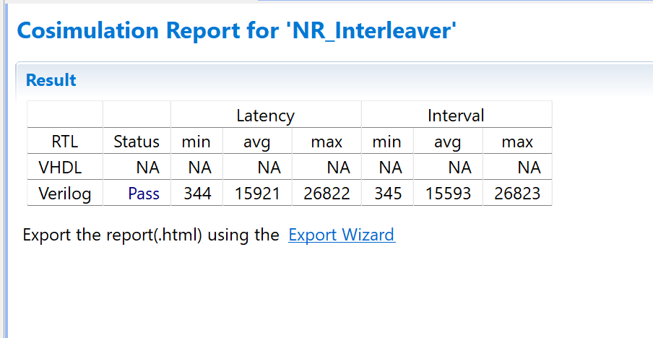
Verification:
  - Testbench runs 14 test cases and sends config + input vectors through streams.
  - Output written to file and compared against reference using diff.
Synthesis report
C simulation
Cosimulation

Slide 6
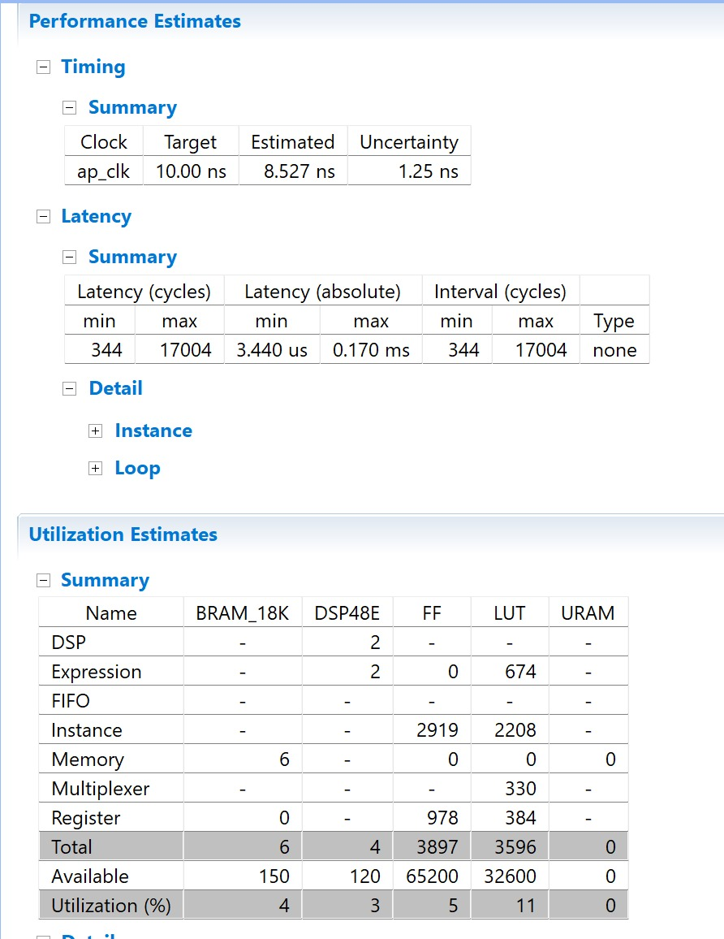
Synthesis Report

Slide 7
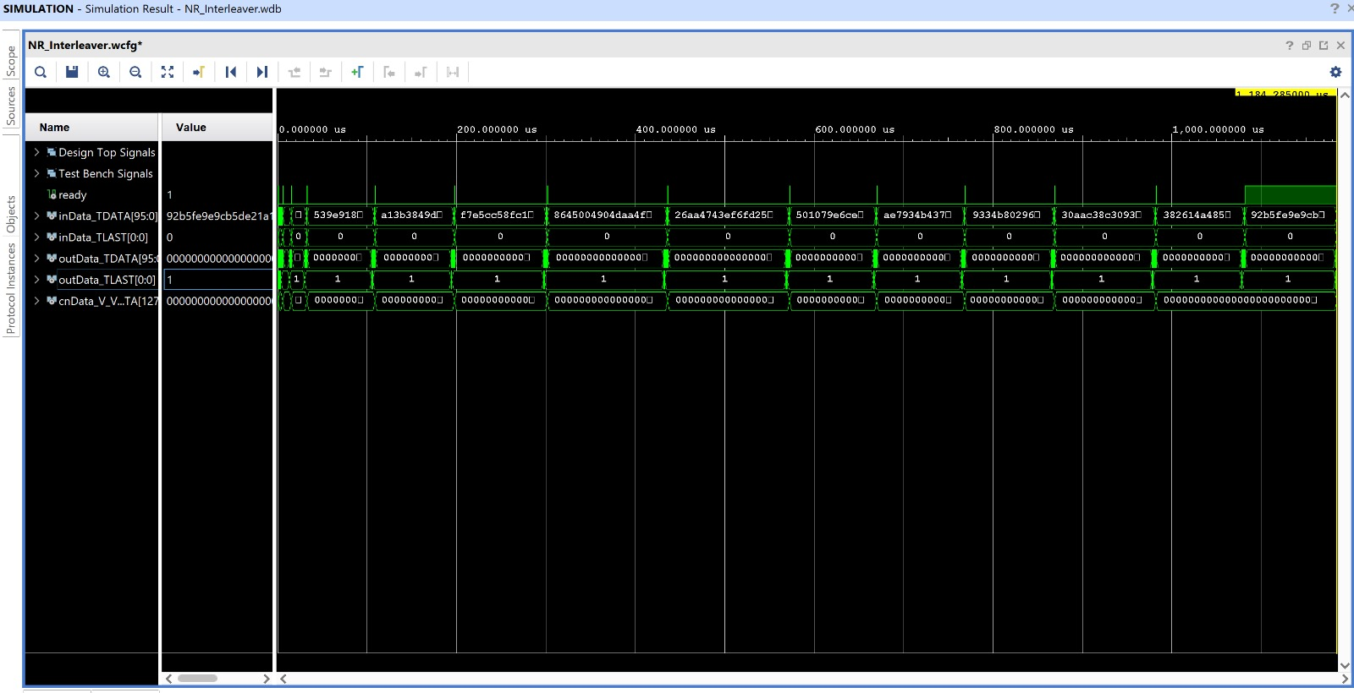
Waveform

