Slide 1
TS 38.212 § 5.4.1.3
5G-NR Channel Interleaver
PUCCH Coded Bit Interleaving — Mini Project 2
Taral Sanka IMT2023588
Likith Kasam IMT2023573

Slide 2
1
Burst Error Resilience
2
Frequency-Selective Fading
Why Channel
Interleaving?
PUCCH carries ACK/NACK, SR, and CSI — control signals with zero tolerance for bursty fading. Interleaving spreads consecutive coded bits across the time-frequency grid, converting burst errors into random errors that the channel code can correct.
5G-NR operates in wide bandwidths (FR1/FR2) where fading varies sharply across sub-carriers. Interleaving ensures no single deep fade wipes out a contiguous block of coded bits, preserving the minimum distance of the code.
PUCCH in 5G-NR
TS 38.212 § 5.4.1.3
3
HARQ Reliability
4
Isosceles Triangle Structure
PUCCH HARQ feedback drives retransmission decisions for the entire data channel. A single missed ACK can waste an entire slot. Interleaving maximises diversity gain, keeping BLER low even at the cell edge.
The triangular write-then-column-read pattern (Algorithm 1) achieves a near-optimal bit-separation distance with a simple, low-latency HW implementation — critical for the 11 µs timing budget in 5G slot processing.
Slide 2 / 7

Slide 3
Implementation Overview
① Read E
& Derive T
② Receive
Input Bits
③ Interleave
(Flat Loop)
④ Pack
Output Bits
⑤ Transmit
Output
▶
▶
▶
▶
cnData stream
LUT lookup
≤4 AXI words
128-bit bus
k_src formula
II=1 pipeline
MSB-first
buffer
outData stream
tlast on last
No 2-D Array Storage
Narrow ap_uint Types
k_src formula maps read-order indices directly to write-order positions. Source bit e[k_src] is copied to f[k_dst] without materialising a T×T matrix, saving both memory and cycles.
flat_i, flat_j, T → ap_uint<6>; k_src, k_dst → ap_uint<10>. This turns all multiplications into 6×6-bit LUT operations, eliminating DSP48 usage and shrinking adder widths by ~60%.
Flat Loop (LOOP_INTERLEAVE)
Register-Based Buffers
A single pipelined loop of T×(T+1)/2 iterations (max 528) replaces nested loops, letting HLS achieve II=1. An odometer register advances (flat_j, flat_i) through the triangle in read order.
e_buf / f_buf are 4×128-bit = 512-bit arrays, fully partitioned. They map to flip-flops, not BRAM, so parallel read/write is synthesis-trivial and latency is zero.
Slide 3 / 7

Slide 4
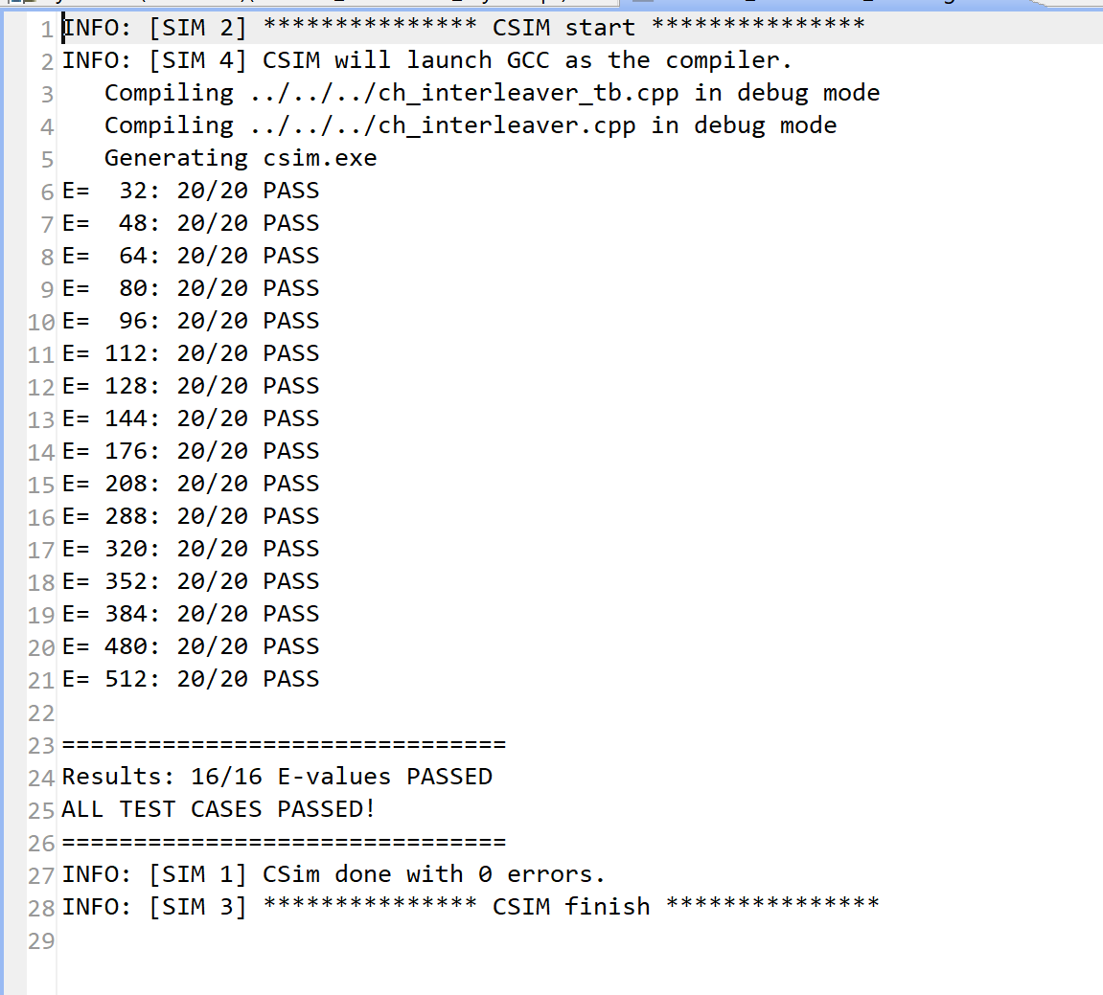
C/C++ Simulation (CSIM)
16 / 16 CASES PASSED
Slide 4 / 7

Slide 5
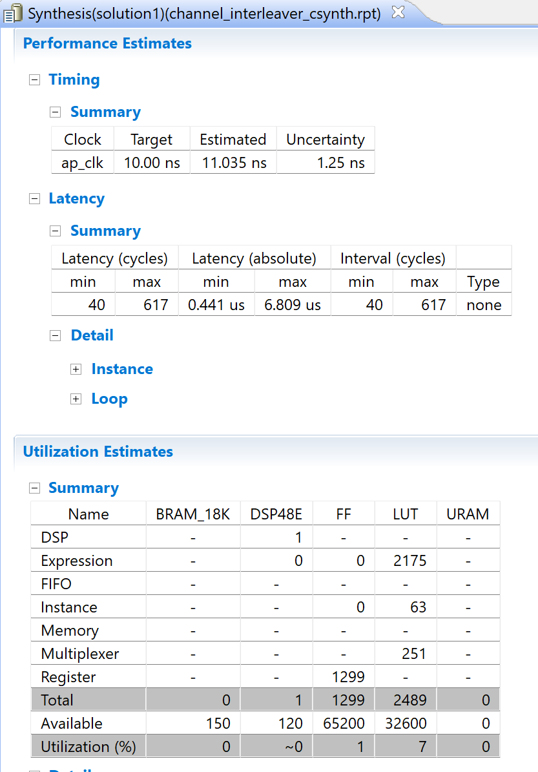
Synthesis Results
Latency: 6.809 us < 11 us
Resource Utilization:
Total/Available – 3.86% < 8%
Slide 5 / 7

Slide 6
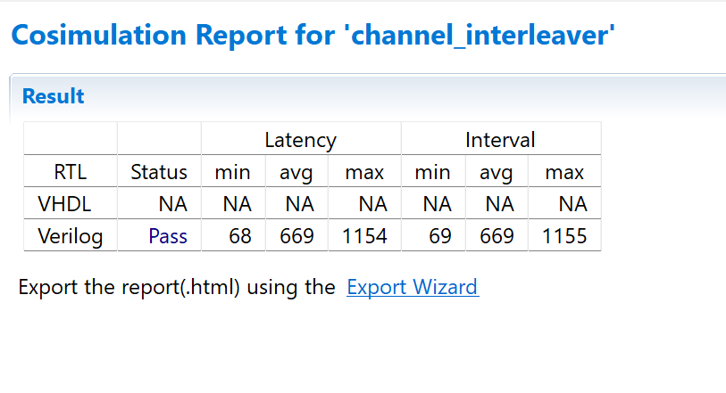
RTL / Co-Simulation
COSIM PASS
Slide 6 / 7

Slide 7
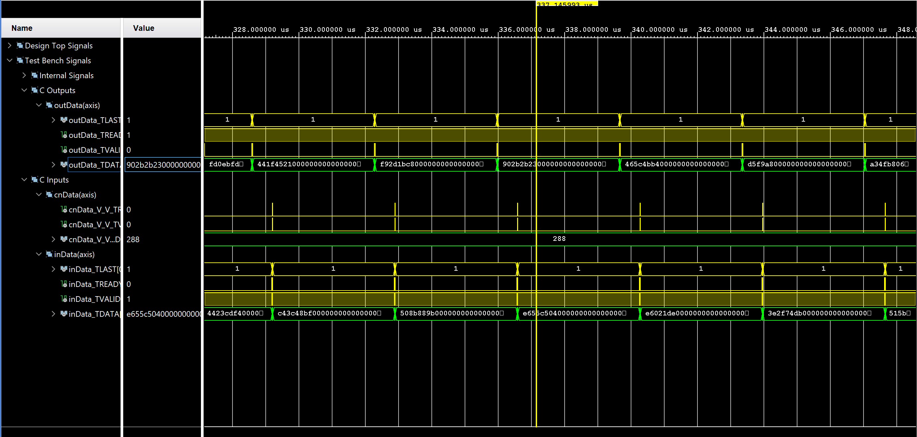
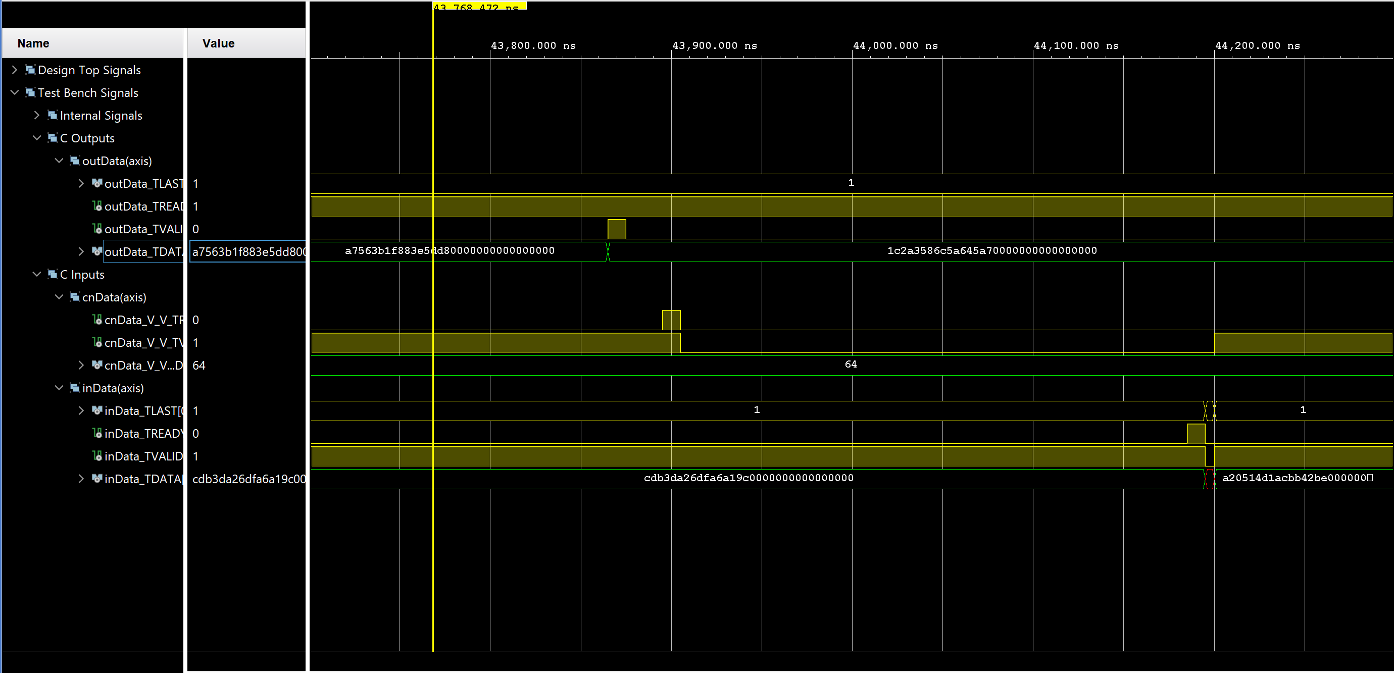
RTL Waveform
Slide 7 / 7

