Slide 1
ARTIFICIAL INTELLIGENCE TERM PROJECT PROPOSAL
LIKITH KAGITA
SURENDRA MEKALA

Slide 2


Implementing a Baroque Chess Agent

Slide 3
Statement of Objectives
Objective 1: Develop a Baroque Chess Agent
The primary objective of this project is to understand and develop a Baroque Chess Agent that can play the game at a high level of proficiency. In Baroque, the king is the one piece alone that is limited to moving exactly one square at a time. All of the remaining pieces on the first rank may move like the queen, in all directions. The pawns, on the other hand, move just like the rook moves in chess, unable to move diagonally. The agent should be able to make strategic moves and decisions based on the rules and objectives of the game, as well as adapt to different playing styles and opponent strategies.
Objective 2: Optimize the Baroque Chess Agent's Performance(What’s new?)
In addition to developing a functional Baroque Chess Agent, the project also aims to optimize its performance. Zobrist hashing is also implemented , which will help to reduce the search time by at least 30%.
Objective 3: Test and Evaluate the Baroque Chess Agent
The final objective of the project is to test and evaluate the performance of the Baroque Chess Agent. This will involve playing the agent against other computer programs, analyzing its strengths and weaknesses, and identifying areas for further improvement and development.

Slide 4
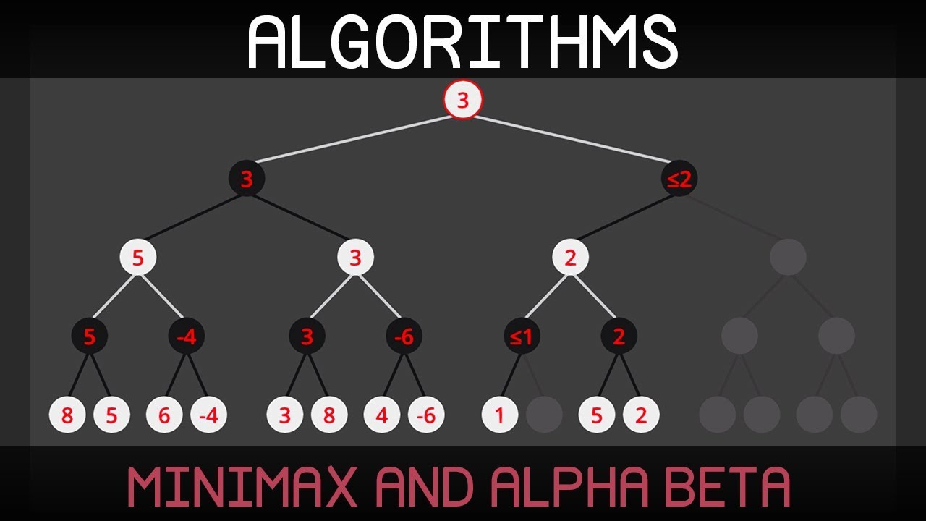
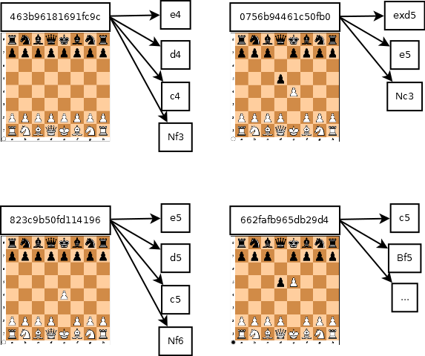
Approach
Tools
Used PyCharm, Windows Powershell, Visual Studio Code.
Algorithm Development(Techniques)
We are using minimax search algorithm with alpha beta pruning for finding the most optimal move given a board state.
Alpha-Beta Pruning: An enhancement to the minimax algorithm, alpha-beta pruning reduces the number of nodes evaluated in the search tree. This optimization allows the algorithm to disregard branches of the tree that are proven to be suboptimal.
Zobrist Hashing: This technique is used to store the hash value of each piece at each square on the chessboard. Zobrist hashing helps in identifying repeated board positions efficiently, reducing the time needed for certain operations, especially in the context of transposition tables.

Slide 5
Deliverables
Single .py file
Our team will deliver a fully functional Baroque Chess with main file containing the code and supporting file to run the main file.
Github
Will compare the results with different methods and upload the file in github.
Documentation
We will provide comprehensive documentation outlining the design, implementation, and testing of the Baroque Chess Agent.

Slide 6
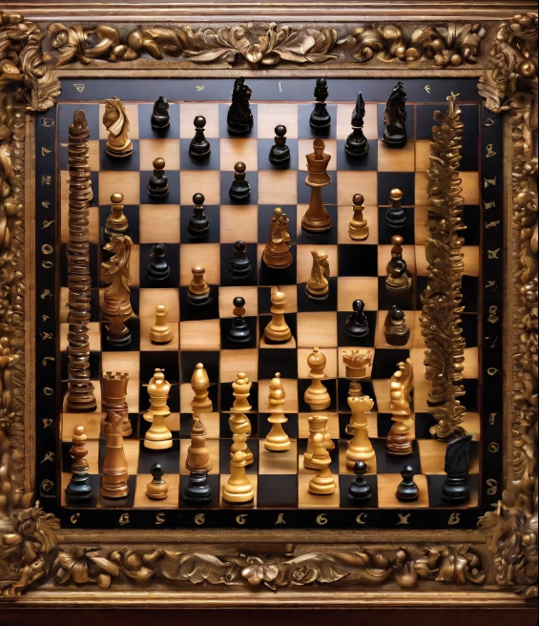
Evaluation Methodology
To ensure the success of our Baroque Chess Agent project, we will use the following evaluation methodology:
Success rate: We will conduct functional testing to ensure that the Baroque Chess Agent meets the requirements specified in the Statement of Objectives. There are two players(black and white). They will compete against each other to win the tournament.
Accuracy: We will conduct usability testing to ensure that the Baroque Chess Agent is user-friendly and easy to use. There is a time limit of 100 which is equal to 100 turns. The players must complete the game within the time limit. If the time limit exceeds then the outcome is a draw.

