Slide 1
EMOTION RECOGNITION AND SENTIMENT ANALYSIS FUSION
LIKITH KAGITA
SAI KUMAR REDDY
RAJA VARA PRASAD

Slide 2

DATA OVERVIEW
Dataset link: https://www.kaggle.com/c/challenges-in-representation-learning-facial-expression-recognition-challenge/data
Technologies:

Slide 3
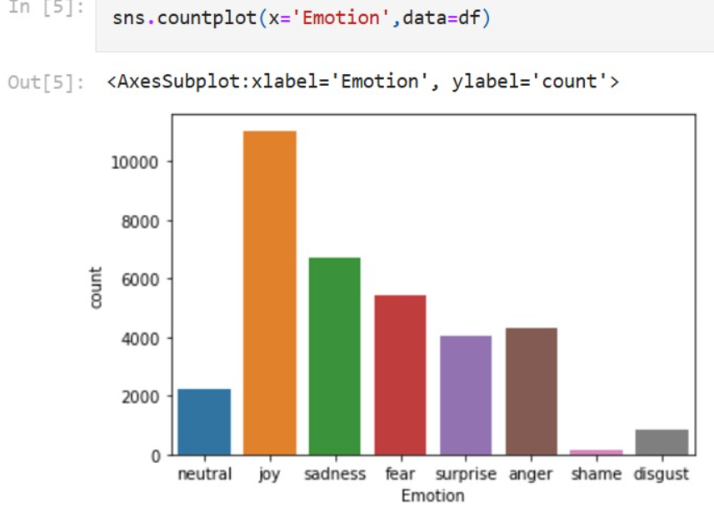
DATA PREPROCESSING
1. Text Data Preprocessing
Use Natural Language Processing (NLP) techniques:
Lowercasing: Convert text to lowercase for uniformity.
Tokenization: Split sentences into words using libraries like NLTK or SpaCy.
Stopword Removal: Remove common words like "the," "and," etc.
Lemmatization: Convert words to their root forms (e.g., "running" → "run").
Vectorization/Embeddings:
Use TF-IDF, Bag of Words, or pre-trained embeddings (e.g., Word2Vec, GloVe).
Sequence Padding: For deep learning models, ensure consistent input lengths using padding (Keras or PyTorch).

Slide 4
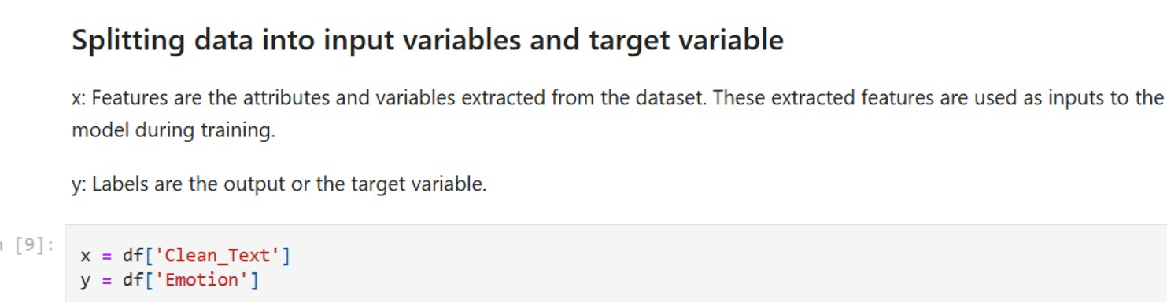
DATASET SPLIT
Load Dataset: Load your dataset into a DataFrame.
Preprocess Text: Clean and preprocess the text data.
Split Dataset: Use train_test_split from Scikit-learn to split the data.

Slide 5
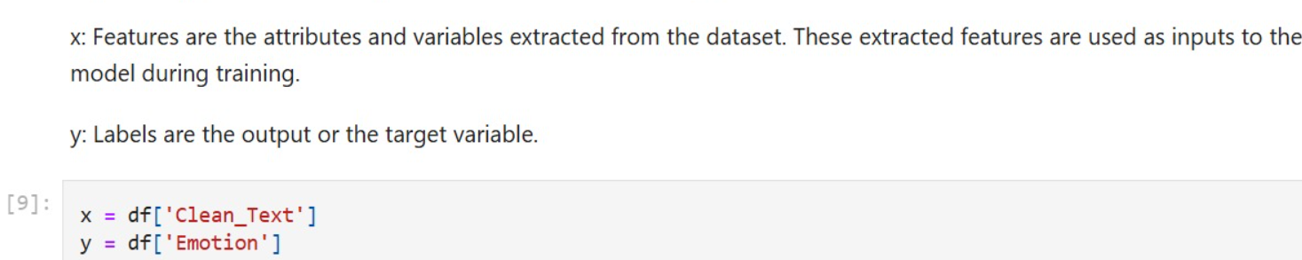
Splitting data into input variables and target variable

Slide 6
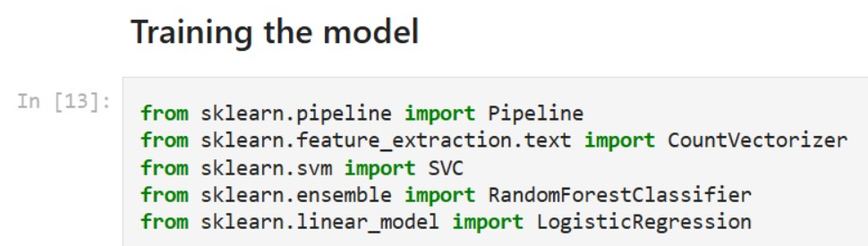
MODEL TRAINING

Slide 7
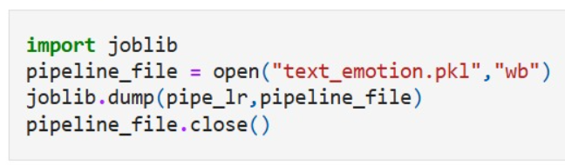
Saving the model

Slide 8
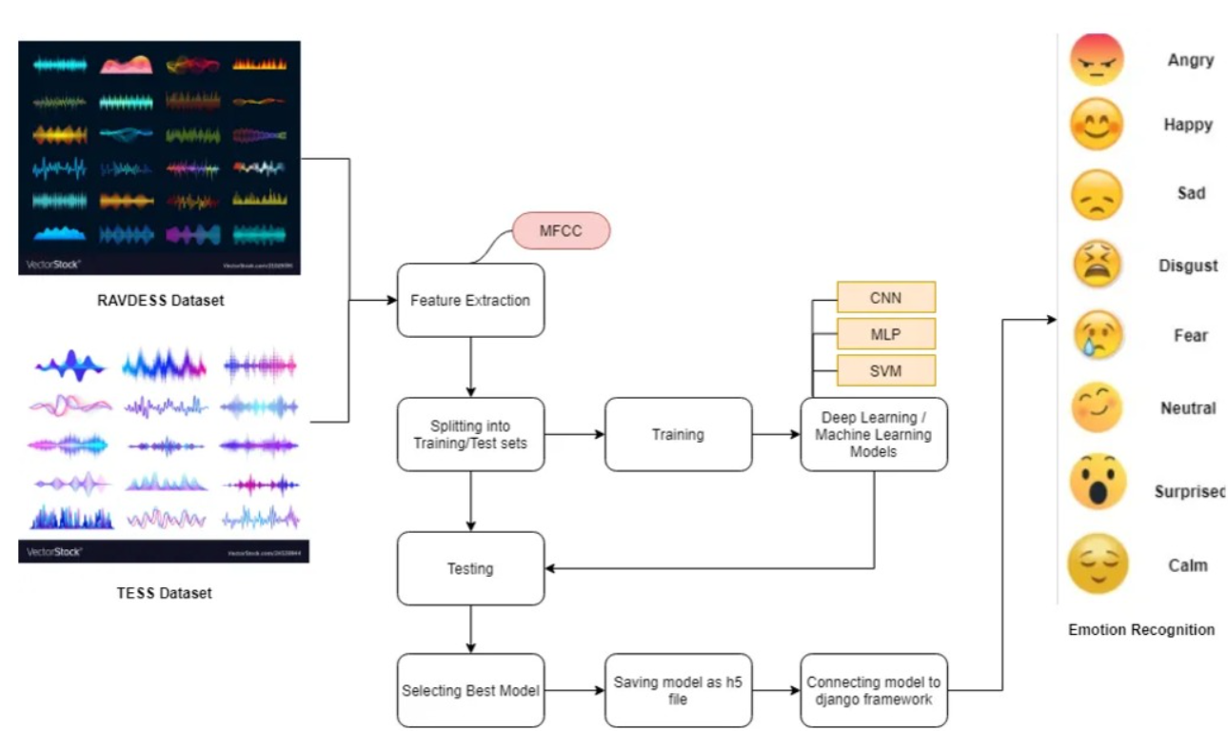
FLOWCHART

Slide 9
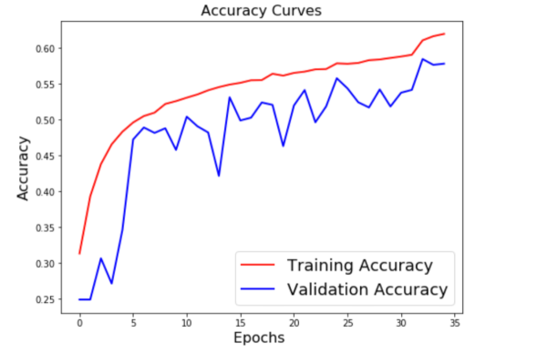
RESULT AND TRANSLATIONS
This graph displays training and validation accuracy curves over epochs. Here are some observations:
1.Training Accuracy (Red Curve): It steadily increases with epochs, indicating that the model is learning the training data well.
2.Validation Accuracy (Blue Curve): It follows a more fluctuating trend but gradually improves. However, there might be a slight gap between training and validation accuracy, suggesting potential overfitting

Slide 10
CONCLUSION
This project successfully combines emotion recognition and sentiment analysis, leveraging their synergy to enhance the understanding of textual and non-textual data. The fusion of these approaches provides a more comprehensive framework for identifying nuanced human expressions, enabling:
1.Improved Accuracy: The integration of both techniques captures deeper emotional context, enhancing prediction reliability.
2.Applications: This work is applicable in fields like customer feedback analysis, mental health monitoring, and human-computer interaction.
3.Future Scope: Further research can focus on refining models using multimodal data (e.g., text, audio, video) and addressing cultural and linguistic variations to improve robustness.

