Slide 1
IBM Call For Code Challenge 2020
Optimized Warehouse Management of Perishable Goods for a Food Delivery Company

Slide 2
Problem Statement
“A food delivery service has to deal with a lot of perishable raw materials which makes it all, the most important factor for such a company is to accurately forecast daily and weekly demand. Too much inventory in the warehouse means more risk of wastage, and not enough could lead to out-of-stocks - and push customers to seek solutions from your competitors. The replenishment of majority of raw materials is done on weekly basis and since the raw material is perishable, the procurement planning is of utmost importance.”

Slide 3
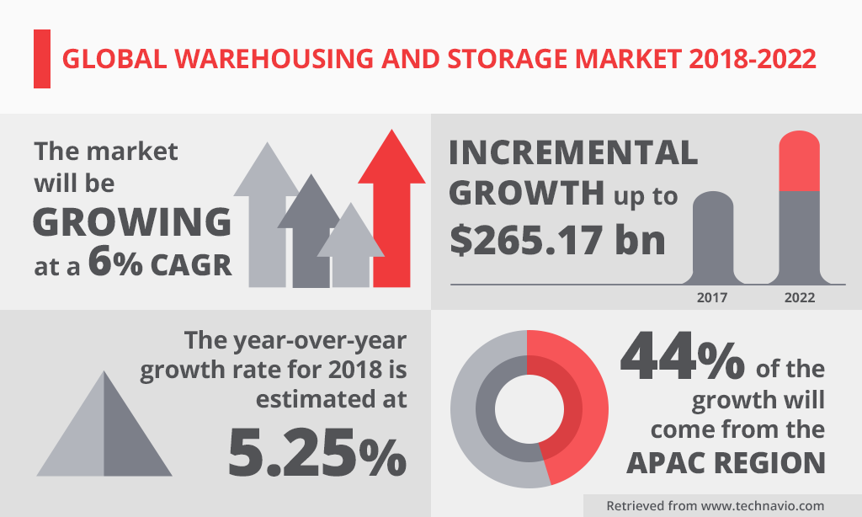
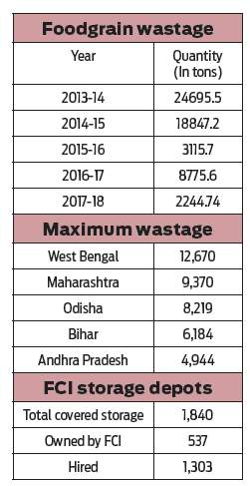

Slide 4
Solution
Develop a Machine Learning model and integrate it with IBM Cloud. Then create a dashboard where the demand of any particular product at any particular center can be predicted.

Slide 5
Key-Features
Predictions
Dashboard
Visualizations
The predictions are done by a Machine Learning model with an accuracy of 87%.
An interactive dashboard allows the user to give inputs. It is user friendly and easy to understand.
Visualizations provide a better way for the user to grasp data and understand the need and demand.

Slide 6
Implementation

Slide 7
Node-RED Dashboard
Collect Dataset
Project Demo
1st
2nd
3rd
4th
5th
Understand Data and develop a ML model
Integrate Node-RED and ML model

Slide 8
Software Used
Machine Learning
Node-RED
IBM Cloud
Predictions
The Machine Learning model was developed on the XGBRegressor with a train score of 95% and test score of 87%. The rmse value was 136.
Dashboard and Visualizations
The Node-RED application was used to develop an user-friendly dashboard. Charts were also developed for the visualization of data.
Storage
IBM Cloud provides excellent storage features. It also provides various services like Watson Studio and Node-RED.

Slide 9
Machine Learning
Developed a model in IBM Watson Studio Notebook.
The dataset is taken from https://www.kaggle.com/shashkhr25/food-demand-forecasting-challange/data
The given problem statement is a regression type problem.
The algorithm used is XGBRegressor.
XGBoost (Extreme Gradient Boosting) belongs to a family of boosting algorithms and uses the gradient boosting (GBM) framework at its core. It is an optimized distributed gradient boosting library.

Slide 10
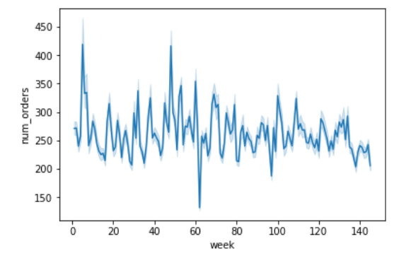
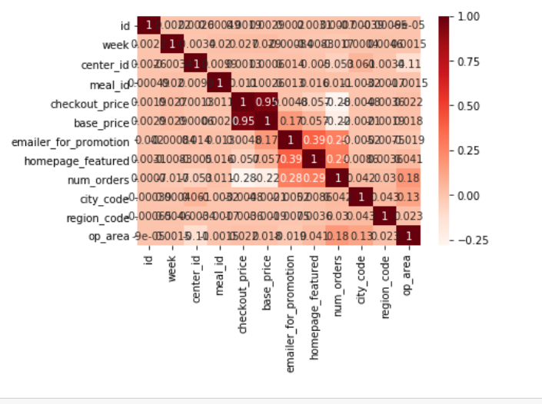
Data analysis

Slide 11
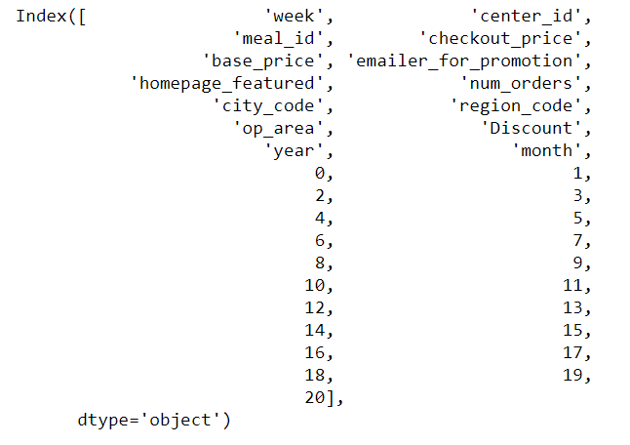
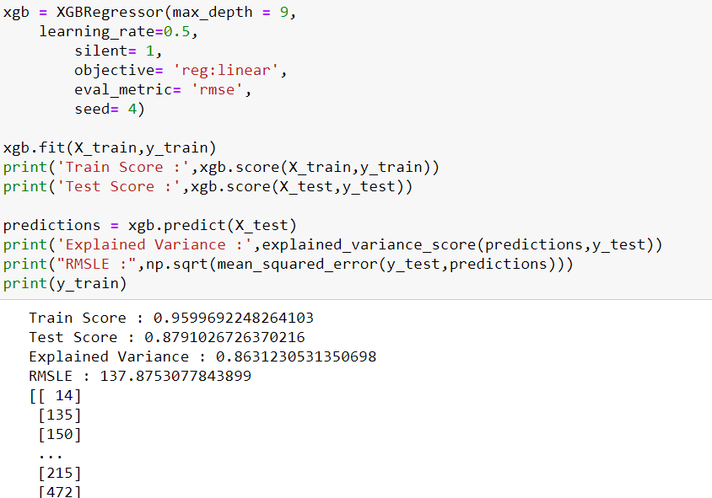
Code Snippets

Slide 12
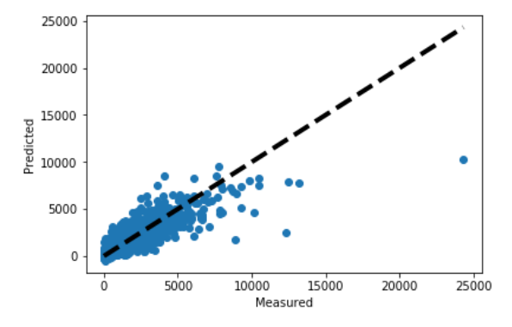
Model Visualization
Actual Data vs Predicted Data
Graph

Slide 13
Node-RED
Node-RED provides a web browser-based flow editor, which can be used to create JavaScript functions.
Part of the IBM Services.
Node-RED has three main types of nodes - Input, Output and Function nodes.
Used Node-RED to create a dashboard which takes user inputs.

Slide 14

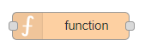

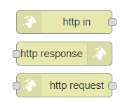
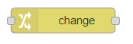
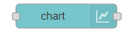

Nodes Used

Slide 15
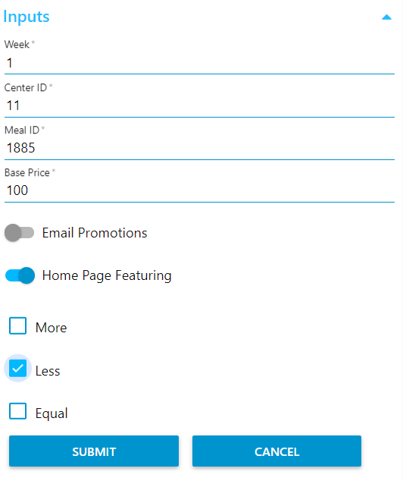
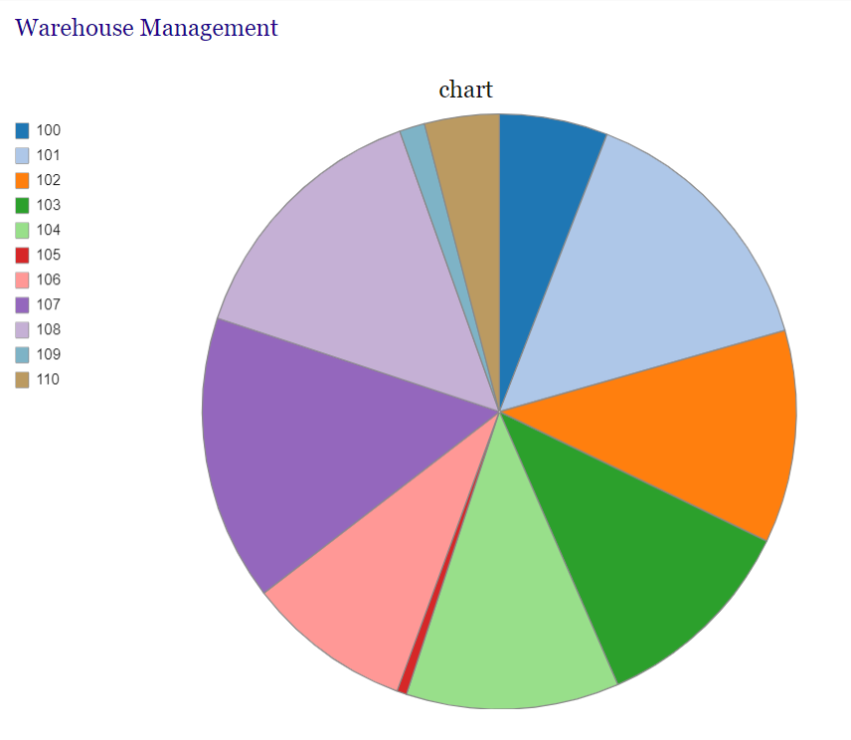
Input and Output
Prediction: Number of Orders

Slide 16
Conclusion
A better warehouse management system will help businesses to gain profits but can also lead to food scarcity.
A proper warehouse dashboard will help companies to be able to track their
Supplies.
Therefore, an optimised warehouse management can be applicable to all types of businesses - small or large.

