Slide 1
Natural Language Processing with Disaster Tweets
Sai Kumar Reddy Nossam
Vineeth Billa Kanti
Likitha Guthikonda
Abhinay Reddy Guntipally

Slide 2
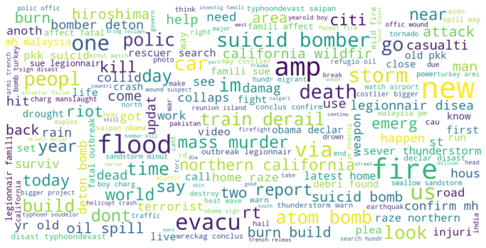
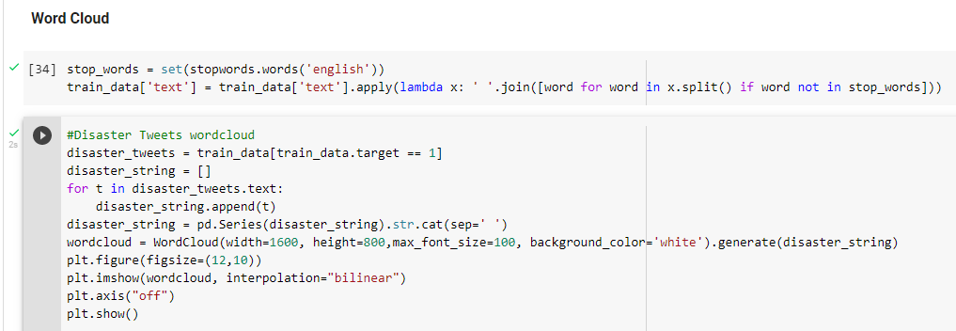
Disaster Tweets Word Cloud

Slide 3
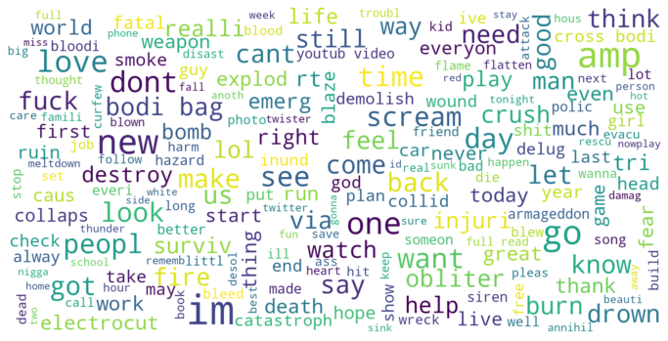
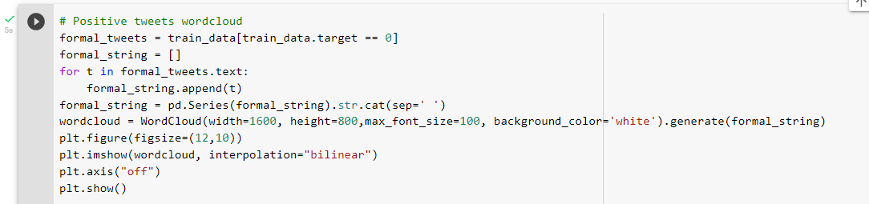
Positive Tweets Word Cloud

Slide 4
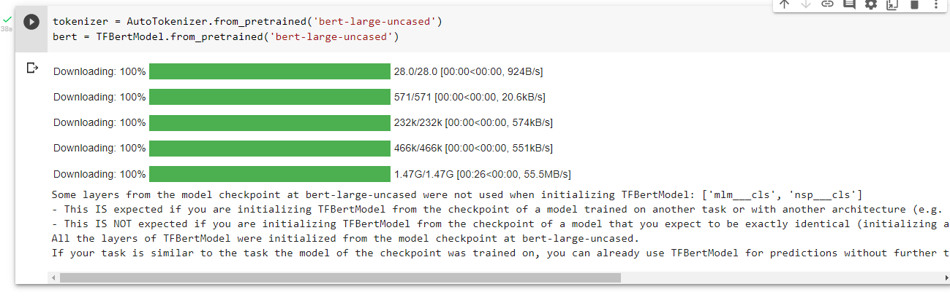
Loading the BERT Model

Slide 5
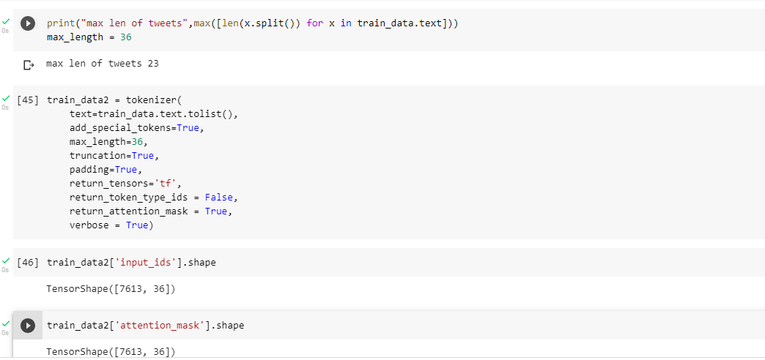
Conversion Of Text Data Into BERT Input Format

Slide 6
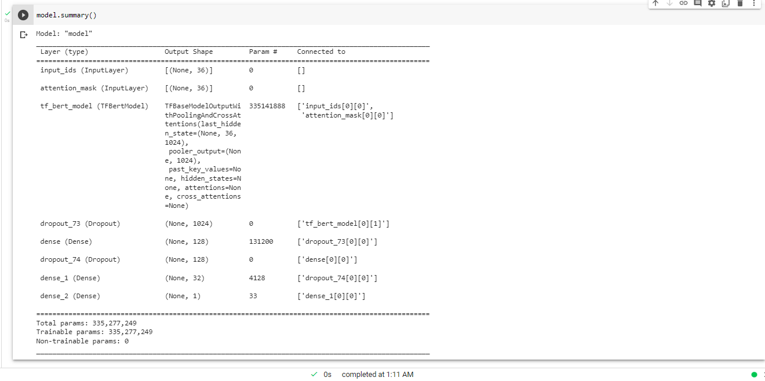
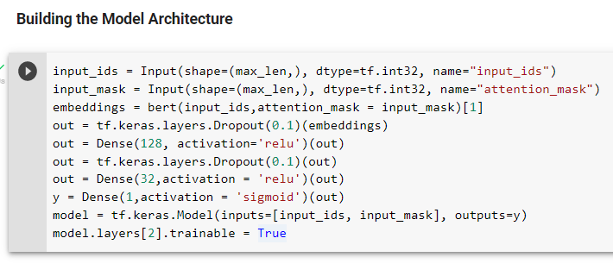
Building the Model Architecture

Slide 7
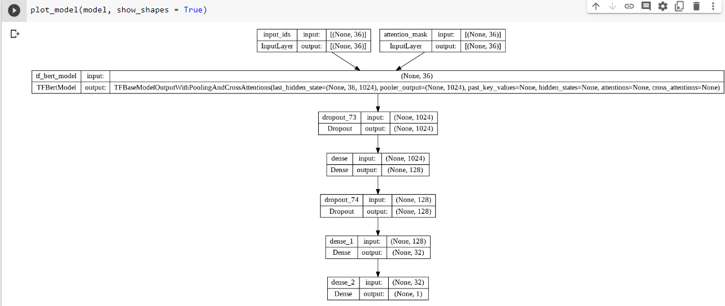
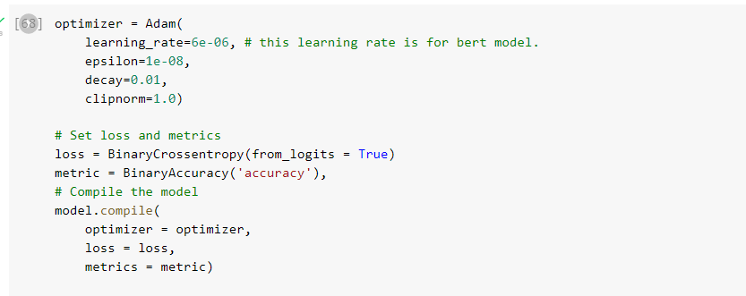
Optimizer Implementation For BERT

Slide 8
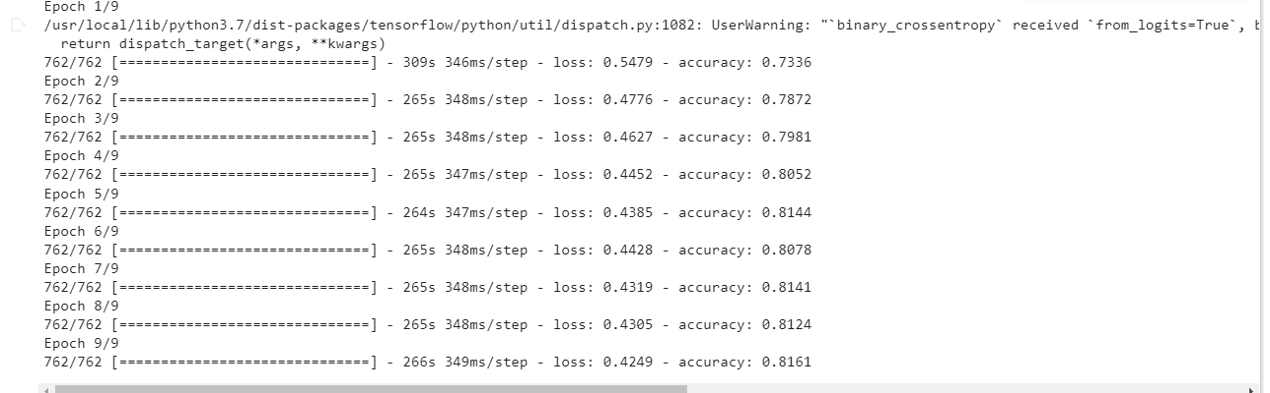
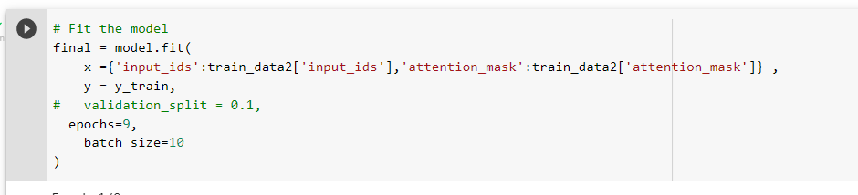
Fitting the Model

Slide 9
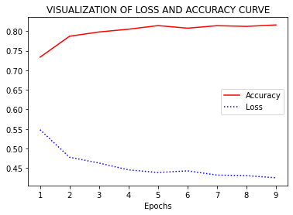
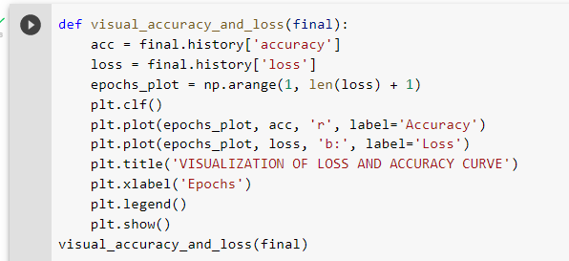
Loss and Accuracy Curve

Slide 10


