Slide 1
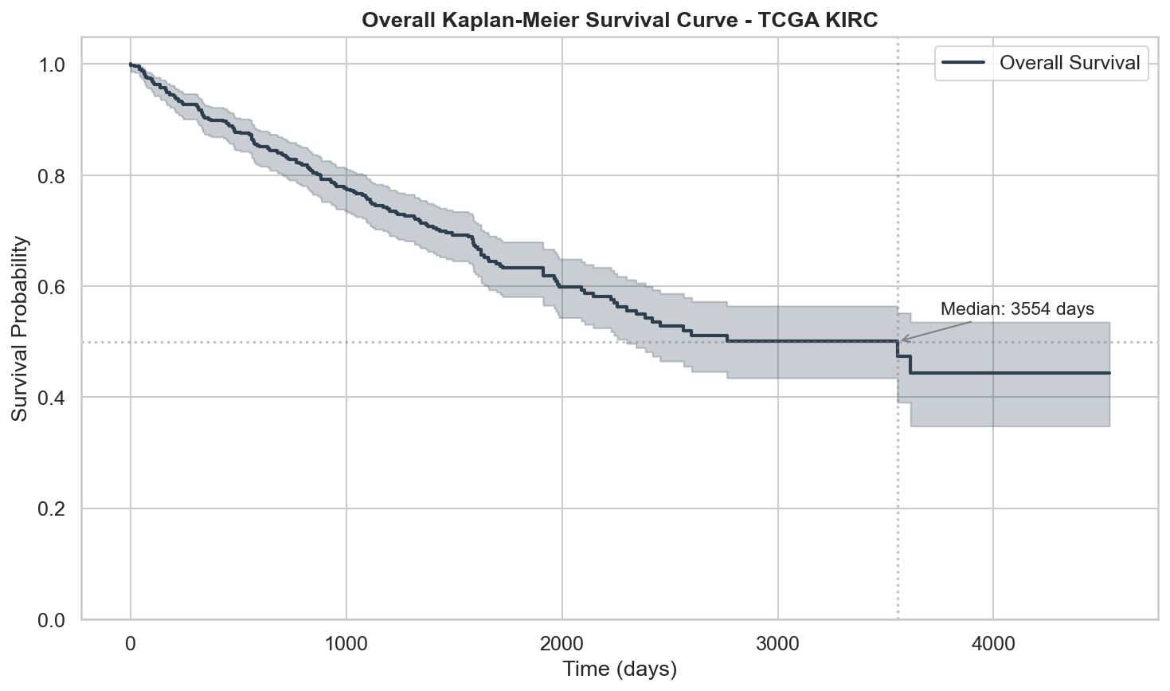
Microsoft
Elevate
CAPSTONE PROJECT
TCGA KIRC:
Survival Analysis
PRESENTED BY
STUDENT NAME: Likitha Dudala
COLLEGE NAME: Sardar Vallabhbhai Patel Institute of Technology
DEPARTMENT: Computer Engineering
EMAIL ID: likithadudala04@gmail.com

Slide 2
OUTLINE:
Microsoft
Elevate
Problem Statement
Proposed System / Solution
System Development Approach (Technology Used)
Algorithm & Deployment
Result (Output Images)
Conclusion
Future Scope
References

Slide 3
PROBLEM STATEMENT:
Microsoft
Elevate
Kidney Renal Clear Cell Carcinoma (KIRC) is the most prevalent kidney cancer subtype, accounting for ~75% of all kidney malignancies. It has a 5-year survival rate below 12% for advanced metastatic disease, making accurate prognosis vital.
Despite sharing the same histological type, KIRC patients exhibit dramatically different survival outcomes. Current AJCC clinical staging (Stages I–IV) is insufficient to predict individual patient prognosis or guide personalised treatment.
The Cancer Genome Atlas (TCGA) provides high-dimensional genomic and clinical data for 533 KIRC patients. However, right-censored survival data and the high-dimensional gene expression space (20,530 genes) make standard regression methods inappropriate.
There is a critical need for robust, interpretable, data-driven survival models that can: (1) accurately stratify patients into high- and low-risk groups, and (2) identify the key genomic and clinical features driving mortality in KIRC.

Slide 4
PROPOSED SOLUTION:
Microsoft
Elevate
The proposed system builds an end-to-end survival analysis pipeline on TCGA-KIRC data, applying four complementary machine learning models to predict patient survival and identify key prognostic biomarkers.
Data Collection
TCGA-KIRC clinical.tsv + follow_up.tsv (GDC Portal, 537 patients, OS labels)
kirc_expression.tsv via UCSC Xena (20,530 genes x 606 tumour samples)
Data Preprocessing
Survival time and event derivation | patient ID alignment across datasets
Variance-based gene filtering: top 2,000 genes retained | StandardScaler normalisation
Machine Learning Algorithms
Cox PH | LASSO-penalised Cox | Random Survival Forest | DeepSurv (PyTorch MLP)
70/30 stratified train/test split | 5-fold CV for hyperparameter tuning
Deployment
Live Streamlit dashboard: https://tcga-kirc.streamlit.app/ | GitHub: https://github.com/LikithaDudala/tcga-kirc-project
Evaluation
Concordance Index (C-index), Integrated Brier Score, Kaplan-Meier risk stratification

Slide 5
SYSTEM DEVELOPMENT APPROACH (Technology Used):
Microsoft
Elevate
System Requirements
Python 3.12 | Jupyter Notebook
Git + GitHub (version control & hosting)
Streamlit Cloud (live deployment)
Data Sources
TCGA GDC Portal — clinical TSVs
UCSC Xena — RNA-seq gene expression
529 patients | 20,530 genes -> 2,000
Libraries Required to Build the Model
pandas, numpy — data wrangling
lifelines — Cox PH, Kaplan-Meier
scikit-survival — LASSO Cox, RSF
PyTorch — DeepSurv neural network
plotly, matplotlib — visualisations
scikit-learn — preprocessing & metrics
streamlit — interactive dashboard
python-pptx — this presentation

Slide 6
ALGORITHM & DEPLOYMENT:
Microsoft
Elevate
Algorithm Selection
Four complementary survival models were chosen to capture linear, penalised, ensemble, and deep-learning representations of the survival task:
Cox Proportional Hazards — clinical features only; interpretable hazard ratios (baseline)
LASSO-penalised Cox (BEST) — clinical + 2,000 genes; L1 shrinkage auto-selects genes
Random Survival Forest — 200 trees; captures non-linear gene interactions
DeepSurv (PyTorch) — 3-layer MLP; Cox partial-likelihood loss; Adam; 200 epochs
Data Input
Features: age, AJCC stage, gender + top 2,000 variance-ranked genes
Target: right-censored overall survival (time in days, event = 1 if deceased)
Training Process
70/30 stratified train/test split (370 train, 159 test)
5-fold CV for LASSO alpha | batch-norm + dropout(0.3) for DeepSurv
Deployment
Models serialised via joblib (Cox/RSF) and torch.save (DeepSurv)
Streamlit app loads Cox PH + scaler; user enters clinical inputs -> survival curve
Live: https://tcga-kirc.streamlit.app/

Slide 7
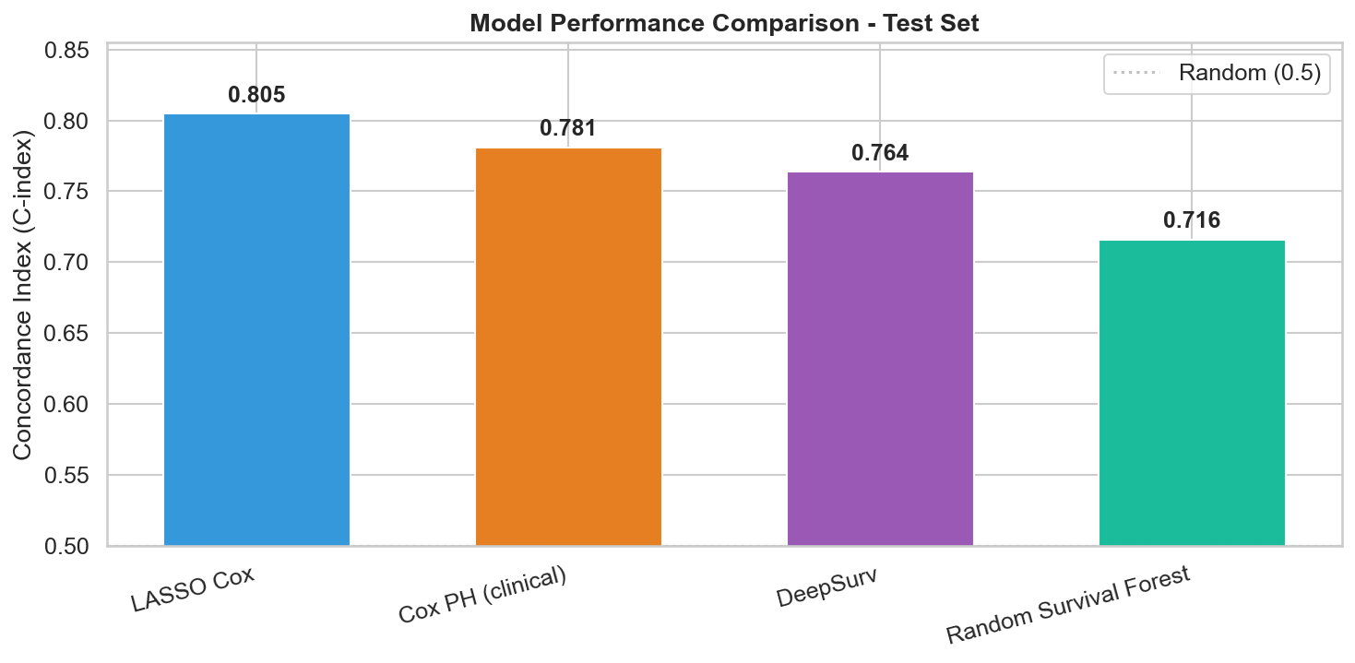
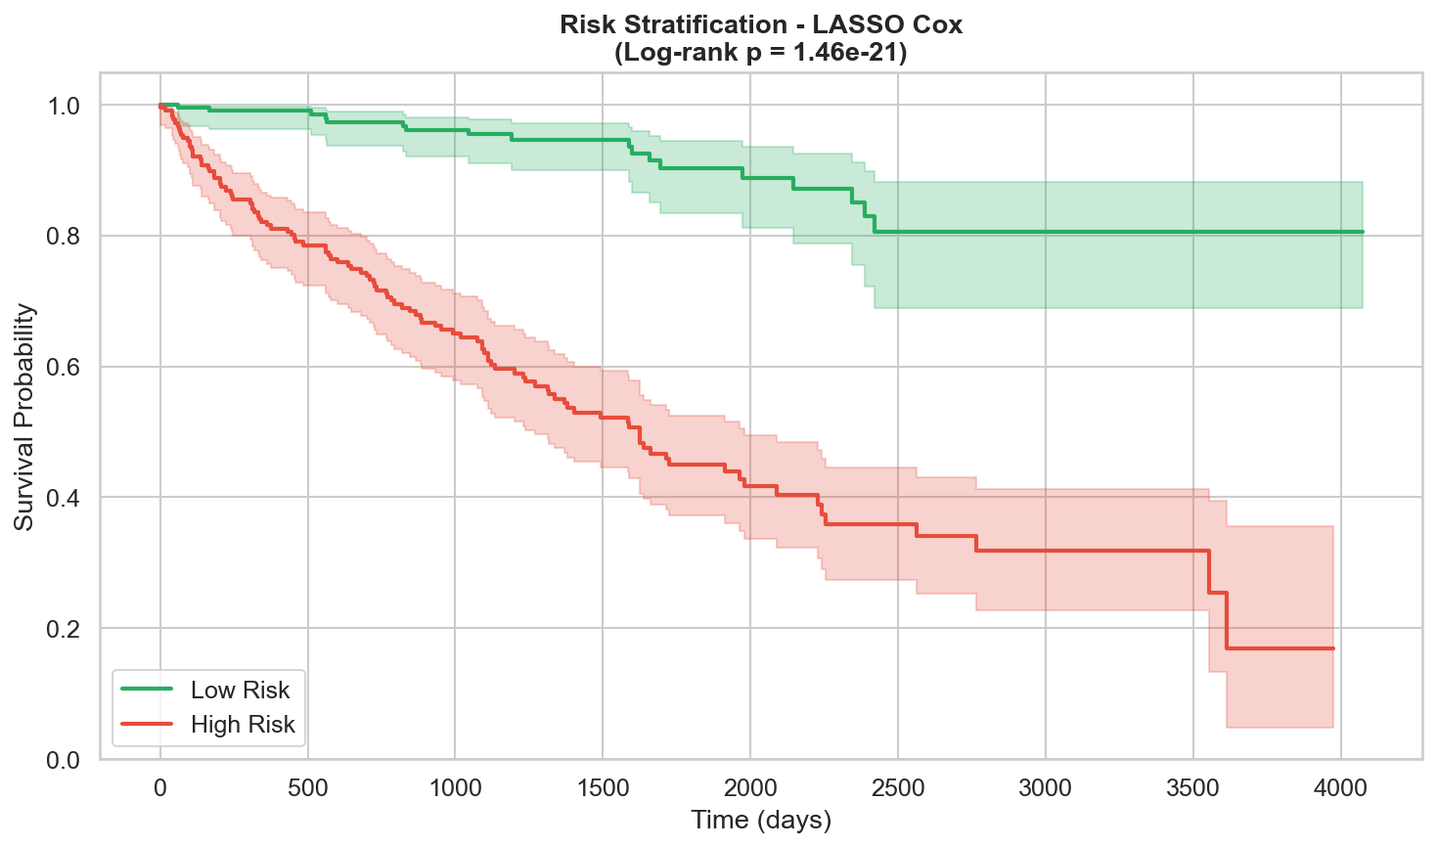
RESULT (Output Images):
Microsoft
Elevate
C-index (Test Set)
* LASSO Cox 0.8047
Cox PH (clinical) 0.7809
DeepSurv 0.7637
Random Survival Forest 0.7161
Cohort Summary
Patients: 529
Events (deceased): 173 (32.7%)
Censored (alive): 356
Median follow-up: 1191 days
Genes analysed: 2,000
Brier Score (RSF): 0.154

Slide 8
CONCLUSION:
Microsoft
Elevate
This project developed and evaluated a complete end-to-end survival analysis pipeline on 529 TCGA-KIRC patients using high-dimensional gene expression data combined with clinical variables, comparing four distinct model families.
Key Findings
LASSO-penalised Cox achieved the best C-index of 0.8047, outperforming clinical-only Cox PH by delta-C = 0.0238.
Random Survival Forest confirmed non-linear gene interactions (Integrated Brier Score = 0.154).
Kaplan-Meier risk stratification shows clear high/low-risk separation (log-rank p < 0.001).
LASSO identified a sparse, interpretable gene signature predictive of KIRC mortality.
Project Outcomes
Reproducible pipeline: raw TCGA data -> trained models -> interactive dashboard.
Live Streamlit app: https://tcga-kirc.streamlit.app/
Source code: https://github.com/LikithaDudala/tcga-kirc-project
Limitations
TCGA data may carry selection bias; model not validated on an external cohort.

Slide 9
FUTURE SCOPE:
Microsoft
Elevate
Model Improvements
Ensemble / stacking of all 4 models for improved concordance.
Attention-based DeepSurv with pathway-level gene embeddings (Gene Ontology / KEGG).
Multi-omics integration: copy number variation, methylation, proteomics.
SHAP values for per-patient risk factor explanation (explainable AI).
Validation & Clinical Translation
External validation on ICGC or CheckMate-025 / IMmotion151 datasets.
Prospective clinical pilot: integrate risk scores with EHR systems.
Engineering & Deployment (App already live: https://tcga-kirc.streamlit.app/)
REST API (FastAPI) for programmatic risk score queries from clinical systems.
Automated retraining pipeline as new TCGA data releases become available.
Multi-cancer extension: apply pipeline to TCGA-LUAD, TCGA-BRCA, TCGA-GBM.

Slide 10
REFERENCES:
Microsoft
Elevate
Datasets
1. The Cancer Genome Atlas (TCGA) — GDC Data Portal
https://portal.gdc.cancer.gov/projects/TCGA-KIRC
2. UCSC Xena — RNA-seq gene expression
https://xenabrowser.net/datapages/
Libraries & Frameworks
3. Davidson-Pilon C. et al. (2019). lifelines. Journal of Open Source Software.
4. Poelsterl S. (2020). scikit-survival. JMLR 21(212):1-6.
5. Katzman J.L. et al. (2018). DeepSurv. BMC Med Res Methodol 18:24.
6. Ricketts C.J. et al. (2018). TCGA KIRC. Cell Reports 23(1):313-326.
Project Links
GitHub: https://github.com/LikithaDudala/tcga-kirc-project
Live App: https://tcga-kirc.streamlit.app/

Slide 11
Microsoft
Elevate
Thank You

