Slide 1
BLUESTOCK FINTECH
Capstone Project
Mutual Fund Analytics Platform
Submitted By:
Likitha R
B.Tech - Computer Science and Engineering
Data Analyst Intern
May 2026 - July 2026

Slide 2
Problem & Objective
Problem
Objective
Data Fragmentation
Performance Comparison Gap
No Benchmark Tracking
Investor Behaviour Blind Spot
Slow Reporting
Build an ETL pipeline from raw AMFI data
Design a normalised SQL schema for MF data
Perform comprehensive EDA on NAV & AUM data
Compute performance & risk metrics per scheme
Build an interactive BI dashboard
Analyse investor transaction patterns
Compare fund returns vs benchmark indices
Document and present the entire project

Slide 3
Data Sources
01_fund_master.csv
06_industry_folio_count.csv
02_nav_history.csv
07_scheme_performance.csv
03_aum_by_fund_house.csv
08_investor_transaction.csv
04_monthly_sip_inflowscsv
09_portfolio_holdings.csv
05_category_inflows.csv
10_benchmark_indices.csv
10 Datasets | 46,000+ Records | 4 Years Historical Data

Slide 4
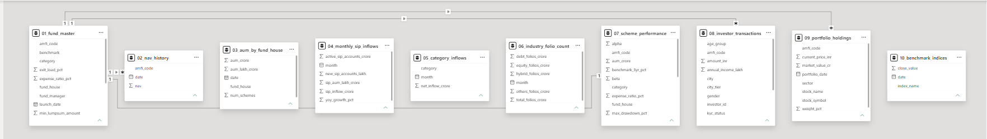
System Architecture
Raw CSV files | Data Cleaning & Validation | Feature Engineering | SQLite Database | Analytics Engine | Power BI Dashboards | Business Insights
Power BI Model

Slide 5
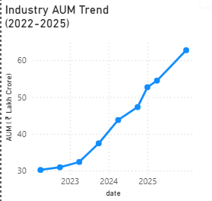
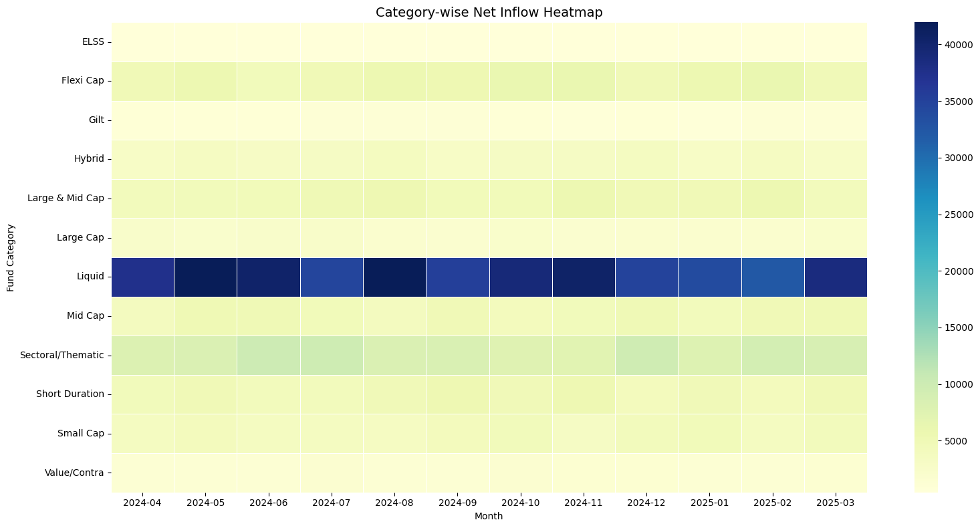
Exploratory Data Analysis
Industry AUM increased steadily from 2022–2025
Liquid funds attracted the highest inflows
Equity categories remained investor favorites
Strong growth in mutual fund participation

Slide 6
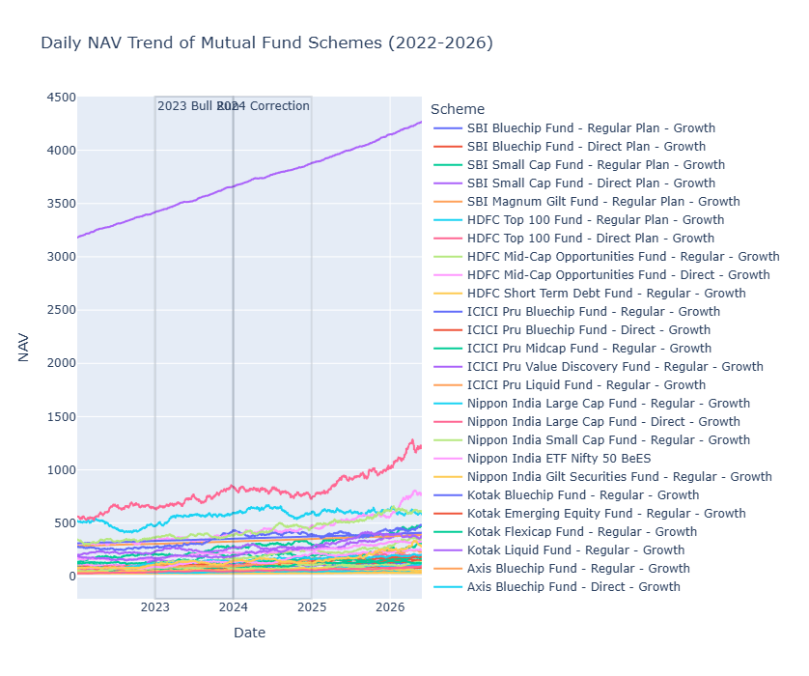
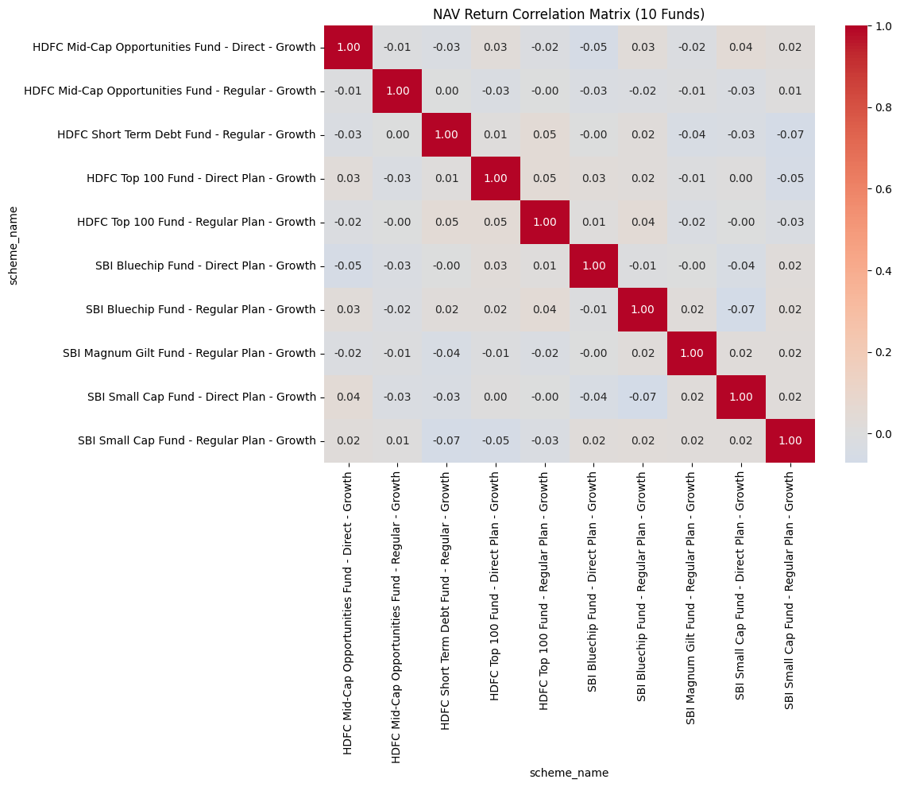
Exploratory Data Analysis
Strong correlations observed among leading schemes
NAV values displayed long-term growth trends
Market movements significantly influenced fund performance

Slide 7
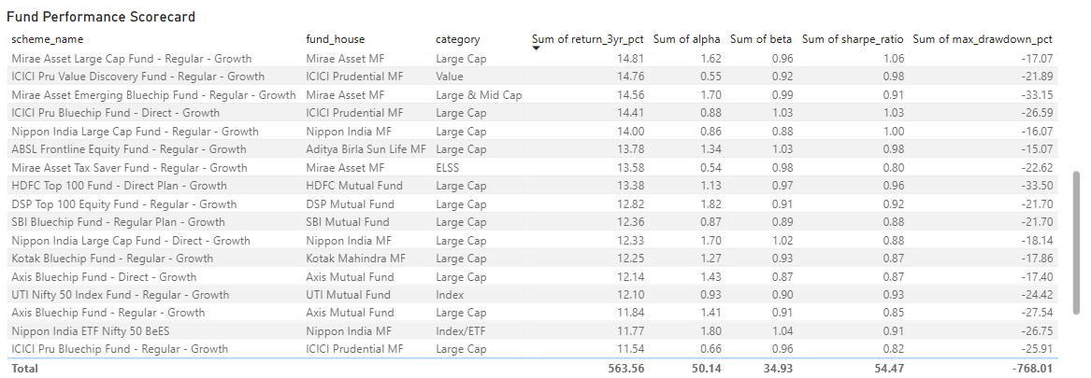
Fund Performance Analytics
These metrics were used to evaluate growth, risk-adjusted returns, and benchmark performance.

Slide 8
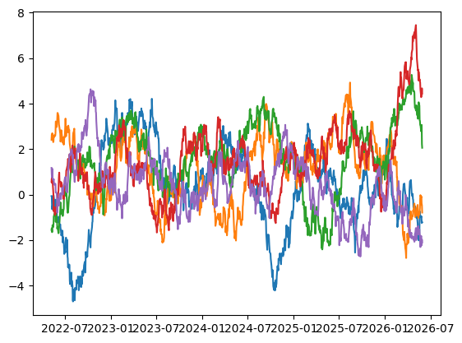
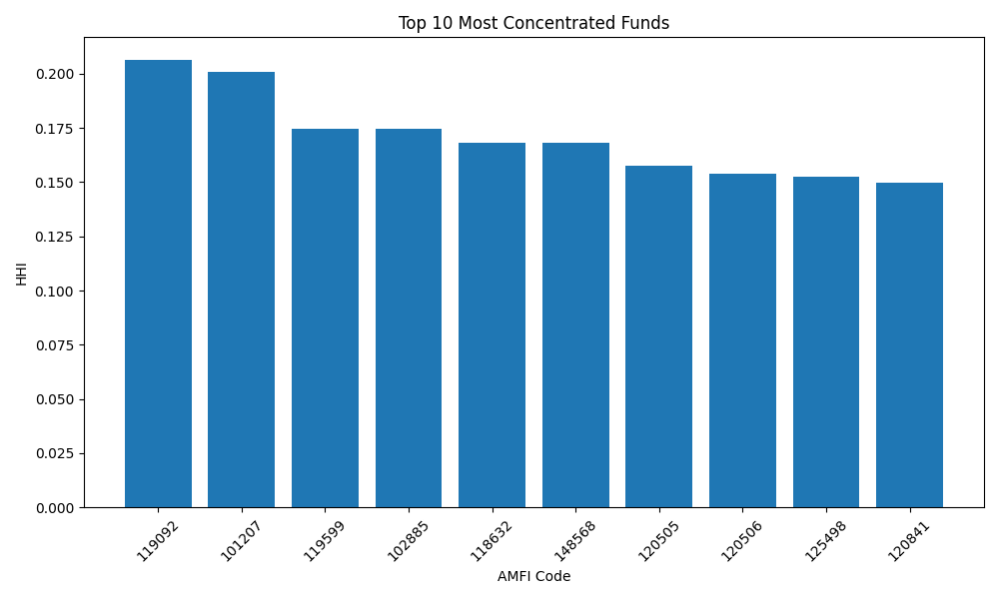
Rolling Sharpe Ratio
Sector Concentration (HHI) Chart
Risk-adjusted performance varied significantly across schemes and sectors.

Slide 9
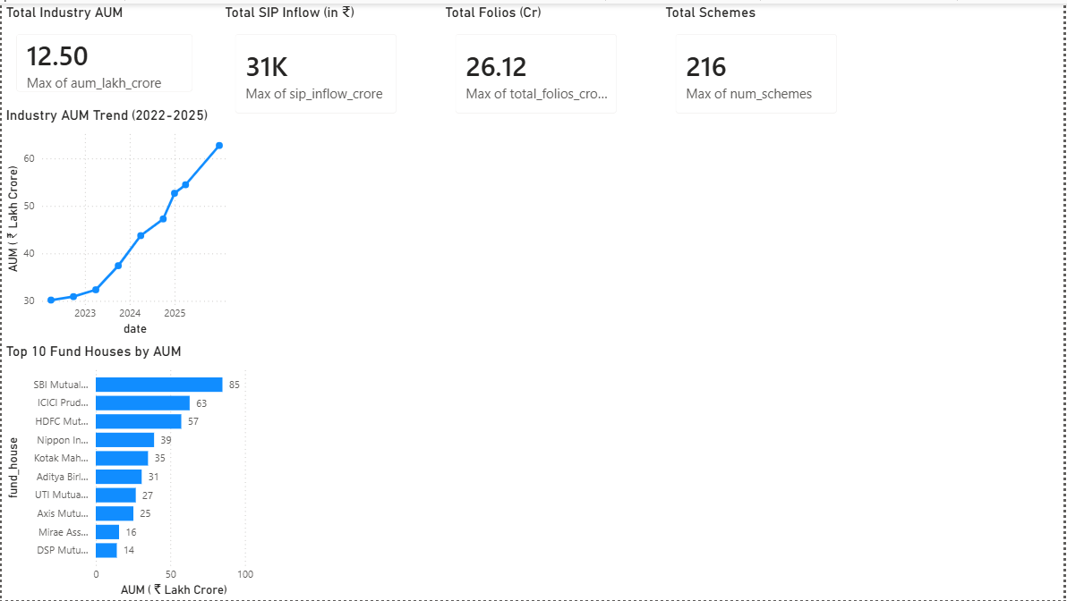
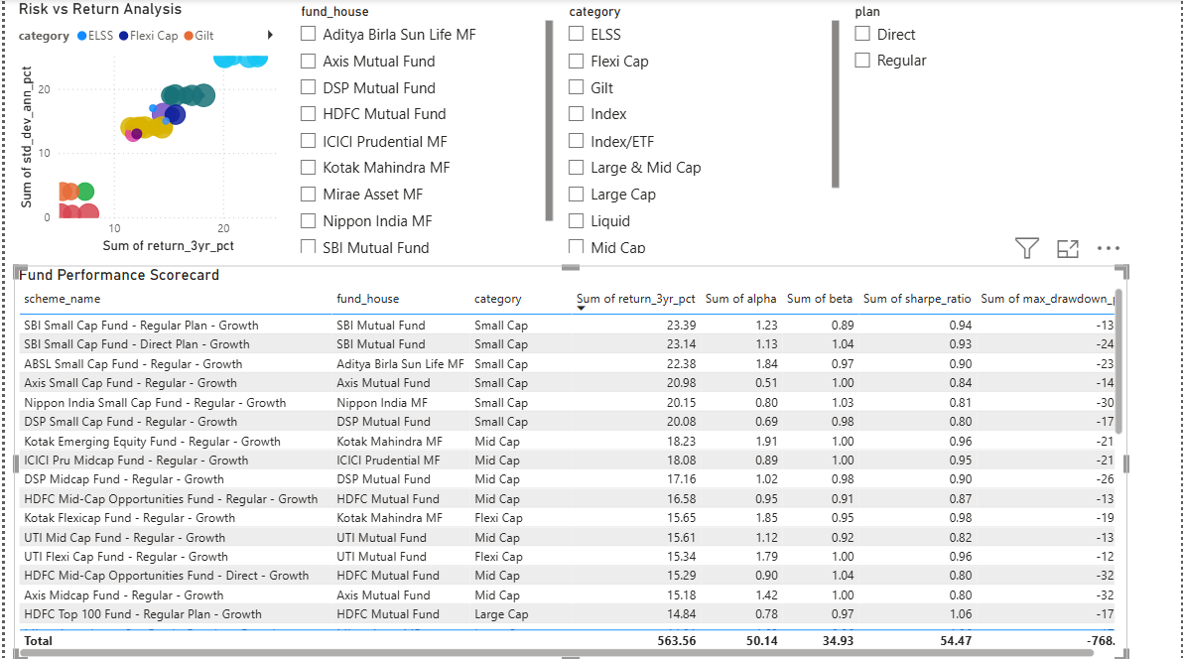
Dashboard Development
Industry Overview Dashboard
Fund Performance Dashboard
Provides a high-level view of industry growth and market participation.

Slide 10
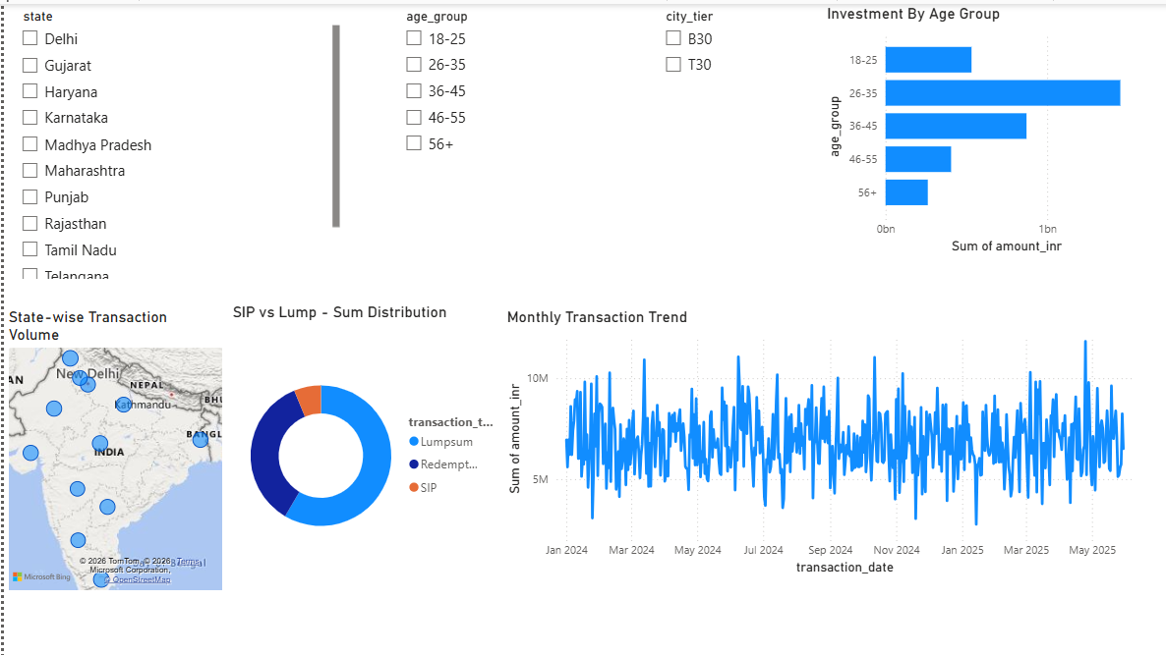
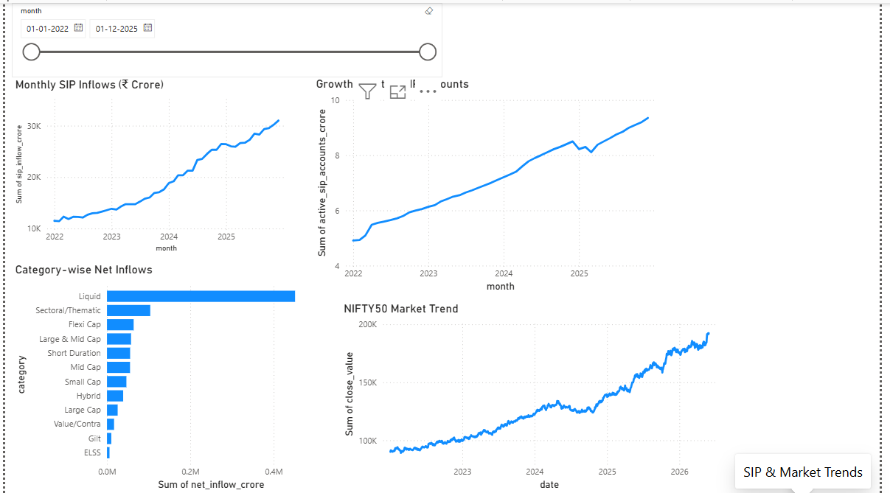
Dashboard Development
Advanced Analytics Dashboard
SIP & Market Trend Dashboard
Compare risk and returns
Analyze investor demographics
Monitor SIP growth trends
Track benchmark market movements

Slide 11
Key Findings
Mutual fund industry AUM showed continuous growth.
SIP inflows increased significantly during the analysis period.
Large-cap and diversified funds demonstrated stable performance.
Risk-adjusted returns varied across fund categories.
Investor participation increased across states and age groups.
Certain funds showed higher sector concentration risk.
Benchmark analysis identified outperforming schemes.
Dashboard visualizations improved decision-making efficiency.

Slide 12
Conclusion
The Bluestock Mutual Fund Analytics Platform successfully integrated data engineering, financial analytics, and business intelligence techniques into a unified solution.
The project enabled performance evaluation, risk assessment, investor behavior analysis, and dashboard-driven decision making using Python, SQLite, and Power BI.
THANK YOU

