Slide 1

Vel Tech Rangarajan Dr. Sagunthala R&D Institute of Science and Technology
School of Computing
Department of Computer Science and Engineering
10211CS224 / FULL STACK APPLICATION DEVELOPMENT (JAVA)
END SEMESTER PROJECT REVIEW
Date: 06-05-2026
JOB PORTAL MANAGEMENT SYSTEM
SDG: 9 – Industry, Innovation and Infrastructure
Presented By:
P.LIKITHA HARSHINI DEVI– VTU26654– 23UECS0456
Courses Handling Faculty:
Dr.S.Hemamalini – Assistant Professor(Senior Grade)-M.E,Ph.D

Slide 2
.
INTRODUCTION
• The Job Portal System is a web-based platform designed to connect job seekers and employers in a unified and efficient environment.
It enables users to explore opportunities, apply for jobs, and manage recruitment activities seamlessly from anywhere.
• The system provides a user-friendly interface that allows candidates to search and filter jobs based on skills, location, and experience.
This ensures a personalized and convenient job-hunting experience for every user.
• Employers can create and publish job postings with detailed descriptions, requirements, and selection processes.
They can efficiently manage applications and shortlist candidates through a centralized dashboard.
• The platform supports profile creation and resume management, helping job seekers showcase their skills and qualifications effectively.
This increases visibility and improves their chances of getting selected.
• Role-based authentication ensures secure and controlled access for Admin, Student, and Employer modules.
Each user type is provided with a customized dashboard based on their responsibilities.
• The system maintains a record of all job applications and provides real-time updates on application status.
This improves transparency and keeps users informed throughout the recruitment process.
• By automating job posting, application tracking, and communication, the system reduces manual effort and saves time.
It enhances efficiency and accuracy in the hiring workflow.
• Overall, the Job Portal System modernizes the traditional recruitment process by making it faster, more organized, and accessible.
It acts as a comprehensive solution for managing job opportunities and candidate applications effectively.
1
2
3
4
5
6
7
8
9

Slide 3
PROBLEM STATEMENT
1
• Job recruitment processes are often manual, unorganized, and time-consuming, leading to delays in hiring.
• Job seekers need to visit multiple platforms and websites to find suitable job opportunities, which is inefficient.
• There is no proper system available to track job applications and monitor their current status.
• Employers struggle to manage and organize large numbers of applicants effectively.
• Lack of a centralized database leads to data mismanagement and difficulty in accessing information.
• It is difficult to filter candidates based on required skills, qualifications, and experience.
• There is no proper communication system between job seekers and employers for updates and notifications.
• There is a high risk of duplicate applications or missing application records in manual systems.
2
3
4
5
6
7
8
9

Slide 4
OBJECTIVE(S)
1
• To design and develop a comprehensive web-based Job Portal System that enables job seekers to efficiently search, filter, and apply for job opportunities based on their skills, qualifications, and preferences, while providing a user-friendly interface that enhances accessibility, simplifies the job application process, and improves the overall user experience.
• To build a centralized recruitment platform that allows employers and administrators to create and manage job postings, track and review candidate applications, and streamline the hiring workflow through automation, role-based access control, and secure data management, thereby increasing efficiency, transparency, and effectiveness in the recruitment process.
2
3
4
5
6
7
8
9

Slide 5
PROPOSED SYSTEM
1
• The system is a web-based Job Portal Management System.
• It allows users to register and log in securely.
• Job seekers can create profiles and upload resumes.
• Users can search and filter jobs based on skills and location.
• Job seekers can apply for jobs and track their application status.
• Employers can post, edit, and delete job vacancies.
• Employers can view applicants and shortlist or reject candidates.
• The system stores all data in a centralized database and provides real-time updates.
2
3
4
5
6
7
8
9

Slide 6
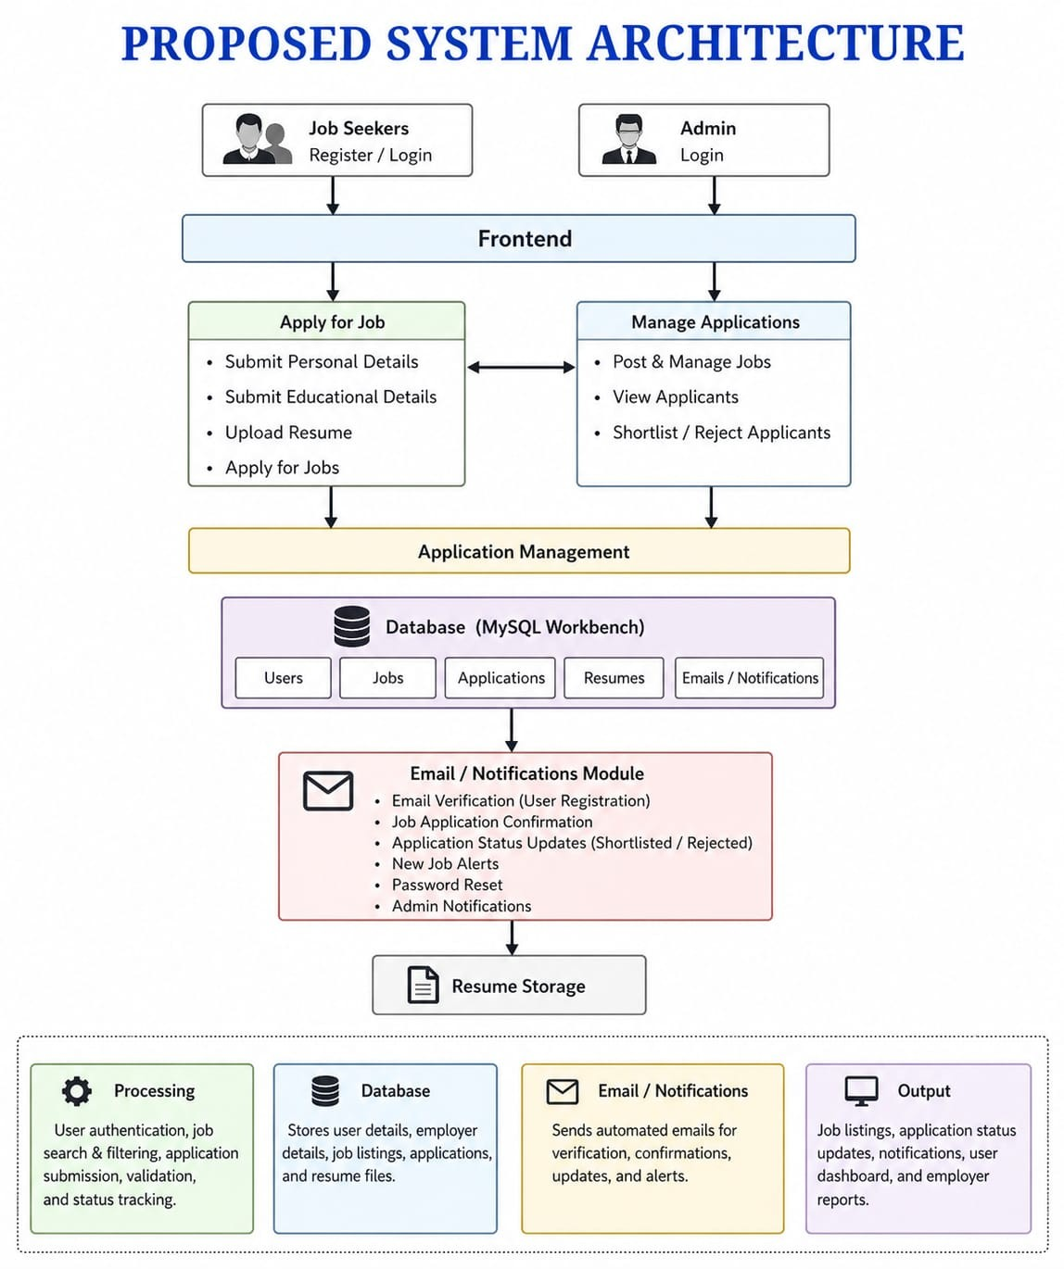
PROPOSED SYSTEM ARCHITECTURE
1
2
3
4
5
6
7
8
9

Slide 7
PROPOSED SYSTEM ARCHITECTURE
Input: User registration details, login credentials, job postings, resume uploads, and job applications.
Processing: User authentication, job search and filtering, application submission, validation, and status tracking.
Database: Stores user details, employer details, job listings, applications, and resume files.
Output: Job listings, application status updates, notifications, user dashboard, and employer reports.
1
2
3
4
5
6
7
8
9

Slide 8
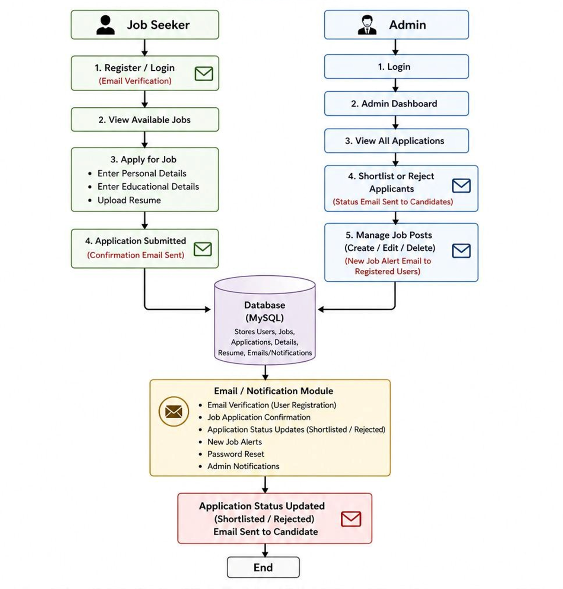
WORKFLOW
1
2
3
4
5
6
7
8
9

Slide 9
TECHNOLOGIES USED
1
Frontend:
- HTML5 , CSS3 , JavaScript , Bootstrap
Backend:
- Java, Spring Boot
Database:
- MySQL
Tools:
- Visual Studio Code, MySQL Workbench
Hardware/Software Requirements:
- System with minimum 4GB RAM
- JDK 8
- Spring Boot
- MySQL Server
- Web Browser (Chrome)
2
3
4
5
6
7
8
9

Slide 10
MODULE DESCRIPTION
1
Authentication Module: Handles secure user and admin registration and login with role-based access.
User Module: Allows users to view jobs, apply for jobs, and submit personal, educational details, and resumes.
Admin Module: Enables admin to manage job postings and review, shortlist, or reject applicants.
Job Management Module: Manages creation, updating, and deletion of job postings.
Application Management Module: Handles storage and tracking of all job applications and their status.
Database Module: Stores all user data, job details, applications, and resume information securely.
2
3
4
5
6
7
8
9

Slide 11
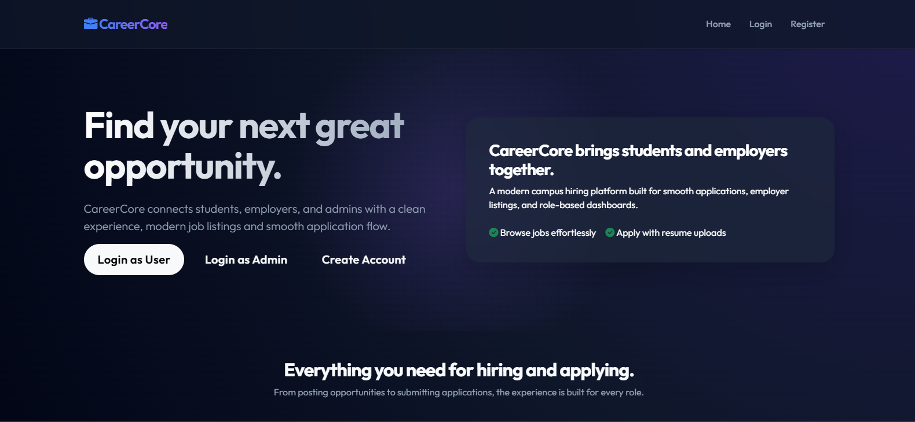
IMPLEMENTATION SCREENSHOTS
HOME PAGE
1
2
3
4
5
6
7
8
9
This is the main entry page of the Job Portal where users can navigate to login or sign up.
It provides an overview of the platform and allows users to explore job opportunities or get started.

Slide 12
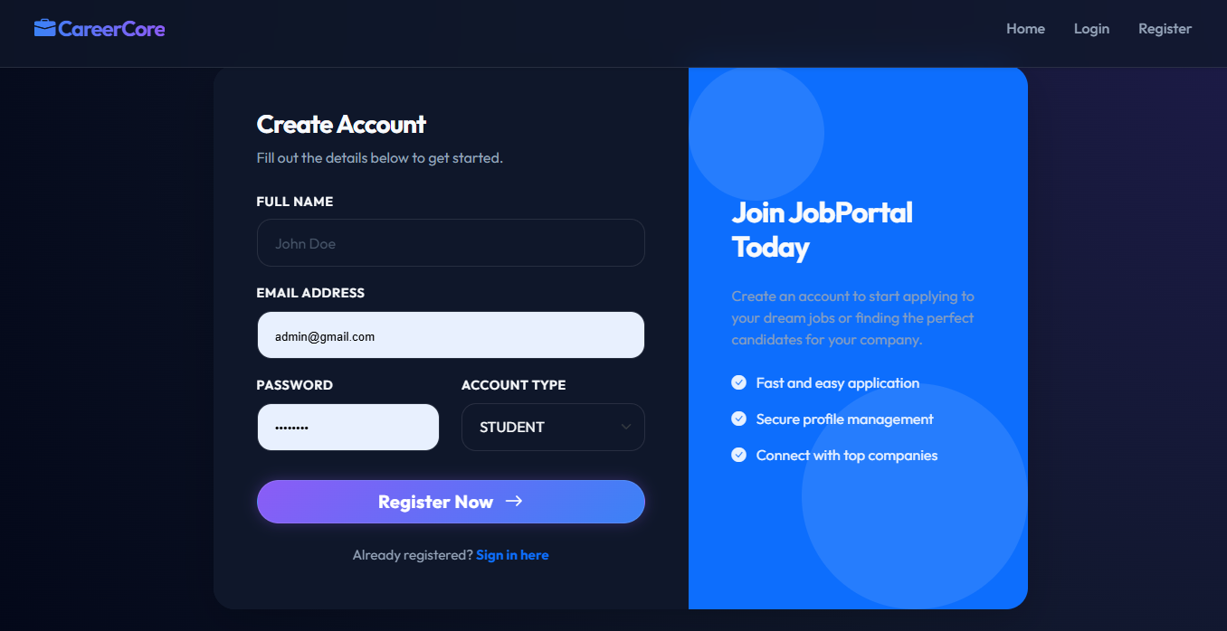
IMPLEMENTATION SCREENSHOTS
REGISTRATION PAGE
1
2
3
4
5
6
7
8(A)
• This page allows users or employer to create a new account by entering details like name, email, and password.
• It ensures secure user or employer registration and provides access to the job portal features after successful signup.
9

Slide 13
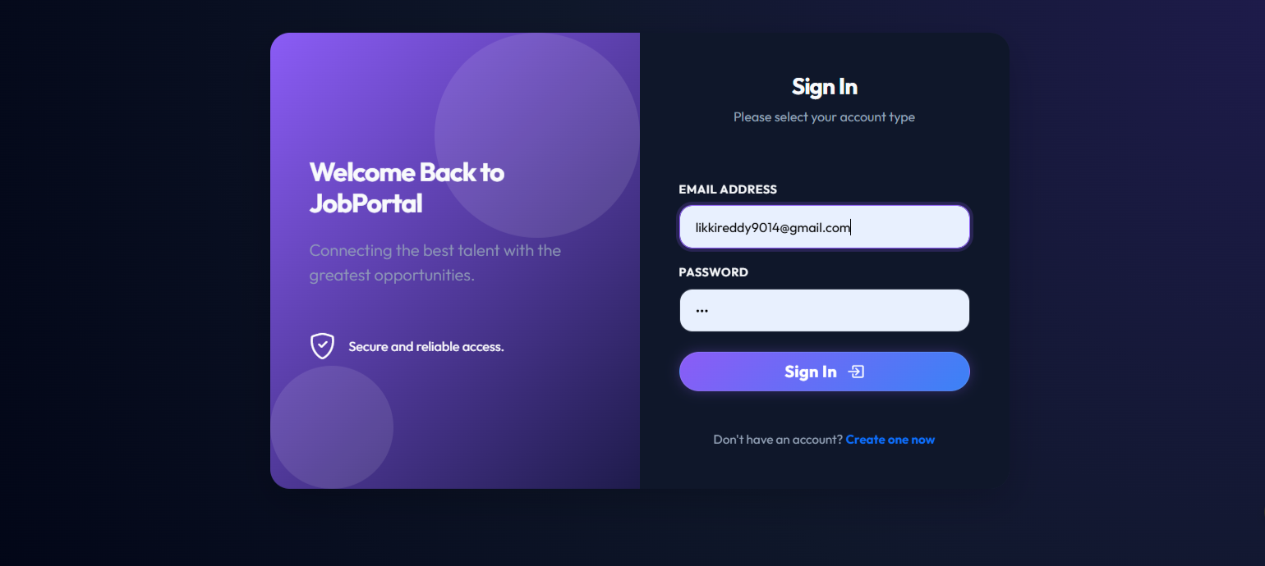
IMPLEMENTATION SCREENSHOTS
LOGIN PAGE
1
2
3
4
5
6
7
8(B)
• This page allows registered users or employers to log in using their email and password.
• It provides two separate logins one for admin and other for user
9

Slide 14
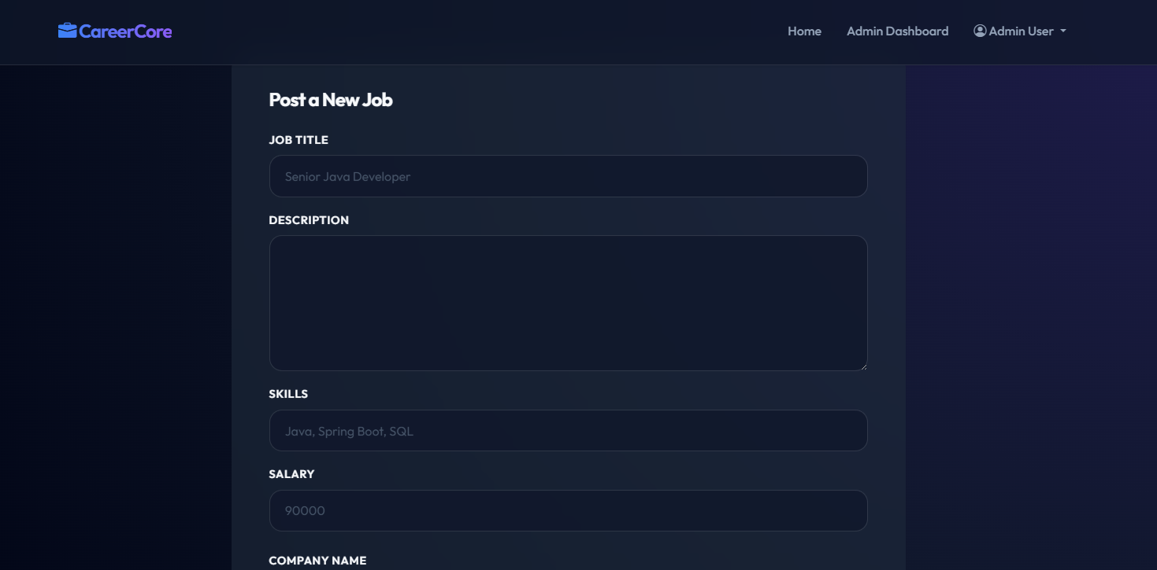
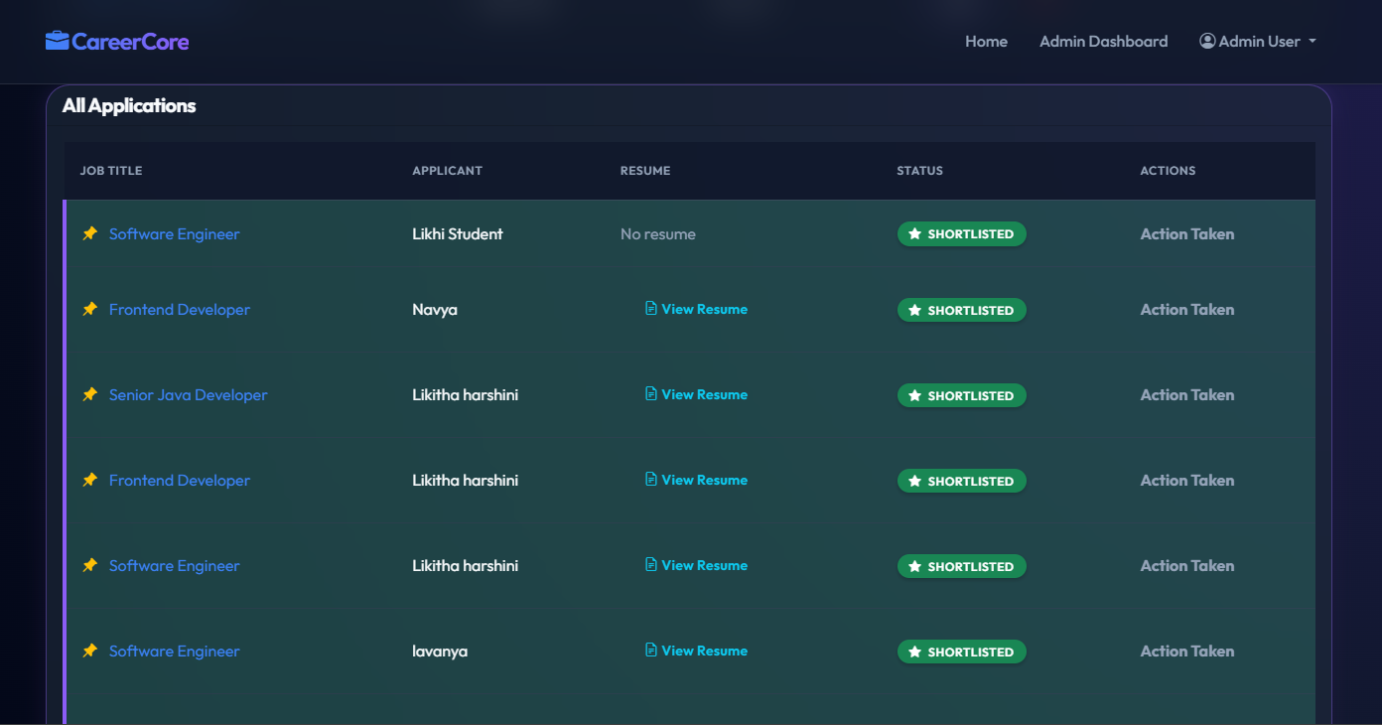
IMPLEMENTATION SCREENSHOTS
ADMIN JOB POSTING PAGE
1
2
3
4
5
6
7
8(C)
9

Slide 15
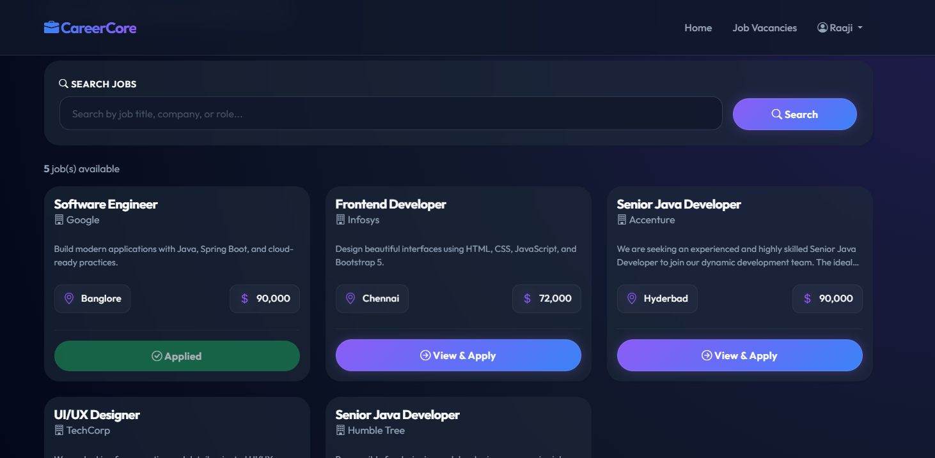
IMPLEMENTATION SCREENSHOTS
USER MODULE
1
2
3
4
5
6
7
8(D)
9

Slide 16
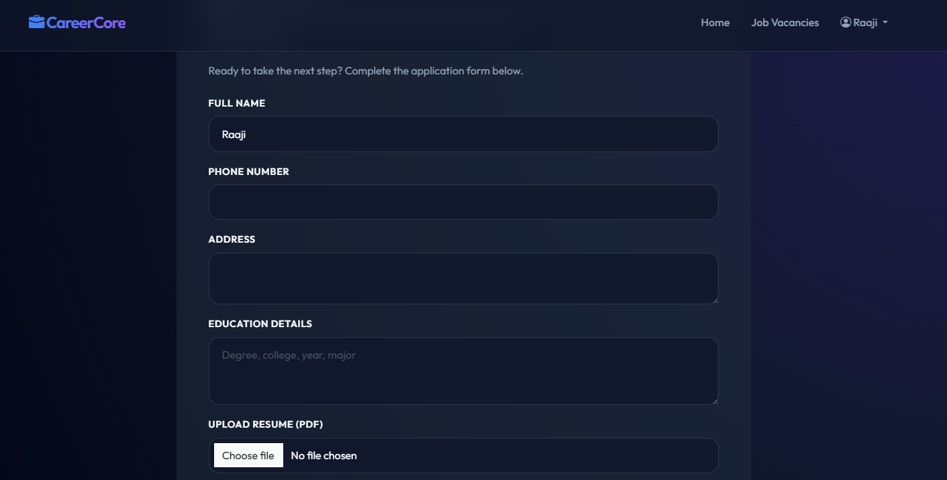
IMPLEMENTATION SCREENSHOTS
APPLICATION MODULE
1
2
3
4
5
6
7
8(E)
9

Slide 17
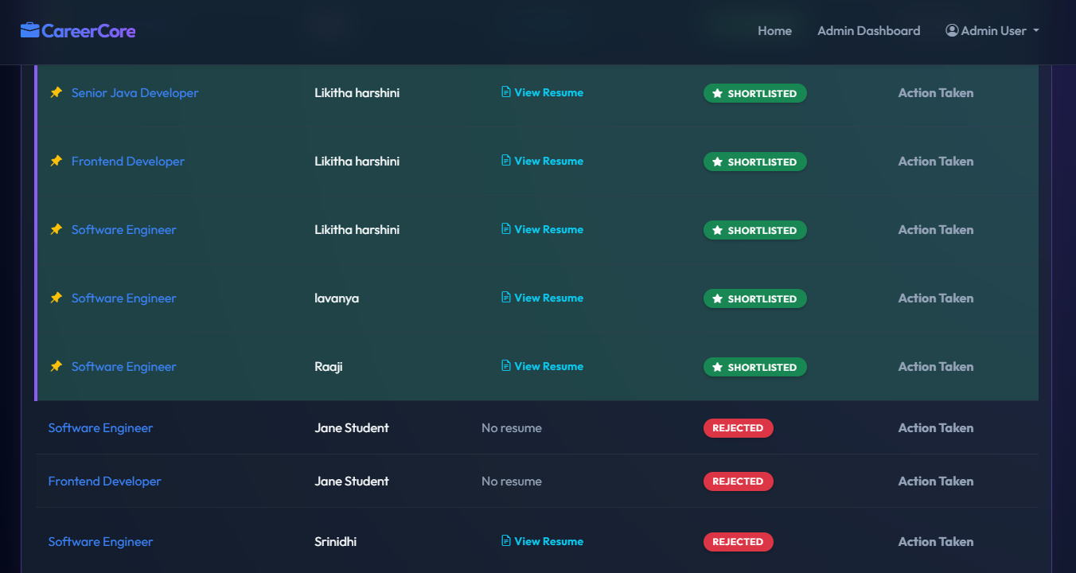
IMPLEMENTATION SCREENSHOTS
APPLICANT MANAGEMENT PAGE
1
2
3
4
5
6
7
8(F)
• This page allows employers to view all applicants for a specific job along with details like name, email, background, and resume.
• It enables employers to update application status by shortlisting or rejecting candidates.
9

Slide 18
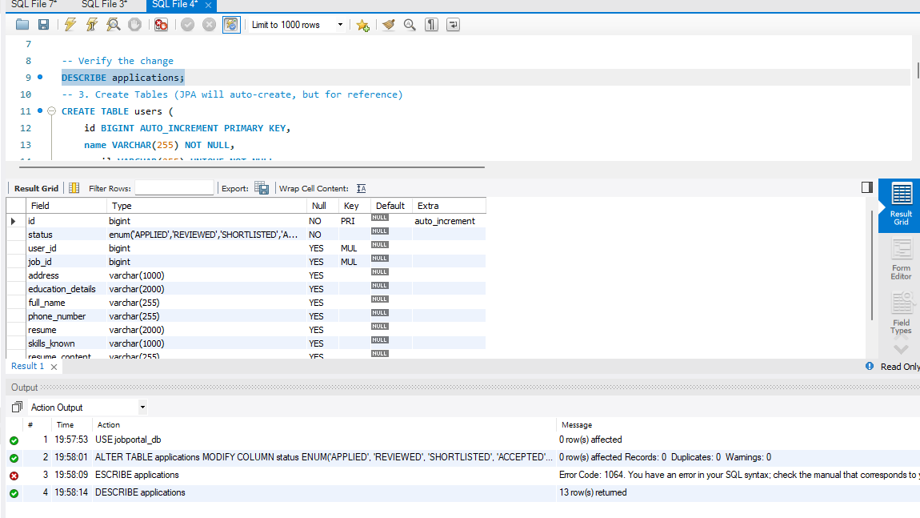
IMPLEMENTATION SCREENSHOTS
DATABASE:MYSQL
1
2
3
4
5
6
7
8(F)
9

Slide 19
ADVANTAGES & LIMITATIONS
1
ADVANTAGES:
• Reduces manual recruitment process and saves time. • Easy job search and application for users. • Employers can manage job postings and applicants efficiently. • Provides real-time application tracking and updates. • Centralized database ensures organized data management.
Limitations:
• Requires internet and system availability. • Basic security (can be improved with advanced encryption). • Depends on server availability (Spring Boot/MySQL).
2
3
4
5
6
7
8
9

Slide 20
Thank you

