Slide 1
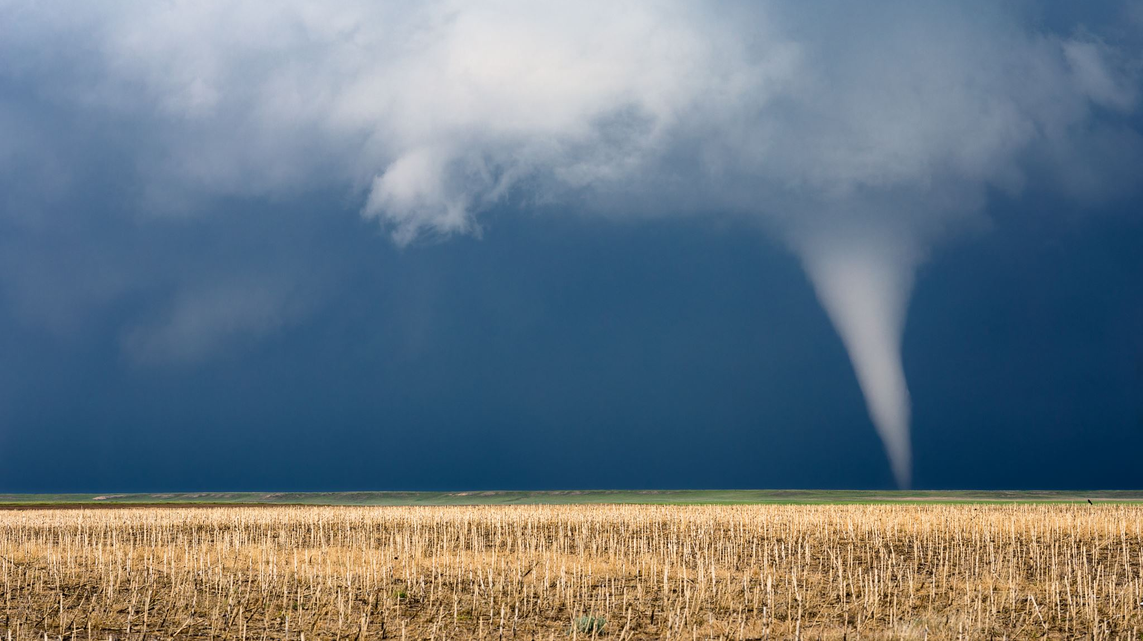
Data-Driven Insights to Prioritize Tornado Preparedness
MSDA 3060 - Data Visualization and Story Telling Project Emon Tofazzal &

Slide 2


Data Source
Overview:
Sourced from the NOAA Storm Prediction Center & National Weather Service.
The dataset includes detailed tornado occurrences (date, time, location, intensity).
Accessible for researchers, meteorologists, and educators.
Purpose:
Analyze patterns in tornado frequency and severity.
Support improved storm prediction efforts.
Enhance public safety and resource allocation.

Slide 3
Target Audience
Target Audience:
Meteorologists, weather researchers, and emergency management professionals.
Relevance:
Assists meteorologists in refining tornado prediction models.
Enables emergency planners to develop more effective response strategies.
Data-driven decisions can improve preparedness and save lives.

Slide 4
Big Idea Sentence
Understanding the frequency and severity of tornadoes across different states can help decision-makers prioritize disaster preparedness and resource allocation.

Slide 5
Conclusion
Tornado Patterns
States with the highest frequency of tornadoes is Texas.
Seasonal trends show peaks in May.
Higher tornado magnitudes are linked to increased injuries, fatalities and economic losses.
Insights
Resource allocation should prioritize high-risk areas.
Community education and infrastructure readiness are crucial.
Takeaways:
Use data-driven insights to optimize prediction models.
Focus resources on states and times with the highest risks.
Collaboration between meteorologists and emergency planners is key to mitigating tornado impacts.

