Slide 1


Threads of Insight: Flipkart Fashion Analytics
KANDACHARAM LIKHITHA
BATCH NO:403
Innomatics Research Labs Dilshuknagar

Slide 2

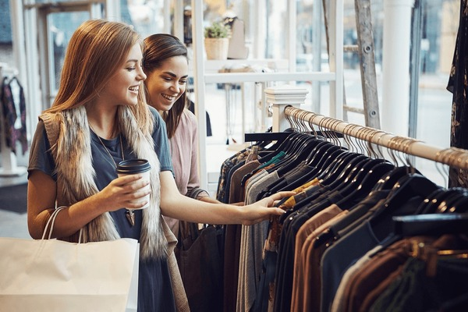
Contents
Introduction
Problem Statement
Data Collection
Collected Data
Data Cleaning
Cleaned Data
Bivariate Analysis
Multivariate Analysis
Insights
Conclusion

Slide 3
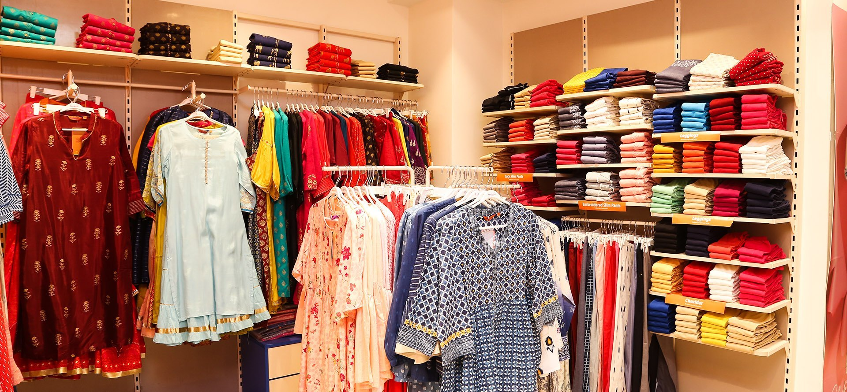
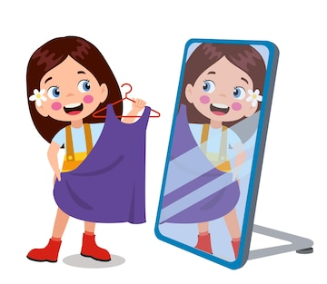
Introduction
Flipkart, started in 2007, is one of India’s biggest online shopping platforms, where people buy everything from mobiles to clothes. Clothing is one of the most popular categories, with thousands of products available in different styles, brands, prices, and discounts.
In this project, we collected Flipkart clothes data and performed Exploratory Data Analysis (EDA). The goal is to study prices, discounts, ratings, and categories to find useful trends and insights about customer choices and fashion patterns.

Slide 4
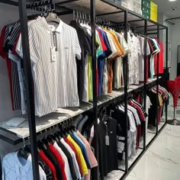
Business Objective
Customers get confused while shopping for clothes online — too many options, fast-changing trends, and unclear signals about what’s stylish. This often leads to abandoned carts and lost sales. Businesses struggle to show the right trending products at the right time, causing revenue loss and excess inventory.
This project uses data analysis to find which clothes are trending, what prices and discounts attract buyers, and how to guide customers better.

Slide 5
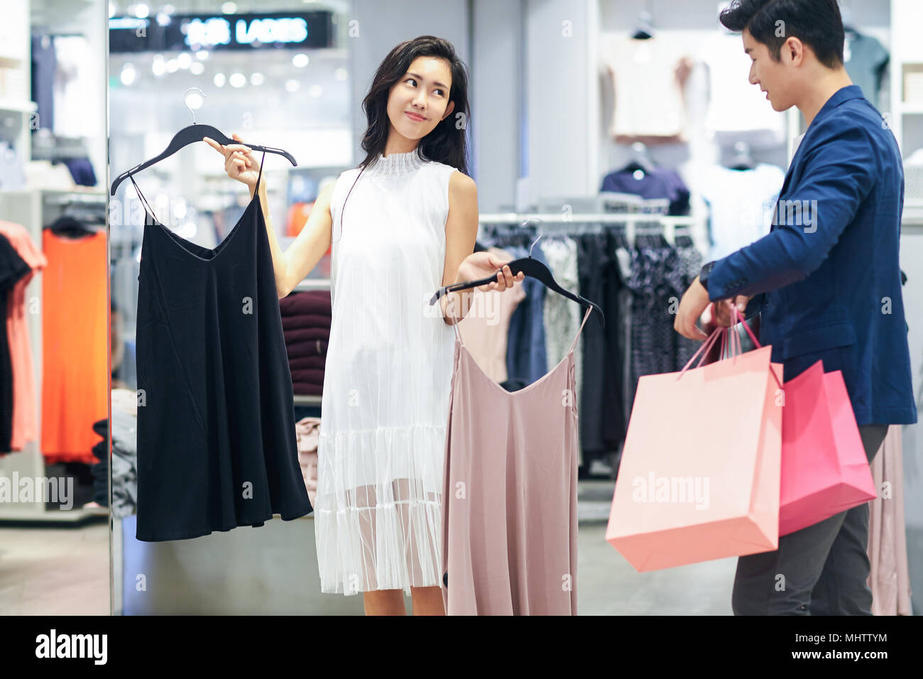
Steps For Collecting Data
Collect Clothing Data from Flipkart
Install Required Python Libraries
Inspect and Understand the Data Structure
Clean and Preprocess Data
Analyze Price, Discount, and Ratings Columns
Visualize Data with Charts and Graphs
Explore Best Deal Categories
Identify Patterns and Customer Preferences
Present Insights and Recommendations

Slide 6
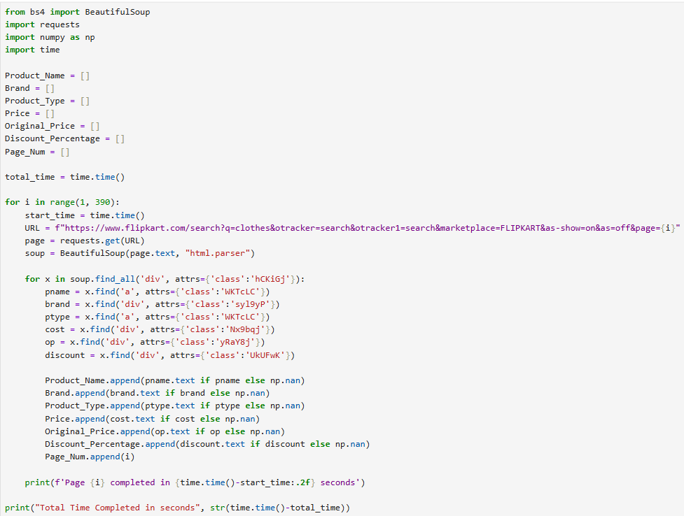
Sample Code

Slide 7
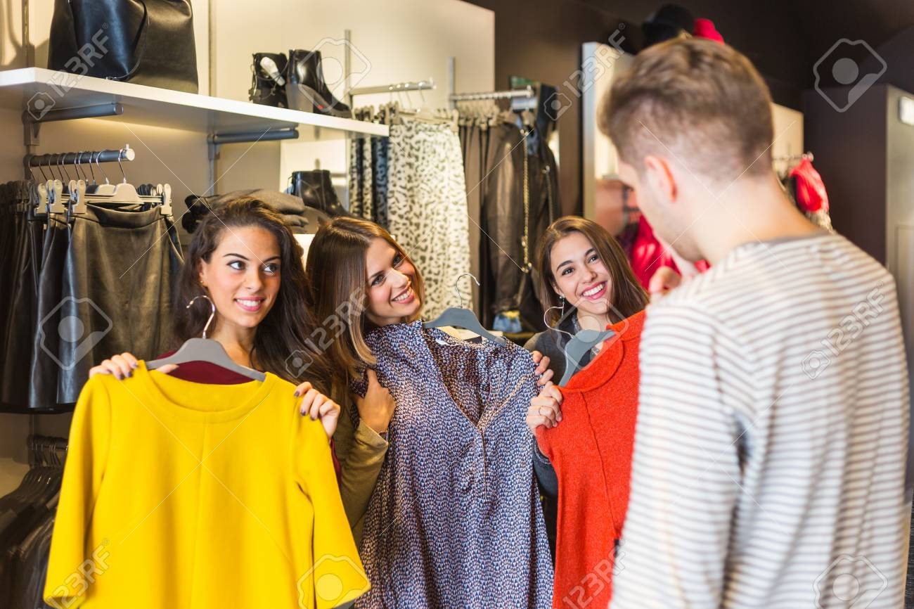
Collected Data
Product Name : The name of the clothing item.
Brand : The company or label that makes the product.
Product Type : The category or type of clothing (like shirt, jeans, etc.).
Price : The selling price of the item after any discounts.
Original Price : The price before any discount is applied.
Discount Percentage : How much discount is given, shown as a percent.
Page Num : The page number where the product was found during data collection.

Slide 8
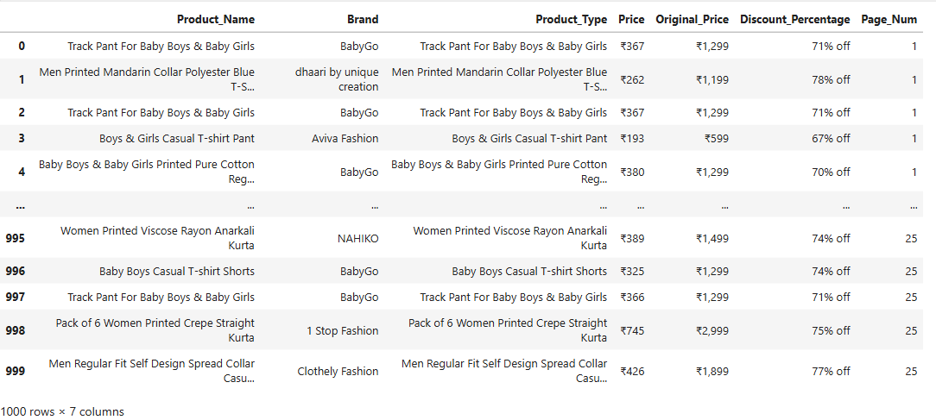
Raw Data

Slide 9
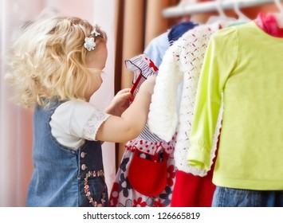
Steps For Cleaning Data
Create a Data Frame from the collected data after running the script and check if the data needs cleaning.
If the data is not clean, start cleaning it.
Check for missing (null) values and duplicate entries in the Data Frame; if there are none, the data is ready for the next steps.
Clean the text columns by removing extra spaces, special symbols, and HTML tags using regular expressions.
Change the data types of each column to the most suitable type, such as float or int, as needed.
Check the size (shape) of the cleaned Data Frame and save it for analysis.

Slide 10
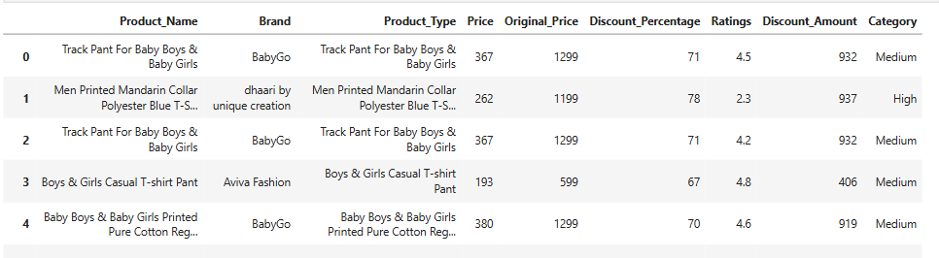
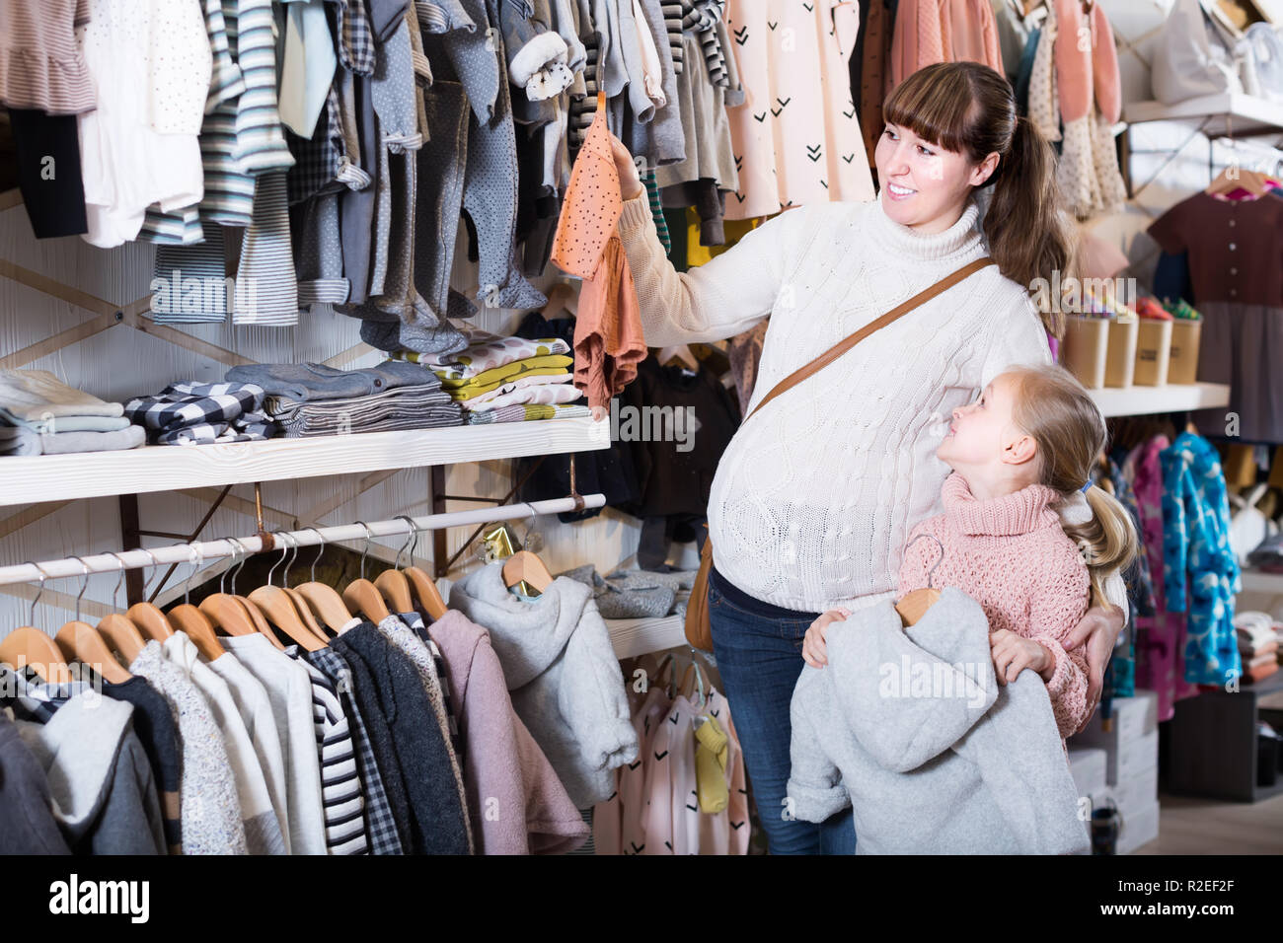
Quick view of Cleaned data

Slide 11
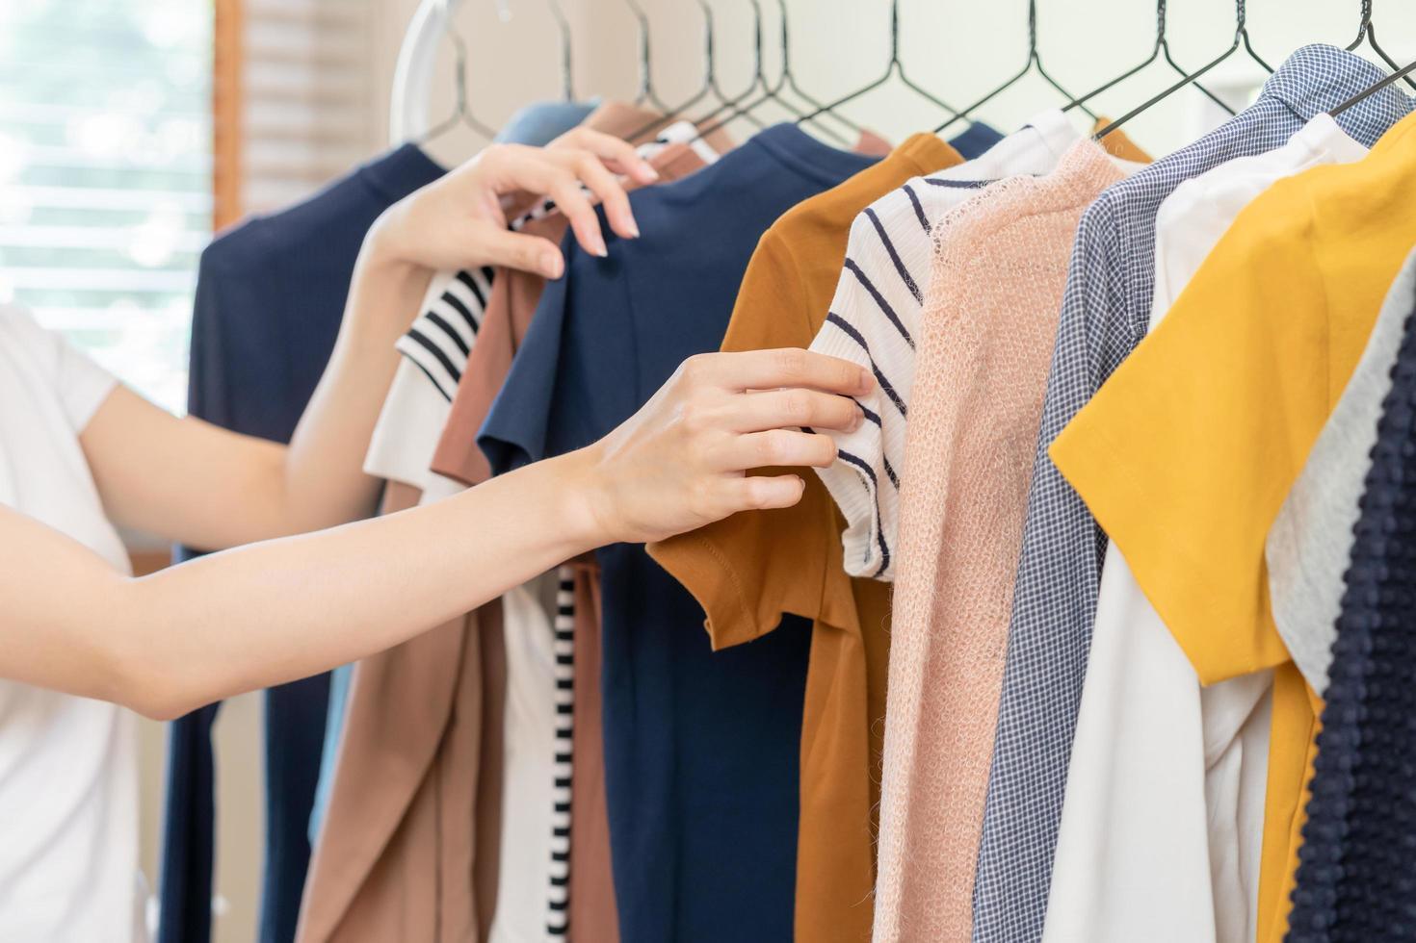

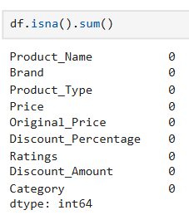
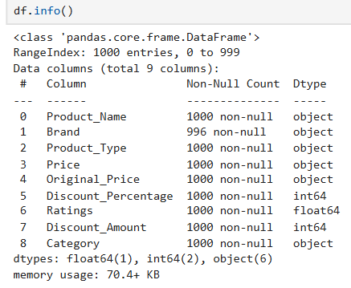
Type and shape of data

Slide 12
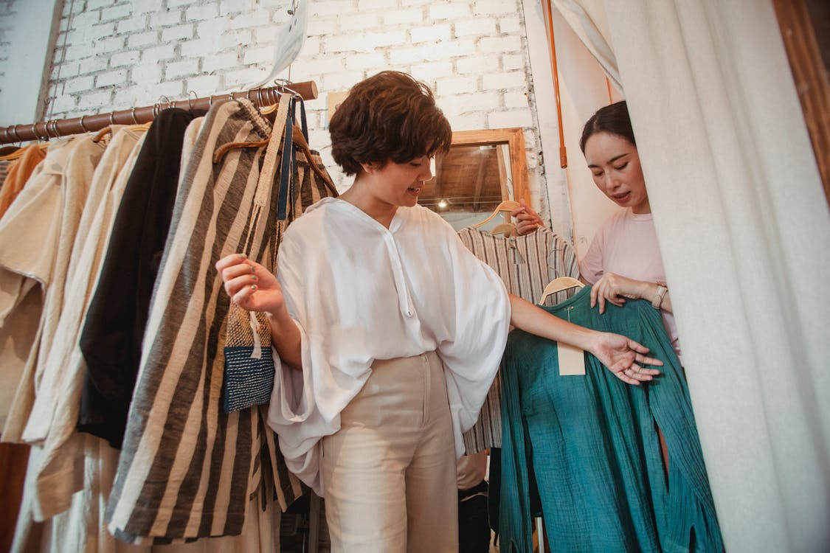
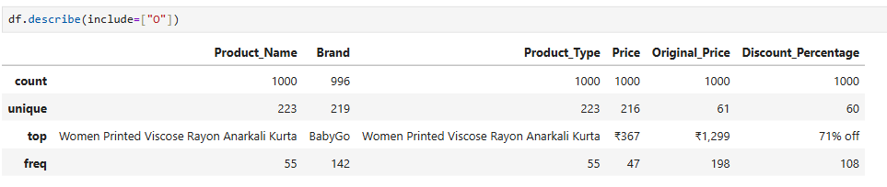
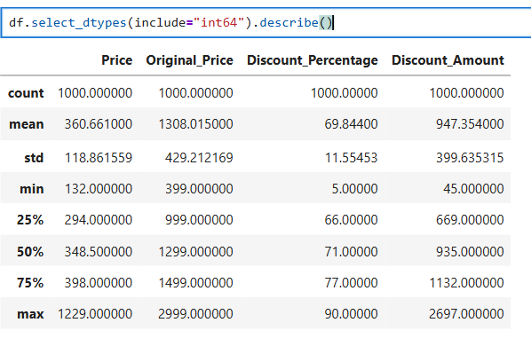
Statistical Data

Slide 13
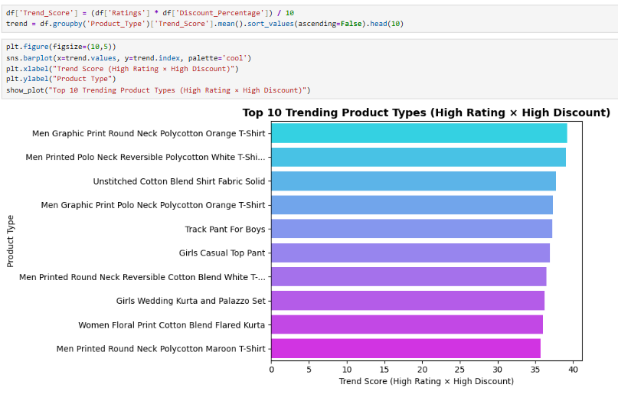
Analysis questions
Which product types combine high ratings and strong discounts ? These reveal what’s currently hot , Ternd and most loved by customers?
Insights:
Men’s T-shirts are the most liked. They show up four times in the top 10. People love wearing T-shirts, and they sell really well.
Good deals make products popular. The “Trend Score” depends on both ratings and discounts. Products that people like and that have good offers become best-sellers.
Everyone is shopping. The list has clothes for men, women, and kids — like T-shirts, Kurtas, track pants, and tops. Families are buying for all.
Some people like to stitch their own clothes. The “Unstitched Fabric” item shows that many people want to buy cloth and make clothes that fit them perfectly.

Slide 14
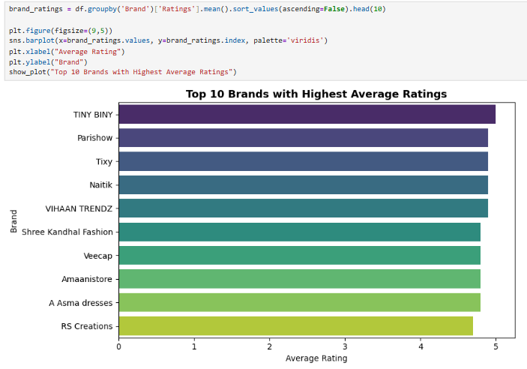
Which brands maintain the highest average ratings? These brands reflect strong customer trust and satisfaction.
Insights:
Customers are very happy. All the top 10 brands have very high ratings, almost perfect scores. People really like their products.
No single top winner. The ratings are very close for all brands, so there’s almost no difference between the first and tenth. The competition is very strong.
Small brands can do great. These top brands aren’t all big names. This shows that even small brands can become popular if they offer good quality.
Quality matters most. To get such high ratings, these brands must give customers great quality every time. Even a few bad products would lower their score.

Slide 15
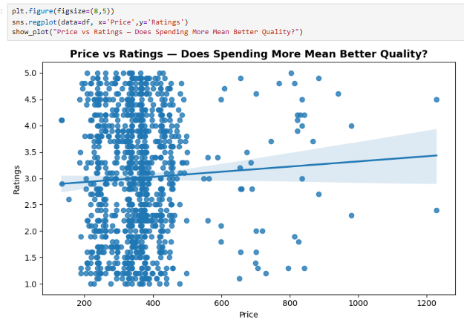
Do customers rate expensive clothes higher? Analyzes whether higher prices actually improve perceived quality.
Insights
Paying more doesn’t mean better quality. The graph shows no clear link between price and rating. Both good and bad products exist at all price levels.
Good quality can be cheap. Many low-priced products have very high ratings. This proves that quality products don’t always cost a lot.
Price doesn’t show quality. Items with the same price can have very different ratings. This means price alone can’t tell you how good a product is.
Most items cost between ₹200 and ₹400. This is the most common price range, but even here, ratings vary a lot — some are great, some are not.

Slide 16
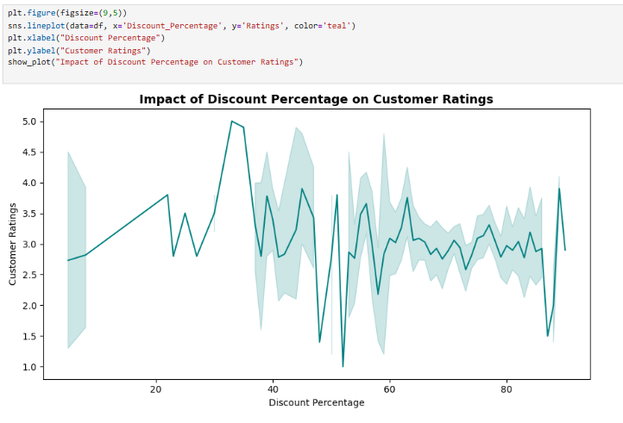
Does increasing discount percentage always lead to higher ratings,or is there an optimal range that maximizes satisfaction?
Insights:
Big discounts don’t always mean happy customers. Products with small discounts can still have high ratings, while big discounts don’t always make people satisfied.
Customer response is hard to predict. Even a small change in discount can make ratings go up or down a lot.
Some discount levels work better. Discounts around 22%, 35%, or 52% seem to make customers happier and get better ratings.
Very high discounts can reduce trust. Huge discounts, like 25–30% or 60–80%, can make customers doubt the product’s quality.

Slide 17
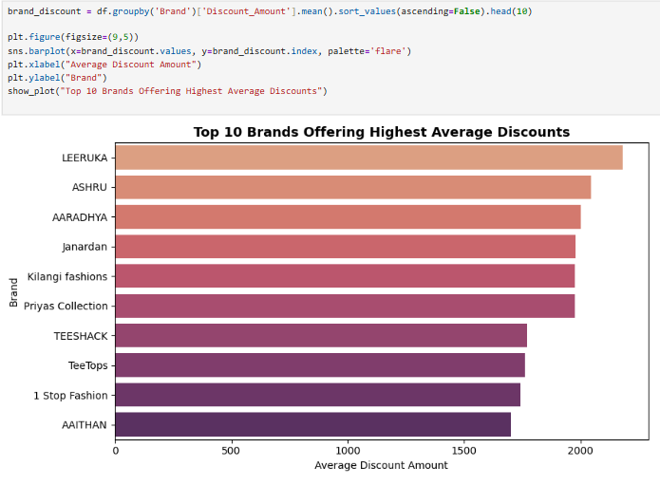
Which brands give the biggest average discounts while keeping product appeal high?
Selection deleted
Insights:
Some brands give very big discounts. Top brands like LEERUKA, ASHRU, and AARADHYA use large discounts to attract customers.
Brands follow different discount plans. There are clear groups — some give very high discounts, some give medium ones, and others give smaller but still good offers. Each brand uses its own strategy.
Most brands sell fashion items. These names show that they belong to the clothing and fashion market, where big discounts are common because of strong competition and seasonal sales.

Slide 18
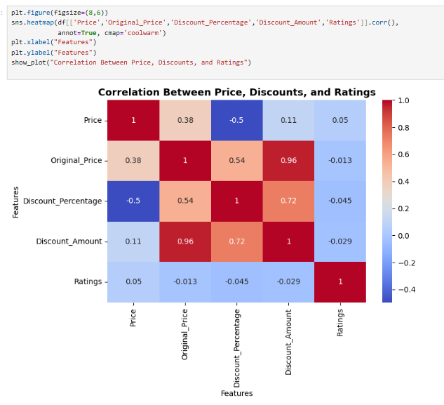
How do numeric factors influence one another? Identifies hidden drivers of satisfaction and value perception.
Selection deleted
Insights:
Product quality matters more than price. Customer ratings don’t depend on price or discount. People judge a product by how good it is, not by how much it costs or how big the offer is.
Big discounts come from high original prices. A strong link (0.96) shows that large discount amounts usually mean the product was expensive before the discount.
Costly items often get higher discount percentages. There’s a clear connection (0.54) showing that brands give bigger percentage discounts on expensive items to make them look like better deals.
Discounts cut prices, not complaints. A negative link (-0.5) shows that bigger discounts make prices lower, but they don’t make customers any happier. Satisfaction still depends on product quality.

Slide 19
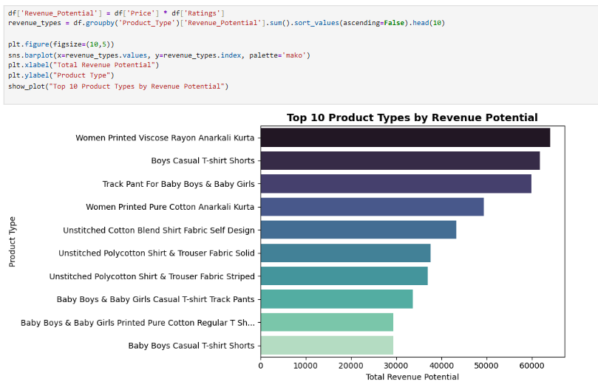
Which product types combine good pricing and customer Satisfaction,Making them most profitable to focus on?
Insights:
Specific Products Make the Most Profit: Highly detailed items, like “Women Printed Viscose Rayon Anarkali Kurta,” earn more than generic products.
Two Markets Drive Revenue: Women’s ethnic wear (Anarkali Kurtas) and children’s casual wear (T-shirts, shorts, track pants) dominate sales.
DIY Fashion is Profitable: Unstitched fabrics for custom tailoring show strong demand, creating a separate revenue stream.
Revenue = Price × Ratings: Top products are priced well and loved by customers, avoiding cheap low-profit or expensive low-rated items.
Strategic Focus for Growth: Expand Anarkali Kurtas, children’s casual wear, and unstitched fabric lines to maximize profit and customer satisfaction.

Slide 20
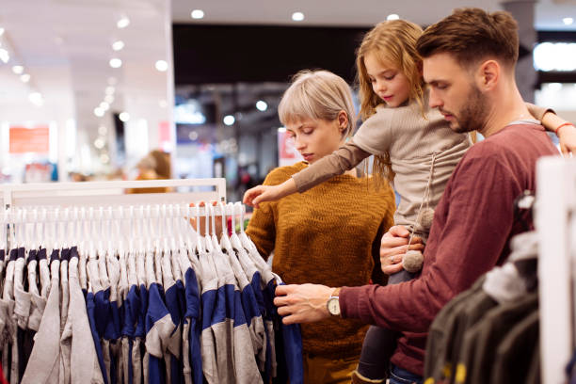
Insights:
Key Insights for Trending Products
Specific Products Sell Best: Customers prefer clear, well-defined items like “Women Printed Viscose Rayon Anarkali Kurta” or children’s T-shirts, rather than generic products.
Comfort and Casual Wear Are Popular: Men’s T-shirts, children’s casual clothes, and everyday ethnic wear for women are always in demand.
Bundles and Multipacks Boost Sales: Packs like “2 T-shirts together” attract buyers because they feel they are getting more value.
Discounts Don’t Guarantee Happiness: Big discounts catch attention but don’t improve customer satisfaction; quality matters more.
Price Doesn’t Equal Quality: Affordable items can be highly rated, and expensive items can still be poorly rated. Customers care about style, comfort, and quality.

Slide 21
Insights:
Clear and Trending Products
Men’s T-shirts sell the most, but women’s Anarkali Kurtas and kids’ T-shirts and track pants are also popular.
Customers like specific designs, colors, fabrics, and special features (like reversible T-shirts or printed kurtas), not generic items.
Quality is More Important Than Price
Customers rate products based on quality, not price or discounts.
Expensive items aren’t always better; cheap items can be highly rated.
Big discounts bring bargain hunters but don’t always lead to happy or loyal customers.
Balanced Discounts Work Best
Medium discounts work better than very big or extreme discounts.

Slide 22
Insights:
Different Customer Groups
Families shop for men, women, and kids.
Many people like DIY/custom clothes like unstitched fabrics for a personal fit.
Profit Comes from Quality and Price Together
Products that are well-priced and highly rated make the most profit.
“Revenue potential” = Price × Rating. Best products balance cost and customer satisfaction.
Growth Opportunities
Focus on Men’s T-shirts, Women’s Anarkali Kurtas, Kids’ Casual Wear, and Unstitched Fabrics.
Show trending items clearly with specific styles, fabrics, and features.
Use moderate, trustworthy discounts to attract buyers without lowering trust.

Slide 23
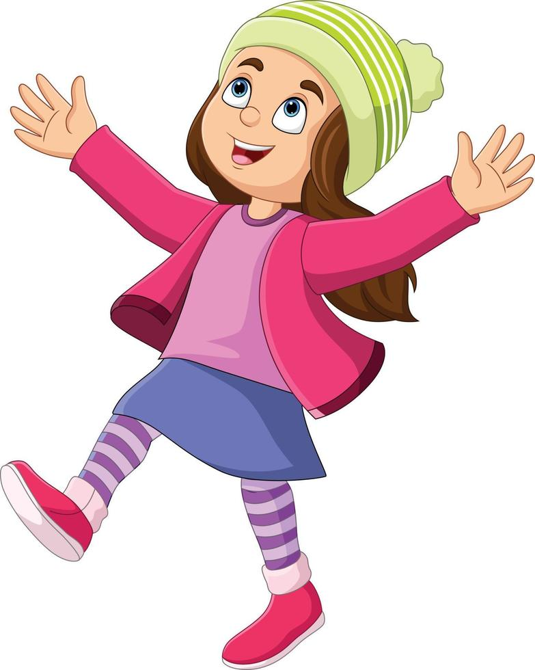
Conclusion
For Customers: Clear information about trending, good-quality, and reasonably priced clothes makes shopping easier and faster.
For Businesses: Helps show the right products, set better prices and discounts, sell more, and manage stock well.
Impact: Fewer abandoned carts, happier customers, better use of inventory, and higher sales.

Slide 24

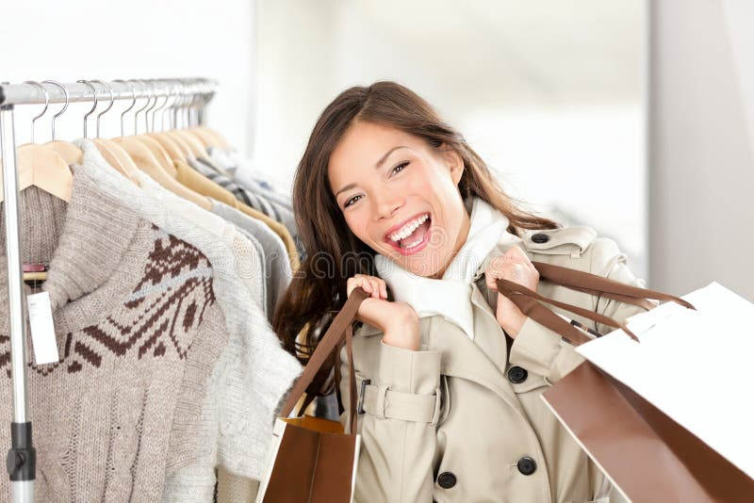
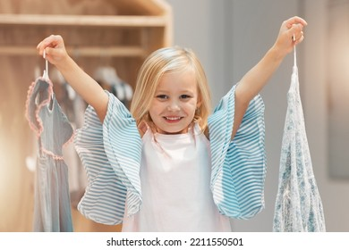
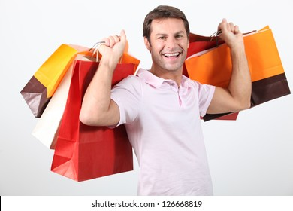
Grateful for your attention—where style meets smart shopping!
Thank you

