Slide 1




INNOVATION. AUTOMATION. ANALYTICS
PROJECT ON
World Wide Energy Consumption
KANDACHARAM LIKHITHA
Batch 403
Innomatics Research Labs,Dilsukhnagar

Slide 2

Objective of the Project
The objective of this project is to analyze worldwide energy data to understand how countries consume, produce, and emit energy, and how these factors connect with population and economic growth. By studying this data, we aim to identify patterns, trends, and relationships between energy use, GDP, and emissions, helping build a clear picture of the link between economy and environmental impact on a global scale.

Slide 3
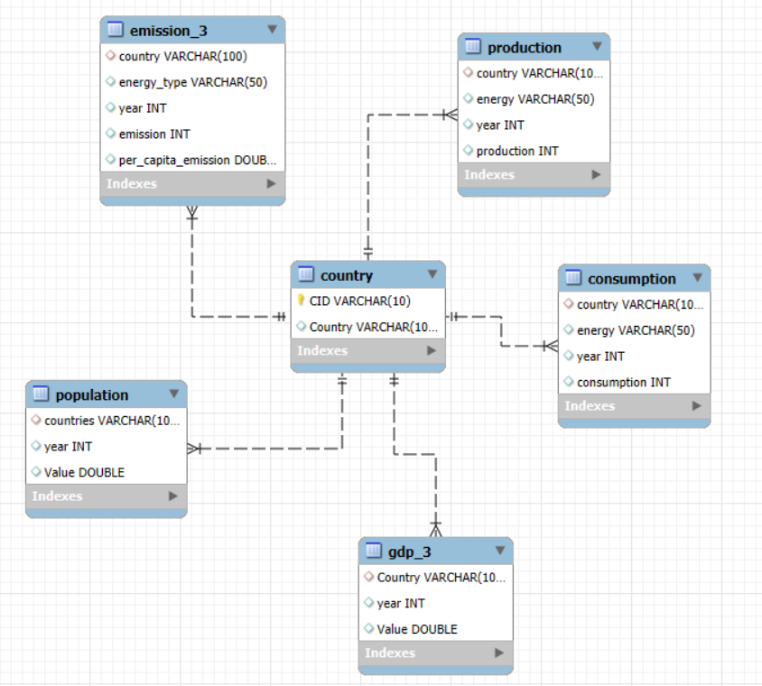
ER Diagram

Slide 4
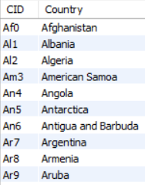
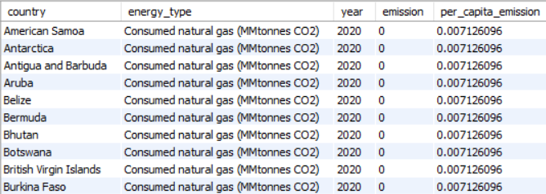
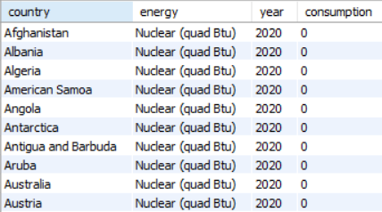

About Tables
Emission_3 Table
Country Table
Consumption Table

Slide 5
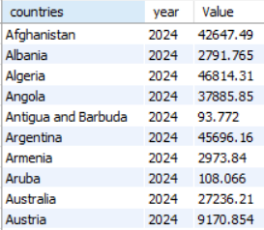
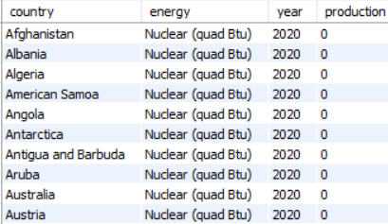
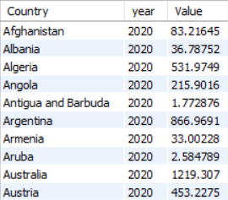

Population Table
Production Table
gdp_3 Table

Slide 6

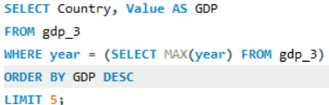
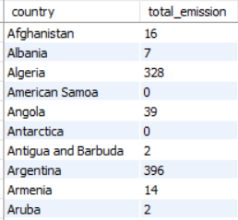
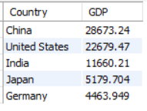
Data Analytics Questions ,Queries and Output
1. Total emission per country for the most recent year
2. Top 5 countries by GDP in the most recent year
Query
Query
Output
Output

Slide 7
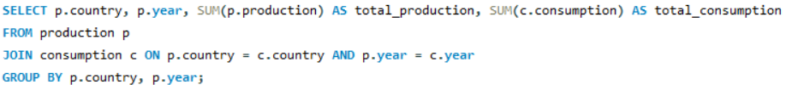
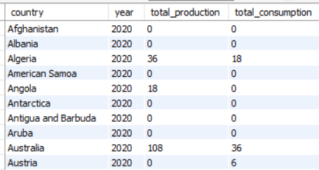
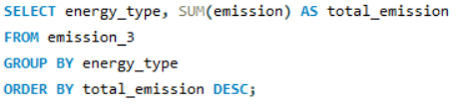
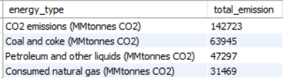
3. Compare energy production and consumption by country and year
Query
Output
4. Energy types contributing most to emissions
Query
Output

Slide 8


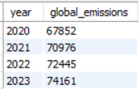
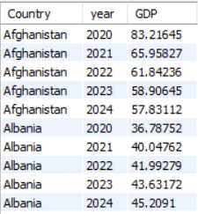
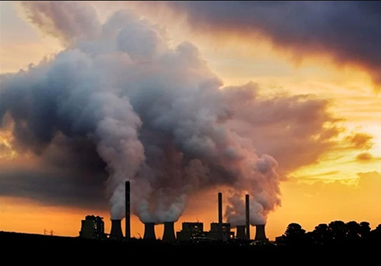
5. Global emissions trend year over year
6. GDP trend by country
Query
Query
Output
Output

Slide 9
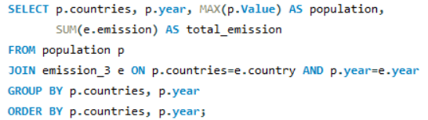
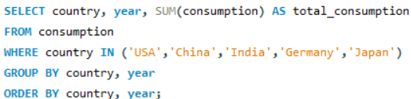
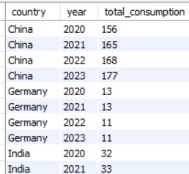
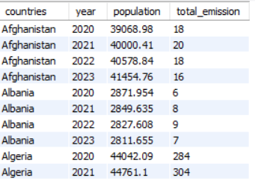
7. Population vs Emissions per country
8. Energy consumption trend for major economies
Query
Query
Output
Output

Slide 10

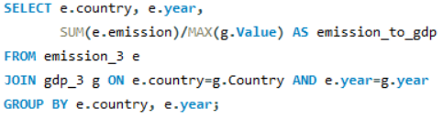
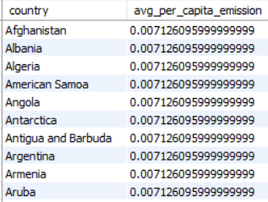
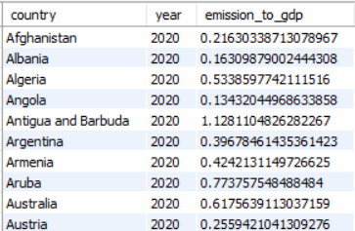
9. Average per capita emissions (per country)
10. Emission-to-GDP ratio (per country per year)
Query
Query
Output
Output

Slide 11
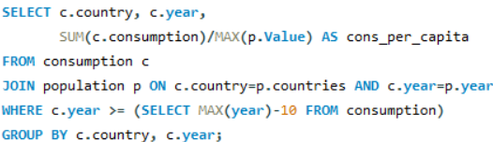
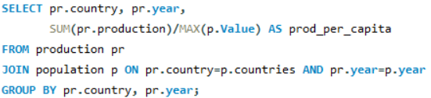
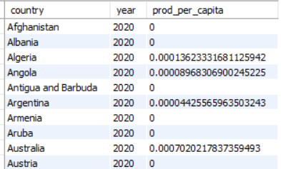
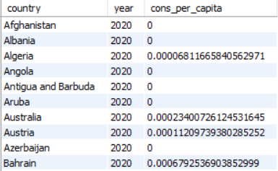
11. Energy consumption per capita (last 10 years)
12. Production per capita across countries
Query
Query
Output
Output

Slide 12
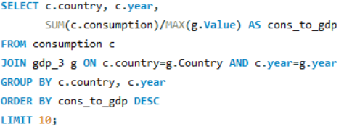
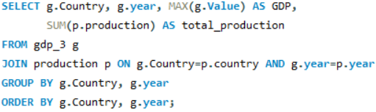
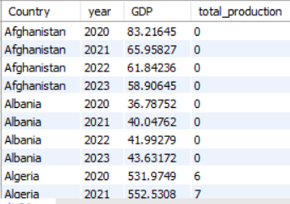
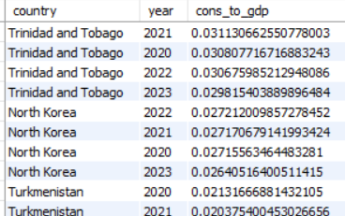
13. Highest consumption relative to GDP
14. GDP vs Production growth
Query
Query
Output
Output

Slide 13
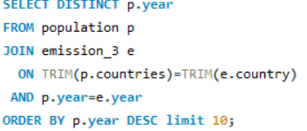
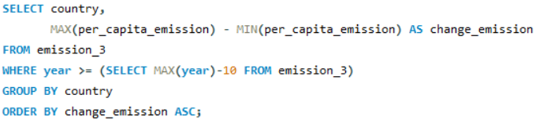

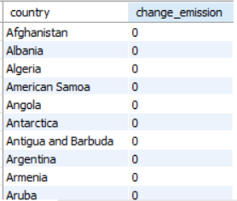

15. Top 10 countries by population & their emissions
16. Countries reducing per capita emissions (last decade)
Query
Query
Output
Output

Slide 14
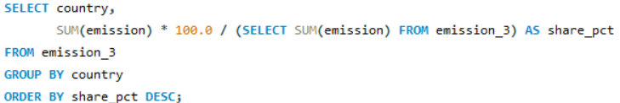
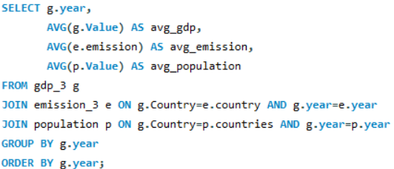
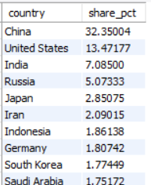
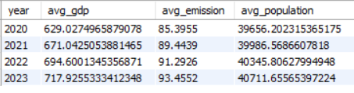
17. Global share of emissions by country
Query
18. Global average GDP, emissions, population per year
Query
Output
Output

Slide 15
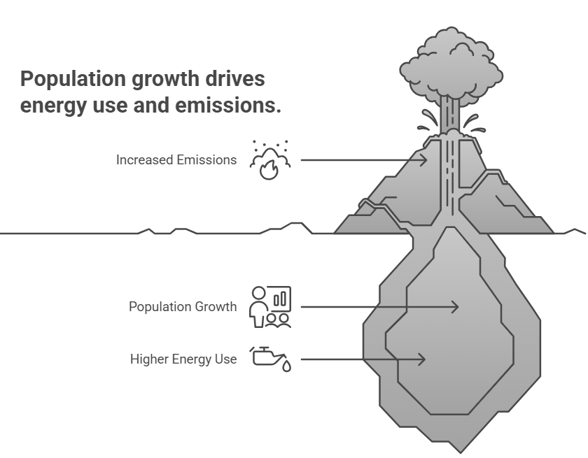
Final Business Insights and Recommendations
A small number of countries are responsible for most global emissions.
When GDP increases, emissions also usually increase.
Population growth leads to higher energy use and more emissions (e.g., India, China).
Renewable energy use is still much lower than fossil fuels – big chance for improvement.
Some countries manage to grow their GDP while keeping emissions low – a good model for others.

Slide 16

Conclusion
Overall, the analysis highlights that economic growth, population, and energy consumption drive emissions. However, some countries demonstrate that sustainable growth is possible with cleaner energy and better efficiency.

Slide 17


Slide 18

Experience/Challenges Working on SQL – Data Analysis Project
Learned to create and connect tables like population, GDP, and emissions.
Faced some issues with joins and grouping.
Needed to clean data (names, years) to get correct results.
Writing ratio and trend queries was hard at first but got easier.
Improved SQL skills for analysis and insights.

Slide 19
Thank you
SELECT planet health FROM energy data WHERE consumption < regeneration

