Slide 1


HireSphere – Job Portal Database
KANDACHARAM LIKHITHA

Slide 2

About the Project
This project, HireSphere – Job Portal Database, is designed to simplify the hiring process by creating a structured system that connects candidates with employers. It manages users, profiles, jobs, skills, and applications in one place, ensuring smooth workflows for posting, applying, and reviewing jobs. By enabling skill-based matching and efficient application tracking, the database provides a reliable backbone for modern recruitment.

Slide 3

About the Tables
The database is structured into 10 key tables that work together to manage the entire job portal.
1. Users store basic account details for candidates, employers, and admins.
2. Candidate Profiles and Employer Profiles capture detailed information.
3. Skills and Candidate Skills link abilities with experience levels.
4. Jobs and Job Skills define openings and required expertise.
5. Applications and Saved Jobs track candidate activity.
6. Job Reviews allow feedback and ratings for transparency.

Slide 4

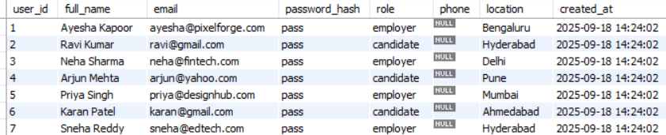
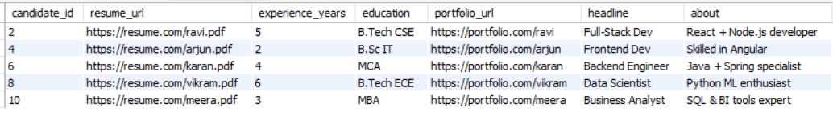
Users
Candidate_Profiles

Slide 5

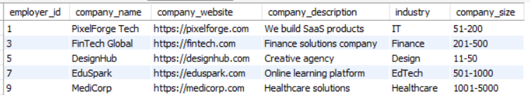
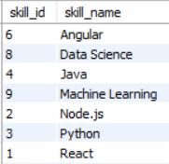
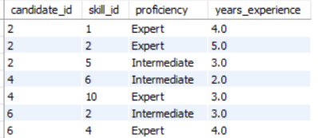
Employer_Profiles
Skills
Candidate_Skills

Slide 6
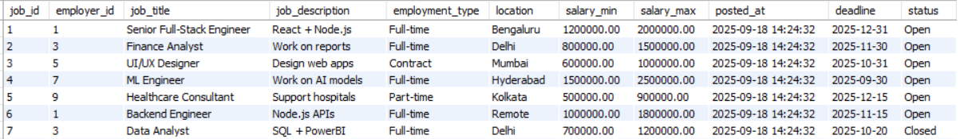
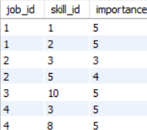
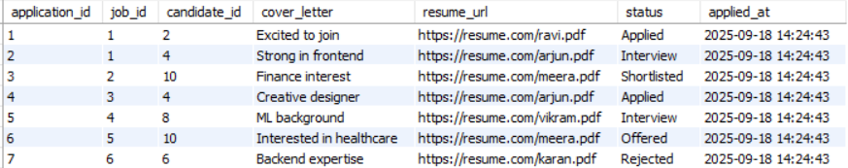
jobs
Job_Skills
Applications

Slide 7
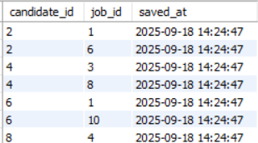
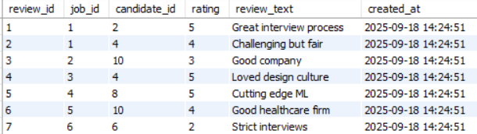

Saved_Jobs
Job_Reviews

Slide 8
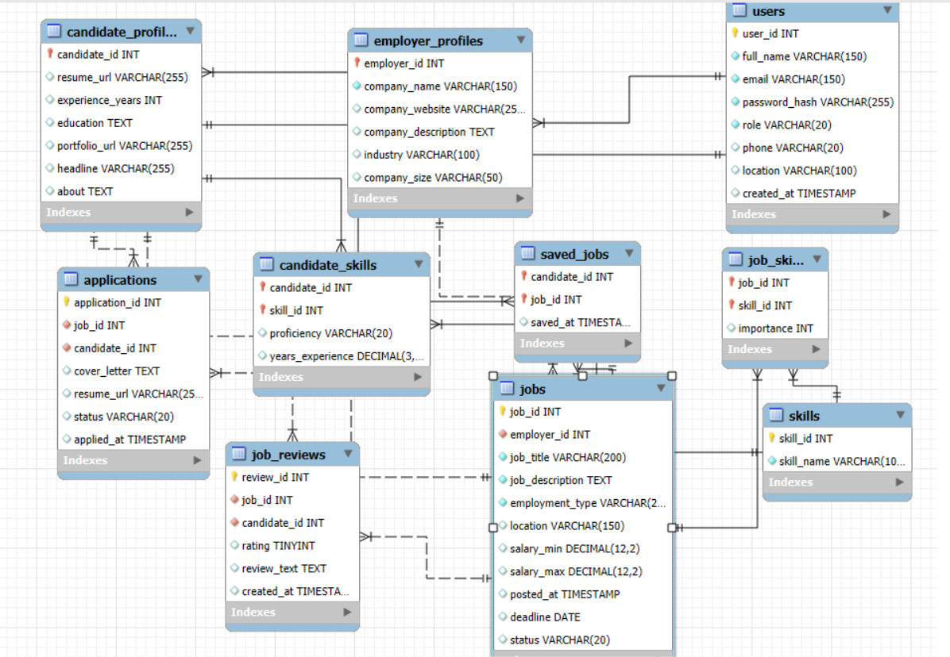
ER Diagram

Slide 9
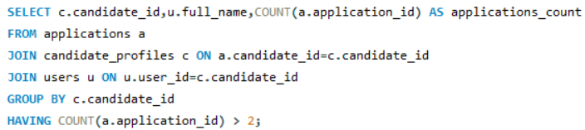
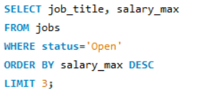
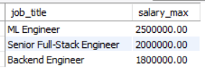


Data Analytics Queries
Q1. Top 3 highest paying open jobs
Q2. Candidates who applied to more than 2 jobs
Query
Query
Output
Output

Slide 10
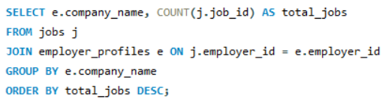
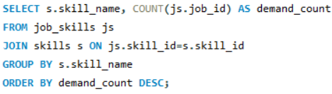
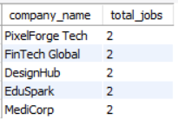
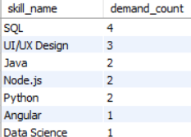

Q3. Employers with most job postings
Q4. Most demanded skills across jobs
Query
Query
Output
Output

Slide 11
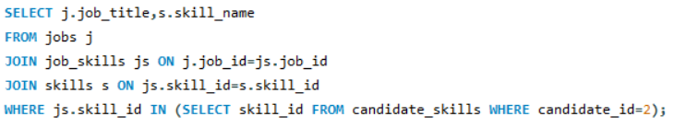
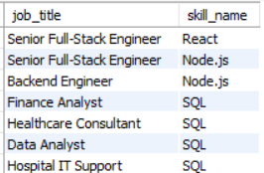
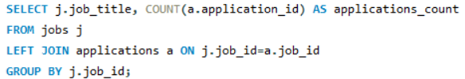
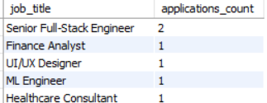
Q5. Match jobs with candidate skills (Example: Ravi, id=2)
Query
Q6. Average application count per job
Output
Query
Output

Slide 12
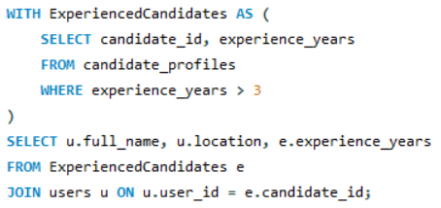
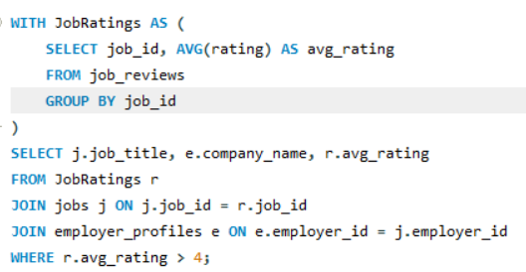

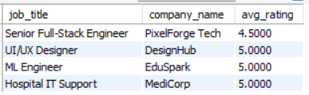
Q7. Find all candidates with more than 3 years of experience
Q8. Show jobs with average rating above 4
Query
Query
Output
Output

Slide 13

Key Insights from Job Portal Data
Most In-Demand Skills
Skills like React, Node.js, and Python appear most frequently in job postings.
Employers prioritize technical expertise in specific areas.
High-Paying Job Roles
Roles like Senior Full-Stack Engineer and Data Scientist offer the highest average salaries.
Helps candidates identify lucrative career paths.

Slide 14

3. Active Employers
Companies with the most job postings indicate growth and hiring trends.
Useful for candidates to target their applications.
4. Candidate Strength
Multi-skilled candidates tend to receive more interview calls and job offers.
Skill diversity improves employability.
5. Application Trends Over Time
Monthly application trends reveal peak hiring seasons.
Supports strategic job posting and recruitment planning.

Slide 15

Conclusion
HireSphere simplifies hiring by connecting candidates and employers in one smart database. It tracks jobs, skills, applications, and reviews, providing insights that make recruitment faster, smarter, and more efficient.

Slide 16


Thank you

