Slide 1


Team Jupifans: Devspace
Members- Shreyas Bhardwaj Likhit Ajeesh Aryan Khubchandani Achinthya Deepak Hiremaglur Shravan Prakash

Slide 2
EduTablero
Track-2: Education Technology
Problem statement-1: Develop tools that would increase Productivity for students and teachers.
Our Project Idea: Interactive Online White Board for Doubt Clarification.
Why we chose this topic: Being students, we personally feel like most of the doubts we asked during our online classes are not answered properly. The major cause of this being the inability of the teacher to understand our doubts as they are unable to visualise it. A simple solution to this would be to provide an easy access virtual white board for the students to express their thoughts in a better way.

Slide 3
Our Aim
To provide a platform for students and teachers to easily visualise their doubts and exchange information with our product ,EduBoard.
A space to draw in real-time, take notes, chat with fellow classmates and get doubts cleared easily.
The teacher maintains decorum by giving access to students one at a time, so that the board doesn’t get crowded or vandalised. However, multiple students can use the board if given access by their teacher.
The note making system at the bottom of the screen automatically copies all the data stored there to your clipboard at the end of the session, which can then be stored based on the student’s convenience.

Slide 4





Tech Stack

Slide 5
Implementation:
It is going to be very easy to implement our project as it only requires a few lines of code and proper merging of the backend and frontend.
It may take a little time to setup.
It is mostly going to be very effective as it provides students an easy way of understanding doubts by presenting them a visual solution, providing them with a chat box and a note storing system.

Slide 6
Problem: Educational Technology | Solution: EduTablero | Uniqueness: Access system for streamlined doubt clearing Note saving software Chat system Students are enabled to draw by teacher | Channels:(path to customers) Integration with apps like Ms Teams and provide our facilities interactive and visual doubt clearing sessions. This can be popularised as a feature of teams through advertisements.
Existing Alternatives: 1) Online boards such as ziteboard ,liveboard and aggie.io | Cost Structure: The only potential cost will be to setup a server to store data once our project blows up. | Revenue: Collaboration with any video conferencing software will allow us to gain our funding. Or simply selling our application to them directly | Customer Segmentation: Our users will mostly be students and teachers from schools and colleges.

Slide 7
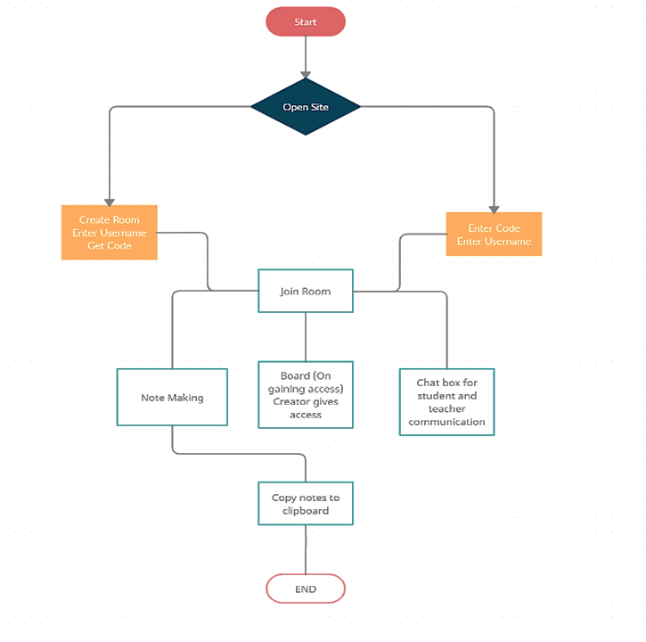

Slide 8
-THANK YOU-

