Slide 1

Building an application and/or process to add product images to Motion.com
Group Members: Hamza Adnan, Sammy Allen,
Hunter Reinhart, Shan Sahib, and Drew Wolfe
Notes:
Hello, our project is to create an application or process for the website Motion.com. Motion.com is a website used to sell industrial products for motion. If you go to motion.com you might think that products already have pictures but if you look closer you’ll notice that the pictures used for products are not an actual picture of the product, but rather a general picture of the type of product. For example, two different tubes that might have two different sizes, might use the same picture on both pages. And that picture might not even look like either product.

Slide 2
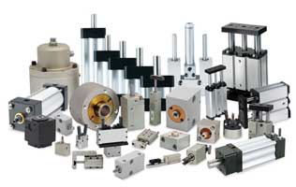
General Motivation
Studies have shown that product images help increase buyer’s attention, trust, and conversion. Generally, listings with one image had twice the conversion rates of listings with zero images. Conversion rates doubled again for listings with two images rather than one. There is a clear trend between photo count and profit probability. This is important because it will improve customers satisfaction while simultaneously increasing the amount of purchases made.
Notes:
Why add pictures in the first place? Well, studies have shown that having images for a product on a website increase the chance of an item being purchased. Generally, the more pictures that are provided to the customer the higher chance that they make a purchase. Adding pictures will benefit both motion and the customers because customers will be more satisfied with their purchases as well as more purchases being made and more profit for motion.

Slide 3

Core Features
Possible core features include:
An efficient process of uploading images
Developing a interface for the user to manage the images
An option for the user to edit the image to best fit their needs
An analytical view of the website’s performance with the images included
A history of the images previously used on the website
Possibly implement a login procedure for image uploading
Notes:
Possible error handling for image uploading and management

Slide 4
Technical Details
For this application there are a variety of approaches we could take. If we are provided with images of products the initial portion of finding appropriate images for the website will be fulfilled. Otherwise, there are tools such as BeautifulSoup, Scrapy, Puppeteer, or Playwright which could be utilized to extract preexisting images of the products from any publicly accessible website correlated to the manufacturing company and/or another supplier.

Slide 5

Technical Details
For the image uploads it would be likely that a Cloud Storage API is utilized such as Amazon S3, or Cloudinary API.
For processing images and ensuring they are appropriately optimized for their allotted space using Cloudinary.

Slide 6
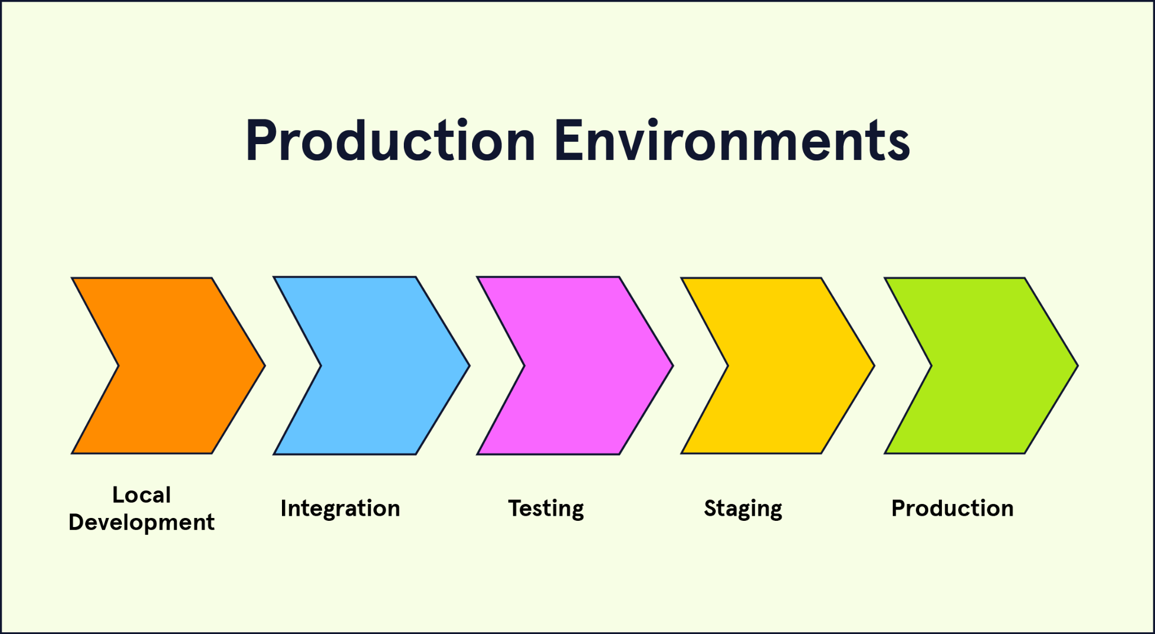
Initial Thoughts on Development Environments
Local Environment: Docker to keep from affecting the live website/database
Version Control: GitHub
Staging Environment: Test database through a subdomain
Build Tools: Image optimization (ImageMagick/Sharp)
Content Management: Where the images are currently stored

Slide 7
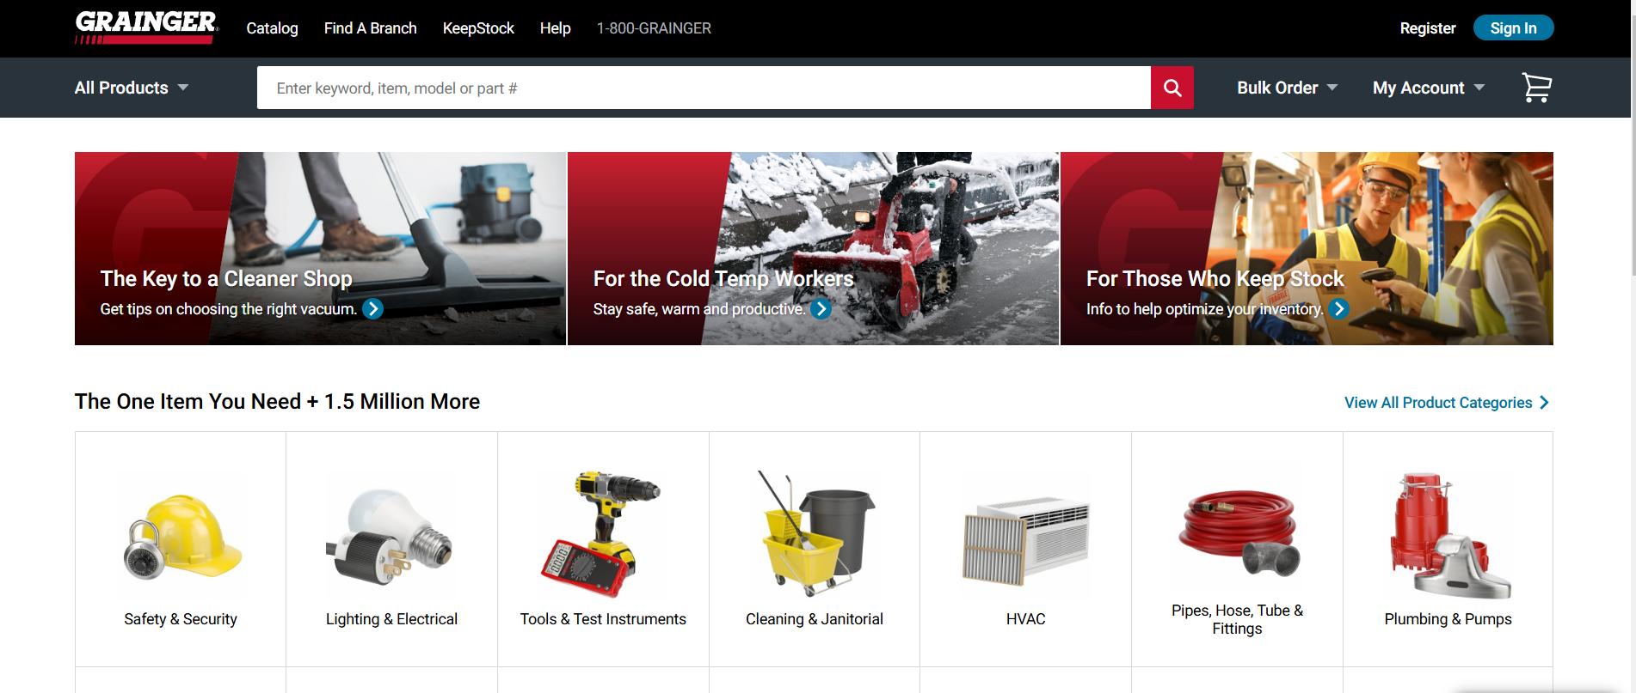
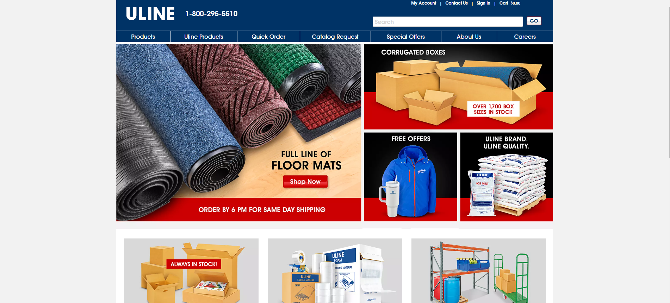
Related Apps
Grainger
Leading broad-line distributor of maintenance, repair, and operating (MRO) products.
Serves businesses and institutions across North America, Europe, Asia, and Latin America.
Offers over 1.7 million products across categories like safety, material handling, and metalworking.
Uline
E-commerce store in shipping, industrial, and packaging materials.
Offers a detailed product catalog with images for over 37,500 items.
High-resolution images help customers make informed decisions about their purchases.
Notes:
Grainger and Uline are online stores for the distribution of different industrial and manufacturing products
They are an example of how we want motion.com to look like
By understanding how their product images work with different SKUs we can develop an application for Motion.com for image upload and processing

Slide 8
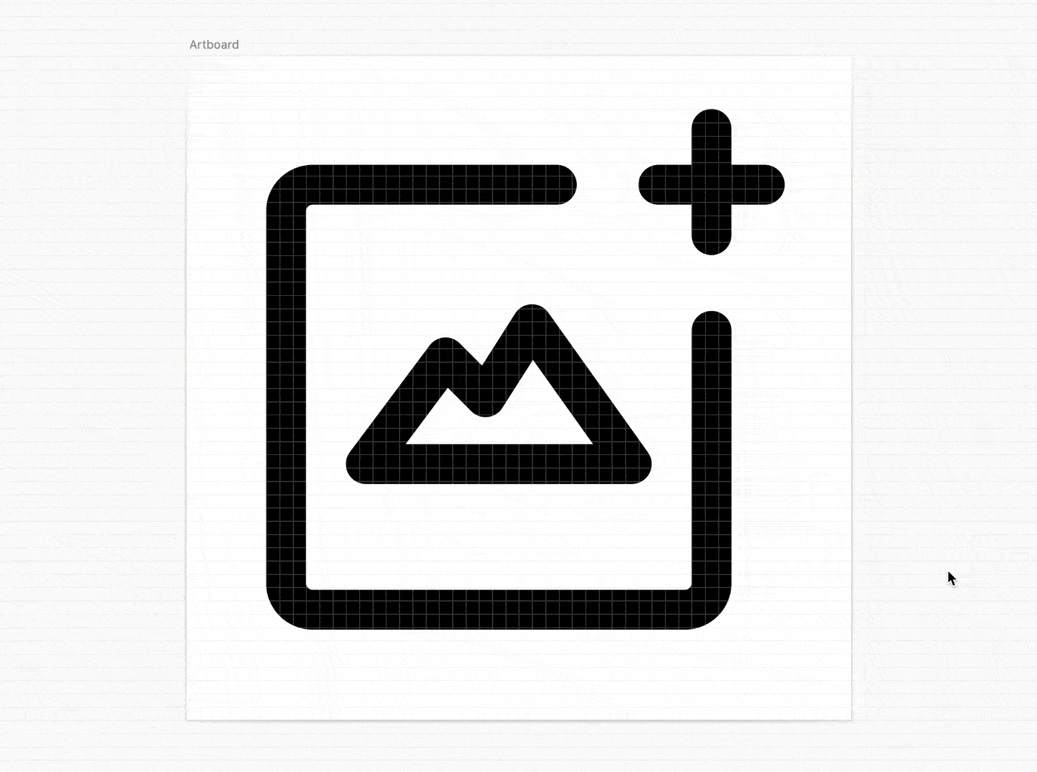
High Priority Challenges
Integration with Existing Systems
Ensuring image upload tools work smoothly with Motion.com’s existing inventory
Correct communication with motion.com’s database and image upload application
Security Concerns
Establishing security measures to prevent malware uploads and protect system from threats
Ensure image validation process by checking file type, size, and content
User Interface Design
Designing a user interface which simplifies process of uploading images
Creating a navigable application with batch processing and drag & drop
Notes:
Integration with Existing Systems
Introduction: We need seamless integration with Motion.com's existing systems for operational efficiency.
Database Communication: Use of APIs or middleware for data exchange between the image upload tool and Motion.com’s database.
Application Compatibility: Adjustments to the image upload tool to ensure compatibility with existing applications.
Security Concerns
Security Importance: the critical need to protect the system against security threats.
Malware Prevention: security measures like antivirus scans and sandboxing to prevent malicious uploads.
Image Validation: Discuss procedures for checking uploaded images for file type, size, and safe content.
User Interface Design
Design Principles: Focus on simplicity and user-friendliness as key design principles.
Interface Features: Describe user interface features like batch processing, drag-and-drop functionality, and a clean layout.
User Feedback: Stress the role of user feedback in refining the interface, with plans for user testing and iterative design based on feedback.

