Slide 1

Building an application and/or process to add product images to Motion.com
Sprint 1
Group Members: Hamza Adnan, Sammy Allen,
Hunter Reinhart, Shan Sahib, and Drew Wolfe
Notes:
Hello, our project is to create an application or process for the website Motion.com. Motion.com is a website used to sell industrial products for motion. If you go to motion.com you might think that products already have pictures but if you look closer you’ll notice that the pictures used for products are not an actual picture of the product, but rather a general picture of the type of product. For example, two different tubes that might have two different sizes, might use the same picture on both pages. And that picture might not even look like either product.

Slide 2
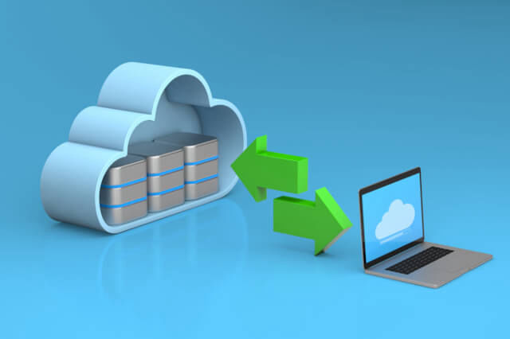
Project Focus
Motion.com is a website used to sell industrial products for the company motion. Of the ~12 million products on their website, they only have images for ~1 million of them. Our goal is to create an application that can search the internet for accurate images to use for the imageless products.

Slide 3

Sprint Goal
A large scale Google search for images utilizing the Excel Spreadsheet provided.

Slide 4

Sprint Achievement / Sponsor’s feedback
Achievements:
Our program has a parser that goes through an excel file with the manufacturer information and the part number of the product
In addition, our program has a functional image scraper that goes through multiple internet searches to gather the images
Feedback:
Our sponsor mentioned concerns with the product images’ accuracy from the searches

Slide 5
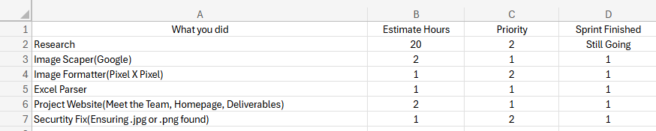
Sprint / Project Backlogs

Slide 6
What Was Completed / Lessons Learned
Successfully accessed and parsed Excel file containing MFR_Name and Part_Number
Developed Python scraper to search Google/Bing for images based on extracted data
Stored Retrieved Images in a designated folder
Lessons Learned
Need more search parameters → Improved image accuracy
Eliminate repeated images → Refine to avoid duplicate images
Fix image quality → Eliminate lower resolution images
Notes:
What Was Completed?
Excel Data Extraction: Successfully parsed MFR_Name and Part_Number from an Excel file.
Python Scraper: Developed a web scraper to fetch images from Google/Bing.
Image Storage: Retrieved images were saved in a designated folder.
Lessons Learned
Improving Search Accuracy: Need better search parameters for more relevant images. (i.e. Product Description)
Avoiding Duplicates: Implement filtering to remove repeated images. (5 images searched for and only 2 duplicates)
Enhancing Image Quality: Exclude or enhance low-resolution images for better results. (Bad quality images cannot go on the website)

