Slide 1
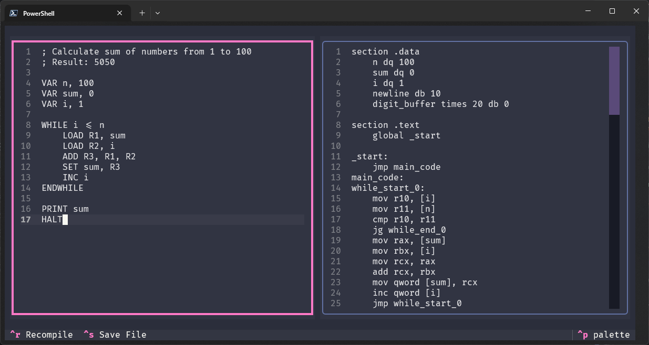
TinyCompiled
A Small Educational Compiler and Visualizer for Assembly Language Learning
Authors: Denys Shevchenko, Yehor Karabanov

Slide 2
The Problem & Solution
The Challenge:
TinyCompiled Solution:
Assembly language is intimidating for beginners
Gap between high-level logic and machine code is hard to visualize
Lack of interactive learning tools
Custom assembly-like language (.tc) → Real x86-64 NASM
Side-by-side visualization of code translation
Interactive GUI with real-time feedback
Makes low-level programming accessible and engaging

Slide 3
Overview
TinyCompiled takes .tc files (simplified assembly-like language) and translates them into x86-64 NASM assembly.
Focus: Demonstrates how high-level instructions map to low-level operations.
Target Audience: Students, educators, hobbyists.
Bridges abstract concepts with machine instructions via compilation and visualization.

Slide 4
Key features
Simple Syntax: Human-readable assembly-like language
Real Assembly Output: Generates actual x86-64 NASM code
8 Virtual Registers: R1-R8 mapped to x86-64 registers
Complete Language: Variables, functions, loops, I/O
Multiple Modes: CLI compilation, GUI editor, build & run
Side-by-Side Visualization: Diff-style table for .tc vs.NASM
Real-Time GUI: Editor, compilation preview, save/load

Slide 5



Compilation Pipeline
TinyCompiled follows a traditional compiler architecture:
Lexical Analysis (src/lexer/)
Syntax Analysis (src/parser/)
Code Generation (src/generator/)
Tokenizes source code into keywords, identifiers, numbers, and operators.
Parses tokens into an Abstract Syntax Tree (AST).
Translates AST into NASM x86-64 assembly code.
Example: VAR x, 10 → [VAR] [x] [,] [10]
Example: Creates AST nodes representing variable declaration
Example: VAR x, 10 → mov rax, 10

Slide 6
Virtual registers and memory
Register mapping
Memory
TinyCompiled provides 8 virtual registers that map directly to x86-64 registers, making the transition from learning to real assembly seamless:
R1 → rax (accumulator register)
R2 → rbx (base register)
R3 → rcx (counter register)
R4 → rdx (data register)
R5 → rsi (source index)
R6→ rdi (destination index)
R7 → r8 (general purpose)
R8 → r9 (general purpose)
Variables
Stored in .data section with labels
Stack
Used for function calls and local variables

Slide 7
Supported Operations
Arithmetic: ADD, SUB, MUL, DIV, INC, DEC
Bitwise Logic: AND, OR, XOR, NOT, SHL, SHR
Data Movement: LOAD, SET, MOVE, PUSH, POP
Control Flow: IF/ELSE, WHILE, FOR, LOOP, REPEAT/UNTIL
Functions: FUNC, CALL, RET
Input/Output: PRINT, INPUT
Other: HALT, NOP, comments (; )

Slide 8
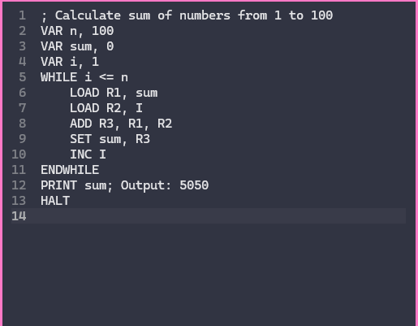
Example: Sum calcualtor
What This Demonstrates:
Variable declaration with initialization.
WHILE loop with condition checking
Register operations (LOAD, ADD, SET)
Variable increment (INC)
Output operation (PRINT)
Program termination (HALT)
Run it: uv run cli.py run examples/sum.tc

Slide 9
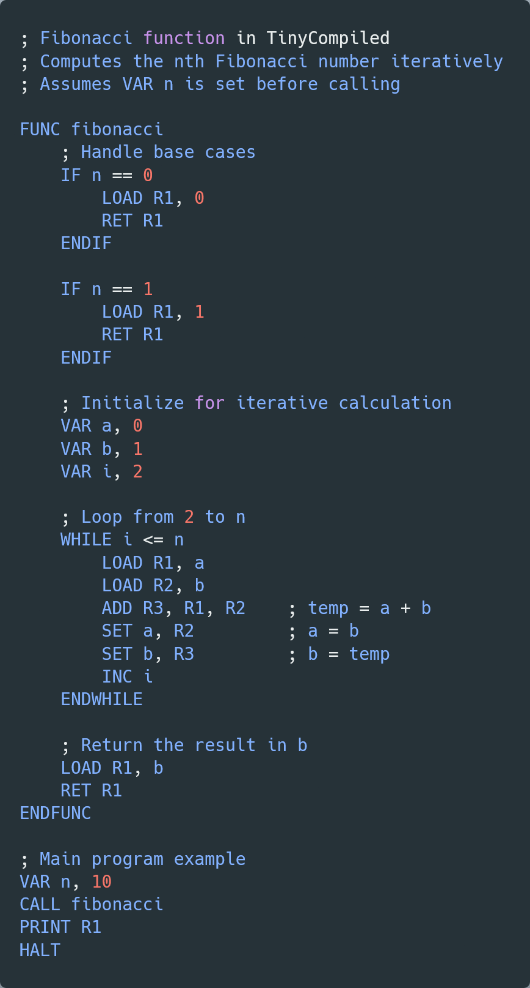
Other examples
fibonacci.tc - Fibonacci sequence with functions
prime_check.tc - Prime number checker
calculator.tc - Interactive calculator
for_loop_demo.tc - Loop variations
bitwise_demo.tc - Bitwise operations (AND, OR, XOR, shifts)

Slide 10
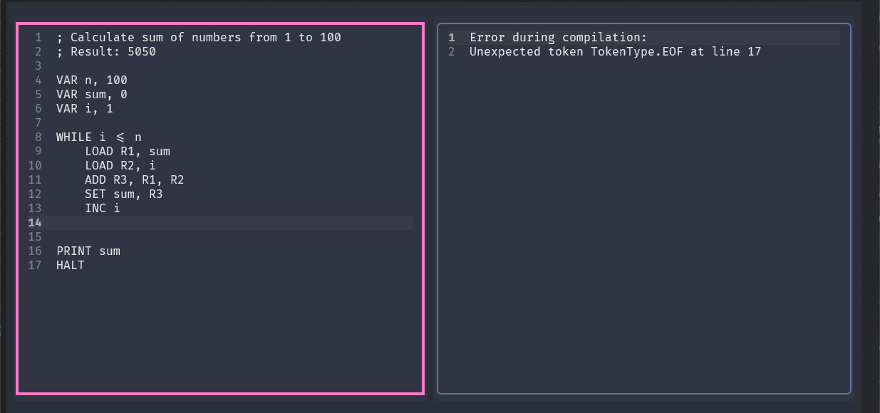
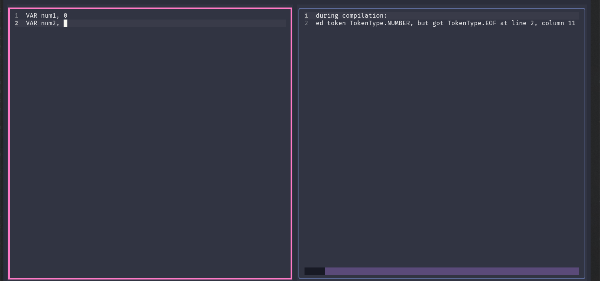
Error Handling & Feedback
Provides real-time feedback in GUI and CLI.
Error Messages: Include line numbers, context, and suggestions.
Examples: Syntax errors, undefined variables.

Slide 11
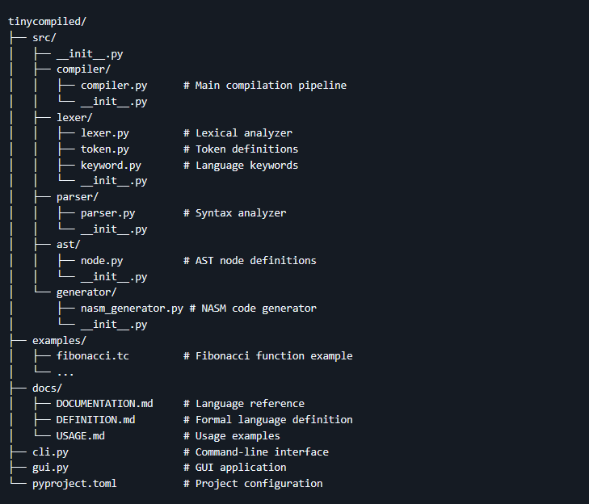
Project structure

Slide 12
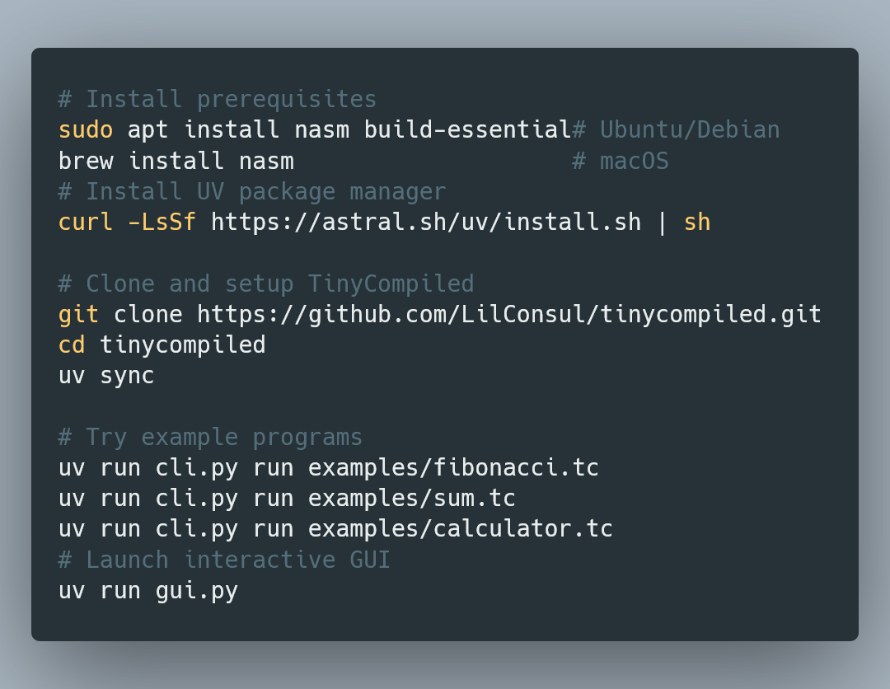
Getting started & installation

Slide 13
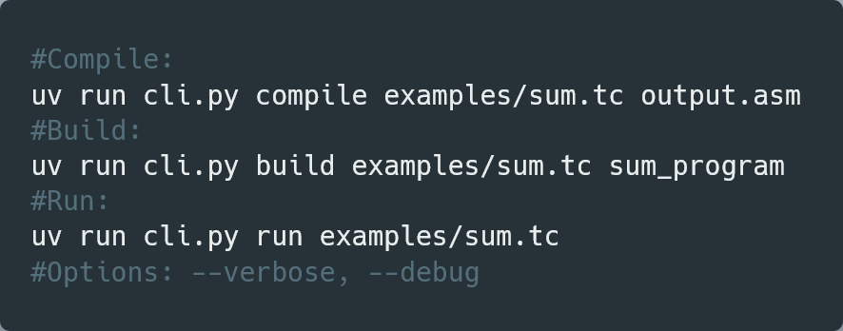
Usage
CLI
GUI
Ctrl+R to compile, Ctrl+S to save, Ctrl+Q to quit

Slide 14
Documentation & References
Documentation
References
Documentation:
docs/DOCUMENTATION.md (language reference)
docs/DEFINITION.md (BNF grammar)
More Examples: examples/ directory (fibonacci.tc, prime_check.tc, etc.)
License: MIT
GitHub:
https://github.com/LilConsul/tinycompiled
NASM Docs:
https://www.nasm.us/docs.html
Textual Framework:
https://textual.textualize.io/

