Slide 1
KENYATTA UNIVERSITY
SCH 330; KINETICS OF CHEMICAL REACTIONS

Slide 2
Teaching/Learning Methodologies
Lectures; Class discussion; Class exercise; Research assignments.
Materials and Equipment
Whiteboard, projector, handouts, calculator
Course Assessment
Continuous Assessments; 330
Tests and class activities 10 %
Practical reports 10%
Cats 20%
Final Examination 60%

Slide 3
Recommended Text Books
Atkins, P. W., Physical Chemistry, 8th Edition
Gordon M Barrow, Physical Chemistry, McGraw-Hill Education (India) Pvt Ltd
Atkins P. and Jones L., Chemical Principles; The Quest for Insight, 2nd Edition, USA
Levine, I. A. Physical chemistry. 6th edition
Laidler K. J. and Meiser J. H. Physical Chemistry. 3rd edition
https://chem.libretexts.org/Bookshelves/Physical_and_Theoretical_Chemistry_Textbook_Maps/Supplemental_Modules_(Physical_and_Theoretical_Chemistry)/Kinetics/Rate_Laws/The_Rate_Law/Order_of_Reaction_Experiments

Slide 4
Course Purpose:
To introduce the concepts of reaction kinetics and reaction mechanisms

Slide 5
Course Learning Outcomes:
By the end of the course, the learners should be able to:
Explain the fundamental principles of reaction kinetics, including elementary and complex reactions, molecularity, and rate equations.
Differentiate between reaction order, rate constant, and half-life, and apply appropriate methods to determine them experimentally.
Evaluate the dependence of reaction rates on temperature using the Arrhenius and Boltzmann frameworks.

Slide 6
Illustrate the kinetics of parallel, consecutive, reversible, and including chain reactions, with examples from both organic and inorganic chemistry.
Demonstrate use of rate determining steps in interpreting reaction mechanisms
Interpret the concepts of steady-state approximation and induction period in relation to reaction mechanisms and rate determinations.
Assess the role and mechanisms of catalysis, including enzyme and heterogeneous catalysis
Design and conduct experiments to determine reaction kinetics parameters

Slide 7
Course Content:
Reaction kinetics: elementary and complex reactions, molecularity of elementary reactions, Rate equations. Order of reaction, rate constant, half life. Methods of determining rates and orders of reaction of chemical reactions. Reaction mechanisms. Dependence of reaction rates on temperature. Qualitative treatment of Boltzman factor, chain reactions. Parallel, consecutive and reversible reactions, The approach to the steady-state and induction period (examples from organic and inorganic chemistry to determine the rates of chain reactions). Branched chain reactions and explosions. Catalysis: Heterogeneous catalysis, Enzyme catalysis (Michaelis constant). Mechanism(s) for enzyme catalyzed reaction(s). Addition polymerization. Theories of reaction rates.

Slide 8
Outline
Types of reactions
Rate equations
Order of reactions
Methods of determining rates and orders of reaction of chemical reactions
  Initial rate methods
  Isolation methods
  Log method/graphical method
  Integrated rate law and half life

Slide 9
Cont,
Dependence of reaction rate on temperature and Boltzmann framework
Transition state theory
Reaction mechanisms; consecutive reactions and chain reactions
Catalysis; enzymatic and heterogenoeus catalysis (Langmuir Adsorption Isotherm
Transition state theory

Slide 10
Review exercise
What favors a chemical reaction
Using an energy level diagram, describe what would favour one path of a chemical reaction for a reaction that has two pathways
How do you determine the rate of a chemical reaction

Slide 11
Cont
What are some of the factors that affect the rate of a chemical reaction
How can you increase the rate of a chemical reaction
Give two practical ways of reducing the rate of a chemical reaction
Explain the differences in the following terms
a. chemical dynamics
b. chemical kinetics

Slide 12
Introduction
Chemical Kinetics / reaction kinetics; branch of physical chemistry that deals with the rates of chemical reactions and the factors on which the rates depends.
Concerned with
  Rates of chemical reactions
  Factors affecting the rates
  Mechanisms of chemical reactions
Goals
  Determination of rate of reaction
  Reaction mechanisms
Notes:
Thermodynamic product; products are at lower energy but may require higher kinetic energy/activation energy; favored at high temperatures
Kinetic product; lower activation energy but the products have a high/higher energy than thermodynamic products. Favoured at lower temperatures

Slide 13
Cont.
Chemical thermodynamics vs Chemical kinetics;
Chemical thermodynamics; all about ‘if’
  Tells whether or not a process or a reaction can occur (is there a decrease in free energy?); will a reaction occur or not; ΔG <0
  Applicable to systems in stable or metastable equilibrium
  Sufficient driving force is needed to enforce a favourable transformation
Notes:
Thermodynamic product; products are at lower energy but may require higher kinetic energy/activation energy; favored at high temperatures
Kinetic product; lower activation energy but the products have a high/higher energy than thermodynamic products. Favoured at lower temperatures

Slide 14
Cont.
Chemical kinetics; all about ‘how’
  How fast or slow a process can occur; determines the rate
  Applicable to systems in transitions from non equilibrium to equilibrium, or between two equilibrium states
  About how to overcome the energy barrier to finish the transformation from the starting state to the final state
Notes:
Thermodynamic product; products are at lower energy but may require higher kinetic energy/activation energy; favored at high temperatures
Kinetic product; lower activation energy but the products have a high/higher energy than thermodynamic products. Favoured at lower temperatures

Slide 15

The kinetics and thermodynamics could be of
    A chemical reaction
    Phase transformation
    Rearrangement; cis to trans
Rate α (kinetic factor) X thermodynamic factor
    Kinetic factor ΔGª = activation energy
    Thermodynamic factor refers to ΔG = G₂ –G₁, the driving force
Notes:
Thermodynamic product; products are at lower energy but may require higher kinetic energy/activation energy; favored at high temperatures
Kinetic product; lower activation energy but the products have a high/higher energy than thermodynamic products. Favoured at lower temperatures

Slide 16

Shows the reaction progress
One the left; reactants; initial state
At the middle; transition state; activated complex
At the right; products; final state
X-axis; reaction progress
Y-axis; an indication of energy

Slide 17
Thermodynamics vs Kinetics
G
a
ΔGª
b
G₁
c
ΔG
G₂
initial
state
activated
state
final
state

Slide 18
Types of Chemical Reactions
Elementary reactions / steps / processes; proceed in a single step with no identifiable reaction intermediates
a,b,c,d: Stoichiometric coefficients
Composite, stepwise or complex reactions; goes in more than one step
Homogeneous reaction; occurs in one phase
Heterogeneous reaction; involves species present in two or more phases.
aA + bB → cC + dD
A + B → C → D
Notes:
products formed directly from reactants

Slide 19
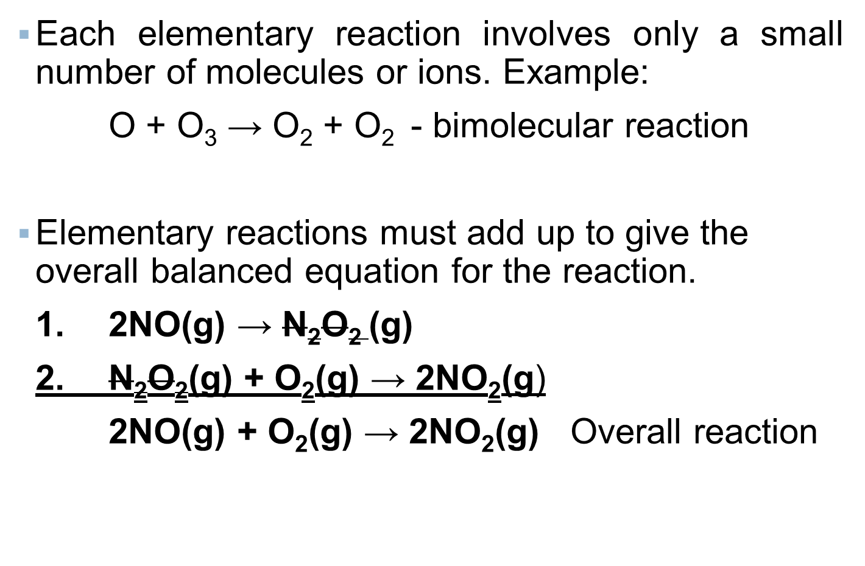
Elementary vs. Overall Reactions

Slide 20
Intermediates
Species produced in one step of a reaction mechanism and consumed in another.
1. 2NO(g) → N₂O₂ (g)
2. N₂O₂(g) + O₂(g) → 2NO₂(g)
2NO(g) + O₂(g) → 2NO₂(g) Overall reaction

Slide 21
Molecularity of Elementary Reactions
Molecularity of an elementary reaction is the number of particles (ions, atoms or molecules) coming together to react in an elementary step.
Unimolecular reaction: A reaction in which a reactant spontaneously decomposes or rearrange itself to yield product(s) in a single reaction step; one reactant
R → P e.g. cis trans isomers
allotropes transformation

Slide 22
Molecularity of Elementary Reactions
Bimolecular reaction: Two reactants/particles collide with each other simultaneously to yield products.
A + B → P
Termolecular reaction: Three reactants / particles collide with each other at the same time to yield products. Very rare
A + B + C → P
Notes:
Na + O → NaO

Slide 23
Rates of a Chemical Reaction/Reaction Rates
Change in concentration of reactants or products as a function of time.
Rate = Δ concentration
Δ time
The reaction rate tells us how much of the reactant is consumed and how much of the product is formed at a given time
Obtained by monitoring the concentration of one of the reactants or products as a function of time

Slide 24
Cont,
Consider a reaction of the form
aA + bB → cC
The reaction rates depends on the rates of reactants (and products) in a way that can be expressed as a differential equations
A differential rate law expresses the reaction rate in terms of changes in the concentration of one or more reactants (Δ[R]) over a specific time interval (Δt)
Rate = d[x]/dt where x is analyte
Notes:
Reaction rates are reported in moles per liter per second (mol L⁻¹ s⁻¹)
The rates of disappearance of reactants or appearance of products can be measured. Divide by coefficient in the equation

Slide 25
A + bB → cC
- (d[A]/dt)= -1/b (d[B]/dt) = 1/c (d[C]/dt)

Slide 26
Types of Rates of a chemical reaction
Can be classified according to the time of interest
  Average rate of a chemical reaction
  Instantaneous rate of a chemical reaction
  Initial rate of a chemical reaction

Slide 27
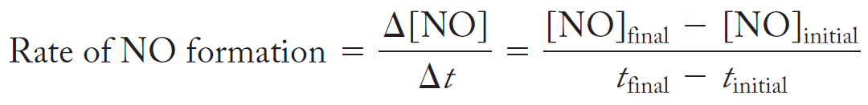
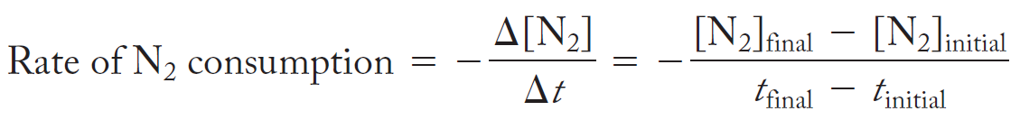
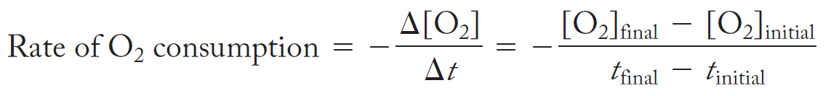
The average rate of a reaction
Its equal to the decrease (or increase) in the concentration of a species (analyte) divided by the time in which that change occurs
N₂(g) + O₂(g) → 2 NO(g)

Slide 28
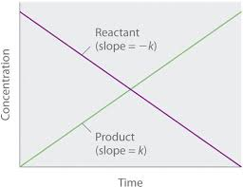

Slide 29
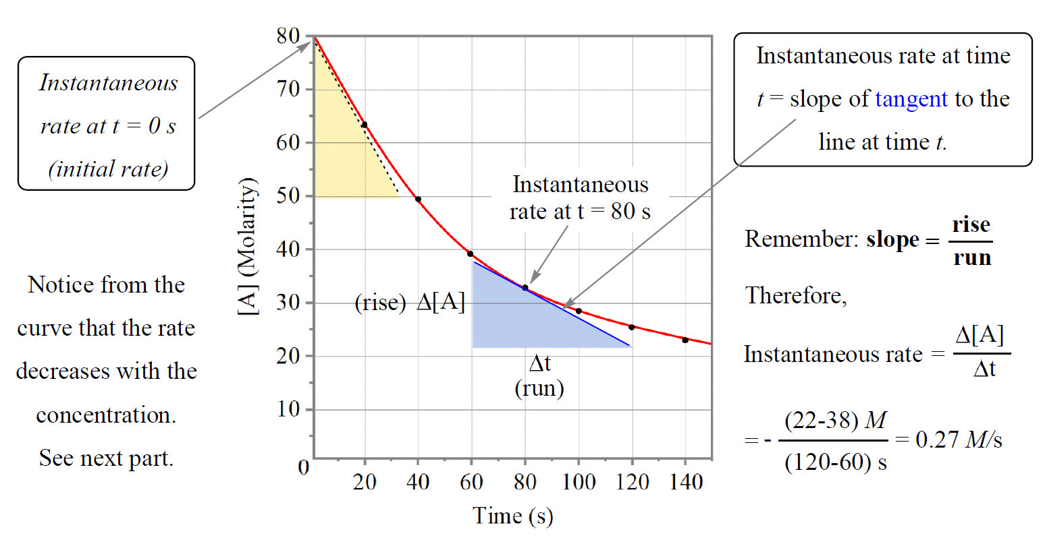

Slide 30
Application
Predict the rate of reaction from composition of the mixture
Predict the composition of the reaction mixture at a later stage of the reaction
A guide to the mechanism of the reaction

Slide 31
Appn
a. How is the rate of disappearance of ozone related to the rate of appearance of oxygen in the following reactions
2O₃ (g) → 3O₂ (g)
Rate = -(1/2) d[O₃] = (1/3) d[O₂]
dt dt
b. If the rate of appearance of O₂ is 6.0 x 10 ⁻⁵ M/s at a particular instant, what is the value of the rate of disappearance of O₃ at this time
(1/2) d[O₃] = (1/3) d[O₂]
dt dt
Notes:
Example 1&2 dr onindo. ; 3; atkins; 4,dr onindo

Slide 32

If the rate of appearance of O₂ is 6.0 x 10 ⁻⁵ M/s at a particular instant, what is the value of the rate of disappearance of O₃ at this time-
(1/2) d[O₃] = (1/3) d[O₂]
dt dt
(1/2) d[O₃] = (1/3) X
dt
(1/2) d[O₃] = (1/3) x 6.0 x 10 ⁻⁵
dt

Slide 33
Appn
2. If the rate of formation of NO in the reaction
2NOBr (g) → 2NO(g) + Br₂ (g)
is reported as 1.6 x 10 ⁻⁴ mol/L/s. What will be the rate of consumption of NOBr.
3. The decomposition of N₂O₅ proceeds according to the equation
2N₂O₅ (g) → 4NO₂ (g) + O₂ (g)
If the rate of decomposition of N₂O₅ at a particular instant in a reaction vessel is 4.2 X 10 ⁻⁷ M/s. What is the rate of appearance of a)NO₂, and b) O₂
Notes:
Example 1&2 dr onindo. ; 3; atkins; 4,dr onindo

Slide 34
Ans
  a. rate = -1/2 d[O₃]/dt = 1/3 d[O₂]/dt
b. 2/3 d[O₂]/dt = 4.0 x 10 ⁻⁵ M/s
2. 1.6 x 10 ⁻⁴ mol/L/s
3. a, 8.4 X 10 ⁻⁷ M/s b, 2.1 X 10 ⁻⁷ M/s
Notes:
Example 1&2 dr onindo. ; 3; atkins; 4,dr onindo

Slide 35
Assignment
Consider the following ionic equation
H₂O₂(aq) + 3I⁻ (aq) + 2H⁺(aq) → I⁻₃ (aq) + 2H₂O (L)
In the first 10.0 seconds of the reaction, the concentration of B dropped from 1.000 M to 0.868M
Write the differential rate law for the above equation
Calculate the average rate of this reaction in this time interval
Predict the rate of change in the concentration of H+ during this time flame.

Slide 36
The Rate Laws and Rate Constants
Rate of a reaction is ∞ to the concentration of the reactants raised to a power.
    A + B → Products
    -d[A] = k[A][B] M/s
      dt
      Rate = k[A]^{m}[B] ^{n} M/s
k; rate constant
Rate law; equation that expresses the rate of reaction as a function of the concentrations of the reactants. Determined experimentally
Rate = k[A]^{m}[B]^{n}; m & n; reaction order
May or may not reflect the stoichiometry of the reaction

Slide 37
Reaction Order and Rate Law
Reaction Order / order of a reaction; the power to which the concentration of a species is raised in a rate law
  Determined experimentally
Rate = k[A]^{m}[B]^{n} m & n; reaction order
Overall order; sum of individual order, m + n
e.g. Rate = k[A]¹[B]¹; the reaction is first order in A and first order in B. The overall order is 2 (1+1)

Slide 38
Cont,
Example
Rate = k [A]^{1/2} [B]; half order in A, first order in B, three-halves (3/2) order overall
  Indicator of a complex reaction mechanism
Zero-order rate law; independent of the concentration of the reactant (s)
Negative orders; reactant is an inhibitor, slows down reaction; poisoning

Slide 39
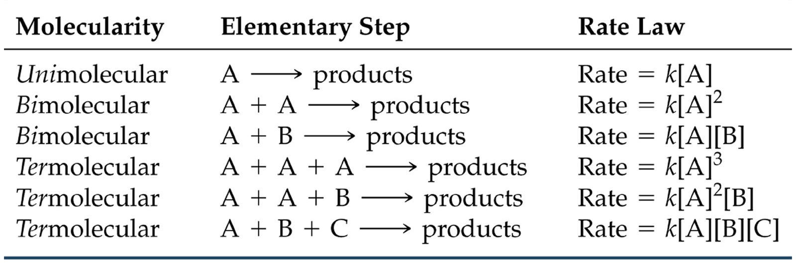
Elementary Steps & Rate Laws
An elementary unimolecular reaction has first-order kinetics
An elementary bimolecular reaction has second-order kinetics etc.

Slide 40
The Rate Constant; k
Determined experimentally
Units depends on the overall reaction order of the rate law
E.g. reaction that is second order overall
Units of rate = (units of rate constant) (units of concentration)²
Units of rate constant
= units of rate = M/s = M ⁻¹ s ⁻¹
(units of concentration)² (M) ²

Slide 41

Determine the units of k for a first order reaction
Determine the units of k for a third order reaction
Determine the units of k for a third order reaction

Slide 42
Appn
If the rate law for the reaction of ammonium and nitrite ions in water at 25 ºC is Rate = k[NH₄⁺][NO₂⁻], calculate k when the observed initial rate M/s was 5.4 x 10⁻⁷ at initial NH₄⁺ concentration and initial NO₂⁻ concentration of 0.0100 and 0.0200 M respectively
2. Using the rate law, Rate = k[NH₄⁺][NO₂⁻] and k = ; 2.7 x 10 ⁻⁴ M⁻¹s⁻¹. Calculate the rate when [NH₄⁺] = 0.100M and [NO₂⁻] = 0.100M
Notes:
Ans = 2.7 x 10 – 4 M-1 s-1

Slide 43
Answer 1
Rate = k[NH₄⁺][NO₂⁻]
k = Rate / [NH₄⁺][NO₂⁻]
[NH₄⁺] = 0.0100 M [NO₂⁻] = 0.0200 M
Rate = 5.4 x 10⁻⁷ M/s
k = (5.4 x 10⁻⁷)/(0.1x0.2) = 2.7 x 10 ⁻⁴

Slide 44
Rate Law Determination
Determined experimentally
Examples of the methods used:
Isolation method
Initial rate method
  Changing the initial concentration of reactant will affect the initial rate of the reaction
The log Method / Van’t Hoff Method
    Reactions that involve a single reactant
    Plots of concentration vs. time data
Notes:
Perform a demostration

Slide 45
Isolation Method
The dependence of the rate on the concentration of each of the reactants may be found by isolating them in turn
Concentrations of all the reactants except one are in large excess
Rate = k[A][B]; if B is in excess, can approximate order wrt A
Rate = k’[A]; pseudofirst-order rate law
Isolate all reactants in turn from which the overall rate can be obtained
Notes:
Forcing concentrations to be constant

Slide 46
Method of Initial Rates
Rate measured at the beginning of the reaction for several different initial [c] of reactants
Used in conjunction with isolation method
Zero order; changing [C] has no influence on rate
First order; change in [C] bring proportional change in rate; doubling [c] doubles the rate
Second order; doubling [c] increases rate by a factor of 2² = 4; tripling; 2³ = 8

Slide 47
Example
N₂(g) + O₂(g) → 2 NO(g)
Rate = k[O₂]^{n}[N₂]^{m}
Values for n & m can be determined by measuring initial rates under different conditions.
Experiment | [N₂]₀ (M) | [O₂]₀ (M) | Initial reaction rate (Ms⁻¹)
1 | 4.0 x 10⁻³ | 2.0 x 10⁻³ | 1007
2 | 4.0 x10⁻³ | 1.0 x 10⁻³ | 500
3 | 2.0 x10⁻³ | 1.0 x 10⁻³ | 125

Slide 48
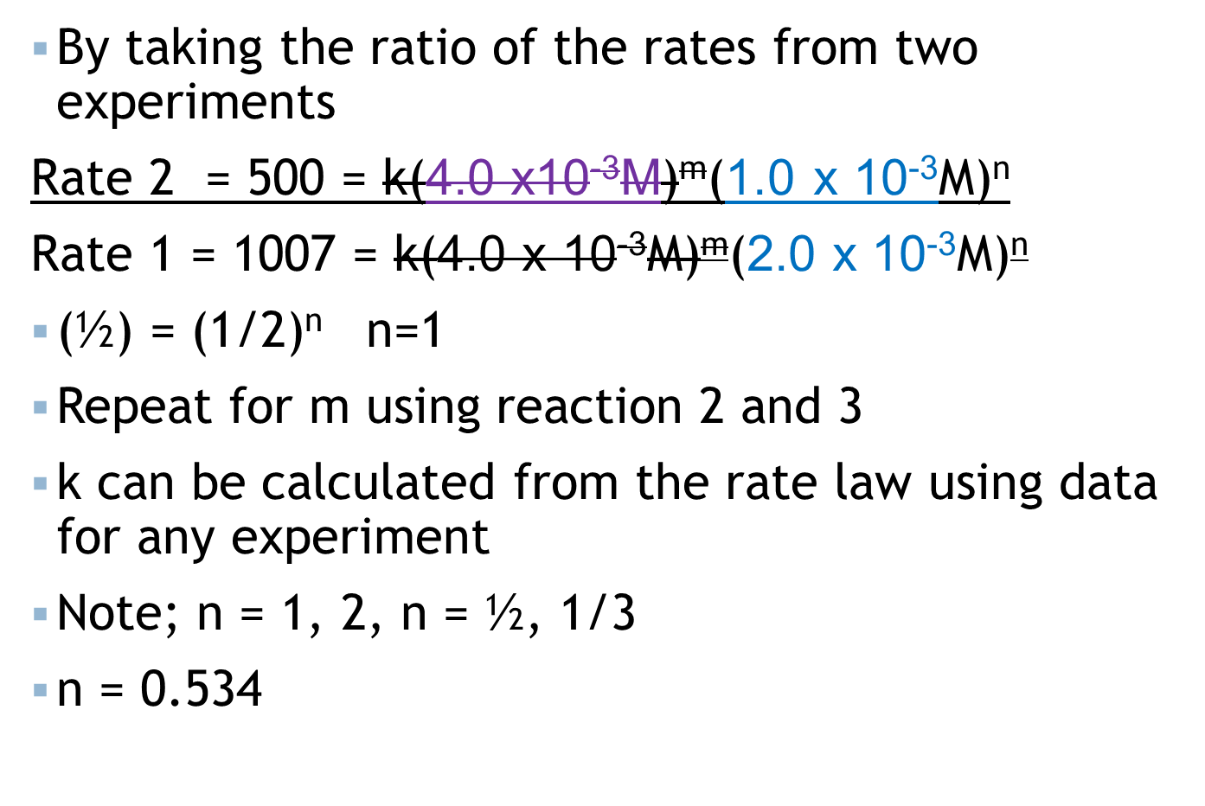
Cont,
Notes:
M = 2

Slide 49
Cont,
Rate = k[O₂]^{n}[N₂]^{m}
To find n:
  Compare experiments #1 and #2
        (½) ^{n} = ½ ; n =1
[N₂] | [O₂] | Rate
Constant | 0.001/0.002 | 500/1007
 | Halved | Halved

Slide 50
Cont,
Rate = k[O₂]^{n}[N₂]^{m}
To find m:
  Compare experiments #2 and #3
        ½ ^{m} = ¼ ; m =2
Rate = k[O₂][N₂]²;
k can be calculated from the rate law using data for any experiment.
Calculate k
[N₂] | [O₂] | Rate
0.002/0.004 | Constant | 125/500
Halved |  | Quartered

Slide 51
Using the log Method
Rate law for a given reaction with a single reactant; rate = k[A]ª
At initial concentrations; R_{o} = k[A]_{o}ª
Taking logarithms
Log R_{o} = log k + a log [A]_{o →}y = mx + c
For a series of initial concentrations, a plot of log R₀ vs. log [A]₀ gives straight line with slope a and y intercept = k.
A plot of log of initial rates against the log of initial [c] for all the others is a straight line with slope a
Notes:
A plot of log of initial rates against the log of initial [c] is a straight line with slope a

Slide 52
Example
  1. At 25 ºC, the rate of decomposition of N₂O₅ is 1.4 x 10⁻³ M/s when the initial concentration of N₂O₅ is 0.020M. The experiment was repeated but with 0.010M of N₂O₅. The rate of decomposition at this concentration was observed to be 7.0 x 10⁻⁴ M/s. What is the reaction order for the decomposition

Slide 53
Example
2. The initial rate of reaction A + B →P was measured for several different starting concentrations of A and B, with the results given below.
Using these data, determine
  Rate law for the reaction ➔ Rate = k [A]^{n} [B]^{m}
  The magnitude of the rate constant
  The rate of the reaction when [A] = 0.050M and [B] = 0.100M
Exp. Number | [A] (M) | [B](M) | Initial rate (M/S)
1 | 0.100 | 0.100 | 4.0 X 10 ⁻⁵
2 | 0.100 | 0.200 | 4.0 X 10 ⁻⁵
3 | 0.200 | 0.100 | 16.0 X 10 ⁻⁵
Notes:
Dr onindo pg 14

Slide 54
Cont,
  b. The magnitude of the rate constant
Using the rate law and data from exp1, we have
k = rate / [A]²
= 4.0 X 10 ⁻⁵ Ms ⁻¹ / [0.100M] ²
= 4.0 X 10 ⁻³ M ⁻¹ s ⁻¹
  The rate of the reaction when [A] = 0.050 M and [B] = 0.100M
  Rate = k [A]² = 4.0 X 10 ⁻³ M ⁻¹ s ⁻¹ x [0.050 M] ²
  = 1.0 X 10 ⁻⁵ Ms ⁻¹

Slide 55
Assignment
1. The initial rate of a reaction depended on concentration of a substance J as follows
Determine the order of the reaction with respect to J and calculate the rate constant
[J]_{o}/ 10 ⁻³ mol L⁻¹ | 5.0 | 8.2 | 17 | 30
Rate=10 ⁻⁷ M s⁻¹ | 3.6 | 9.6 | 41 | 130
Notes:
(2, 1.4 x 10 ⁻² L mol ⁻¹ s⁻¹)

Slide 56
Cont,
2. A particular reaction was found to depend on the concentration of the hydrogen ion [H⁺]. The initial rates varied as a function of [H⁺] as follows
  What is the order of the reaction in [H+]?
  Predict the initial reaction rate when [H⁺] = 0.400 M
[H⁺] (M) | 0.0500 | 0.100 | 0.200
Initial rate (M/s) | 6.4 x 10 ⁻⁷ | 3.2 x 10 ⁻⁷ | 1.6 x 10 ⁻⁷
Notes:
Ans: a. -1 (the rate is inversely proportional to
b. 0.8 x 10 ⁻⁷

Slide 57
Integrated Rate Laws
Gives equation that relates concentration of reactants as a function of time
Used to determine how the rates are affected by the concentrations of reactants, products or inhibitors
Notes:
Integral of 1/x = ln x

Slide 58
Zero Order Reactions (rare)
A → Products
Rate is independent of the concentration of the reactants
Occurs when
  The system is saturated with the reactants
  The reaction is catalyzed by attachment to a solid surface (heterogeneous reactions)

Slide 59
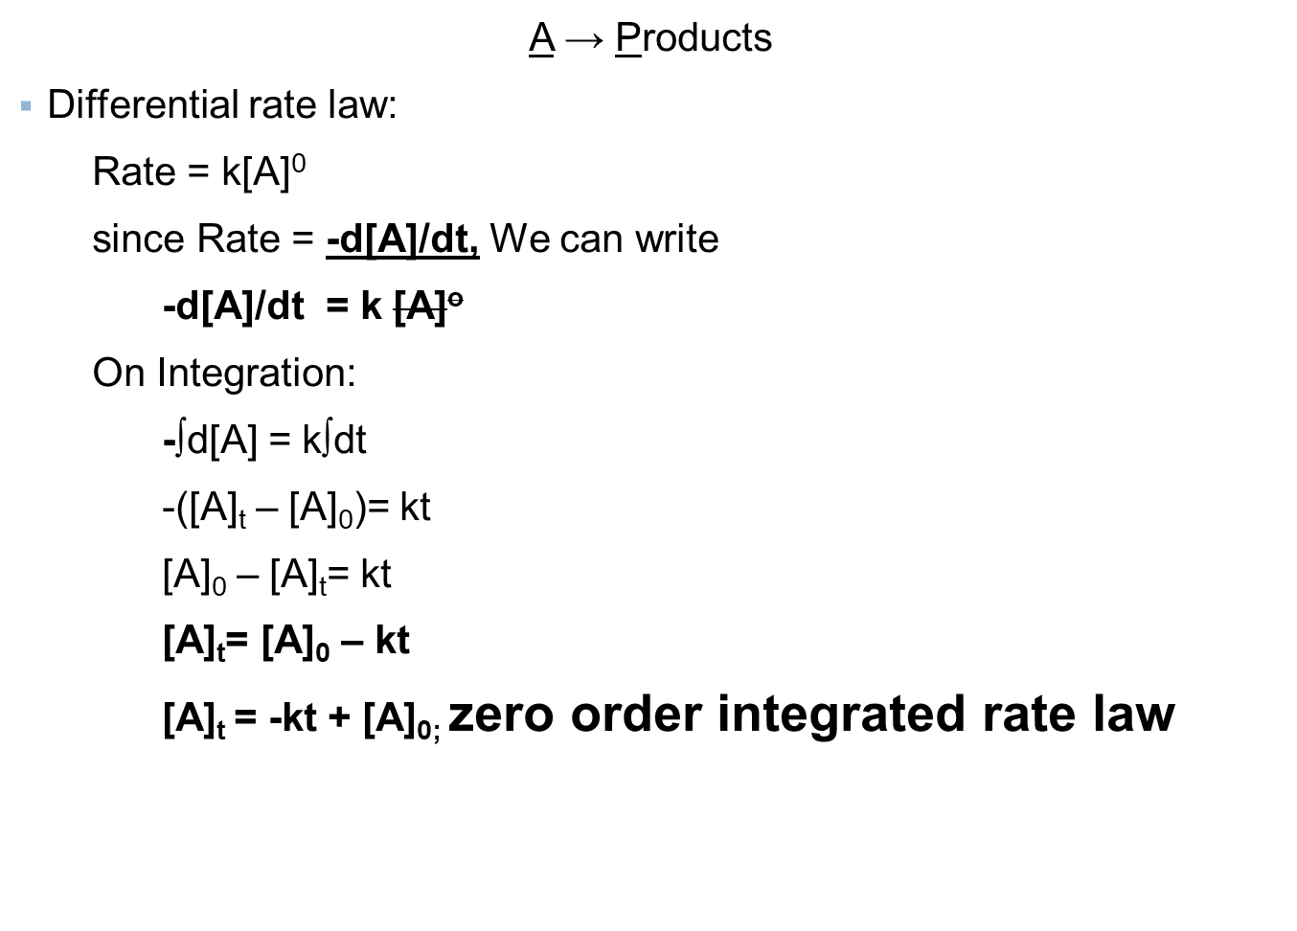
Zero-order integrated rate law

Slide 60
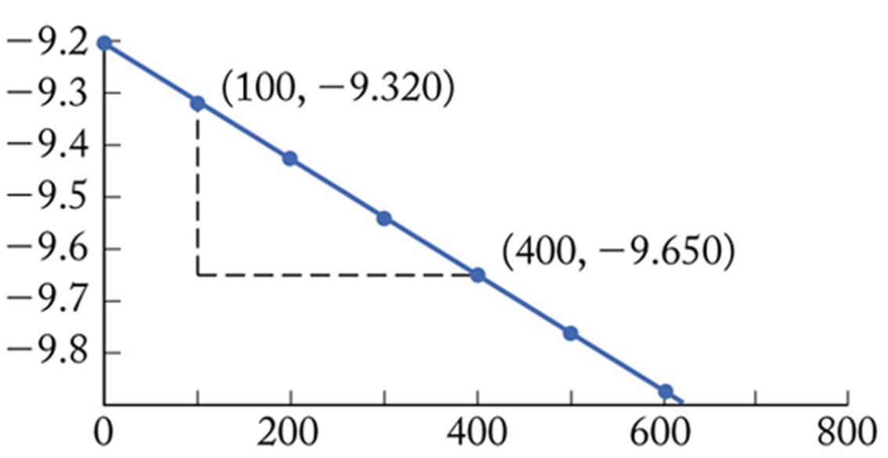
Zero Order Graphs
[A]_{t}= – kt + [A]₀ straight line equation
Y = mx + c
[A]_{t}
Time (s)
Slope; -k
y intercept = initial concentration of A ([A]₀)

Slide 61
Half-Life (t_{1/2}): Zero Order Reactions
  Half-life; the time required for concentration of a reactant to reach ½ its initial concentration.
  At t = 0, concentration is [A]_{o}
  [A]_{t}= – kt + [A]_{0; integrated rate equation}
  At half-life, t = t_{1/2}; [A]_{t1/2} = ½ [A]₀
  ½ [A]₀ = – kt_{1/2} + [A]₀
  Rearranging the equation gives:
  t_{1/2} = [A]₀
        2k

Slide 62
First Order Reactions/Kinetics
Log₁₀
Natural log (ln)
A → Products
Rate = k[A]¹
Differential rate law = -d[A]/dt = k[A] 1a
Equation 1a rearranges to
-∫d[A]/[A] = k∫dt 1b
Integration leads to
ln ([A]_{t} / [A] ₀ ) = -kt 1c
ln[A]_{t} - ln[A]₀ = – kt 1d
ln[A]_{t}= – kt + ln[A]₀ (y = mx + c) 1e

Slide 63
Cont,
In a first order reaction, the reactant concentrations decreases exponentially with time t
([A]/[A]₀)
ln([A]/[A]₀)
t/t_{1/2}
t/s

Slide 64
Cont,
ln[A]_{t}= – kt + ln[A]₀ (y = mx + c)
Slope = -k
Intercept = ln[A]₀
ln [A]_{t}
time (s)

Slide 65
Cont,
([A]_{t}/[A] ₀ ) = e ^{–kt}
[A]_{t}= [A] ₀ e ^{–kt} final integrated format
Equation 1e can be used to determine
  The concentration of a reactant remaining at any time after a reaction has started
  The time required for a given fraction of a sample to react
  The time required for a reactant concentration to reach a certain level

Slide 66
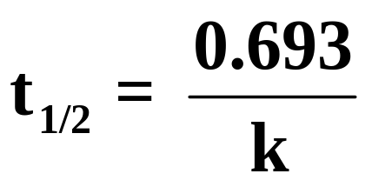
Half-life (t_{1/2}); First Order Reactions
Time taken for [A]₀ to drop to half its value i.e. [A]_{1/2}
At t = t_{1/2} ; [A]_{t/2} = ½ [A]₀;
Rearranging the integrated rate law gives:
ln (1/2 [A]₀/ [A]₀)= -kt_{1/2}
ln ½ = -kt_{1/2}
-kt_{1/2} = -0.693; constant throughout
Half life is independent of the initial concentration
E.g. decay of radioactive isotopes
Notes:
» t_{1/2} = ln(2)/k

Slide 67
Examples
Consider a first order reaction with a rate constant of 5.00 s ⁻¹. What will be the half life of the reaction
Consider the following equation for the decomposition of SO₂Cl₂.
SO₂Cl₂ (g) → SO₂(g) + Cl₂ (g)
If the initial concentration of SO₂Cl₂ is 0.0225 M, what will be the [SO₂Cl₂] after 865 s? k = + 2.90 x 10⁻⁴ s⁻¹.
Use ln[A]_{t}= – kt + ln[A]₀
Notes:
» t_{1/2} = ln(2)/k 0.1386 s→ 0.14 s

Slide 68
Cont,
A first-order reaction has a half life of 26.4 seconds. How long will it take for the concentration of the reactant to fall to one-eighth of its initial value

Slide 69
Cont,
In a particular experiment, it was found that the concentration of N₂O₅ in liquid bromine varies with time as follows.
Confirm the reaction order and determine the rate constant
t/s | 0 | 200 | 400 | 600 | 1000
[N₂O₅]/ML⁻¹ | 0.110 | 0.073 | 0.048 | 0.032 | 0.014

Slide 70
Approach
Zero order reaction
  Integrated rate law; [A]_{t}= – kt + [A]₀
  Plot of [A]_{t} vs t gives a straight line
1st order reaction
  ln[A]_{t} = – kt + ln[A]₀
  Plot of ln[A]_{t} vs t gives a straight line
Notes:
» t_{1/2} = ln(2)/k

Slide 71
In a particular experiment, it was found that the concentration of N₂O₅ in liquid bromine varied with time as follows:
Confirm that the reaction is first-order in N₂O₅
Determine
  The rate constant
  Half-life
t/s | 0 | 200 | 400 | 600 | 1000
N₂O₅ /mol L-1 | 0.110 | 0.073 | 0.048 | 0.032 | 0.014

Slide 72
Exercise
The first-order rate constant for the decomposition of a certain insecticide in water at 12 ºC is 1.45 yr⁻¹. A quantity of this insecticide is washed into a lake in June, leading to a concentration of 5.0 x 10 ⁻⁷ g/cm³ of water. Assume that the effective temperature of the lake is 12 ºC.
  What is the concentration of the insecticide in June of the following year?; 1.2 x 10 ⁻⁷ g/cm³
  How long will it take for the concentration of the insecticide to drop to 3.0 x 10 ⁻⁷ g/cm³; 0.35 yr.

Slide 73
Cont,
2. The decomposition of N₂O₅ according to the equation. 2N₂O₅(g) → 4 NO₂ (g) + O₂ (g) has a first-order rate law. The rate constant k has a value 8.5 x 10⁻³ s⁻¹. If the initial pressure of N₂O₅ is 240 mm Hg. What will its pressure be after 300 s? 18.7
The thermal decomposition of N₂O₅(g) to form NO₂ (g) and O₂ (g) is a first-order reaction. The rate constant for the reaction is 5.1 x 10 ⁻⁴ s⁻¹ at 318K. What is the half-life of this process. ; t_{1/2} = 1.4 x 10³ s.

Slide 74
Cont,
4. A chemical reaction is characterized by a rate constant of 3.4 x 10 ⁻⁵ s⁻¹. Determine the time taken for the reaction to be 75% complete

Slide 75
Second Order Kinetics
The rate depends on two concentration terms which may be similar or not
A+A → P
A +B → P
2nd order in one component; bimolecular, overall order = 2
Rate = k [A]²
Differential rate law
= -d[A]/dt = k[A]²
= -∫d[A]/[A]² = k∫dt
Notes:
Integral of (1/x²) is -1/x; obtain the above equation by substitution of the limits

Slide 76
Cont,
Integrated rate law:
1/[A]_{t} – 1/[A]₀)= kt
1/[A]_{t}= kt + 1/[A]₀
If reaction is second order; a plot of 1/[A]_{t} vs t yield a straight line with slope k
[A]_{t} = [A]_{o}/(1+kt[A]_{o})
Notes:
Integral of (1/x²) is -1/x; obtain the above equation by substitution of the limits

Slide 77
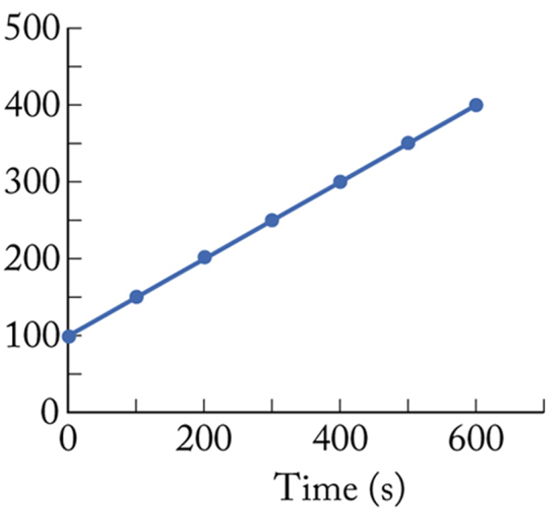
Second Order Plots
1/[A]_{t}= 1/[A]₀ + kt
1/[A]_{t}
A plot of 1/[A]_{t} vs t is a straight line:
  slope = k
  intercept = 1/[A]₀

Slide 78
Half-life (t_{1/2})
1/[A]_{t}= 1/[A]₀ + kt
  At half-life, [A]_{t} = ½ [A]₀
  2/[A]₀ = 1/[A]₀ + k t_{1/2}
t_{1/2} = 1
(k[A]_{o})
Therefore t_{1/2} depends on the initial concentration of the reactants
Consequence; the substances may persist in low concentrations for long periods; half-lives long in low concentrations e.g. environmentally harmful substances

Slide 79
Activity | 0 | 1 | 2 | n
Equation; A → products Rate law Differential rate equation
Integrated rate law
Units of rate constant
Linear plot to determine k
Half life

Slide 80

1.The following data were obtained for the gas-phase decomposition of nitrogen dioxide at 300 ⁰C. Is the reaction first second-order in NO₂ ; 2NO₂ (g) → 2NO (g) + O₂ (g)
Time | [NO₂] (M) | 1/[NO₂]
0.00 | 0.0100 | 100
50.0 | 0.0079 | 126.6
100.0 | 0.0065 | 153.8
200.0 | 0.0048 | 208.3
300.0 | 0.0038 | 263.2

Slide 81
A 0.0200 M solution of substance A undergoes the second-order decomposition, 2A → products at T = 300K, according to the following table:-
What is the half-life of the reaction?
What is the rate constant?
t/min | 5 | 10 | 15 | 20 | 25 | 30 | 40 | 50
[A] (M) | 0.0133 | 0.0100 | 0.0080 | 0.0067 | 0.0057 | 0.0050 | 0.0041 | 0.0033

Slide 82
A reaction 2A → P has a second-order rate law with k = 3.50 x 10 ⁻⁴ L mol ⁻¹ s ⁻¹.
  a. Calculate the time required for the concentration of A to change from 0.260 mol L⁻¹ to 0.011 mol L⁻¹
  Calculate the half-life of the reaction
Determine the concentration of the reactant after 23 minutes
Determine t_{3/4} for the reaction

Slide 83
4. A second-order reaction of the type
A + B →P
was carried out in a solution that was initially 0.050 mol L⁻¹ in A and 0.080 in B. After 1.0 h the concentration of A had fallen to 0.045 mol L⁻¹
a. Calculate the rate constant
b. What is the half-life of the reactants

Slide 84
Determining orders
Getting the data
  Quench the reaction (after a certain time), measure concentrations
  t(s) Concentration
  0 (s) 0.4 M
  120 s measure the concentration
  240 s
  360
  600
  Spectroscopically follow reactants / products

Slide 85
Analyze the data
A. Using integrated equations
The equation which gives a constant value of k indicates order of reaction

Slide 86
Cont,
B. Half-life method:
For nth order reaction
t_{½} α 1
[A]_{o}^{n-1 (not possible for n=1)}
  Given two half-life periods obtained at two different initial concentrations, a ₁ and a ₂, then their half-life periods would be
(t_{½})₁/(t_{½})₂ = (a₂/a₁)^{n-1}
(n-1) log (a₂/a₁) =log(t_{½})₁/(t_{½})₂

Slide 87
Cont,
C. Differential method, log method, also called Van’t Hoff’s method. For a single reactant
rate = k[A]^{n}
At initial concentrations; rate = k[A]_{o}^{n}
Taking logarithms
Log rate = log k + n log [A]_{o}
  If done at two different conditions, can solve the equations
Isolation (flooding) method
Initial rate method
Notes:
Ans = 3

Slide 88
Example
  In the reaction of nitric oxide 50% of the reaction was completed in 140 seconds when initial pressure was given 258 mm Hg and in 224 seconds when initial pressure was 202 mm HG. Find the order of the reaction
  In a particular reaction, the time required to complete half of the reaction was found to increase nine times when the initial concentration was reduced to 1/3. what is the order of the reaction
Notes:
Ans = 3

Slide 89
Collision Theory of Reaction Rates/Molecular Activation
Uses kinetic molecular theory
Applicable to gaseous reactions
Collision model: reactants react because they collide;
  A and B; must collide.
  A+B+C; must collide
Notes:
Probability of reaction is determined by orientation.

Slide 90
Collision Theory of Reaction Rates
Essential requirements for reactions to occur
  Collision between reactant molecules
  Activation of molecules; activated complex
  Proper orientation of the reacting molecules at the time of collision
    Successive collision
Notes:
Probability of reaction is determined by orientation.

Slide 91
Cont,
  To increase reaction rate, increase collision rate.
  Increasing the temperature increases molecular velocities thus increasing collisions
The reaction rate therefore depends on frequency of collisions and probability of reaction occurring upon collision (orientation).
Notes:
Probability of reaction is determined by orientation.

Slide 92
Factors Affecting Rate
Concentration of reactants:
  Number of molecules with minimum required energy increases (activation energy)
  The higher the concentration the higher the frequency of collisions which increases the rate
Energy of collisions (Temperature Effect)
  Energy is needed to break bonds in reactants, leading to the formation of new bonds.
Catalysts:

Slide 93
The Effect of Temperature on Reaction Rate
Lizards become lethargic when their body temperature drops; the chemical reactions that control muscle movement slow down at low temperatures
Rates of chemical reactions highly sensitive to temperature
At Room Temperature, a 10 ºC increase in temperature increases the rate of a typical reaction by two or three times

Slide 94
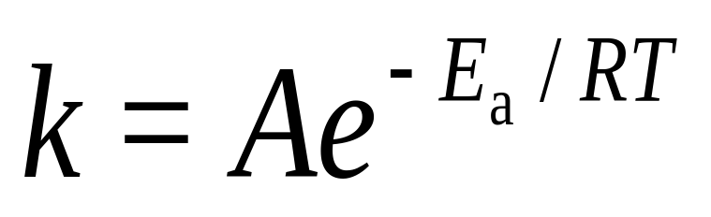
Cont,
Rate = k [A]^{n}
Rate constant is affected by changes in temperature.
An increase in temperature results in an increase in k resulting in a faster rate
This is quantified by Arrhenius equation

Slide 95
Temperature Dependence
In 1888, Arrhenius noted that the increase in rate with temperature fitted the Arrhenius equation
Where:
k rate constant
R: universal gas constant (8.314 J/mol.K)
T: temperature (K)
E_{a} activation energy/energy barrier
A: collisional frequency factor; pre-exponential factor; Arrhenius factor
The parameter A(/s) and E_{a}(kJ/mol); are referred to as Arrhenius parameters
Notes:
The value of A and Ea are specific to each chemical reaction

Slide 96
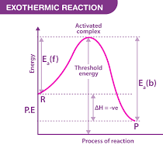
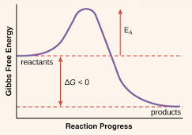
Cont,
The activation energy E_{a} energy barrier or a hump that must be overcome for the reactants to be transformed into products.

Slide 97
Cont
To get to the products, the reactant must go through an activated complex or transition state.
The energy required to create the activated complex is the activation energy
Activation Energy (E_{a}):
  E_{a} is the minimum energy of molecular collisions required to break bonds in reactants, resulting in formation of products.
The higher the activation energy, the higher the energy barrier, the slower the rate of the reaction (at a given temperature)

Slide 98
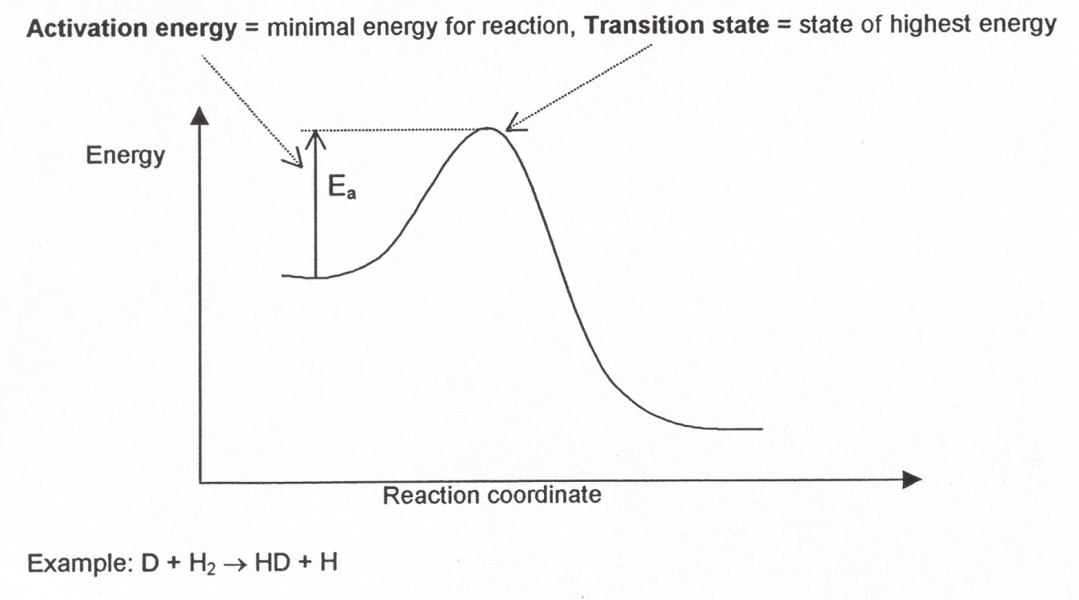
Cont,
The temperature dependence can be explained by assuming the existence of an energy barrier
Reactants
Products
For two reacting molecules to react when they collide, they must have sufficient energy to overcome the energy barrier and pass through the TS.
E_{a}; minimum kinetic energy that reactants must have in order to form products

Slide 99
Cont,
Holds well nearly for all elementary homogeneous reactions and for most composite reactions
Two colliding molecules require a certain minimum kinetic energy to initiate breaking of bonds; activation energy
  A low activation energy means a fast reaction
  A high activation energy means a slower reaction
Note; as the magnitude of E_{a} increases, k becomes smaller, thus reaction rates decrease as the energy barrier increases

Slide 100
Cont,
The rate constant increases as the temperature is raised e.g. for methyl ethanoate; k at 35 ºC is 1.82 times that at 25 ºC
E_{a} is given by the slope for a log form of equation
Therefore the higher the activation energy, the stronger the temperature dependence of the rate constant
Zero activation energy; rate is independent of T
Negative activation energy, rate decreases as T is raised (complex mechanisms)
Notes:
steeper slope observed

Slide 101
Temperature Dependence of Reaction Rates
  Increased temperature increases kinetic energy of molecules and molecules with minimum energy to react
  This increases the velocity & therefore the probability of molecular collisions.
  Increase in molecular collisions increases the reaction rate

Slide 102
The Frequency Factor (A)
  The number of approaches to the activation barrier per unit time
  Any time a bond begins to rotate or vibrate, it approaches the activation barrier
  With each vibration, the reactant approaches the activation barrier
    Remember; the approach will require enough energy to make it over the energy barrier

Slide 103
The Exponential Factor
Exponential factor (e ^{-Ea/RT}) a number btn 0-1
Represents the fraction of molecules that have enough energy to make it over the activation barrier on a given approach
Fraction of approaches that are actually successful and result in the product
E.g. if A = 10⁹/s and exponential factor is 10⁻⁷ at T, overall rate constant = 10²/s. only 1 in 10 ⁷ molecules have sufficient energy to make it over the activation barrier (=A e ^{-Ea/RT})

Slide 104
Cont,
The exp factor depends on T and Ea
A low activation energy and a high temperature make the negative exp small
If Ea = 0, then Exp is zero, the factor = 1
By contrast, a large activation energy and a low T, makes the exponent a very large number, and the exponent becomes very small
Example; at T = 0, exponent approaches infinitely large number, exponential factor approaches zero

Slide 105
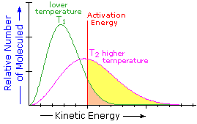
As the temperature increases, the number of molecules having enough thermal energy to surmount the activation barrier increases
At any given temperature, a sample of molecules of molecules will have a distribution of energies
Step 1
T(lower) = 25 ºC; lower KE
T(higher) = 35 ºC; higher KE
T lower; normal/gaussian distribution
Step 2; relation of molecules with temperatures/activation energy
E_{a} = 50 kJ/mol
Step 3; identify the number of molecules with activation energy

Slide 106
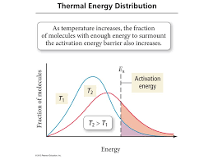

Slide 107
Under common circumstances, only a small fraction of the molecules have enough energy to make it over the activation barrier
But, a small change in temperature will result in a large difference in the number of molecules having enough energy to overcome the barrier

Slide 108
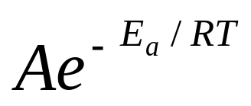
Cont,
The fraction of collissions with a kinetic energy in excess of E_{a} is given by Boltzmann distribution as e ^{-Ea /RT}
Hence ^{-Ea /RT} is the fraction of collissions that have enough kinetic energy to lead to reaction
A = empirical frequency factor (preexponential factor); measure of rate at which collissions occur irrespective of their energy
Hence A and the exponential factor e ^{-Ea /RT} gives the rate of successful collisions

Slide 109
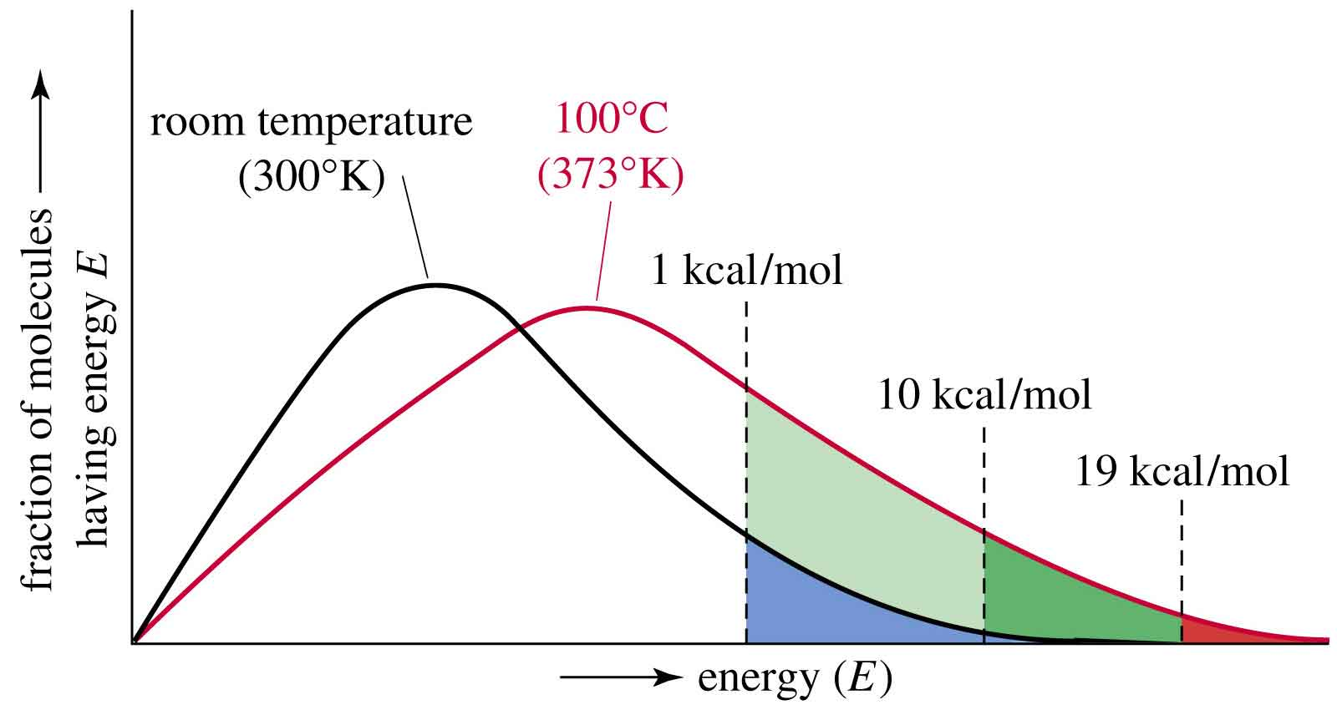
Cont,
Boltzmann statistics tell us; An increase in temperature increases the probability of molecules having enough energy to cross the transition state.
Fraction of collisions that have E_{a} or greater

Slide 110
Conclusion
The frequency factor is the number of times that the reactants approach the activation barrier per time
The exponential factor is the fraction of approaches that are successful in surmounting the activation barrier and forming products
The exponential factor increases with increasing temperature but decreases with an increasing value for the activation energy

Slide 111
Arrhenius Plots
Enables experimental measurements of the frequency factor (A) and the activation energy (E_{a})
k = Ae ^{-Ea/RT}
lnk = lnA + ln (e ^{-Ea/RT})
lnk = - (Ea/R) (1/T) + ln A
y = mx + c
Plot of ln k versus (1/T) yields a straight line
  Slope ; - Ea /R
  Intercept; ln A
Such a plot is called an Arrhenius plot

Slide 112
Arrhenius Plots
lnk = - (Ea/R) (1/T) + ln A
Log k = – E_{a} / (2.303 RT) + log A
Plot of Log k versus (1/T) is a straight line
  Slope; – Ea / 2.303R
  Intercept; log₁₀ A

Slide 113
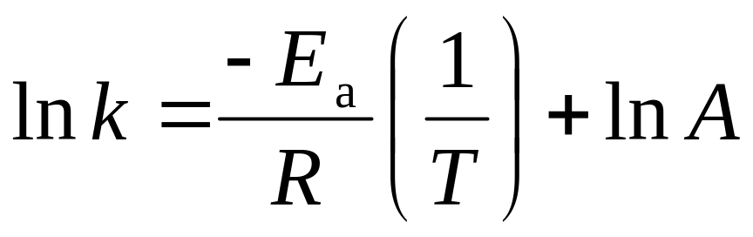
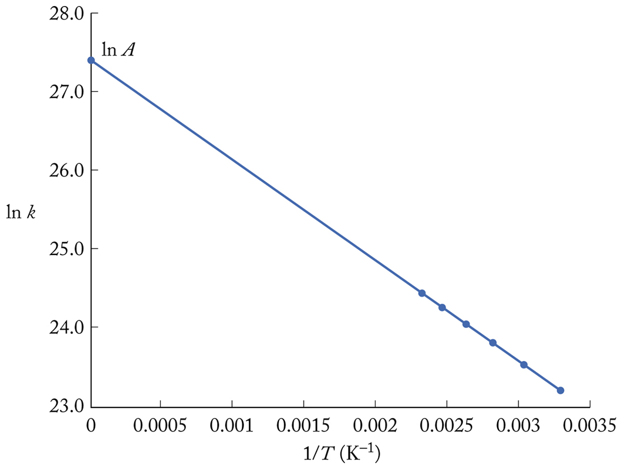
Graphical Determination of E_{a}
Slope = −E_{a}/R
Intercept = ln A

Slide 114
Graphical Determination of E_{a}
Log₁₀ k = log₁₀ A – E_{a}/ (2.303RT)
log₁₀ A
Plot of Log₁₀ k versus (1/T)
Slope = −E_{a}/2.303 R
Intercept = log₁₀ A
log₁₀ k

Slide 115
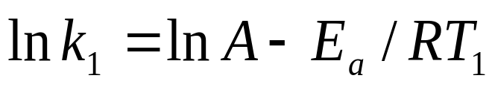
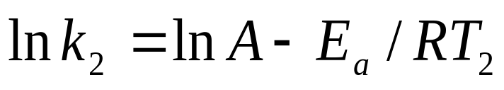
Mathematical Determination of E_{a}
Need to know rate constant (k) values at 2 different temperatures:
ln (k₁/k₂) = Ea/R (1/T₂ – 1/T₁)

Slide 116

The value of rate constant for the decomposition of nitrogen pentoxide (N₂O₅ → N₂O₄ + ½ O₂ ) is 3.46 x 10 ⁻⁵ at 25 ºC and 4.87 x 10 ⁻³ at 65 ºC. Calculate the energy of activation for the reaction
A second-order reaction in solution has a rate constant of 5.7 x 10 ⁻⁵ dm³ mol⁻¹ s⁻¹ at 25 ºC and of 1.64 x10⁻⁴ dm³ mol⁻¹ s⁻¹ at 40 ºC. Calculate the activation energy and the preexponetial factor, assuming the Arrhenius equation apply
Calculate E_{a} for a reaction whose rate constant at room temperature is doubled by a 10- ºC increase in T.

Slide 117
4. The rate of a second order decomposition of acetaldehyde (ethanal) was measured over temperature range 700-1000K, and the rate constants are reported below. Find E_{a} and A.
Graph lnk vs 1/T
Slope; =-Ea /R = -2.27 x 10⁴
E_{a} = slope x R= -2.27 x 10⁴ K x 8.314 TK⁻¹mol⁻¹ = 188 kJmol⁻¹ (same as those for RT)
lnA = intercept = 27.7 (least square analysis)
A = e ^{27.7} L mol ⁻¹ s⁻¹ (units of k)
T/K | 700 | 730 | 760 | 790 | 810 | 840 | 910 | 1000
k/(L mol ⁻¹ s⁻¹) | 0.011 | 0.035 | 0.105 | 0.343 | 0.789 | 2.17 | 20.0 | 145
Notes:
A obtained from the midrange data

Slide 118
Cont,
A can also be calculated from
If extrapolation can not be achieved (use a mid range figure)

Slide 119
5. For the reaction C₂H₅I + OH⁻ → C₂H₅OH + I⁻
The rate constant data versus T are
Use a graph to find E_{a} and A for this reaction.
10 ⁴k/(L Mol 1 s-1) | 0.503 | 3.68 | 67.1 | 1190
lnk | 8.5 | 10.5 | 15.01 | 16.2
1/T | 3.46 x 10 -3 | 3.27 | 3.00 | 2.7
T/k | 289.0 | 305.2 | 332.9 | 363.8

Slide 120
Transition State Theory
Review:
An activated complex forms between reactants as they collide and begin to assume the nuclear and electronic configurations characteristic of products.
The change in potential energy associated with formation of the activated complex accounts for the activation energy of the reaction.

Slide 121
Transition State Theory
Its an attempt to identify the principal features governing the size of a rate constant in terms of a model of the events that take place during the reaction.
Postulates that a hypothetical transition state occurs between reactants and products
The hypothetical distance between the reactants and products is known as the Transition State
Activated complex; high-energy species that is formed during the transition state of a chemical reaction

Slide 122
Transition State Theory
Postulates 3 major factors for a reaction to occur
  Concentration of the activated complex
  The rate at which the activated complex breaks apart
  Mechanism by which the complex breaks apart
It can be used to calculate
  Standard enthalpy of activation
  Standard entropy of activation
  Gibbs energy of activation

Slide 123
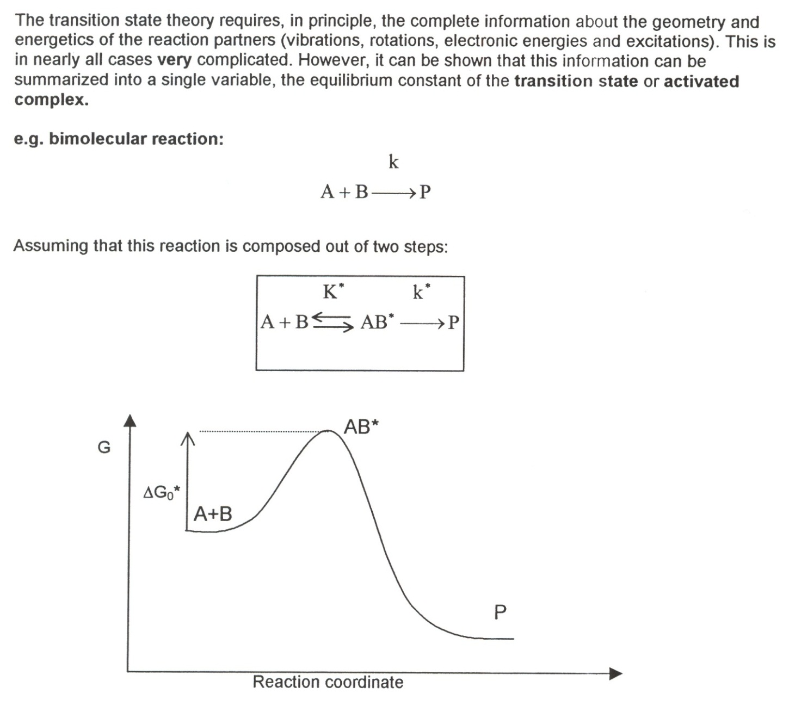

Slide 124
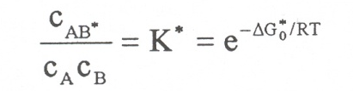
Cont,
Transition state AB*;
  State with highest energy during reaction;
  Chemicals bonds are cleaved and rearranged.
  Rate limiting step = product formation with k*
  Equilibrium constant K*

Slide 125
Application in Biochemistry
Useful in modelling reactions catalysed by enzymes in the body
By knowing the possible transition states that can form in a given reaction and the various activation energies for each transition state, one can predict the course of a biochemical reaction
  Reaction rate
  Rate constant

Slide 126
CATALYSTS & CATALYSIS
A catalyst; substance that accelerates a chemical reaction by providing an alternative path that avoids the slow-rate determining step of the uncatalysed reaction
Provide a pathway with a lower activation energy
  R₁ + C = I + P₁
  I + R₂ = P₂ + C
  Overall reaction: R1 + R2 = P1 + P2
    R1 and R2 = reactant 1 and 2
  I = intermediate

Slide 127
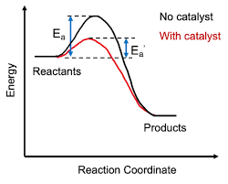

Slide 128
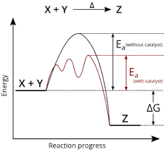

Slide 129
CATALYSTS & CATALYSIS
  Another example
  Cl + O₃ → ClO + O₂
  ClO + O → Cl + O₂
  Overall equation; O₃ + O → 2O₂
  Cl catalyzes destruction of ozone in the atmosphere
  Where the catalyst is Cl and intermediate is ClO
  In most cases, the catalyzed reaction has several steps and more than one intermediate

Slide 130
cont,
E.g by adding iodide to H₂O₂, the activation energy falls from 76 to 57 kJ/mol while the rate constant increases by a factor of 2000.
Enzymes; biological catalysts e.g. enzyme catalase which reduces the activation energy of decomposition of H₂O₂ to 8kJ/mol corresponding to an acceleration by a factor of 10¹⁵
Autocatalytic reaction; a product speeds up the rate of the reaction
  e.g. H₃O⁺ catalyzed hydrolysis of esters
  RCOOR’+ H₂O = ROOOH + R’OH.
  The extra H₃O⁺ formed from ionization of ROOOH tends to speeds up the reaction

Slide 131
Classification of Catalysts
Homogeneous catalysts; catalyst in the same phase as the reaction mixture.
  E.g. decomposition of H₂O₂ by catalase or bromide ion; liquid or gas
Heterogeneous catalyst; a catalyst in a different phase from the reaction mixture; interface between two phases mostly gaseous and solid phases
  E.g. hydrogenation of ethene to ethane, a gas phase reaction is accelerated in the presence of a solid catalyst such as palladium, platinum or nickel. Reactant binds on the surface of the metal; Ni, Pt, Pd

Slide 132
Enzymes
Homogeneous biological catalysts
The compounds are special proteins or nucleic acids with an active site which binds the substrate or the reactants and process them to products
The active site returns to its original state after the products are released
The structure of the active site is specific to the reaction that it catalyses, with groups in the substrate interacting with groups in the active sites by intermolecular interactions e.g. hydrogen bonding , electrostatic or van der Waals interactions.

Slide 133
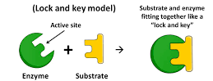
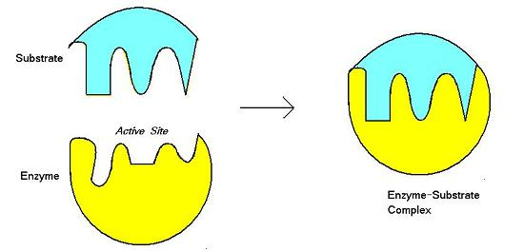
Modes of Interactions
Lock and key model
Induced fit model

Slide 134
Cont,
Lock-and-key model;
  Active site and substrate have complementary three-dimensional structures and dock perfectly without the need for major atomic rearrangements.
Induced fit model
  binding of the substrate induces a conformational change in the active site. Only after the change does the substrate fits snugly in the active site
  Most favoured experimentally

Slide 135
Characteristics of Catalysts
The catalyst remains chemically unaffected at the end of the reaction. Some physical changes may be observed e.g. change in colour, particle size e.t.c
A small quantity of the catalyst is required to catalyse unlimited reaction. A very small amount is sufficient since its not used up in the reaction
A catalyst does not affect the position of equilibrium in a reversible reaction
A catalyst can not initiate a reaction but only increases its speed

Slide 136
Cont,
Specificity of the catalyst;
  A catalyst is specific in nature; can only catalyse the particular reaction and cannot be used for every reaction

Slide 137
Cont,
They exhibit maximum activity at a particular temperature; optimum temperature
A catalyst is poisoned by the presence of traces of certain substances which destroy the catalytic activity.
  They are referred to as Catalytic poisons
  They decrease or destroy the activity of the catalyst e.g. arsenic destroys the catalytic activity of the platinum catalyst in the manufacture of sulphuric acid. Others include; carbon monoxide, HCN, look into hydrogenation of ethyne

Slide 138

Cont,
Catalyst promoter: the activity of a catalyst is enhanced by the presence of a promoter. These are certain substances which increase the activity of the catalyst
E.g. in Haber’s process, molybdenum is used as a promoter to the catalyst iron

Slide 139
Enzyme Inhibition
Enzyme catalysed reactions are prone to inhibition by molecules that interferes with the formation of product
Many drugs are synthesized to act as inhibitors.

Slide 140
Examples of Heterogenous Catalysis
Examples;
  Ozone depletion; It is likely responsible for the ozone hole over Antartica
  Hydrogenation of ethene
  Catalytic converters

Slide 141
Hydrogenation of double bonds
E.g. hydrogenation of ethene
CH₂=CH₂ + H₂ → CH₃-CH₃ slow at 25 ºC
However, in the presence of finely divided platinum, palladium or nickel, the reaction happens rapidly.
The process by the four-step process
  Adsorption
  Diffusion
  Reaction
  Desorption

Slide 142
Cont,
Diffusion
  The reactants diffuse on the surface until they approach each other
Adsorption
  The reactants are adsorbed onto the metal surface
Reaction
  The reactants react to form the products
Desorption
  The products desorb from the surface into the gas phase

Slide 143
Cont,
The activation energy of the hydrogenation reaction due primarily to the strength on the hydrogen-hydrogen bonds in H₂ is greatly lowered once the reactants adsorb onto the surface

Slide 144
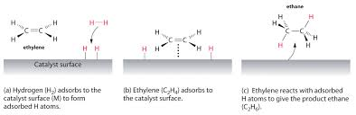
Cont,

Slide 145
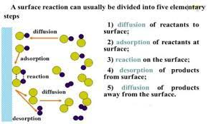
Cont,

Slide 146
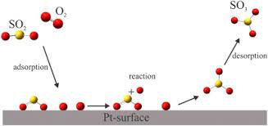
Cont,

Slide 147
Transition State Theory
Review:
An activated complex forms between reactants as they collide and begin to assume the nuclear and electronic configurations characteristic of products.
The change in potential energy associated with formation of the activated complex accounts for the activation energy of the reaction.

Slide 148
Transition State Theory
Its an attempt to identify the principal features governing the size of a rate constant in terms of a model of the events that take place during the reaction.
Postulates that a hypothetical transition state occurs between reactants and products
The hypothetical distance between the reactants and products is known as the Transition State
Activated complex; high-energy species that is formed during the transition state of a chemical reaction

Slide 149
Transition State Theory
Postulates 3 major factors for a reaction to occur
  Concentration of the activated complex
  The rate at which the activated complex breaks apart
  Mechanism by which the complex breaks apart
It can be used to calculate
  Standard enthalpy of activation
  Standard entropy of activation
  Gibbs energy of activation

Slide 151
Cont,
Transition state AB*;
  State with highest energy during reaction;
  Chemicals bonds are cleaved and rearranged.
  Rate limiting step = product formation with k*
  Equilibrium constant K*

Slide 152
Application in Biochemistry
Useful in modelling reactions catalysed by enzymes in the body
By knowing the possible transition states that can form in a given reaction and the various activation energies for each transition state, one can predict the course of a biochemical reaction
  Reaction rate
  Rate constant

