Slide 1


Sleep and Health
By Veronica Warren

Slide 2
Business Problem
We are a mental health company who would like to promote healthy ways of living. One of those healthy habits that is often overlooked is the amount of sleep individuals get. My business is a Healthcare company that believes that sleep is one of the leading factors to health and happiness in more ways than one. We believe that promoting good sleep patterns will assist in life expectancy and overall elevate healthy living and happiness.

Slide 3
Data Explanation
I am going to be using data found on various platforms about sleep. Some of the data I will be using includes a geographic range of the amount of short sleep individuals get; Any and all behavioral risks that have had a positive or negative impact with lack of sleep; Health risk factors that have increased or decreased when measured with the amount of sleep an individual gets per night and any chronic health conditions that have increased or decreased due to sleep deprivation.

Slide 4
Methods
I will pull data from places like the CDC and include studies that are prospective with sleep at their baseline as well as any and all chronic health issues extracting relativity and 95 percent confidence intervals.

Slide 5
Analysis
Short sleep duration was associated with a higher risk of chronic disease and death. It not only had a direct impact on risk of diabetes, but also high blood pressure, memory issues and mood swings.

Slide 6
Conclusion
Taking a break from our busy schedules and taking care of our body will help with overall health and increase life expectancy. Getting a good amount of sleep each night is one thing that is overlooked because of the schedules that we have. Studies have showed however that the long-term effects of not getting the recommended 7-9 hours of sleep each night puts your physical health at risk.
Individuals that do not prioritize sleep have increased risks that range anywhere from weight gain to a weakened immune system. Your cardiovascular system is one process that gets effected. By not getting enough sleep, processes that keep your heart healthy can start to slow down and increase the risk of high blood sugar, blood pressure and inflammation, and have an increased chance of suffering from heart attacks, strokes, and cardiovascular disease.
The lack of sleep can also disrupt your central nervous system. During sleep, there are pathways that form between your neurons in your brain which assist in memory, concentration and coordination. This not only increases the chances of accidents and being able to conduct their usual daily routines to the best of their ability, but it also decreases the amount an individual can learn new processes. It has a direct impact on moods fluctuating and increase the risk of anxiety, depression, and paranoia.
An individual’s immune system and respiratory system can be at risk for lack of sleep as well. When sleeping, your immune system starts to produce infection fighting antibodies but with lack of sleep your body doesn’t have time to create these substances which leaves the body more susceptible to the common cold, flu, and covid!
Along with immune risks, lack of sleep also increases the risk of becoming overweight and can increase the chances of obesity. Without enough sleep your brain reduces the amount of a hormone called Leptin. Leptin is what lets your brain know that you had enough to eat. It also reduces the amount of insulin your body produces which regulates blood sugar and lowers the bodies tolerance for glucose. While reducing these key hormones, lack of sleep increases the hormone ghrelin which tells you that you are hungry. All of these disruptions can lead to serious health conditions like diabetes.
Increasing the amount of sleep one gets each night so that it falls between the recommended hours of 7 to 9 hours will assist in having a long, healthy and happy life.

Slide 7

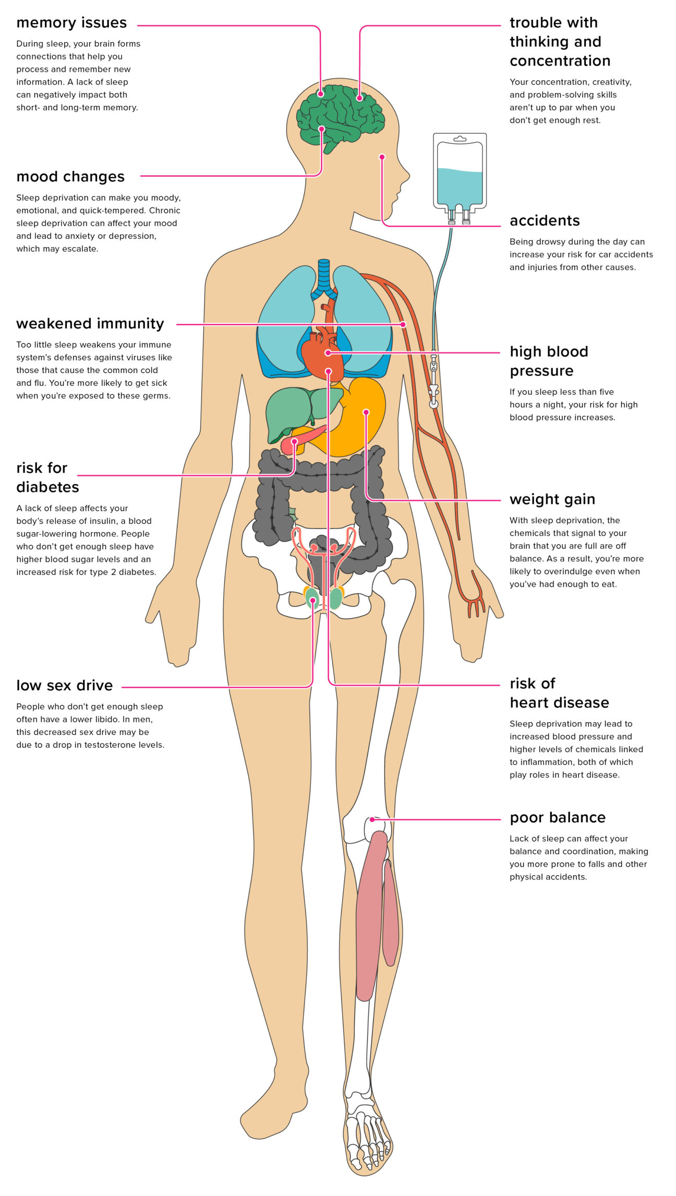
Sleep and the body

Slide 8
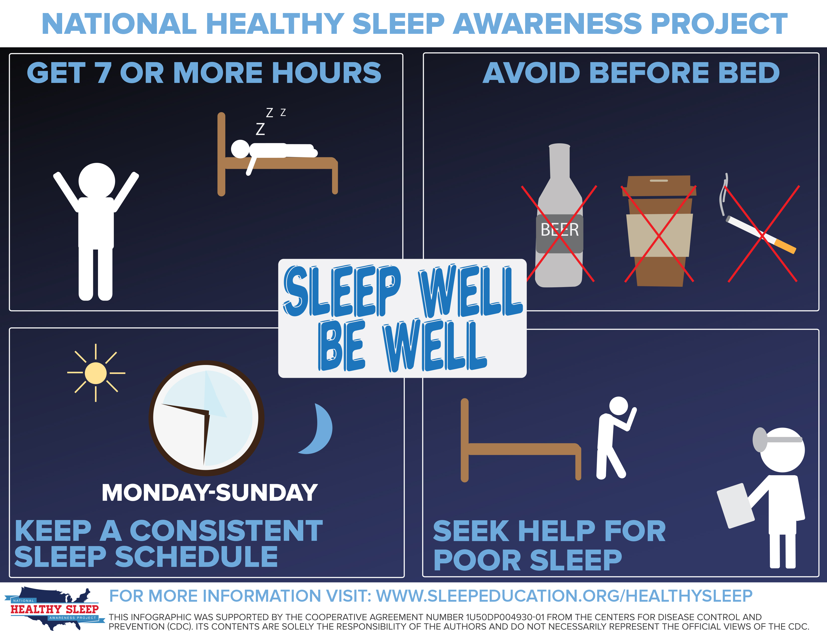
Be Well

Slide 9
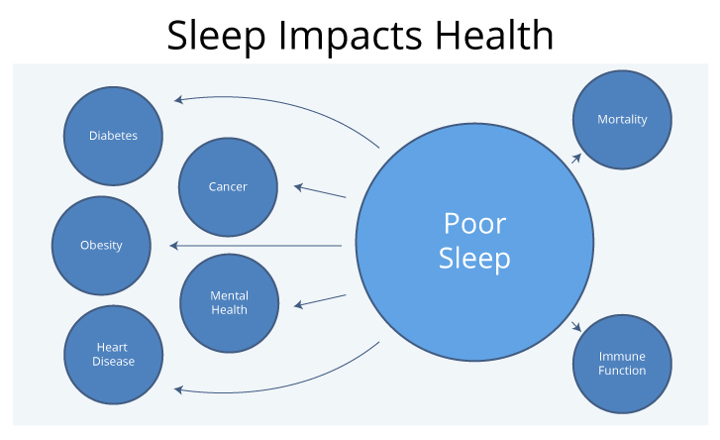
How Sleep Impacts Health

Slide 10
Q & A
Questions
Are naps during the day okay? Do they count towards the 7 hours I need?
What are the different cycles of sleep?
Is snoring a bad thing?
How exactly does the body heal itself at night?
How is lack of sleep correlated to low sex drive?
What are the different types of sleep disorders and what can we do to prevent them?
Are there foods that can assist with sleep?
What are things I can avoid to help me sleep better?
How can I get back on track with my sleep schedule?
What if I oversleep all of the time?

