Slide 1
TIC-TAC-TOE USING TCP/IP SOCKET PROGRAMMING IN JAVA
Ramapavan Kopparapu
123003207
Guided by
Prof. Dindayal Mahto

Slide 2
Agenda
Problem statement
Implementation design diagram
Tools used
Explanation
Library modules
Output screenshots
Conclusion

Slide 3
Problem statement
Tic-Tac-Toe is the strategical turn-based game, where logic is applied to win. It is a 2 player 3x3 grid with players filling the blocks with X’s or O’s and the first player to place three of their marks consecutively in a row, column or diagonal wins. We are using socket programming to communicate between the server and the 2 clients (players) who are distant/in remote areas.
In this project we are illustrating a multiplayer game using client-server architecture and by using socket programming, by using TCP/IP protocol to establish a connection between client and server who are either in

Slide 4
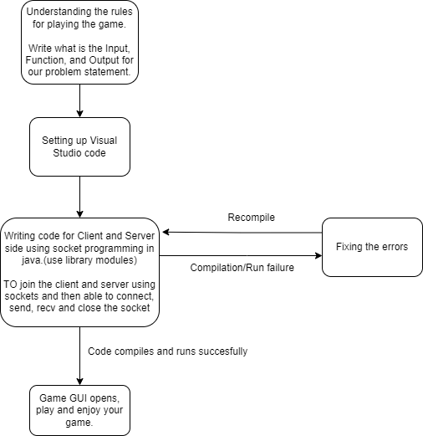
Implementation design diagram

Slide 5
Tools Used
To execute the written java program code using JDK 1.8 software is installed and used. A text editor like Notepad or Visual studio code can be used.
To compile and run the program we use command prompt.
Visual Studio Code - Visual Studio Code is a source-code editor made by Microsoft for Windows, Linux and macOS. Features include support for debugging, syntax highlighting, intelligent code completion, snippets, code refactoring, and embedded Git.
Command prompt - Command Prompt is a command line interpreter application available in most Windows operating systems. It's used to execute entered commands.

Slide 6
Library modules
For implementing of GUI we used
1. java.awt.* library
2. java.swings.* library
3. java.net.* library for creating of applets and also for socket programming
4. java.util.* for using collections

Slide 7
Explanation
The Tic-Tac-Toe multiplayer game that uses socket programming (an API used in java programming), uses TCP/IP protocol to establish a connection between client and server. This strategic game is a 2 player game i.e.; 2 clients interact with each other via a server that records/acts as a communication medium between the 2 clients that are either playing in the same desktop/computer(localhost) or different computers which are connected via IP address.
First a connection is established between the 2 clients via the server using TCP/IP protocol and sockets are used to connect them. When the first player makes a move, the action listener records the move/mark and sends it to the server which is then sent/returned back to the second/other player who has already established

Slide 8
connection. The received mark/move is written as opponent move. Each player plays a move and the move is recorded and reflected back, this continues until one of them wins or is a draw.
A player wins if the marker is the same in all blocks of the certain full row/column/ cross diagonals or if all the blocks are filled and no player wins then is declared as draw. Score of each player is updated until both players decide to exit the game. A function is used to block a player to record more than one move/mark consecutively.

Slide 9
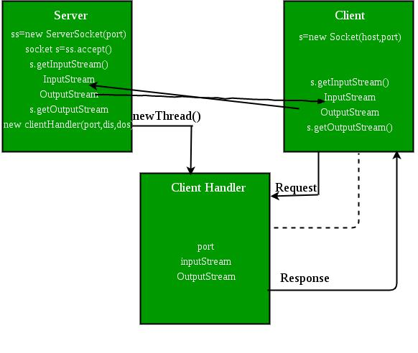

Slide 10
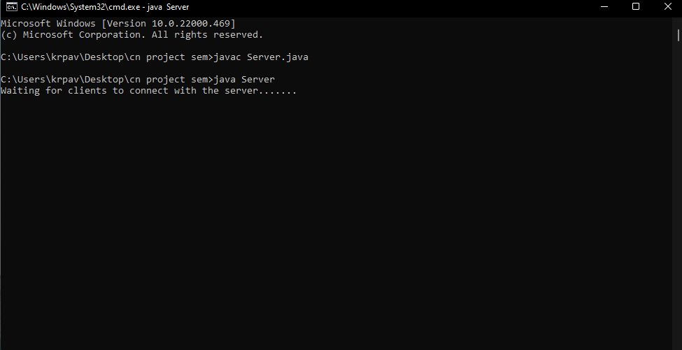
Output Screenshots
Fig 4.1 Server started

Slide 11
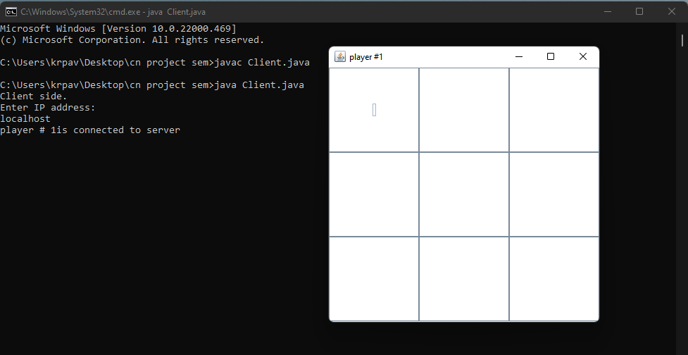
Fig 4.2 Client 1 joined using localhost

Slide 12
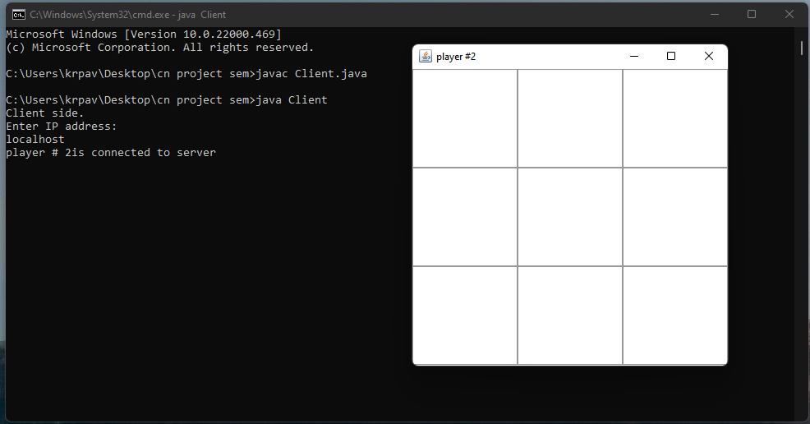
Fig 4.3 Client 2 joined using localhost

Slide 13
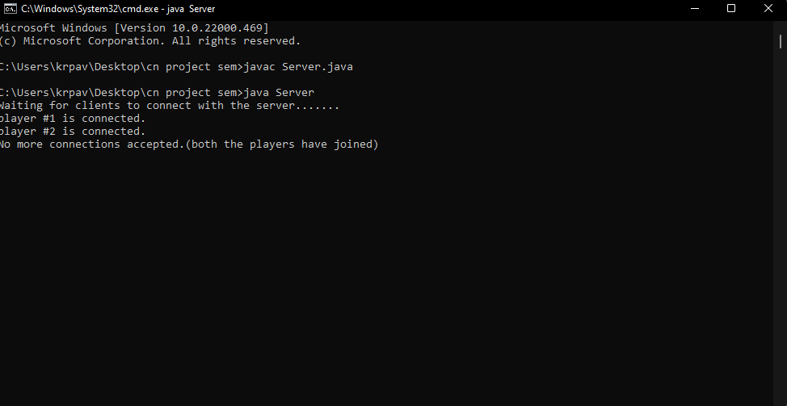
Fig 4.4 Server stops accepting anyomore clients (2 joined)

Slide 14
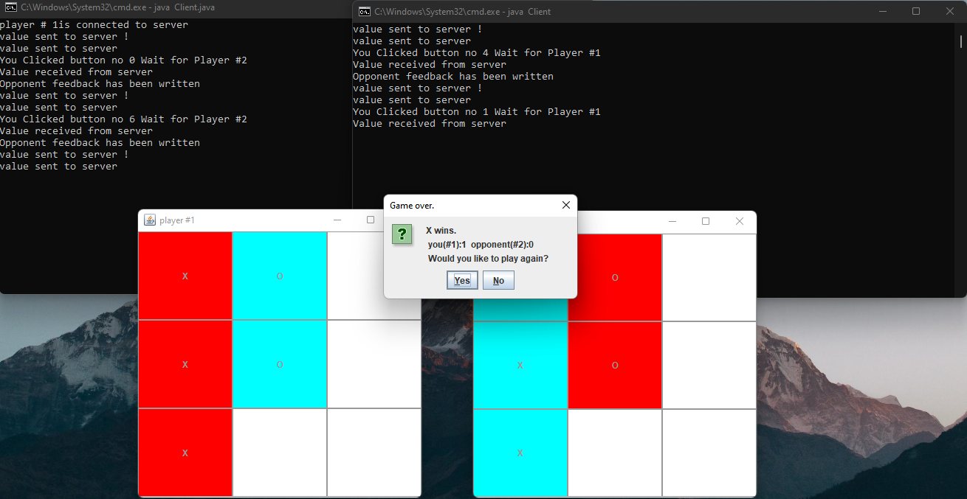
Player 1 wins(“X” wins):

Slide 15
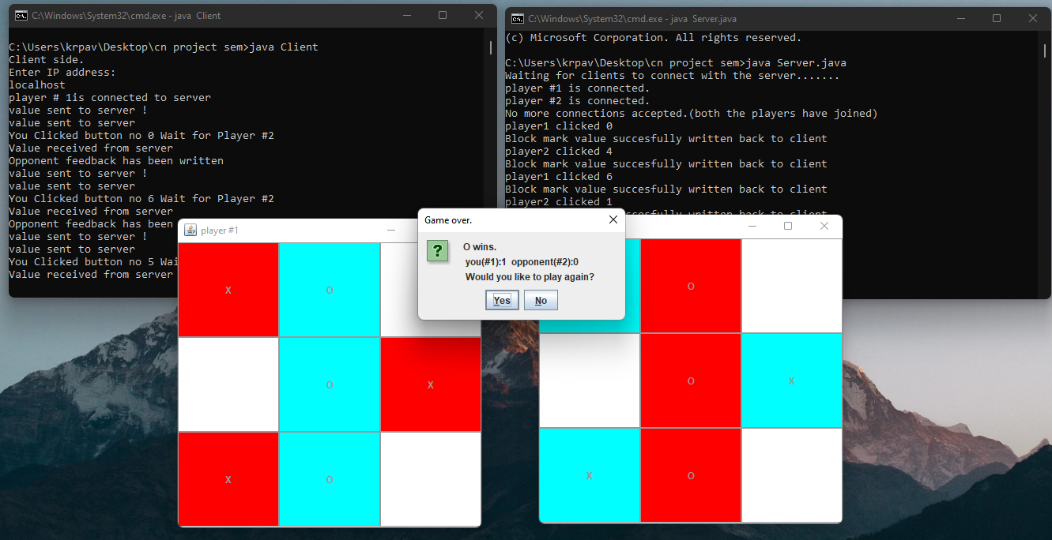
Player 2 wins(“O” wins):

Slide 16
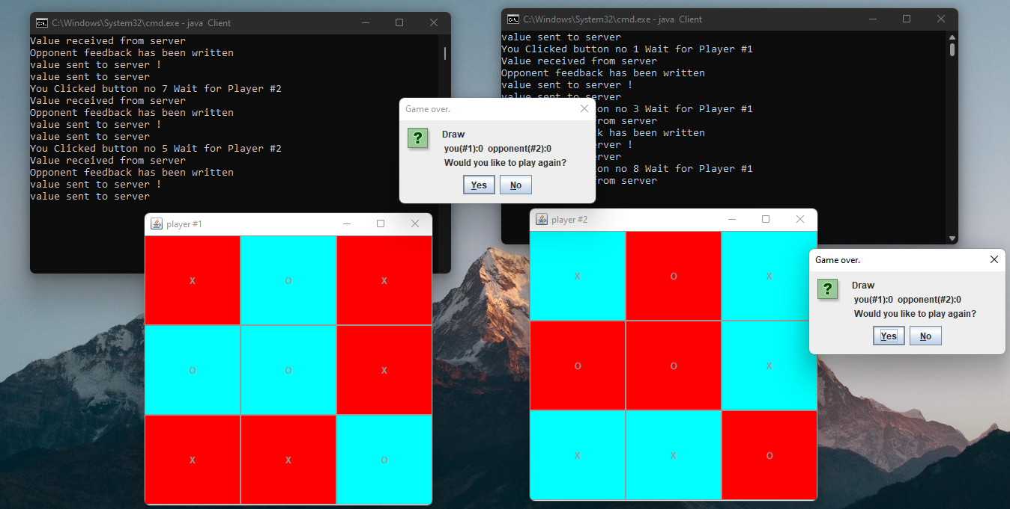
Draw match:

Slide 17
Conclusion
We have created a tic-tac-toe game where 2 players across any computer are able to play with each other(connecting via IP address).
We have implemented using Client Server architecture, Socket programming, TCP protocol, java socket
In order to optimize the current application:
We can make the server connect to more than 2 clients as the server is capable of handling many clients at the same time. The client connecting to each other can be randomised or a specific socket can be given as a key to join a private room of 2 players, to play the game.
Make the game available via web application and a frontpage using GUI.
Have player history for all the previous matches by creating an account.
Create a mobile application using Flutter(dart language similar to java) and play across multi-platform

Slide 18
THANK YOU

