Slide 1
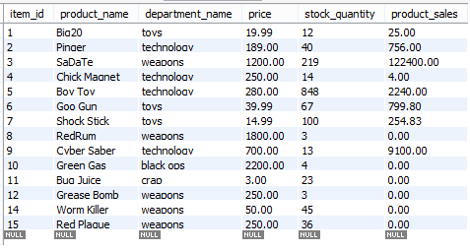
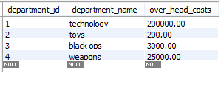
original 'products' table
This masterpiece of code attempts to fullfill the
objectives outlined in and is commonly reffered to as
BAMAZON !!!
- the starting tables used are shown to the right!!
original 'departments' table

Slide 2
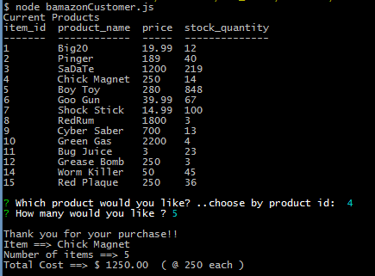
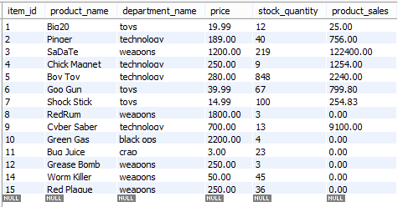
bamazonCustomer.js
products table.
see 'stock_quantity' and 'product_sales' difference for the Chick Magnet !!
run bamazonCustomer.js (from console window type:
node bamazonCustomer.js)
- customer enters chsoen product by product_id
- customer enters the amount of chosen product requested
-the item, number of items, and the total cost of the transaction will be displayed.
-the results of the transaction will be updated in the products table

Slide 3

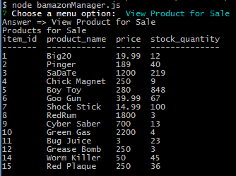
bamazonManager.js View Products for Sale
products table.
run bamazonManager.js (from console window type:
node bamazonManager.js)
- From the 'Choose a menu option' pick 'View Product for Sale'
-a summary from the 'products' table will be displayed showing item_id, product_name, price, and stock_quantity

Slide 4

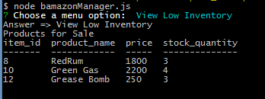
bamazonManager.js View Low Inventory
products table.
run bamazonManager.js (from console window type:
node bamazonManager.js)
- From the 'Choose a menu option' pick 'View Low Inventory'
- a summary from the 'products' table will be displayed showing item_id, product_name, price, and stock_quantity for all products whose stock_quantity is less than 5.

Slide 5


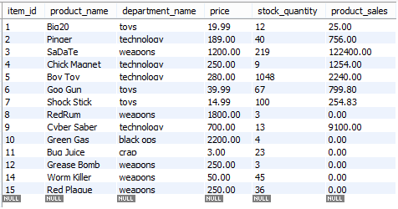
bamazonManager.js Add to Inventory
products table.
see the 200 increase in 'stock_quantity' for item_id 5, the Boy Toy !! !!
run bamazonManager.js (from console window type:
node bamazonManager.js)
- From the 'Choose a menu option' pick 'Add to Inventory'
- the user will chose an item to add to its 'stock_quantity'.
- the user will then input the amount to add.
-the results of the transaction will be updated in the 'products' table

Slide 6


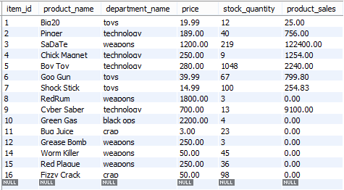
bamazonManager.js Add New Product
products table.
see the new product 'Fizzy Crack' add to the products table with the newest item_id !! !!
run bamazonManager.js (from console window type:
node bamazonManager.js)
- From the 'Choose a menu option' pick 'Add New Product'
- the user will enter a name, department, price, and quantity for the new product.
-the results of the transaction will be updated in the 'products' table

Slide 7

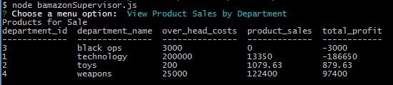

bamazonSupervisor.js View Product Sales by Department
departments table.
see total_profit calculated on the fly !! !!
products table.
run bamazonSupervisor.js (from console window type:
node bamazonSupervizor.js)
- From the 'Choose a menu option' pick 'View Product Sales by Department'
-the results are from the joined tables 'products' and 'departments' and is displayed in the console window.

Slide 8


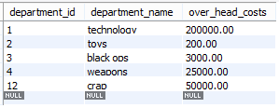
bamazonSupervisor.js Create New Department
departments table.
like everyone else.. we now have a 'crap' department in the updated departments table!! !!
run bamazonSupervisor.js (from console window type:
node bamazonSupervizor.js)
- From the 'Choose a menu option' pick 'Create New Department'
- the user will input a new department name and then input its department overhead cost.
-the results of the transaction will be updated in the 'departments' table

