Slide 1



BERT Has Uncommon Sense: Similarity Ranking for Word Sense BERTology [1]
Gessler Luke & Schneider Nathan
Presentation by Abdellah Rebaine, David Arrustico, Lila Roig

Slide 2
Paper Overview
I) Overview & Methodology II) Paper Reproducibility III) Project Extension
Objective: Propose a new evaluation method for word sense disambiguation
Example: “Je connais un très bon avocat.”
What about rare senses, or words highly polysemic?
Example: “The committee decided to table the motion until the next meeting.”
Example: “The sailor checked the set of the current before adjusting the sails.”
In this context, "set" refers to the direction and drift of a water current
Previous work:
Rely on a k-nearest neighbors classifier, where the predicted sense of a word corresponds to the most frequent sense among its k nearest neighbors in embedding space
Achieves SOTA on SensEval-2 and SensEval-3 datasets [2]
Issue: kNN is too stringent, not robust to noisy labelling

Slide 3

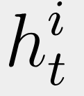
Methodology
I) Overview & Methodology II) Paper Reproducibility III) Project Extension
Idea: Introduction of a similarity ranking method instead of a traditional Word Sense Disambiguation (WSD) approach
Divide a dataset into two annotated corpora:
A large reference corpus (D), containing multiple annotated examples of the same word in different contexts (sentences)
A small query corpus (Q), where sentences with specific occurrences of a word serve as queries
To evaluate a given model, for each sentence in Q:
Feed the sentence into the model and only extract the embedding of the target word
Do the same for each sentence in D that include the same target word
Rank sentences in D using the cosine similarity between and
Compute the Mean Average Precision (MAP) on the top 50 results of D
Additionally:
Working on two datasets PDEP (for English prepositions) and Ontonotes 5.0 (for English nouns and verbs)
Test 7 models: BERT, RoBERTa, DistilBERT, ALBERT, XLNet, GPT-2 and DistilROBERTa

Slide 4
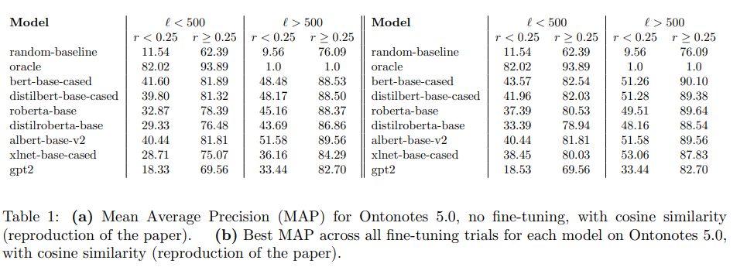
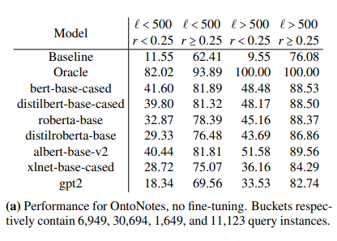
Paper Reproducibility - Results
I) Overview & Methodology II) Paper Reproducibility III) Project Extension
Results divided into 4 categories:
Frequency ℓ ≤ 500, ℓ > 500
of a word in the dataset
Rarity or ambiguity r ≤ 0.25, r > 0.25
of a word (e.g: “avocat” → lawyer or fruit?)
Ran on a T4 GPU
All models > random baseline
Results differ by no more than 0.1
BERT: Best performance
RoBERTa: Surprisingly worse
*Full results available in report’s appendix

Slide 5
Three different extensions
I) Overview & Methodology II) Paper Reproducibility III) Project Extension
Analysis of the impact of the embedding layer…
… From English to French…
… Robustness of the method to a change in metric

Slide 6
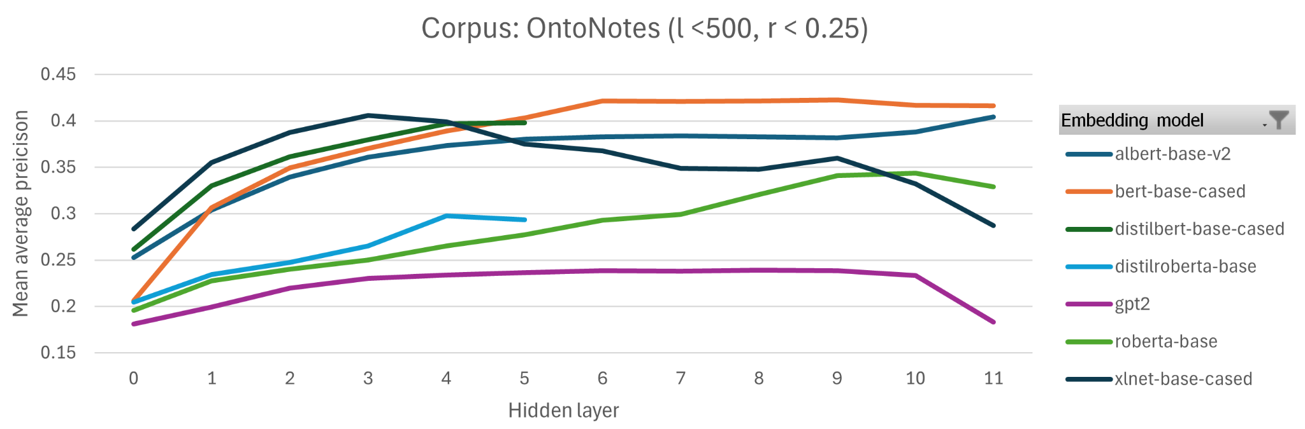
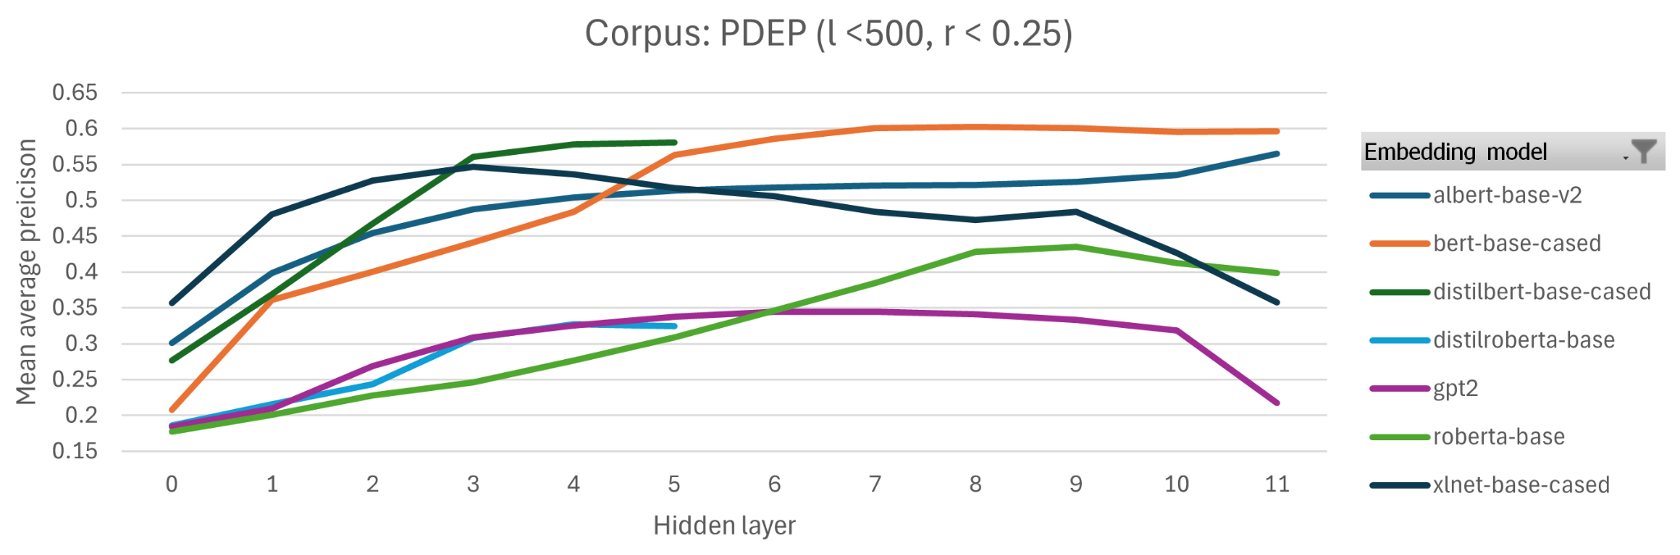
Project Extension 1 – Performance at different layers
I) Overview & Methodology II) Paper Reproducibility III) Project Extension

Slide 7
Project Extension 2 – From English to French
I) Overview & Methodology II) Paper Reproducibility III) Project Extension
Objective: Extend the original paper's method to French
See if similar models perform as well on a language with different characteristics
Why French?
More complex grammar, morphology, and flexible word order
Harder for English-trained models to generalize well
Model Used:
CamemBERT-base,
French Datasets:
FLUE: French benchmark for Verb Sense Disambiguation
EuroSense: Multilingual corpus based on BabelNet for Word Sense Disambiguation

Slide 8
Project Extension 2 – From English to French
I) Overview & Methodology II) Paper Reproducibility III) Project Extension
FLUE dataset
FLUE issues:
Very low word frequencies (most frequent label only appears 24 times)
Rarity (r) bins from the original paper were meaningless
Adaptations Made:
Ignore rarity analysis
Redefined frequency bins using quantiles instead of bins from the original paper
Handled empty bins cases
Limitations:
Frequency in the dataset doesn’t reflect real-world word usage
Categorizing by frequency may not always be valid.

Slide 9
Project Extension 2 – From English to French
I) Overview & Methodology II) Paper Reproducibility III) Project Extension
EuroSENS dataset
EuroSense Issues:
We filtered the dataset to only include French examples
Errors in the dataset: like mislabeled languages, missing or incorrect annotations
Adaptations Made:
Cleaned and split into 4 parts according to POS: verbs, nouns, adjectives, and adverbs + combined version
Applied stratified subsampling to create smaller, balanced datasets (80k examples each) with frequent & rare words.
Adapt the code to support multi-word expressions
Averaging the embeddings of each word,
Option to exclude multi-word annotations for comparison.

Slide 10
Project Extension 2 – From English to French
I) Overview & Methodology II) Paper Reproducibility III) Project Extension
Results
→ French performed slightly worse than English datasets
FLUE Results :
Low across the board
(Frequent words: 17% precision, Rare words: 5% precision)
Likely due to high proportion of rare items
EuroSENS Results:
Nouns — performed best → Gender and syntactic markers in French.
Verbs — performed worst → Complex conjugations and multiple meanings.
Adjectives & adverbs — in between → Performance varying across runs.
Impact of Rarity vs. Frequency:
Rarity influenced performance more than frequency
High-rarity words (more semantically stable) were easier to disambiguate
Surprising Findings:
High-freq high-rarity words performed worse than low-freq high-rarity ones → sampling biases?
High-freq low-rarity bin often empty → frequent words have highly specific labels (especially MWE )
No major difference in performance between single-word and multi-word cases.

Slide 11
Project Extension 3 – Performance using the Euclidean Metric
I) Overview & Methodology II) Paper Reproducibility III) Project Extension
Objective: Assess the robustness of the proposed framework to a change in metric
Motivations
Cosine similarity is often used in NLP tasks because it focuses on the direction of vectors while ignoring their amplitude
When working with models that do not normalize their output embeddings, the norms of the embedding vectors may be important
The Euclidean metric suffer from the “curse of dimensionality” might expect a drop in performance
Methodology:
Working with PDEP only (computational limits)
D contains 33,090 sentences while Q contains 8,020 sentences
We are running 35 experiments, testing the 7 models on the 5 levels of fine-tuning

Slide 12
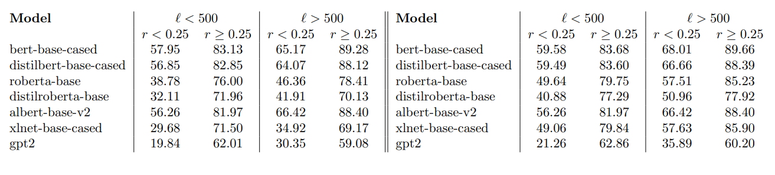
Project Extension 3 – Performance using the Euclidean Metric
I) Overview & Methodology II) Paper Reproducibility III) Project Extension
Results
Only minor differences between cosine similarity and euclidean distance
Surprisingly: Euclidean distance gives results that are comparable, and even, in some cases (ROBERTa) better than cosine similarity

Slide 13
Conclusion
I) Overview & Methodology II) Paper Reproducibility III) Project Extension
In this project, we have
Successfully reproduced the experiments from [1], confirming that BERT-like encoder
models can effectively disentangle rare word senses.
The analysis of embedding layers: later layers usually provide better performance for encoder models; but not true for decoder models like GPT-2 and models with unique training objectives like XLNet
Surprisingly, the choice of the euclidean metric instead of the cosine similarity does not hamper the performances
Finally, we have concluded with a very promising extension of G&S’ work, extending it to French datasets and models
Then, we have explored three new directions

Slide 14
References
[1] Gessler, L., & Schneider, N. (2021). BERT Has Uncommon Sense: Similarity Ranking for Word Sense BERTology. In Proceedings of the Fourth BlackboxNLP Workshop on Analyzing and Interpreting Neural Networks for NLP (eds. Bastings, J. et al.), Association for Computational Linguistics, Punta Cana, Dominican Republic, pp. 539–547. https://aclanthology.org/2021.blackboxnlp-1.43/
[2] Reif, E., Yuan, A., Wattenberg, M., Viégas, F. B., Coenen, A., Pearce, A., & Kim, B. (2019). Visualizing and measuring the geometry of BERT. In Proceedings of the 33rd Conference on Neural Information Processing Systems (NeurIPS), pp. 8592–8600, Vancouver, BC, Canada.

