Slide 1

Predicting
Car Accident Severity

Slide 2
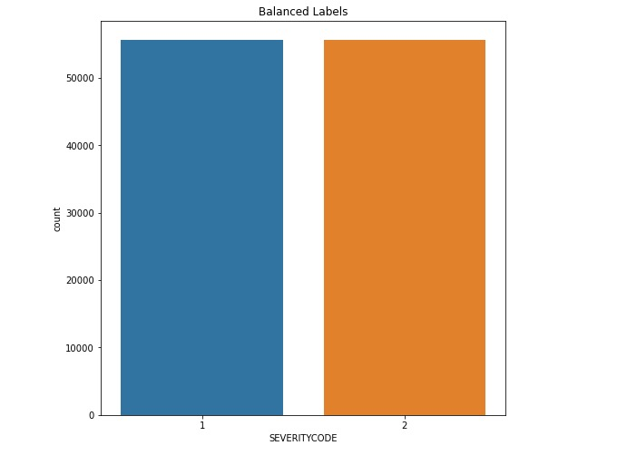
Data Acquisition and cleaning
Unbalanced Labels
The Dataset came with unbalanced labels. Training directly will lead to biased predication. Therefore, it’s necessary to shuffle and balance the number of labels.

Slide 3
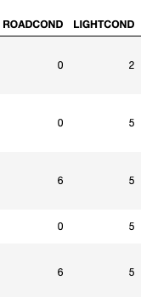
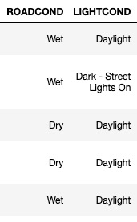
Data Acquisition and cleaning
Categorical Variables Conversion and empty inputs
Some feature sets are using categorical variables. Since I will use KNN model. It’s also necessary to convert them to numeric and drop those rows with empty inputs.
The right figures shows the conversion result.

Slide 4
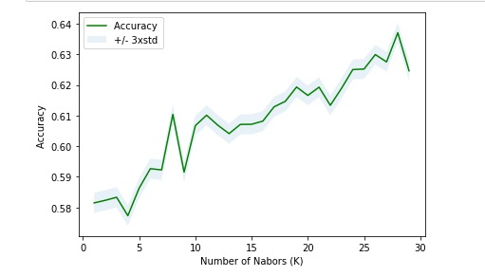


Classification Models and results
I decided to use KNN with features sets like road conditions, weathers, light conditions to make the prediction. The model I built has maximum accuracy when k= 28 with ~64% test set accuracy.

Slide 5
Conclusion
The model could be further optimized by more detailed data analysis.
The employed feature sets like people, vehicles are features after car accidents, which are somehow useless when people tried to predict potential car accidents.

