Slide 1



Sum-Product Networks
Ph.D. Student： Li Weizhuo
2015.1.14

Slide 2
Outline
Motivation
Representation
Inference
Learning

Slide 3
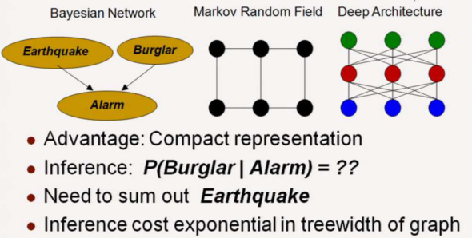
Motivation
Graphical Models

Slide 4
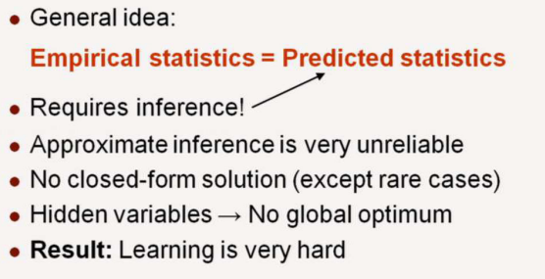
Motivation
Learning Graphical Model

Slide 5
Outline
Motivation
Representation
Inference
Learning

Slide 6
Representation
What does an SPN mean?
How to use SPNs to represent other networks?
The Context Specific independence(CSI)

Slide 7
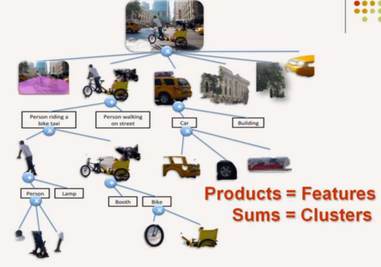

What Does an SPN mean?

Slide 8
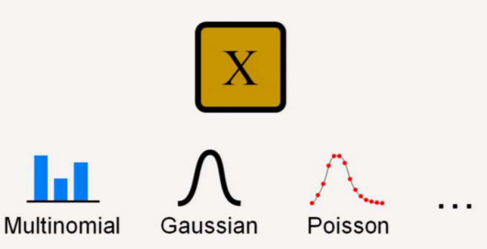
A Univariate Distribution is a SPN

Slide 9
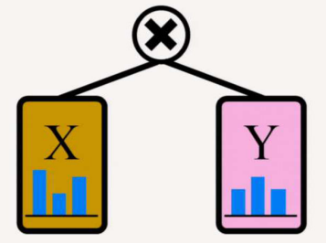
A Product of SPNs over a Disjoint Variables is an SPN

Slide 10
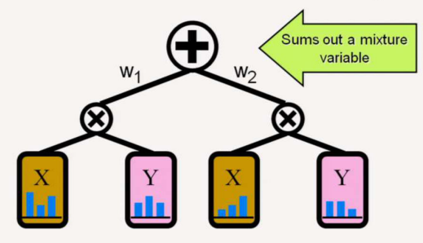
A Weighted Sum of SPNs over the Same variables is an SPN

Slide 11
How to use SPNs to represent other networks?
BN  SPN
MNSPN
Mixture Model  SPN

Slide 12

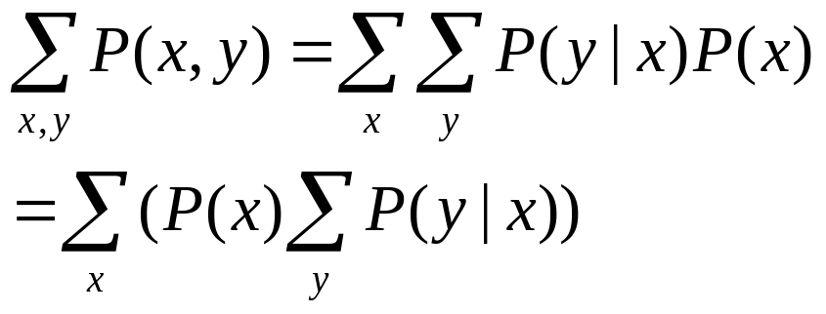








BN →SPN
?
?
?

Slide 13
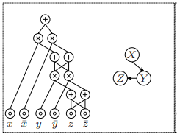
BN →SPN

Slide 14
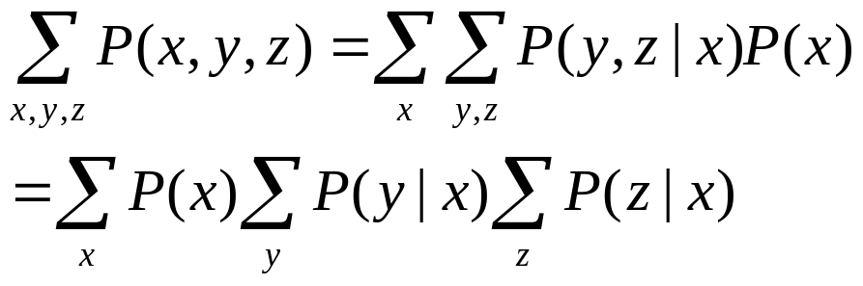
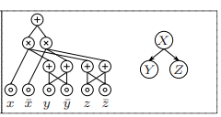
BN →SPN

Slide 15






BN →SPN
?
?
?
?
?

Slide 16

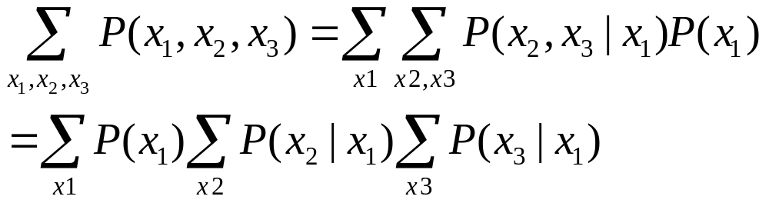
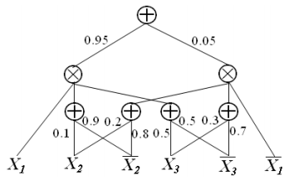
MN →SPN

Slide 17


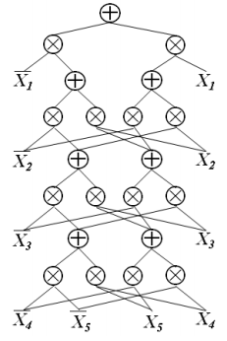
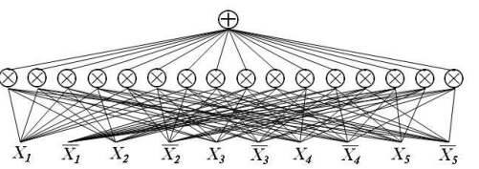
Mixture Model →SPN
or

Slide 18
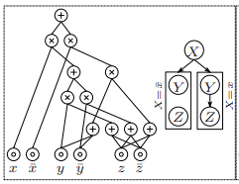
The Context Specific Independence(CSI)

Slide 19
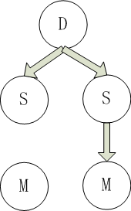


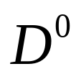
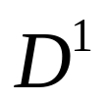






An example in Ontology Matching
SPN  (Sims  Map| Disjoint¹)
SPN  (Sims  Map| Disjoint⁰)
?
?
?
?
?
?

Slide 20
An example in Ontology Matching (Cont)
Context-specific independence
  SPN(Map(Y1,Y2)Similarities(Y1,Y2))|Disjointwith(Y1,Y2)¹)
X1
Z2
SubClassof
Map
Disjoint
Y1
X2
Y2

Slide 21
Outline
Motivation
Representation
Inference
Learning

Slide 22
Inference
All marginals are computable in time linear in size of SPN.
All MAP states are computable in time linear in size of SPN.

Slide 23











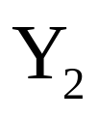
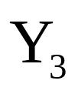
Compute marginals
P(X=0)=?
0.74
?
0.5
0.9
0.5
1
0.9
1
?
?
?
?
0
1
1
1
1

Slide 24
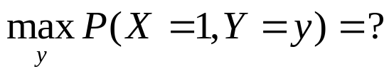
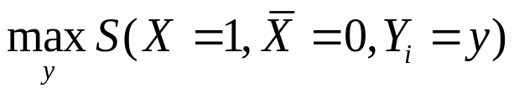
Compute MAP
0.12
?
Max
0.3
0.04
0.5
0.6
0.1
0.4
Max
Max
Max
?
?
?
?
Max
1
0
1
1
1

Slide 25
Outline
Motivation
Representation
Inference
Learning

Slide 26
Learning
Generative weight learning
Discriminative weight learning
Structure Learning

Slide 27
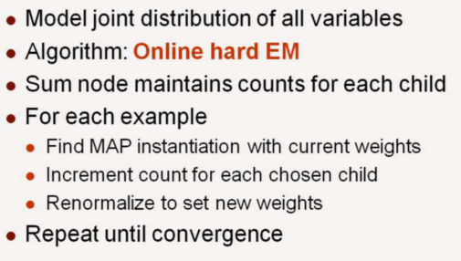
Generative weight learning
(Poon,H & Domingos, UAI (2011))

Slide 28
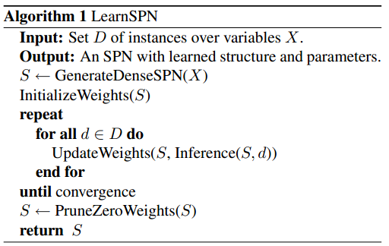
Generative weight learning
(Poon,H & Domingos, UAI (2011))
Random forest
Hard EM

Slide 29
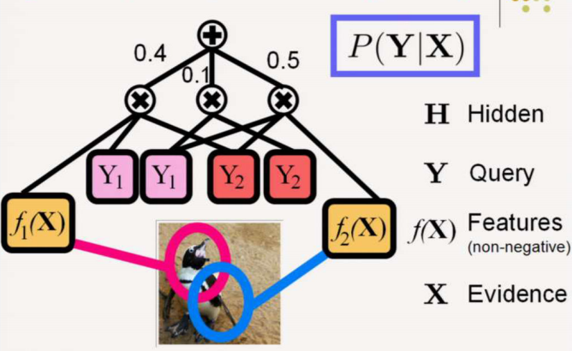

Discriminative weight learning
(Gens,R & Domingos, NIPS(2012))

Slide 30
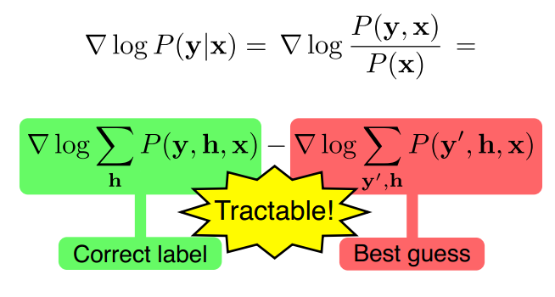
Discriminative weight learning
(Gens,R & Domingos, NIPS(2012))

Slide 31
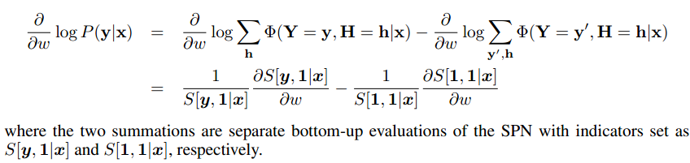

Discriminative weight learning
(Gens,R & Domingos, NIPS(2012))
?

Slide 32
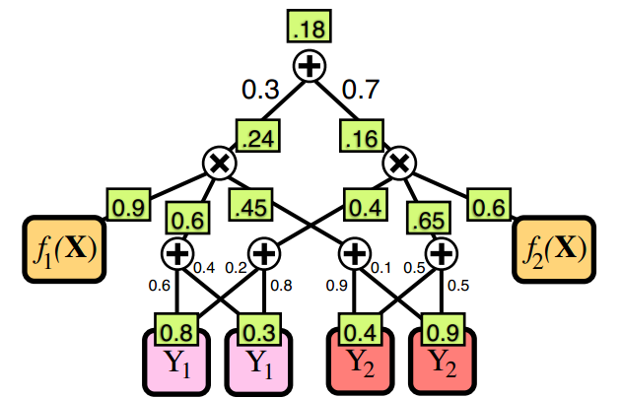
Discriminative weight learning
(Gens,R & Domingos, NIPS(2012))
Bottom-Up

Slide 33
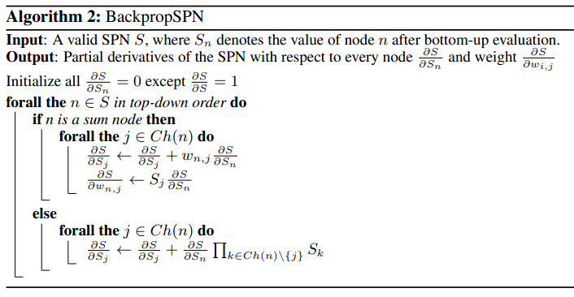
Discriminative weight learning
(Gens,R & Domingos, NIPS(2012))

Slide 34
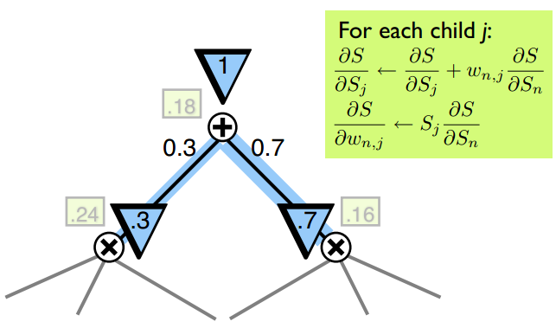
Discriminative weight learning
(Gens,R & Domingos, NIPS(2012))

Slide 35
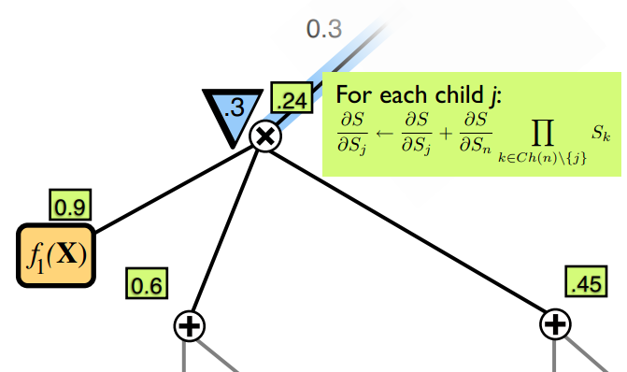
Discriminative weight learning
(Gens,R & Domingos, NIPS(2012))

Slide 36
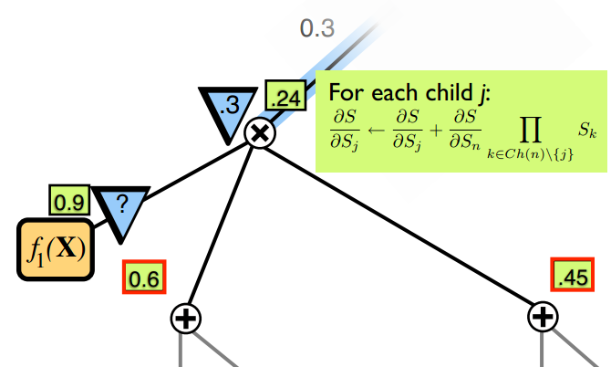
Discriminative weight learning
(Gens,R & Domingos, NIPS(2012))

Slide 37
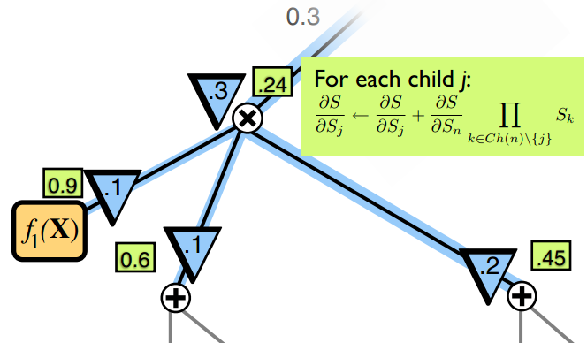
Discriminative weight learning
(Gens,R & Domingos, NIPS(2012))

Slide 38
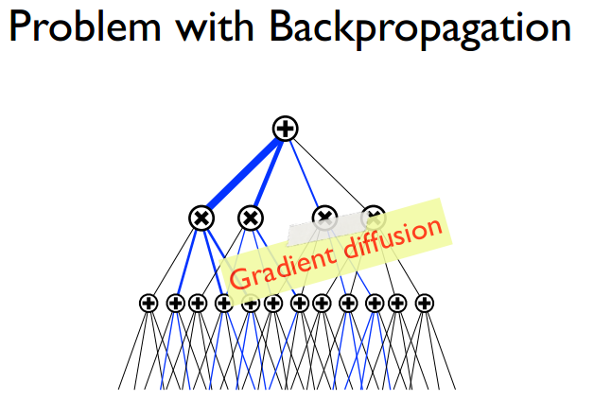
Discriminative weight learning
(Gens,R & Domingos, NIPS(2012))

Slide 39
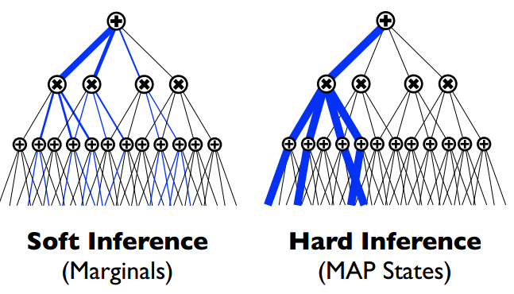
Discriminative weight learning
(Gens,R & Domingos, NIPS(2012))

Slide 40
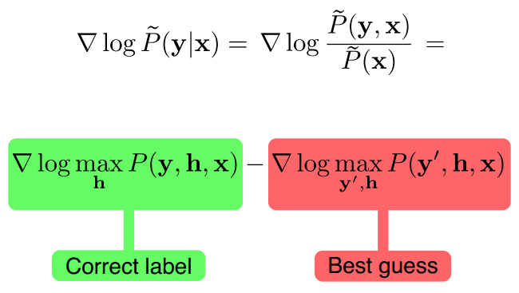
Discriminative weight learning
(Gens,R & Domingos, NIPS(2012))

Slide 41
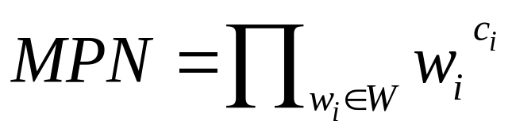

Discriminative weight learning
(Gens,R & Domingos, NIPS(2012))

Slide 42
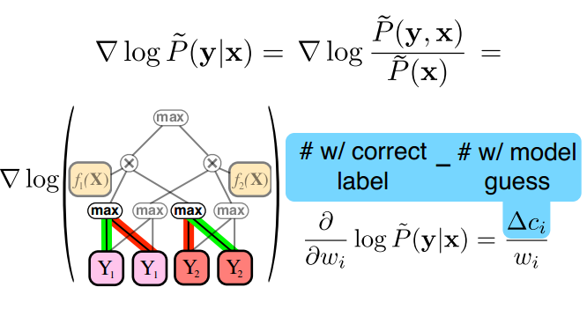
Discriminative weight learning
(Gens,R & Domingos, NIPS(2012))

Slide 43
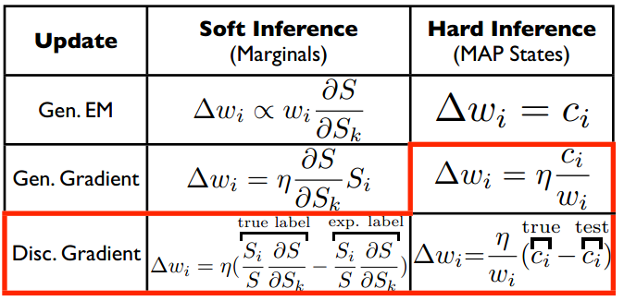
Discriminative weight learning
(Gens,R & Domingos, NIPS(2012))

Slide 44
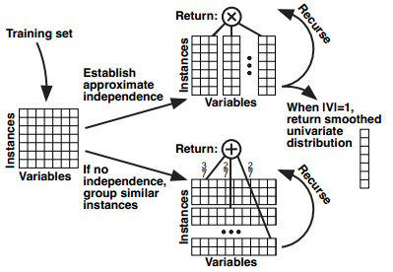
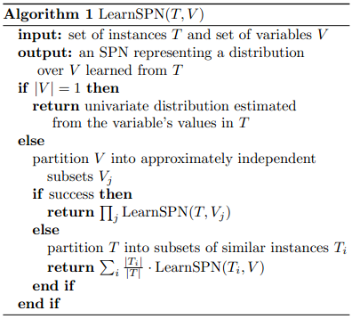
Structure Learning
(Gens,R & Domingos, ICML(2013))
Mutual information
Hard EM

Slide 45
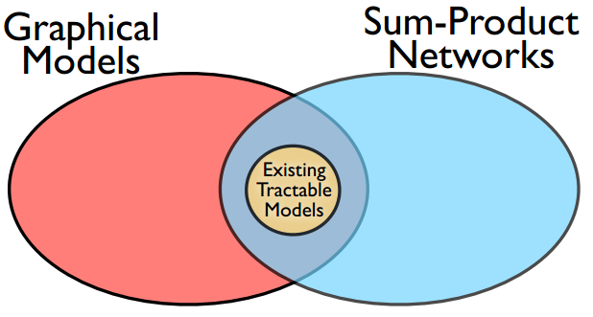
Summary
Maybe Nothing!

Slide 46
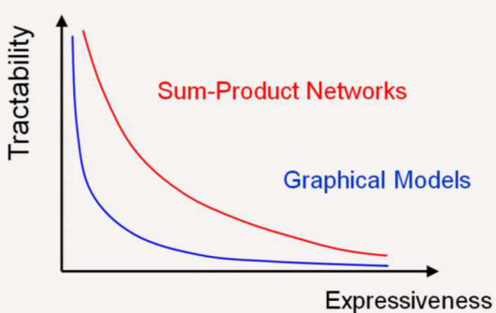
Summary

Slide 47
References
Most of the materials come from Domingo's slides.
Source code
  http://spn.cs.washington.edu/code.shtml
video
  http://videolectures.net/nips2012_gens_discriminative_learning/
  http://research.microsoft.com/apps/video/default.aspx?id=192562&r=1

Slide 48
Thanks!
Q&A

