Slide 1



KSU Data Science Programming Boot Camp - R August 12, 2019
Lili Zhang
Ph.D. Candidate in Analytics and Data Science
Kennesaw State University
Notes:
1

Slide 2
Agenda
Ice Breaker Discussion
The Role of Programming in Analytical Problem Solving
Analytical Solution Process
2

Slide 3
Agenda
Part 1: Introduction
R and RStudio Overview
Download and Install R
Download and Install RStudio
R Notebook Overview
Install R Packages
Getting Help in R
3

Slide 4
Agenda
Part 2: Importing, Exporting, Manipulation
Read Data from csv File into R
Examine the Structure of the Dataset
Clean Data
Transform and Discretize Variables
Save Data from R into csv File
Work with Other Data Sources
4

Slide 5
Agenda
Part 3: Scraping
CSV File Online
HTML Table
Web API
5

Slide 6
Agenda
Part 4: Data Management
Merge & Append
Matrix Algebra
Statistical Functions
6

Slide 7
Agenda
Part 5: Exploratory Data Analysis
Univariate Analysis
Bivariate Analysis
7

Slide 8
Agenda
Part 6: Modeling
Variable Selection
Train Test Split
Logistic Regression Model
Linear Regression Model
8

Slide 9
Ice Breaker Discussion
Your Name and Major
What tasks do you expect R to help you with?
Online Discussion Chanel: http://backchannelchat.com/Backchannel/p32wm
9

Slide 10
The Role of Programming
Four Steps for Analytical Problem Solving
Formulate the problem
Design the solution
Implement the solution
Analyze and interpret results
10

Slide 11
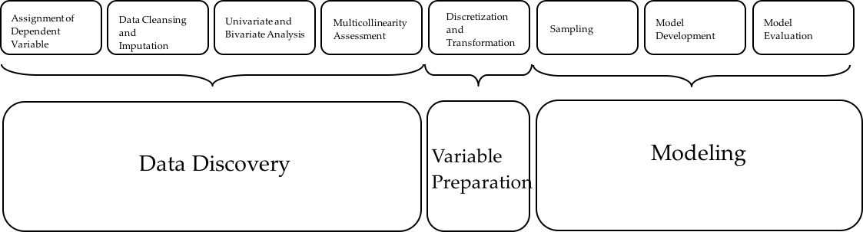
Analytical Solution Process
Source: http://facultyweb.kennesaw.edu/jpriestl/courses/stat-4330-8330.php
11

Slide 12
R and Rstudio Overview - R
https://www.r-project.org
A language and environment for statistical computing and graphics
Open Source under GNU General Public License
Packages for a wide variety of statistical and graphic techniques: linear and nonlinear modelling, statistical tests, time series analysis, classification, clustering, etc.
12
12
12

Slide 13
R and RStudio Overview - RStudio
https://www.rstudio.com/products/rstudio/#Desktop
Integrated Development Environment (IDE) for R from a commercial vendor
Requires R to be installed first
Free version available
13
13
13

Slide 14
R and RStudio Overview - R Packages
https://cran.r-project.org/web/packages/available_packages_by_name.html
Collections of functions and data sets developed by the community
CRAN is a network of ftp and web servers around the world that store identical, up-to-date, versions of code and documentation for R.
14
14
14

Slide 15
R and RStudio Overview - R Applications
Statistical Computing
Graphics
Machine Learning Advance
15
15
15

Slide 16
Download and Install R
R can be downloaded from
https://cran.r-project.org
Follow installation instructions on the download page.
16
16
16

Slide 17
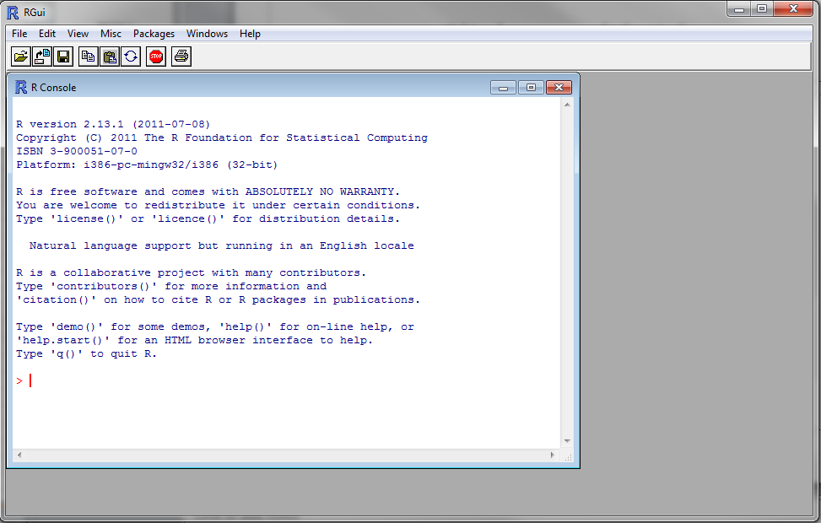
Download and Install R
Command prompt
17
17
17

Slide 18
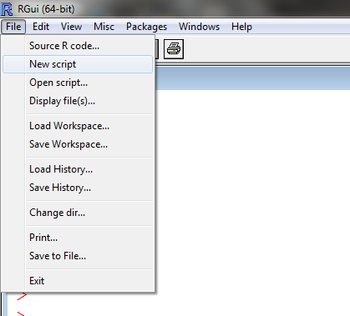
Download and Install R
New Script
Open a new or existing R script.
Save your R script immediately. Then periodically save as you work. Often better to type your commands in the script and run from there (rather than from the command line)
Run R commands by copying and pasting from R script into command window, or by using Ctrl-R
18
18
18

Slide 19
Download and Install RStudio
RStudio can be downloaded from
https://www.rstudio.com/products/rstudio/download/
Follow installation instructions on the download page.
19
19
19

Slide 20
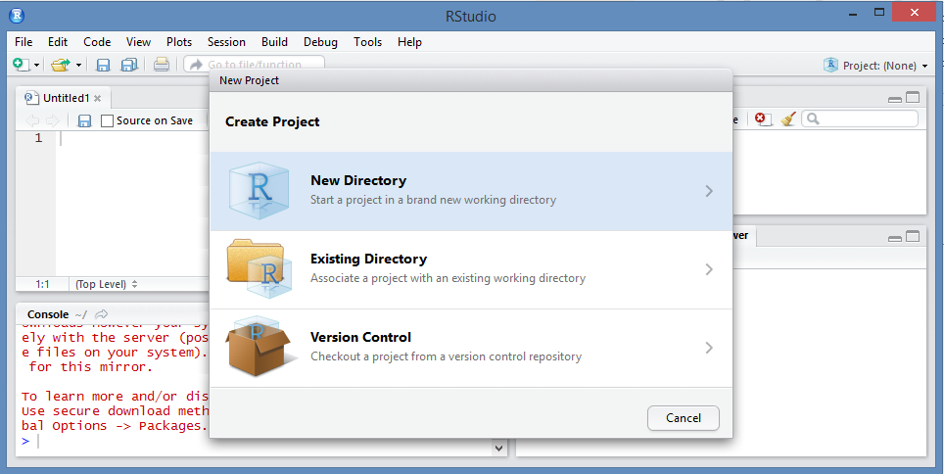
Download and Install RStudio
Click the shortcut icon to launch the session
To save work as a project, go to File → New Project… and then identify either a new or existing directory.
20
20
20

Slide 21
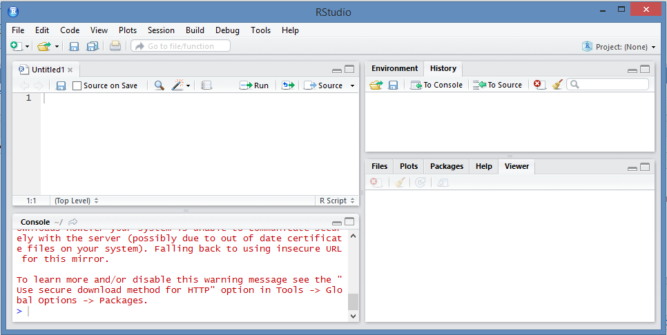
Download and Install RStudio
Script: Write your program here
Environment: Defined variable names
History: Executed Code
Console: Shows output and can be used to run one-off code directly from the command line
This has many options
21
21
21

Slide 22
R Notebook Overview
Documentation: https://rmarkdown.rstudio.com/r_notebooks
Create a Notebook
Insert Chunks
Execute Code
Chunk Output
Notebook HTML File
22
22
22

Slide 23
Install R Packages
Install from CRAN: install.packages(“packageName”)
e.g. install.packages("ISwR")
Load a package:
library(packageName)
e.g. library(ISwR)
23
23
23

Slide 24
Getting Help in R
If function name known
?functionName or help(functionName)
e.g. ?plot
If function name unknown
help.search(‘search keyword(s)’)
e.g. help.search(‘regression’)
24
24
24

Slide 25
Read Data from csv File into R
Data Used in the Code:
CLEAN1A.csv
CLEAN1B.csv
CLEAN1C.csv
NOTCLEAN1A.csv
NOTCLEAN1B.csv
NOTCLEAN1C.csv
25
25
25

Slide 26
Read Data from csv File into R
NOTCLEAN1A.csv and CLEAN1A.csv
Variable Name | Description
MATCHKEY | unique customer id
AGE | customer's age
TRADES | number of accounts on file
RBAL | total balance on revolving account
26
26
26

Slide 27
Read Data from csv File into R
NOTCLEAN1B.csv and CLEAN1B.csv
Variable Name | Description
MATCHKEY | unique customer id
DELQID | delinquency number
CRELIM | credit limit
goodbad | binary version of DELQID (only in CLEAN1B.csv)
27
27
27

Slide 28
Read Data from csv File into R
NOTCLEAN1C.csv and CLEAN1C.csv
Variable Name | Description
MATCHKEY | unique customer id
BRNEW | age of the newest bank revolving account
BRAGE | age of the oldest bank revovling account
28
28
28

