Slide 1
Arrays, Loops, and Methods

Slide 2
Review: Why Use Java?
“Write Once, Run Anywhere”
JVM compiles Java to bytecode, translates bytecode to machine code
Java is “safe”
No memory management in Java
Java is free
Java has an incredibly rich library and frameworks

Slide 3
Arrays
Arrays are collections of multiple values of the same type.
int[] : an array of integer values
String[] : an array of String references
Arrays have a fixed length, determined at creation
int[] myArray = new int[10]; // size-10 int array
This is because arrays reserve memory space. One int is 4 bytes, so an array of 10 ints reserves 40 bytes (plus some overhead). Reserved space is (usually) adjacent in memory.
Arrays can be pre-populated with values
int[] otherArr = {1, 5, 6}; // size-3 int array
Arrays are accessed by index, starting at ‘0’, through length-1.
System.out.println(otherArr[1]); // print 2nd element

Slide 4
Arrays continued
Can be created using literal notation:
{ 1, 90, -3}
{"Hi", "Hello", "Howdy"}
And using a constructor:
new int[3];
new String[3];
Can contain primitives or objects
Datatype[] variableName
Datatype variableName[]
String[] myArray= new String[5];
String[] another = {"Hello", "Hello", "Fun", "Another String"};
index
0 | "Hello"
1 | "Hello"
2 | "Fun"
3 | "Another string"
4 | 6

Slide 5
So let’s draw this out…
int[] arrayOfInts = new int[4];
arrayOfInts[1] = 5;
arrayOfInts[3] = 6;
Note that this is the length of the array – 1
5
6

Slide 6
While Loops
while(conditional expression){
//Instructions }
So long as the condition is true continue the instructions
Be careful of infinite loops- they will not cause a compilation error
int x = 0;
while(x<3){
System.out.println(x); x++; }
Prints:
0 1
2

Slide 7
Do-While Loops
do{
//Instructions }while(conditional expression);
So long as the condition is true continue the instructions
Be careful of infinite loops- they will not cause a compilation error
Do-while loops will always run once
int x = 0;
do{
System.out.println(x); x++; }while(x<3);
Prints:
0 1
2

Slide 8
For Loops
for(initialization; condition; update){
//Instructions }
So long as the condition is true continue the instructions
Be careful of infinite loops- they will not cause a compilation error
The initialization statement is considered part of the loop's block
for(int x = 0; x<3; x++){
System.out.println(x); }
Prints:
0 1
2

Slide 9
Looping over Iterable Objects
for(variable : iterableObject){
//Instructions }
Variable takes on the value of each element in the iterableObject
This prevents an infinite loop
You typically define the variable within the parentheses
int[] myArray= {1,2,7};
for(int x : myArray){
System.out.println(x); }
Prints:
1 2
7

Slide 10
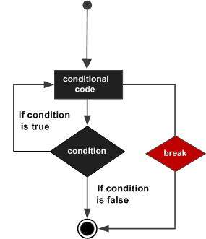
Break
The break statement is used to transfer control out of the enclosing statement. This statement can be used with while, do/while, for loops and switch statements.

Slide 11
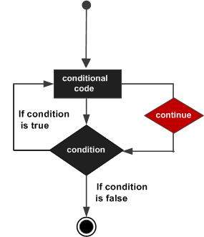
Continue
The continue statement is used to finish execution of the current, enclosing statement. This statement can be used with while, do/while, for loops and switch statements.

